Slide 1
VR Self-Employment Guide
A resource for Clients and counselors

Slide 2
Rates of Self-Employment
Notes:
As this data shows, rural people turn to self-employment at higher rates than urban people AND
People with disabilities turn to self-employment at higher rates than the general population.
HOWEVER, VR closure rates to self-employment are drastically different than rates found in the population

Slide 3
SE Outcomes in VR
Closure rates to self-employment increased as case became more rural.
Ipsen, C. & Swicegood, G. (2017) Rural and urban vocational rehabilitation self-employment outcomes. Journal of Voc Rehab, 46, 97-105
Notes:
Despite low rates of self-employment, clients earned comparable wages.

Slide 4
Explaining Low Rates of VR Self-Employment Closures
Counselor unpreparedness to assist consumers with self-employment exploration
Not trained in business start-up
Third-party providers not in place to support business development services
Confusion about process
Counselor concerns about self-employment
Outcomes will not result in viable employment
VR self-employed clients earned comparable wages to those in competitive employment
Earned significantly higher wages (p<.001)
Worked significantly fewer hours (p<.001)
Case costs will be higher
Costs of purchased services were significantly higher for all geographies (Ipsen & Swicegood, 2017)
Notes:
Past research provided some reasons why self-employment is not supported as often as expected when looking at national rates.

Slide 5
Addressing Barriers
VR Self-Employment Guide
Self-guided content
Classroom format
Business owner interviews
Audio and video examples
http://vrselfemployment.org
Partners
Margot Dana, Utah State Office of Rehabilitation
Dr. Nancy Arnold, Consultant
Jennifer Stephens, Small Business Development Center
UM School of Extended and Lifelong Learning
UM Media Arts
Business owners with disabilities

Slide 6
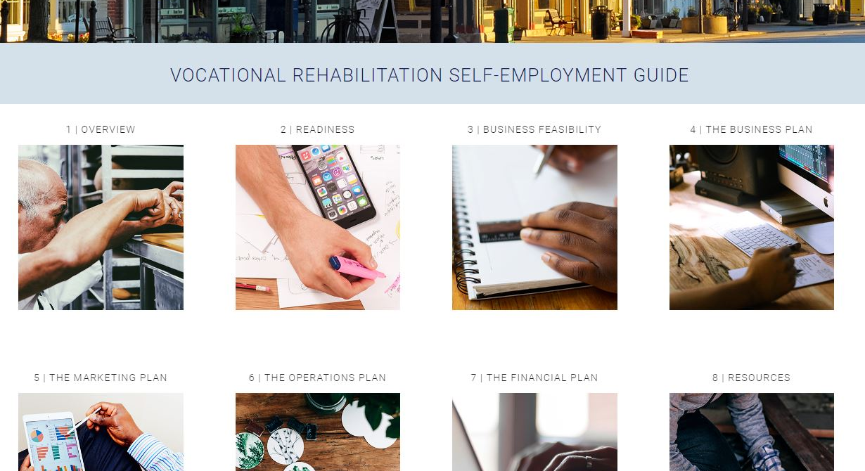
Notes:
The site is organized into 8 chapters.
The first three chapters relate to self-employment exploration within the VR system
Chapter 1 is focused on understanding how the self-employment process might unfold during the VR process. It provides an orientation for getting started.
Chapter 2 asks the business owner to consider their motivations for becoming self employment and then their readiness to do so
Chapter 3 if focused on preliminary evaluation of the business idea and whether or not it constitutes a viable business
Chapters 4 – 7 lay out the steps to preparing a comprehensive business plan. The information in these chapters builds on preliminary data gathered for exploring the business’ feasibility (in Chapter 3)
Finally, Chapter 8 include a variety of external resources to help navigate the business planning process.

Slide 7
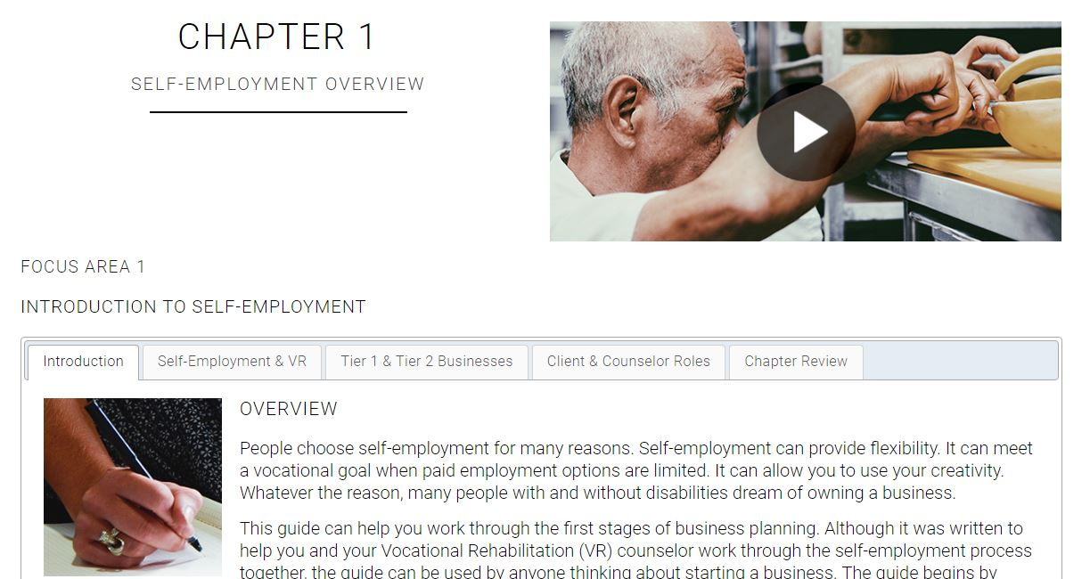
Notes:
Several chapters have overview videos with audio and video from several business owners with disabilities. We interviewed 8 business owners about their experiences starting a business. These owners included people with mental health, visual, learning, and physical disabilities. Businesses included floral design, consulting, photography, computer repair, gaming, and retail sales.

Slide 8
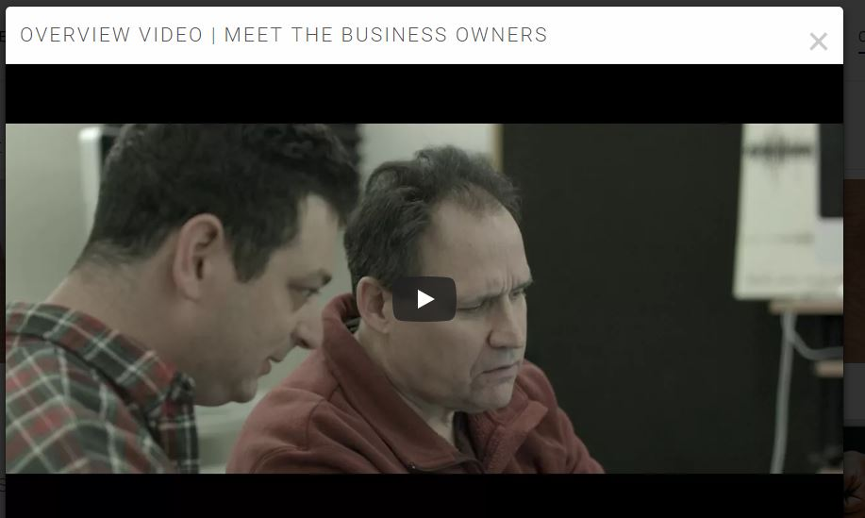

Slide 9
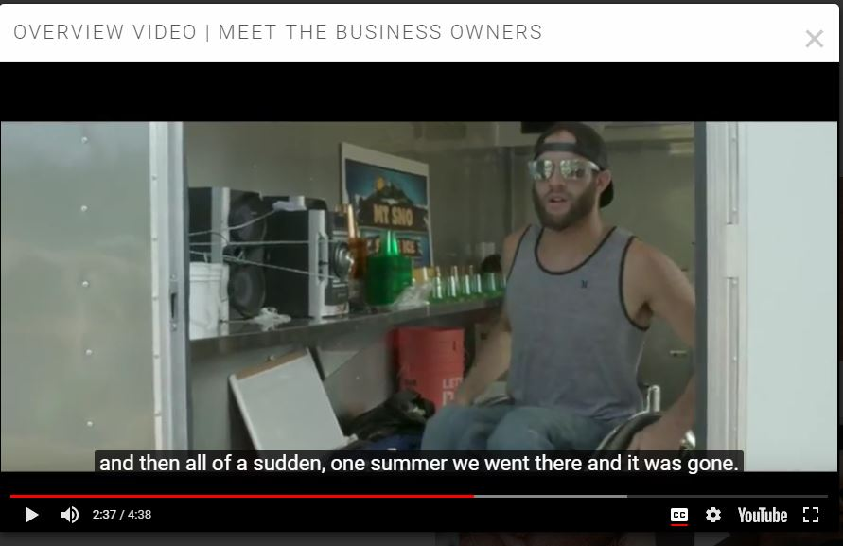

Slide 10
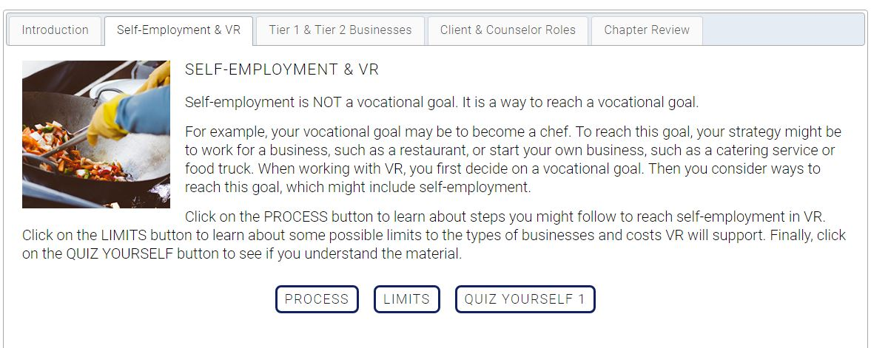
Notes:
We included dynamic interface to increase engagement with the website. Through this process, we were able to break down the information into smaller segments that counselors could focus on with their consumers.

Slide 11
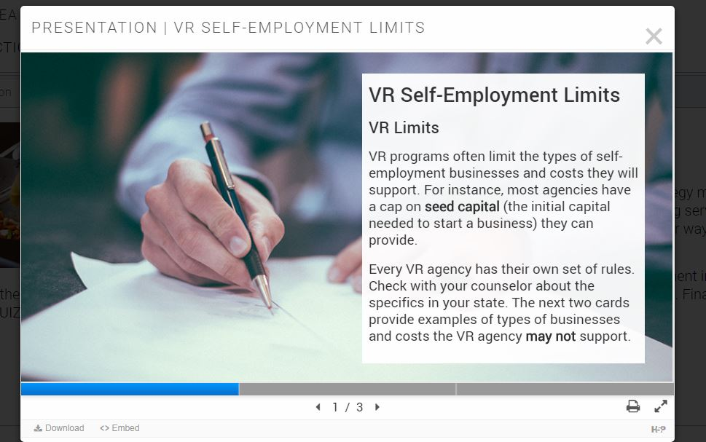

Slide 13
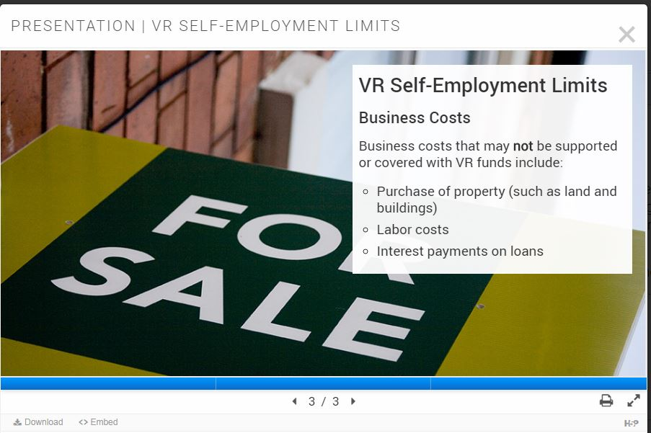

Slide 14
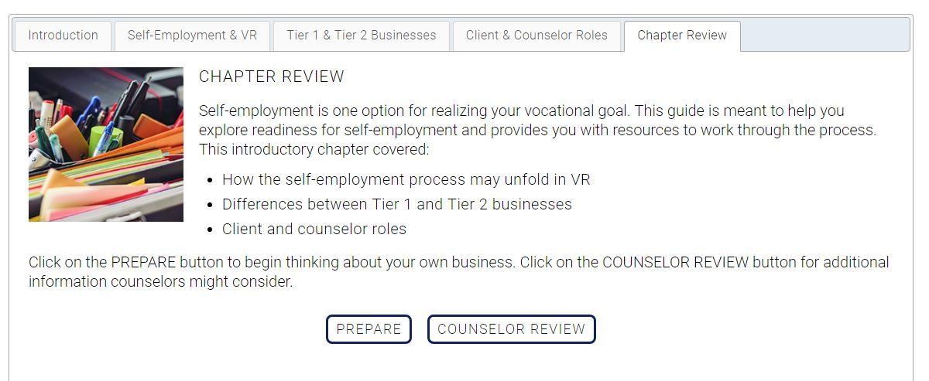

Slide 15
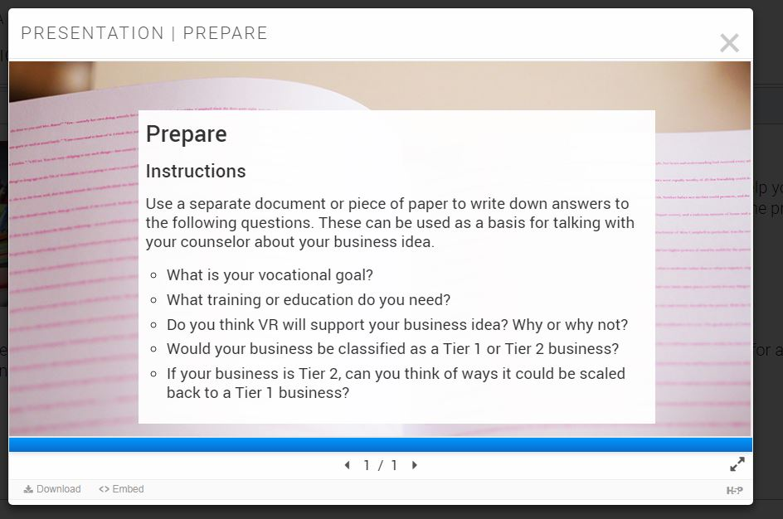

Slide 17
Notes:
Play audio here.

Slide 19
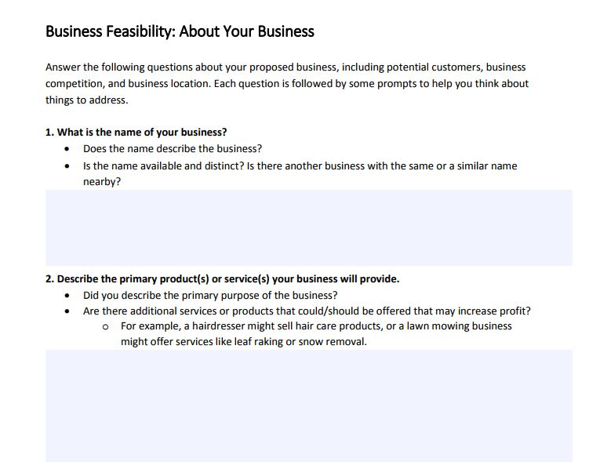
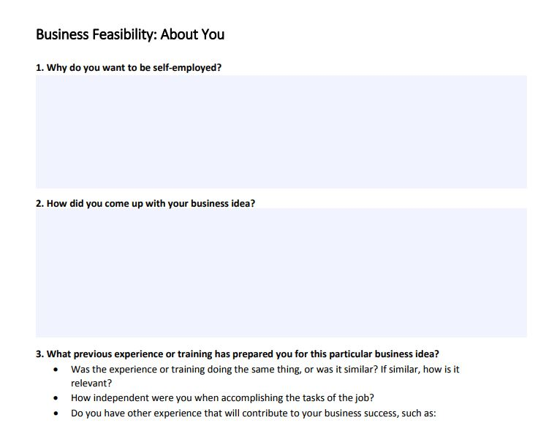

Slide 25
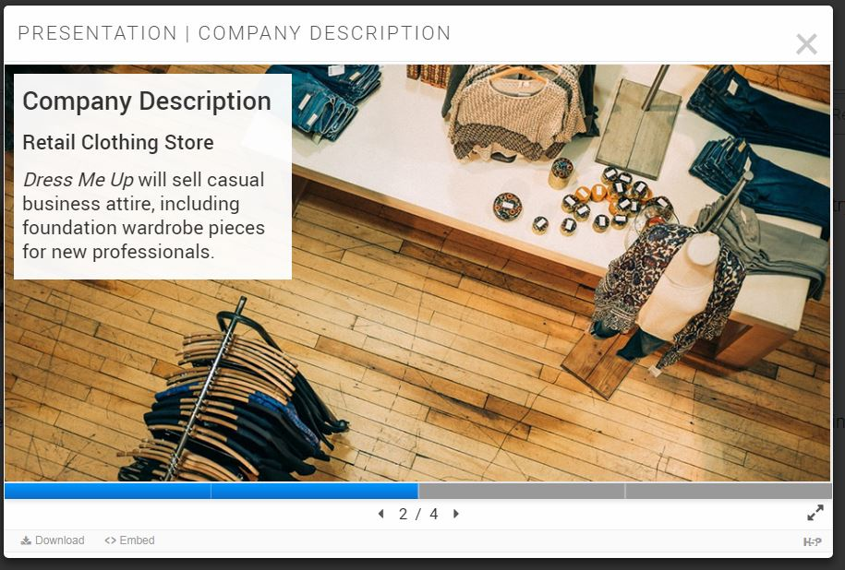

Slide 27
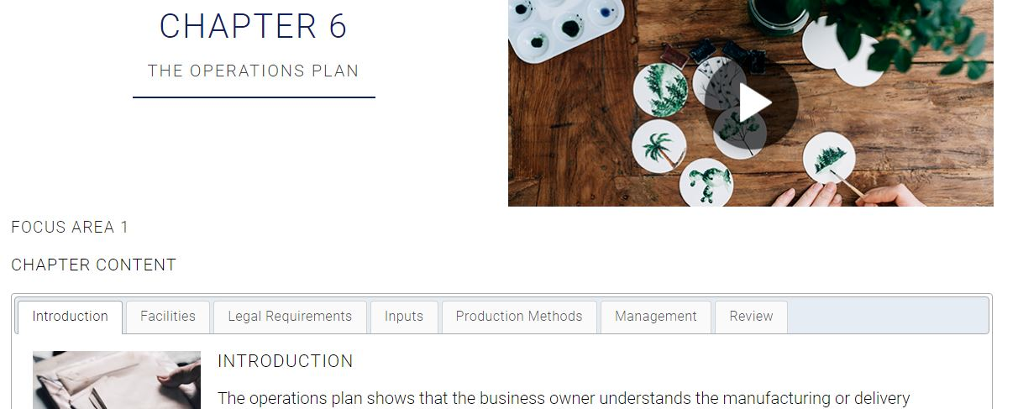

Slide 28
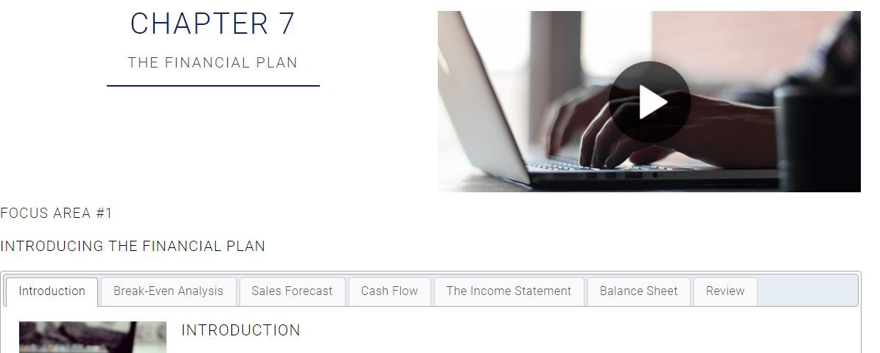

Slide 29
Next Steps
Remaining work:
Refining resources
Checking accessibility
Creating print-only versions of all chapter content
Anchoring content to glossary, audio transcripts etc.
Small revisions based on feedback from the field
Help us review this resource:
Catherine Ipsen, Ph.D
University of Montana Rural Institute
RTC:Rural
Catherine.ipsen@mso.umt.edu
(406)243-4562

