Slide 1
Session 3: Taking the Mystery out of Match and Making Match Work For You (Part 1)
Charting Our Course: Maximizing VR Resources - Increasing Customer Outcomes
2023 CSAVR Spring Conference

Slide 2
Disclaimer
This content was developed by the VRTAC-QM, a project funded under #H264J200002; the VRTAC-QE, a project funded under #H264K200003; the NTACT:C, a project funded under #H326E200003, of the U.S. Department of Education (Department); and CSAVR, a member organization of State Vocational Rehabilitation Agencies. The information contained herein does not necessarily reflect the position or policies of the Department, and no official endorsement of any non-Federal product, service, or venture should be inferred.

Slide 3
Presenters for today
Dacia Johnson, Executive Director, Oregon Commission for the Blind
Joe Xavier, Administrator, California DORS
John Connelly, CSAVR
Chris Clause, Assistant Commissioner, Missouri General
Jill Cremer, Coordinator of Administrative and Independent Living Services
Carol Pankow, VRTAC-QM

Slide 4
Match: Why Leadership Matters
Joe Xavier, California Combined
Dacia Johnson, Oregon Blind

Slide 5
Match: Why Leadership Matters
Why is this important?
We must maximize our resources to improve the workforce participation rate of job seekers with disabilities.
Maximizing our resources includes leveraging our full federal award.
We need match in order to make that happen.

Slide 6
Match: Why Leadership Matters (2)
Some states are seeing increases in awards that exceed current matching capacity.
There are a variety of options for matching the federal award.
Important for VR Directors to understand the fundamentals of match.
This is not just a fiscal issue; solutions require leadership and planning.

Slide 7
Match: Why Leadership Matters (3)
Time to be bold, take risks, try some new things.
This is a national call for action.
We can’t rely on other states to pick up what we aren’t able to.
We are all in this together in the important work to improve the workforce participation rate of job seekers with disabilities.
Notes:
We are all in this together in the important work to improve the workforce participation rate of job seekers with disabilities.

Slide 8
A Few Match Basics
NEW!!!!
Technical Assistance Circular, RSA-TAC-23-01, Allowable Sources of Non-Federal Share for the State Vocational Rehabilitation Services Program

Slide 9
But first…what on earth is match?
2 C.F.R. § 200.1 – Cost sharing or matching.
34 C.F.R. § 361.60 – Matching requirements.
Cost sharing or matching means the portion of project costs not paid by Federal funds (unless otherwise authorized by Federal statute).
Compliance with the matching requirement is assessed on a State basis. When determining compliance in States with Blind and General agencies, the non-Federal share is calculated for both agencies individually and at the State level; however, compliance is determined only on the basis of the State level calculation.
While the term “match” is used in the VR regulations, the process described in the statute is “cost sharing” as defined in 2 C.F.R. § 200.1.

Slide 10
Match Requirements Differ Based on the Program
VR:
Federal = 78.7%
Non-Federal = 21.3%
Note: At least 50% match is required for construction of a facility for community rehabilitation program purposes (34 C.F.R. § 361.60(a)(2))
SE:
Supported Employment funds reserved and expended for supported employment services to youth with the most significant disabilities (ALN 84.187):
Federal = 90%
Non-Federal = 10%
OIB:
Federal = 90%
Non-Federal = 10%

Slide 11
Matching Example
The matching requirement for $100.00 in Federal Vocational Rehabilitation (VR) funds is calculated using the following formula:
(Grant Award Amount/Federal Share) X (State Match)
($100/.787) * (.213) = $27.06
In this example, total project costs are $127.06: $100 Federal and $27.06 non-Federal
Use the
RSA.ED.GOV Match Calculator

Slide 12
Match Requirements
Uniform Guidance Requirements at 2 C.F.R. § 200.306
Expenditures reported as match are subject to the same
requirements as Federal funds. Match must be:
Verifiable from records
Not reported as match for any other Federal award
Allowable, necessary and reasonable
Not paid by the Federal government under another Federal award (unless Federal authorizing statute permits the Federal funds to be used as match)

Slide 13
Match Requirements (2)
Three Keys to Allowable Match
For allowable VR expenditures
From allowable sources
Through allowable mechanisms
Except for OIB (34 § C.F.R. 367.63), third party in-kind contributions may not be used as match
(34 C.F.R. §§ 361.4, 361.60(b)(2), 363.23(b))
Program income cannot be used as match
(34 C.F.R §§ 361.63(c)(4), 363.24, 367.65(b)(3))
Matching requirements must be met by the end of the year of appropriation
(September 30/fourth quarter)

Slide 14
When is Match Reportable?
Match can only be reported as such after an obligation has been incurred with non-Federal funds or the expenditure has been made.
Example: A grantee receives a State appropriation at the beginning of the State fiscal year for $1,000,000. The $1,000,000 may not be counted as non-Federal share until the funds have been obligated or expended for allowable program purposes.
Plain language: You either committed to spending the funds - PO/Auth - or you spent them - they are out the door.

Slide 15
Sources of Match
State Appropriations
State appropriation to the State VR agency and State fund expenditures made on behalf of the State VR Agency from a central account maintained by the State’s Department of Treasury for the purpose of paying expenses common to all State Agencies, such as fringe benefits, indirect costs, etc.
RSVFP Unassigned Federal Vending Machine Income and RSVFP Set-Aside Funds
The matching source comes from the expenditures made by these sources for allowable VR purchases- the purchase of new equipment, the maintenance and replacement of equipment, and management services.
Notes:
Talking points
Interagency cash transfer
Although these are no longer specifically mentioned in the VR regulations, they are an allowable source of match. NPRM at 64494 stated that although they streamlined the regs it was not construed to mean those sources of match no longer existed.
Those allowable VR expenditures
incurred with funds contributed by a
private entity, deposited into the
state VR agency’s account, and
earmarked for meeting, in whole or
in part, the agency’s non-federal
share of establishing or constructing
a Community Rehabilitation Program
(CRP) (34 CFR 361.60(b)(3)(i));
Those allowable VR expenditures
incurred with funds contributed by a
private entity, deposited into the
state VR agency’s VR account, and
earmarked for meeting, in whole or
in part, the agency’s non-federal
share for any purpose (except
establishment of a CRP) under the
State Plan for a particular
geographic area within the state (34
CFR 361.60(b)(3)(ii));

Slide 16
Sources of Match (2)
Contributions by private entities
Establishing or constructing a Community Rehabilitation Program
34 C.F.R 361.49 allows for the establishment, development, or improvement of a public or other nonprofit community rehabilitation program that is used to provide vocational rehabilitation services that promote integration and competitive employment, including, under special circumstances, the construction of a facility for a public or nonprofit community rehabilitation program. Match rate for establishment projects is 21.3%; the match rate for construction projects is 50%.
For meeting any purpose under the State Plan (this is for non-CRP purposes)
Expenditures do not benefit the donor.
Notes:
Talking points
Interagency cash transfer
Although these are no longer specifically mentioned in the VR regulations, they are an allowable source of match. NPRM at 64494 stated that although they streamlined the regs it was not construed to mean those sources of match no longer existed.
Those allowable VR expenditures
incurred with funds contributed by a
private entity, deposited into the
state VR agency’s account, and
earmarked for meeting, in whole or
in part, the agency’s non-federal
share of establishing or constructing
a Community Rehabilitation Program
(CRP) (34 CFR 361.60(b)(3)(i));
Those allowable VR expenditures
incurred with funds contributed by a
private entity, deposited into the
state VR agency’s VR account, and
earmarked for meeting, in whole or
in part, the agency’s non-federal
share for any purpose (except
establishment of a CRP) under the
State Plan for a particular
geographic area within the state (34
CFR 361.60(b)(3)(ii));

Slide 17
Sources of Match (3)
Third-party cooperative agreements
The VR Agency enters into an arrangement with another State Agency or local public agency that is furnishing all or part of the non-Federal share and providing VR services to participants of the State VR Agency under the VR program.
Specific VR regulatory provisions apply that must be met.
Interagency Cash Transfer
State or Local Public Agency provides State-appropriated matching funds to the VR Agency for it to provide VR services to its VR-Eligible consumers-The agreement may call for the VR agency to dedicate counselors or other requirements. The VR Agency must remain in control of the non-Federal and Federal share.
Notes:
Talking points
Interagency cash transfer
Although these are no longer specifically mentioned in the VR regulations, they are an allowable source of match. NPRM at 64494 stated that although they streamlined the regs it was not construed to mean those sources of match no longer existed.
Those allowable VR expenditures
incurred with funds contributed by a
private entity, deposited into the
state VR agency’s account, and
earmarked for meeting, in whole or
in part, the agency’s non-federal
share of establishing or constructing
a Community Rehabilitation Program
(CRP) (34 CFR 361.60(b)(3)(i));
Those allowable VR expenditures
incurred with funds contributed by a
private entity, deposited into the
state VR agency’s VR account, and
earmarked for meeting, in whole or
in part, the agency’s non-federal
share for any purpose (except
establishment of a CRP) under the
State Plan for a particular
geographic area within the state (34
CFR 361.60(b)(3)(ii));

Slide 18
Areas that may be overlooked!
May include State expenditures made on behalf of the program from a central account.
For example, a State pays for personnel fringe benefits and indirect costs from a central pool of State funds. The actual State expenditures from this pool for VR staff providing allowable VR services could be used as match.
Services to Groups - NFB Newsline

Slide 19
Match Source - State Appropriations
A Conversation with Missouri General
Chris Clause
Jill Cremer
John Connelly

Slide 20
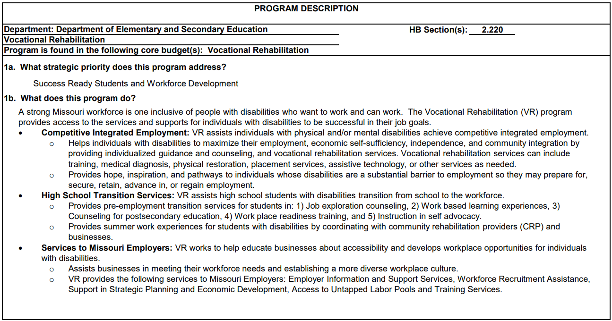
Strategic Priorities and Program Services

Slide 21
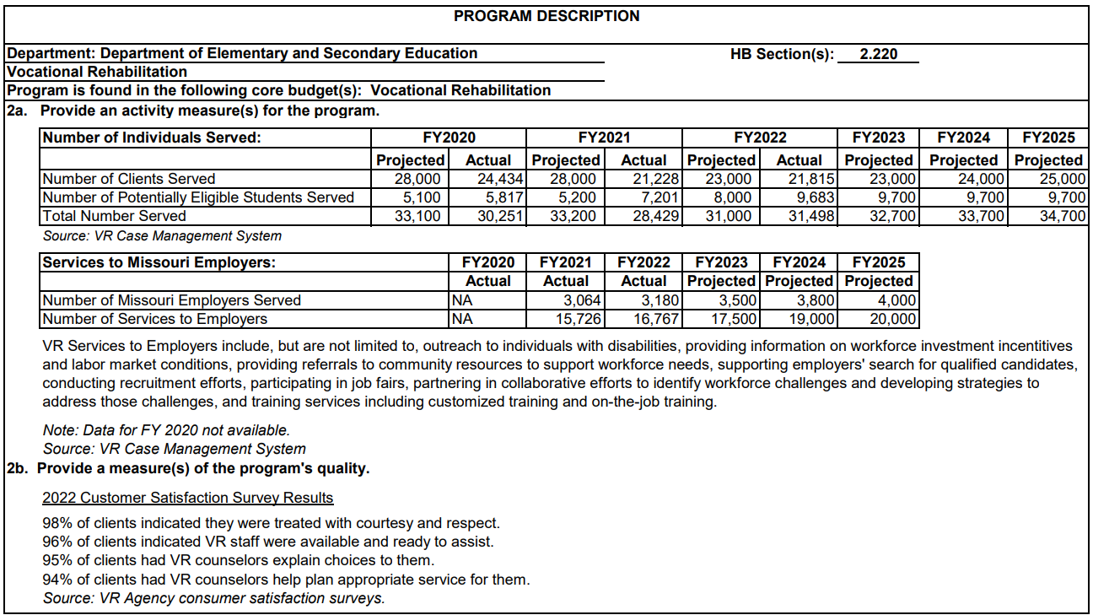
Program Activity Measures: People Served
Notes:
Screenshot of a program description page that highlights program activity measures including number of individuals served including Clients, Potentially Eligible Students, and a total. This list of people served is listed for the last 3 fiscal years with projected number served and actual number served. It then includes projections for number served for future three fiscal years. Another program activity measure is Services to Employers. The number of employers served and the number of services are totaled for the last three fiscal years and the projected number served are totaled for the future three fiscal years. In addition, another measure of program quality is customer satisfaction survey results. The results from the most recent survey are shared.

Slide 22
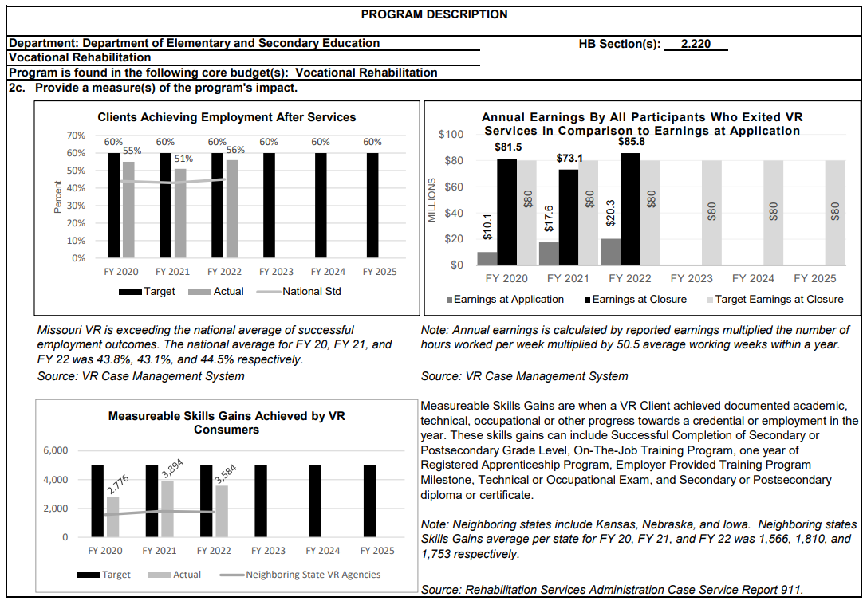
Program Activity Measures: Program Impact
Notes:
A program description screenshot showing charts measuring a program’s impact. The first chart shows Clients Achieving Employment After Services with targeted percentages for the last three fiscal years and actual percentages. These are also compared to the national standard. The targeted percentages for the next three fiscal years are indicated as well. The next chart shows Annual Earnings by All Participants Who Exited VR Services in Comparison to Earnings at Application. Earnings at Application, Earnings at Closure, and Targeted Earnings at Closure are outlined for last three fiscal years and earnings targets are shown for future three fiscal years. The final chart outlines Measurable Skills Gains Achieved by VR Consumers. Targeted Gains Vs. Actual are compared for last three fiscal years with a comparison to neighboring state VR agencies. Measurable skills targets are shown for future three fiscal years.
Measurable Skills Gains are when a VR Client achieved documented academic, technical, occupational or other progress towards a credential or employment in the year. These skills gains can include Successful Completion of Secondary or Postsecondary Grade Level, On-The-Job Training Program, one year of Registered Apprenticeship Program, Employer Provided Training Program Milestone, Technical or Occupational Exam, and Secondary or Postsecondary diploma or certificate. Source: Rehabilitation Services Administration Case Service Report 911.

Slide 23
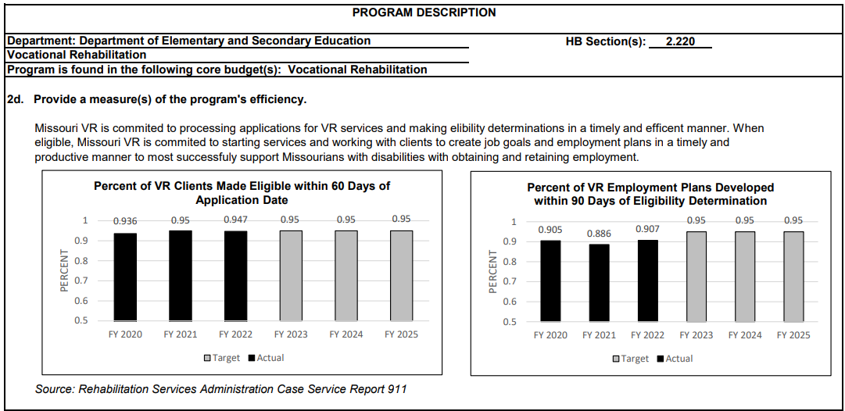
Program Activity Measures: Program Efficiency
Notes:
Screenshot of charts measuring the program’s efficiency. The first chart shares Percent of VR Clients Made Eligible within 60 Days of Application Date. The actual percent is shared for last three fiscal years and the targeted percent is shared for the next three fiscal years. The second chart outlines Percent of VR Employment Plans Developed within 90 Days of Eligibility Determination. The actual percent is shared for last three fiscal years and the targeted percent is shared for the next three fiscal years. The source of this information is from the Rehabilitation Services Administration Case Service Report 911.

Slide 24
Match source: Certain RSVFP Expenditures- Business Enterprises Program (BEP)

Slide 25
Business Enterprises Program- In a Nutshell
VR regulations at 34 C.F.R. § 361.49(a)(5) permit the following BEP-related services as “services to groups” under the VR program:
Management services and supervision provided by the State unit;
The acquisition by the State unit of vending facilities or other equipment (including costs incurred to ready the site or equipment to serve its purpose or additional space acquired to expand a vending facility);
Initial stocks and supplies not to exceed six months; and
Initial operating expenses. (e.g., rent and utilities) not to exceed six months.

Slide 26
Business Enterprises Program- In a Nutshell (2)
The RSVFP regulations at 34 C.F.R. §§ 395.8(c) and 395.9(b) authorize many different uses for the unassigned Federal vending machine income and set-aside funds, respectively, however, only the following RSVFP expenditures, which are also allowable under the VR program may be used for match purposes.
Maintenance and replacement of equipment,
Purchase of new equipment, and
Management Services.
Any State expenditures from the RSVFP unassigned Federal vending machine income or set-aside funds for these purposes must be reported!

Slide 27
BEP Set-Aside Funds that may Not be used as Match
Establishment of retirement or pension funds;
Health insurance contributions;
Provision for paid leave (e.g., vacation) for blind vendors;
Liability insurance; and
Fair minimum return.

Slide 28
BEP Set-Aside Funds that May Not Be Used as Match (2)
Arbitration Expenses under the Randolph-Sheppard Act
Any damage awards ordered by arbitration panels under the Randolph-Sheppard Act are not allowable costs under the VR program or the BEP.
The prohibition against using Federal funds to share in the award also would cover any voluntary payment made by a SLA to settle arbitration disputes, as well as panel-ordered.
SLA payments of vendor attorney fees.
These activities may also not be paid with Federal VR funds.

Slide 29
Match Source: Contributions by Private Entities

Slide 30
Private Contributions
VR agencies may report match from allowable VR expenditures incurred with cash contributions from private entities, deposited into the State VR agency’s account, and earmarked for meeting, in whole or in part, the agency’s non-Federal share of expenditures under the VR program for:
Establishment or construction of a community rehabilitation program (CRP) (34 C.F.R. § 361.60(b)(3)(i));
Particular geographic areas when the State cannot otherwise provide the non-Federal share (34 C.F.R. § 361.60(b)(3)(ii)); and
Other VR purposes provided the expenditures do not benefit the donor in any way (34 C.F.R. § 361.60(b)(3)(iii)).

Slide 31
Private Contributions (2)
Reversion to Donor for Private Contributions
If a business provides funds directly to the VR agency for use as match for the VR program, pursuant to 34 C.F.R. § 361.60(b)(3)(iii), regarding contributions by private entities, the prohibition against reversion to donor is triggered. This means the VR agency would not be permitted to pay the business directly for services provided to VR program participants unless the business was paid through a contract that was implemented under the State’s regular competitive procurement procedures, even if the VR agency is typically exempt from some or all of those procedures.

Slide 32
Questions
Please direct questions to your RSA-SMPID state liaison.

Slide 33
Conference Partners

Slide 34
Thank You

