Slide 1
2023 NET Summit
Department of State
Educational and Cultural Affairs Bureau (ECA)
Katheryn King CCDP/AP M.S.
September 20, 2023

Slide 2
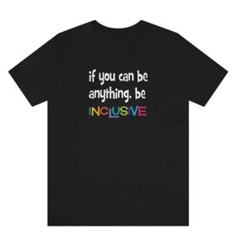
If I May Introduce Myself
Katheryn King
ECA DEIA Policy Officer
They/Them/Theirs

Slide 3
Educational and Cultural Affairs Bureau
5 DEIA and Equity Strategic Development Areas: Examples for U.S. Embassies & Consulates
International
Exchanges and Programs:
Recruit Participants from Underrepresented Groups
WORKFORCE
WORKPLACE
MISSION
COMMUNITIES
PROCUREMENT
Diversity of Thought:
Hire Locally Employed Staff
from Marginalized
Communities In-country
.
Psychologically Safe
Workspace:
Foster Allyship to Empower the Systemically Excluded
American Spaces:
Launch Standards Promoting Accessibility
for People w/Disabilities
Supplier Diversity:
Acquire Products and Services
from Local Small
Disadvantaged Businesses
Educational and Cultural Affairs Bureau Policy Office - Version 3.0 September 2023
UNCLASSIFIED

Slide 4
Educational and Cultural Affairs Bureau - Promoting Mutual Understand

Slide 5
Mobility International USA

Slide 6
National Clearinghouse on Disability and Exchange

Slide 7
Non-Competitive Eligibility
Exchange Program Alumni
Critical Language Scholars
Fulbright Scholars
Gilman Scholars
Non-competitive Eligibility Letter
NCE allows eligible exchange program alumni to compete for certain federal employment jobs that are only open to federal employees.
Area of Consideration in USAJOBS, is 'Status' applicants or those who are current of former federal civilian employees

Slide 8
Questions? Comments! Concerns*

Slide 9
Be Intentionally Inclusive…OR…Unintentional Exclusion Will Prevail-
Katheryn King, DEIA Policy Officer,
Educational and Cultural Affairs Bureau
Whats App (202) 802-7268
KingK@State.Gov
Notes:
.

