Slide 1
We Are VR: NH’s Experience Implementing an Integrated Public Awareness Campaign
CSAVR 2024 Spring Conference

Slide 2
The Challenge
To break out of “best-kept secret” mode
To challenge misconceptions (and/or narrow perceptions) about people with disabilities and employment
To convey the value VR adds to individuals, employers and the state’s economy

Slide 3




The Solution
Phase 1
Needs assessment/ message development
Phase 2
Rebranding, including website and materials refresh
Phase 3
Production of media assets
Phase 4
Distribution of media assets

Slide 4
Phase 1: Needs Assessment/ Message Development
Comprehensive intake process with internal and external stakeholders, resulting in:
  Needs assessment
  Messaging map
  Short-term recommendations
  Long-term campaign concept ideas

Slide 5
Phase 2: Rebranding
Logo/name refresh
Tagline development
Website refresh
Materials development
Social media presence

Slide 6
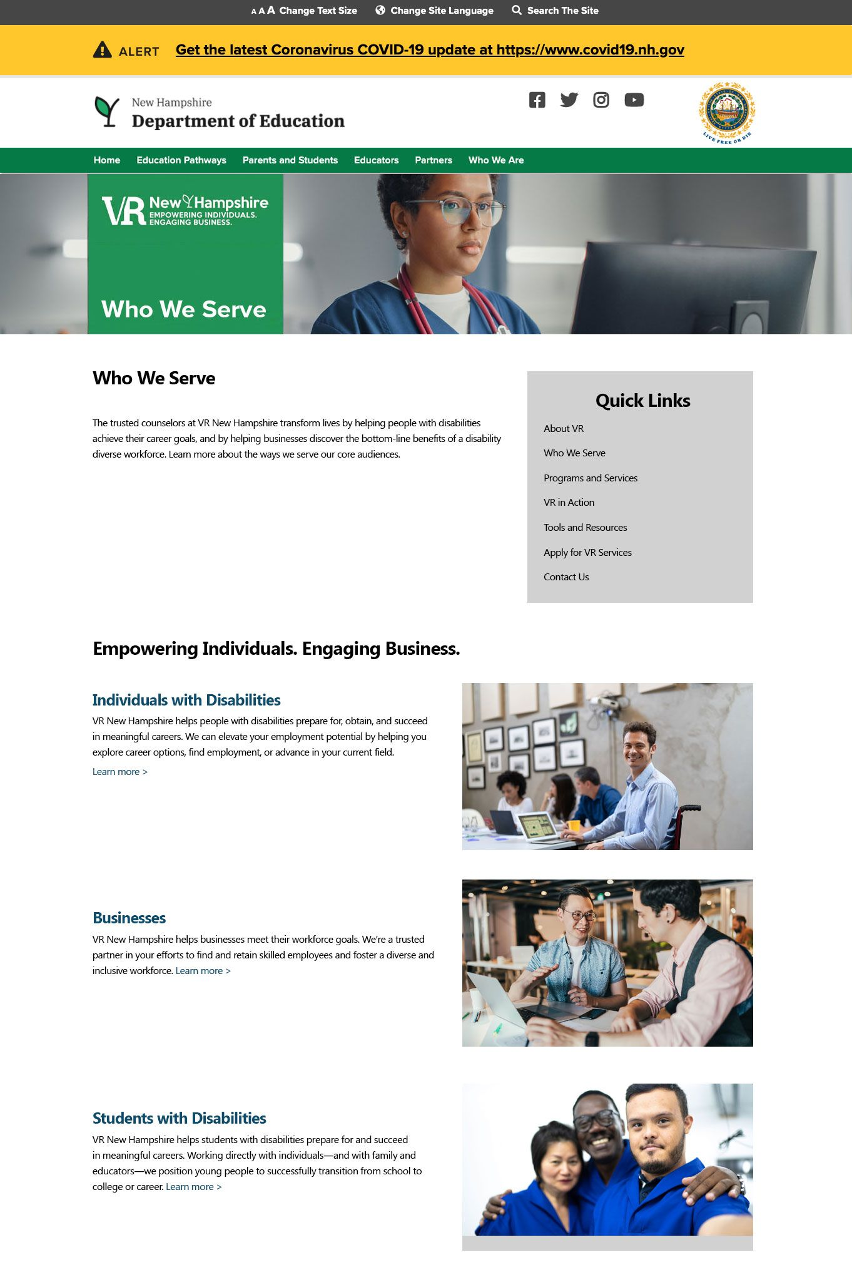
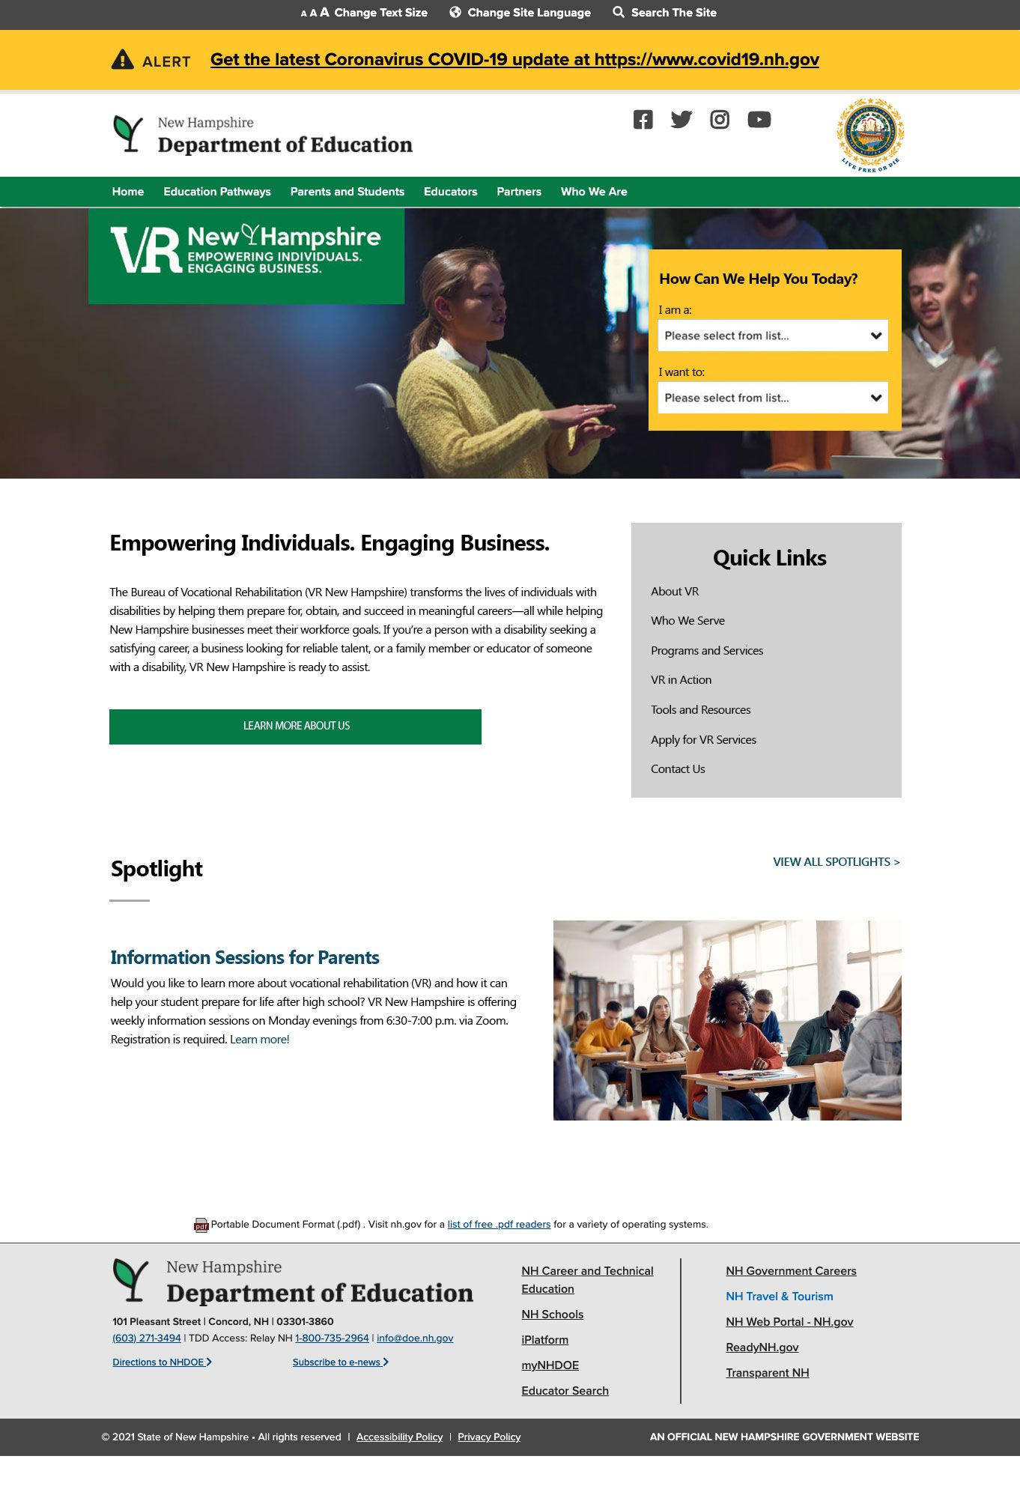
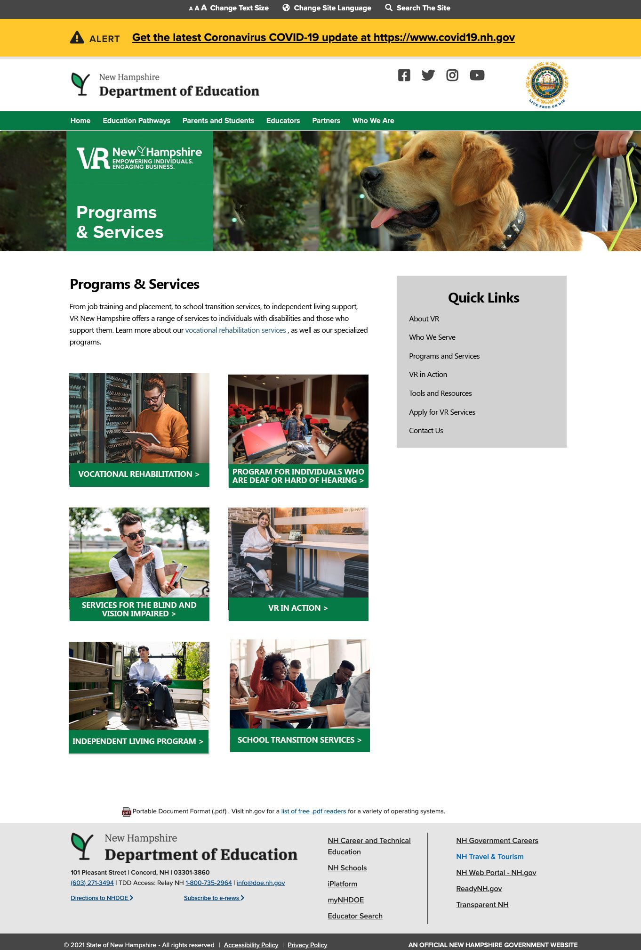
Phase 2 Outcomes: Website

Slide 7
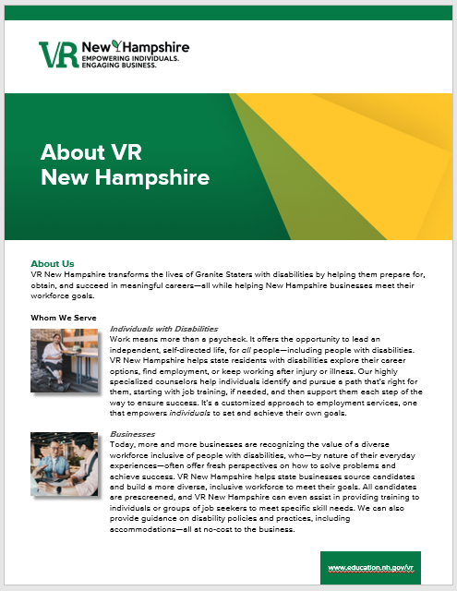
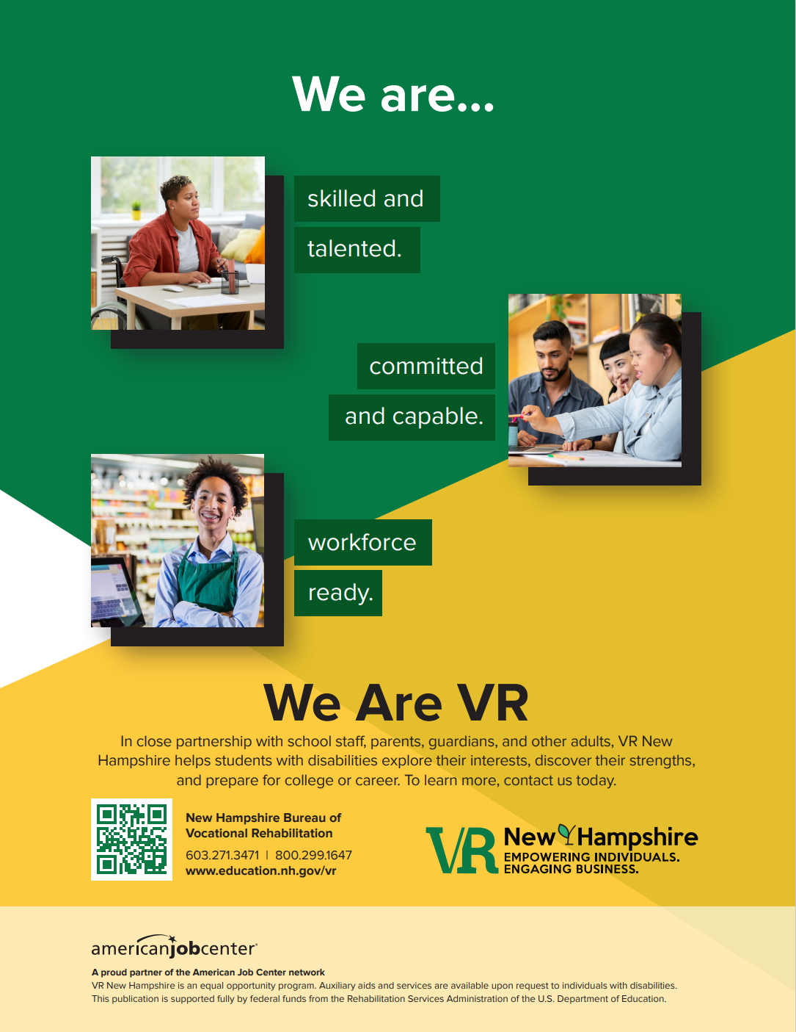
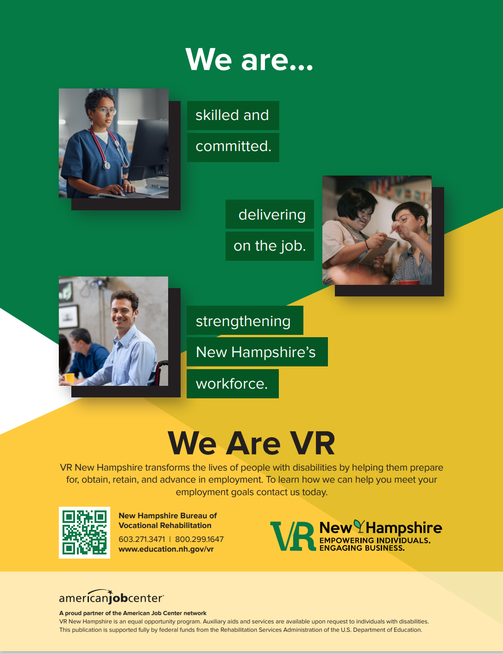

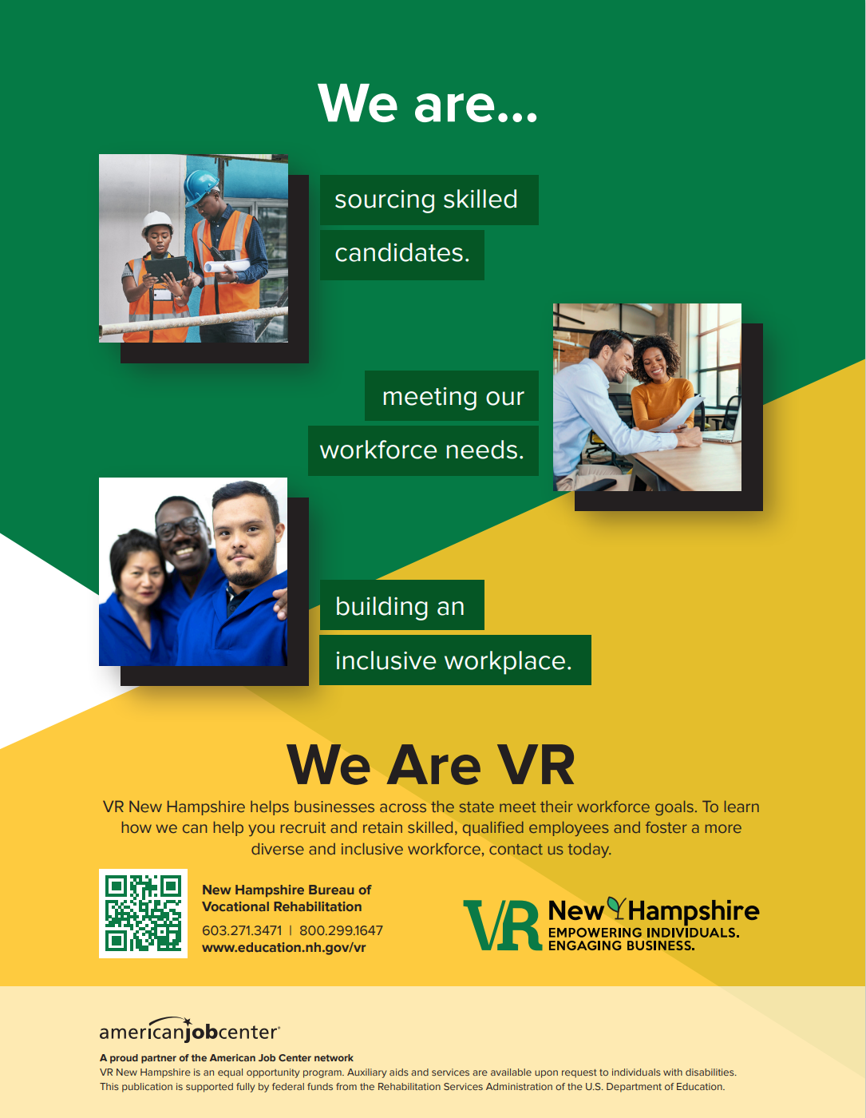
Phase 2 Outcomes: Materials

Slide 8
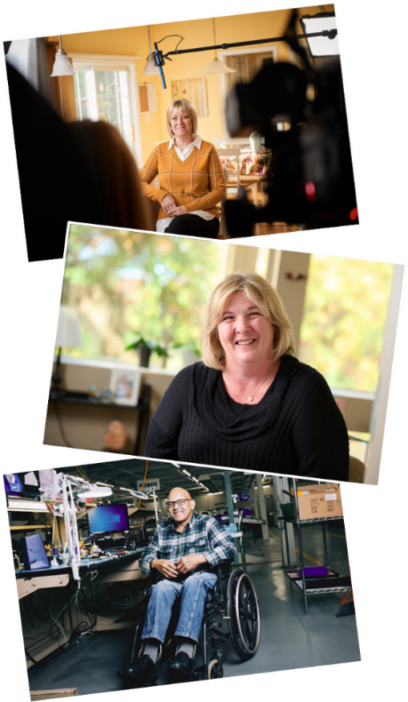
Phase 3: Production of Media Assets
Foundation for all materials was series of video and photo shoots conducted October 2022
Planning involved:
  Casting (seeking diversity across numerous variables)
    Development of interview questions
    Participant communication and preparation
  Scheduling and site visits

Slide 9
Phase 3 Outcomes: Video Assets
30-second video (for use on TV, online and at events)
  Audio serves as radio ad
Eight long-form, documentary-style videos:
  Four focused on specific audiences (adults, youth, blind and vision impaired, businesses)
  Four individual success stories

Slide 10

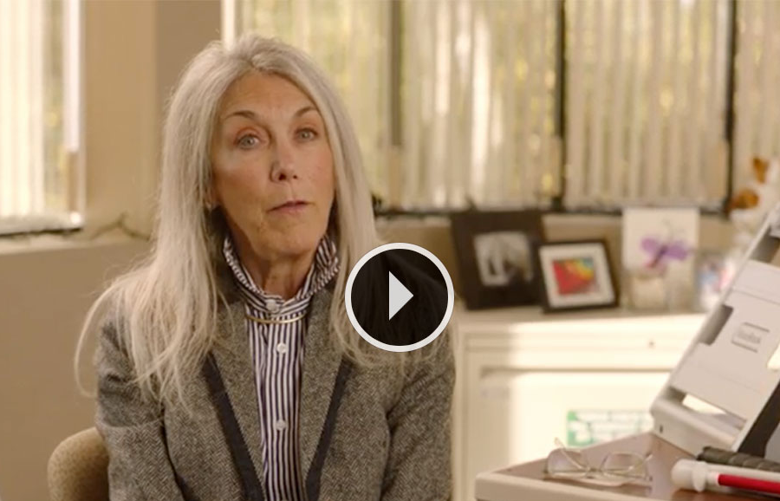
We Are VR Video Spot
Port City Pretzels video?
Or Business
We are VR.

Slide 11
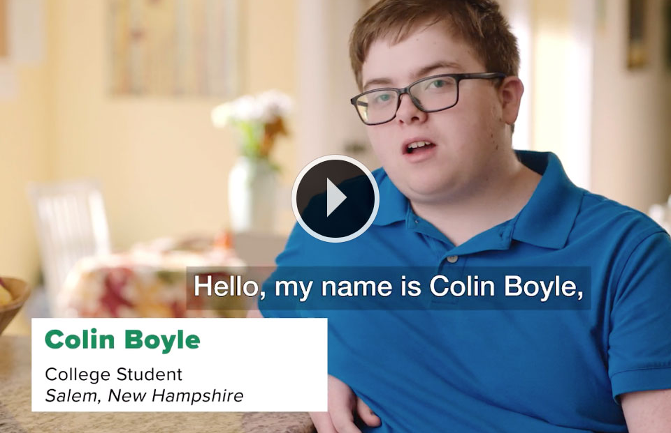
Port City Pretzels Video

Slide 12



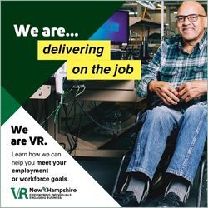
Phase 3 Outcomes: Print/Digital Ads

Slide 13
Phase 4: Distribution of Media Assets
Development of ad buy plan
Placement/sharing of long-form videos:
  VR New Hampshire website and Facebook page
  Department of Education YouTube channel
  Department of Education social media
  Partners’ social media

Slide 14
Phase 4 Outcomes: Ad Buy Plan
Television (WMUR – ABC9 Manchester; MeTV – Classic Television/news; and EffecTV/Xfinity/Comcast)
Radio (NH Public Radio, WZID Adult Contemporary; STPL “The Pulse” – News/Talk; and streaming networks)
Print (603 Diversity Magazine; NH Business Review; Business New Hampshire)
Digital/Social Media (YouTube; GoogleAds; LinkedIn; Facebook/Instagram)

Slide 15
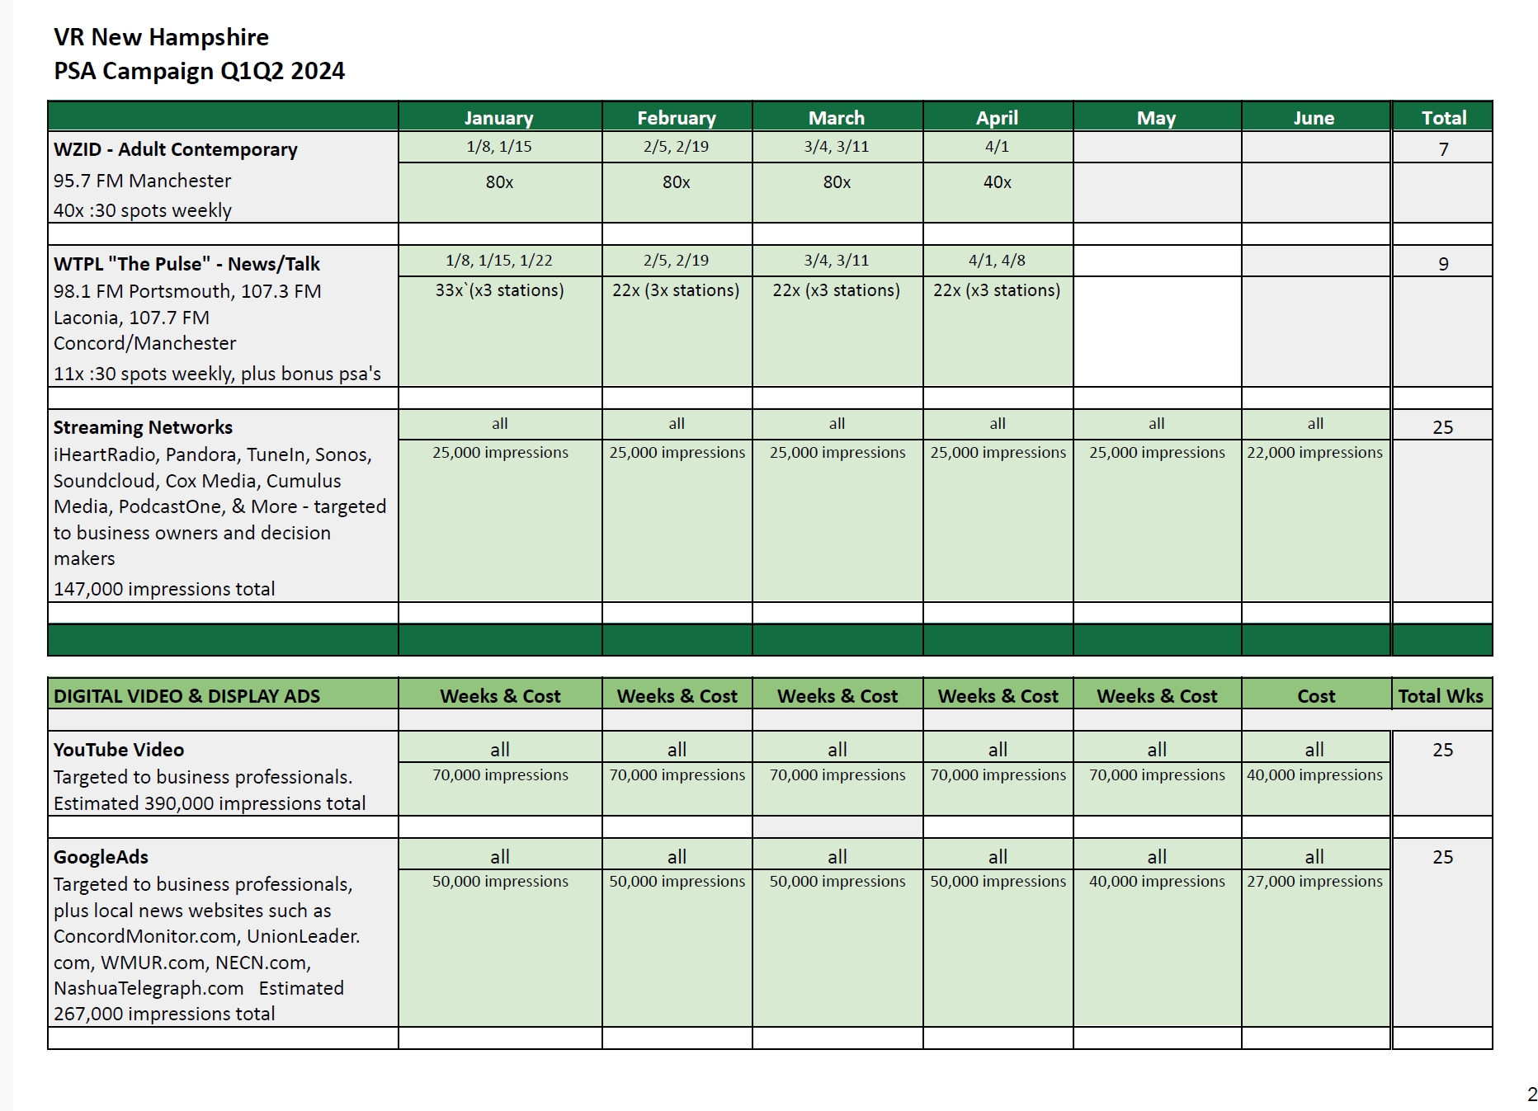
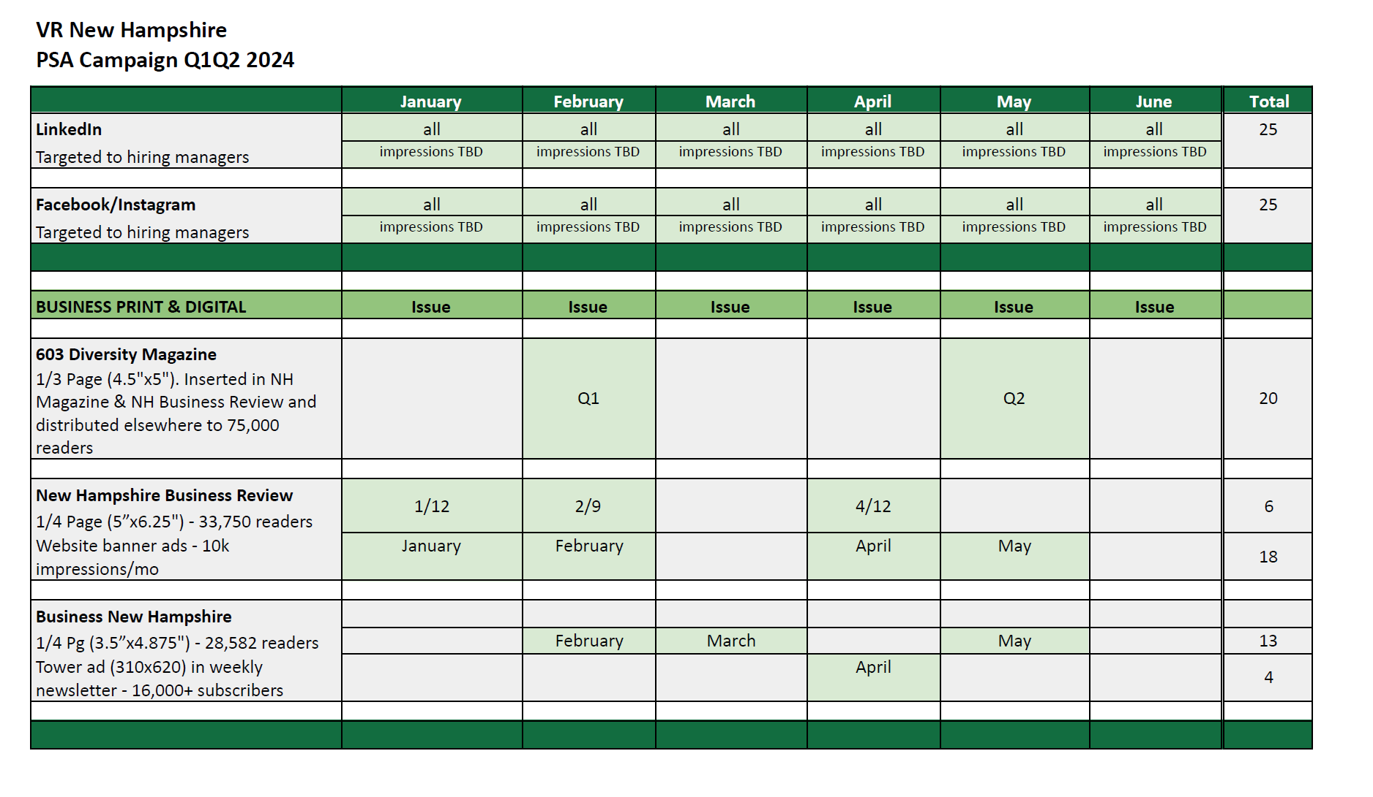
Ad Buy Plan

Slide 16
Phase 4 Outcomes
Estimated reach (1/2/24 through 2/12/24):
  Broadcast TV: 185,000 impressions
  Cable/Digital TV: 94,180 impressions
  Broadcast radio: 251,850 listeners
  Streaming radio: 16,698 individual users with 33,740 impressions
  Print: 113,500 readers
  Digital display ads: 233,065 impressions (143 clicks to site)
  Digital video ads: 107,325 impressions (839 clicks to site)
  Social media: 153,800 impressions (624 clicks to site)

Slide 17
Challenges Encountered/
Lessons Learned
Project Management – With many moving parts, organization, attention to detail, and communication are key
Logistics – Transportation was a concern for some participants; also needed to be efficient with number of filming locations
Preparing for Outcomes – Distribution was delayed due to counselor shortage and concern about being prepared for possible spike in applications

Slide 18

Questions

