Slide 1

WIOA Performance Accountability and
VR Program Data:
RSA Update and State Agency Presentations
CSAVR Fall Conference
Jacksonville, FL
October 29, 2019

Slide 2
Introductions
Dacia Johnson
  Executive Director, Oregon Commission for the Blind
Christopher Pope
  Chief, Data Collection and Analysis Unit, RSA
Kristen Mackey
  Administrator, Arizona RSA
John Gelletta
  Chief, Special Services Section, Wisconsin DVR

Slide 3

Welcome to the Fifth General Session

Slide 4
Overview
WIOA Annual Reports
PYs 2017 and 2018 Performance Data
PYs 2020-2023 WIOA State Plans
Case Service Report (RSA-911)
Arizona RSA Presentation
Wisconsin DVR Presentation
Q&A

Slide 5
WIOA Performance Indicators
Measurable Skill Gains (MSG)
Credential Attainment
Median Earnings 2nd Quarter after Exit
Employment Rate 2nd Quarter After Exit
Employment Rate 4th Quarter After Exit
Effectiveness in Serving Employers
#1 through 5 measure State’s VR program
#6 measures all WIOA Core Programs in State

Slide 6
Title IV WIOA Annual Reports
Titles I, II, and III began WIOA data collection and reporting in PY 2016. Title IV began in PY 2017.
As a result, the VR program is one year behind the other five core programs with the full year’s data that is available for publication in WIOA Annual Reports.
Taken together with the periods of performance and the lag in receiving UI wage record information, title IV will not publish WIOA Annual Reports with all five indicators until the completion of PY 2019.

Slide 7
Title IV WIOA Annual Reports
PY 2016
  WIOA Annual Report Not Published for VR
PY 2017
  MSG (PY 2017)
PY 2018
  MSG (PY 2018)
  Median Earnings 2nd Quarter after Exit (PY 2017)
  Employment Rate 2nd Quarter after Exit (PY 2017)
PY 2019
  MSG (PY 2019)
  Median Earnings 2nd Quarter after Exit (PY 2018)
  Employment Rate 2nd Quarter after Exit (PY 2018)
  Credential Attainment (January 1, 2018 – December 31, 2018)
  Employment Rate 4th Quarter after Exit (January 1, 2018 – December 31, 2018)

Slide 8
Intra-State UI Data Matching: Q2
UI data has a two-quarter lag:
  Participant exits VR program in PY19 Q1
  Participant’s second quarter after exit is PY19 Q3
  In PY19 Q4, employer reports PY19 Q3 wages to UI
  In PY20 Q1, UI shares PY19 Q3 wage data with VR agency who reports to RSA
  Four Quarters After Exit: Reporting Continues

Slide 9
Intra-State UI Data Matching: Q4
UI data has a two-quarter lag:
  Participant exits VR program in PY19 Q1
  Participant’s fourth quarter after exit is PY20 Q1
  In PY20 Q2, employer reports PY20 Q1 wages to UI
  In PY20 Q3, UI shares PY20 Q1 wage data with VR agency who reports to RSA
  Six Quarters After Exit: Reporting Concludes

Slide 10
Inter-State UI Data Matching: SWIS
As of October 28, 2019, 25 States have signed the Agreement – one SUIA and PACIA.
About half of these States have received training from the SWIS contractor and tested receiving data.
With ETA and OCTAE, RSA is funding the infrastructure costs of the database to allow State VR agencies to query wage records.

Slide 12
Order of Selection (10/25/2019)
41/78 agencies have an OOS
31/41 agencies with an OOS have one or more categories closed
  8/31 agencies with closed categories have no categories open as of October 25, 2019 (a reduction of 1 agency from July 1, 2019).
5 agencies with some or all closed categories on July 1, 2019 opened one or more categories as of October 25, 2019 - 3 of which opened all categories.
1 agency with all categories open on July 1, 2019 had closed all categories as of October 25, 2019.

Slide 13
PYs 2017 and 2018: Applicants and
Eligible Individuals
  Number of Applicants
    PY17: 473,609
    PY18: 479,437
  Number of Eligible Individuals
    PY17: 414,531
    PY18: 398,205

Slide 14
PYs 2017 and 2018: Participants and Exiters
  Number of Participants
    PY17: 932,835
    PY18: 916,083
  Number of Participants Who Exited During PY
    PY17: 311,748
    PY18: 300,794

Slide 15
PYs 2017 and 2018: Demographics
  Percentage of Participants with Disabilities
    PY17: 99.5%
    PY18: 99.8%
  Percentage of Participants Age 24 and Under
    PY17: 49%
    PY18: 51%
  Percentage of Participants Age 25 and Older
    PY17: 51%
    PY18: 49%

Slide 16
PYs 2017 and 2018: Students and
Pre-Employment Transition Services
  Number of Students with Disabilities Reported
    PY17: 525,958
    PY18: 638,601
  Number of Potentially Eligible Students with Disabilities
    PY17: 85,245
    PY18: 137,780
  Number of Students with Disabilities who Received Pre-Employment Transition Services
    PY17: 179,716
    PY18: 248,320

Slide 17
PYs 2017 and 2018: MSG
  Number of Participants who Earned MSG
    PY17: 43,496
    PY18: 54,273
  Number of MSGs Earned
    PY17: 46,065
    PY18: 56,831
  MSG Rate
    PY17: 21.1%
    PY18: 23.1%

Slide 18
PY 2018: 2nd Quarter after Exit
  Employment Rate 2nd Quarter after Exit
    PY18: 49.2%
  Median Earnings 2nd Quarter after Exit
    PY18: $3,714
  Lowest Earnings 2nd Quarter after Exit
    PY18: $0.01
  Highest Earnings 2nd Quarter after Exit
    PY18: $644,248

Slide 19
PYs 2017 and 2018: Rehab Rate
  Number of Participants exiting with employment:
    PY17: 152,425
    PY18: 142,722
  Number of Participants exiting w/o employment:
    PY17: 156,683
    PY18: 157,300
  Employment Rate
    PY17: 49.3%
    PY18: 47.6%

Slide 20
PY 2018: SOC Codes
  Top Five SOC Codes
      Stock Clerks and Order Fillers
      Customer Service Representatives
      Janitors and Cleaners (except Maids and Housekeeping Cleaners)
      Laborers and Freight, Stock, and Material Movers
      Retail Salespersons

Slide 21
PY 2018: Reasons for Exit
  300,794 participants exited during PY18.
  Reasons for Exit:
    No Longer Interested in Receiving Services or Further Services: 65,438
    Unable to Locate or Contact: 61,269
    All Other Reasons: 18,682
  145,389 or 48% of participants exited the VR program unsuccessfully in PY18 for these three reasons.

Slide 22
PYs 2020-2023 WIOA State Plans
On October 10, 2019, DOL and ED announced the availability of WIOA State Plan ICR: https://doleta.gov/wioa/docs/State-Plan-ICR.pdf
Planning requirements are mostly the same as the PY 2016-2019 Plans. RSA did not make any changes to the VR Services Portion.
DOL and ED anticipate that States may begin officially submitting Plans in early March 2020; however, the portal will open before March.

Slide 23
PYs 2020-2023 WIOA State Plans
DOL and ED plan to issue guidance regarding the Plans to provide submission instructions and outline requirements related to due dates.
DOL and ED also plan to issue guidance regarding the negotiation of performance levels and performance sanctions.

Slide 24
PYs 2020-2023 WIOA State Plans
Program Years 2020 and 2021
MSG
PY Data Available: 2017 and 2018
When States submit Plans in March/April 2020, RSA will also have PY 2019 Q1 and Q2 reports.
RSA will establish levels of performance with VR programs for MSG.

Slide 25
PYs 2020-2023 WIOA State Plans
  Program Years 2022 and 2023
MSG
Credential Attainment
Median Earnings 2nd Quarter after Exit
Employment Rate 2nd Quarter after Exit
Employment Rate 4th Quarter after Exit
PY Data Available: 2017, 2018, 2019, 2020
When States submit Plans in March/April 2022, RSA will also have PY 2021 Q1 and Q2 reports.

Slide 26
Effectiveness in Serving Employers
Baseline Indicator for All Core Programs during Pilot:
  PYs 2016 and 2017
  PYs 2018 and 2019
  PYs 2020 and 2021
Core programs must collect data and report on this indicator in PYs 2019, 2020, and 2021 as they have done for PYs 2017 and 2018.
Data collection and reporting is not optional for VR program; State VR agencies must share data with State partners.

Slide 27
New WIOA State Plan Portal
State Plans and other data from the current portal are being migrated to a new portal hosted by DOL and ED – funded through an IT contract.
DOL and ED are testing the new portal now and providing training to Federal staff.
Training for State agency staff will begin soon.

Slide 28
Case Service Report (RSA-911)
Number of Data Elements
  Deleted 94 Data Elements from PD 16-04…
  Added 14 new Data Elements to PD 19-03…
  Net gain of 80 fewer Data Elements that require reporting on PD 19-03.
New Layout
  Data Elements on PD 19-03 are numbered 1 through 407 (14 new Data Elements are numbered 394 through 407).
  Deleted Data Elements from PD 16-04 will be left blank.
  RSA-911 in PD 19-03 has six Appendices.
  RSA-911 in PD 19-03 is Excel-based.

Slide 29
Case Service Report (RSA-911)
RSA will implement PD 19-03 for PY 2020 – effective July 1, 2020.
Expiration of OMB Approval (1820-0508): April 30, 2022; RSA-911 will expire during PY 2021.
On October 28, 2019, RSA issued an Excel file version of the RSA-911.
This file includes minor corrections (e.g., typos).

Slide 30
RSA-911 Training
The WINTAC and RSA are providing a series of eight mini-webinars on the RSA-911.
Two webinars per month beginning this month through January 2020. Two are available now - WINTAC:
1. Background and Implementation
2. Reporting Expenditures for VR Services
Future topics will include:
3. Pre-Employment Transition Services (November 2019)
4. Supported Employment Services (November 2019)
5. MSG and Credential Attainment (December 2019)
6. Exit and Post-Exit Data Elements (December 2019)
7. New Data Elements – Additional Information (January 2020)
8. RSA-911 Information Used in the WIOA Annual Report (January 2020)

Slide 31
Using RSA-911 Data
  RSA’s Data Dashboards (quarterly)
  VR Agency Monitoring Reports
    Data Tables
    Service Record Review Results
  Eligibility/IPE Timeliness Data
  MSG Data (forthcoming)
  WIOA Annual Reports

Slide 32


Metrics and Tiered Accountability
Kristen Mackey – Arizona Combined

Slide 33

Why use Metrics?
What gets measured gets done
Metrics are numbers that tell important information about processes
Metrics are a reflection of what is actually happening
Metrics make the process objective
Metrics help to set strategic and targeted goals

Slide 34
Metric Categories
Indicator
Provides context for the metric outcomes and allows the team to be better informed regarding the metric values.
Quality
Are we providing services at the customer’s expected level of quality?
How does the customer define quality?
Service
Are we providing the service timely?
What is the unmet demand?
Cost
How much does it cost to achieve an outcome?
Are we providing services efficiently?
Are the services provided leading to an outcome?

Slide 35
What does GOOD look like?
How will we know if we are doing a good job?
How will we know if the customer is getting a good service?
Is the process working?
Are we meeting the customer demand?

Slide 36
Tiered Accountability
Offices
Regions
Administration
Department
Counselor

Slide 37
Statewide Administration Stats

Slide 39
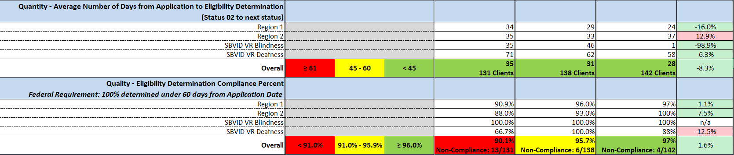
Regional Stats

Slide 40
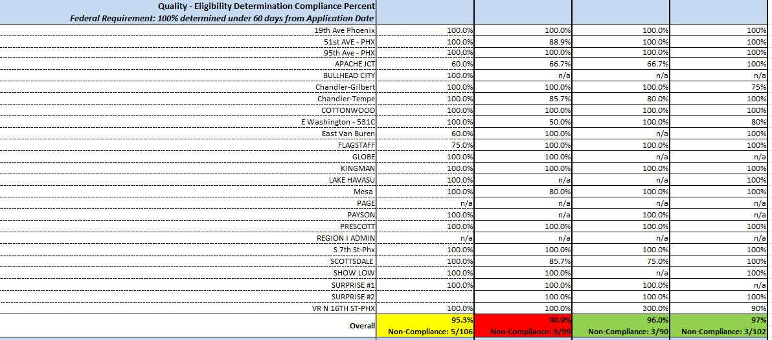
Office Level Stats

Slide 41
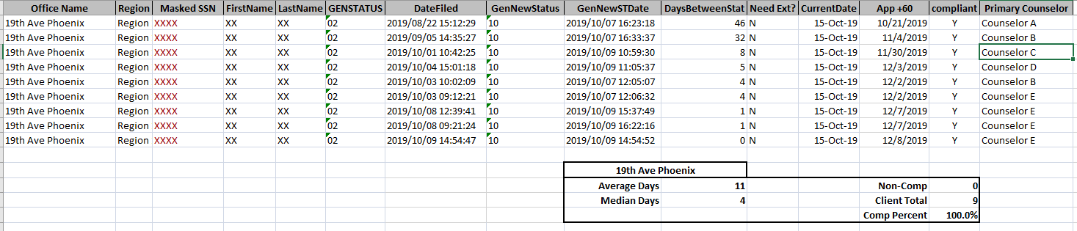
Counselor Level Stats

Slide 42
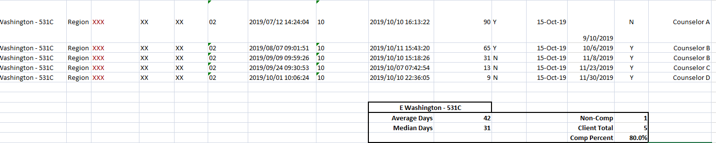
Counselor Level Stats

Slide 43
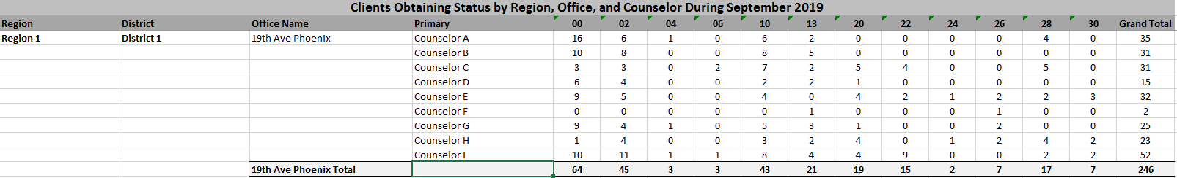
Counselor Level Stats

Slide 44
Using the Data
Performance Management
Identify gaps
Target areas for improvement
Problem solving with data
Celebrate Success !

Slide 45
Outcomes !!
 | 2017 | 2018 | 2019 | % cumulative change 2019 over 2018
# of clients found eligible | 6,468 | 6,809 | 7,277 | 6.9% more
# of plans written | 5,568 | 4,978 | 5,160 | 3.7% more
# of placements | 2,038 | 1,872 | 2,070 | 10.6% more
# of closures with employment | 1,580 | 1,574 | 1,689 | 7.3% more
Avg days application to eligibility | 37.9 | 38 | 31.7 | 6.6 fewer days
Avg days eligibility to IPE completion | 101.8 | 73.4 | 74.6 | 1.6 more days
Avg hourly wage | $ 11.82 | $ 12.54 | $ 13.09 | 4.4% more

Slide 46
Data Visualization for Performance Improvement in Wisconsin
John Gelletta
Special Services Section Chief
CSAVR Fall 2019 Conference
Department of Workforce Development
October 29, 2019
Jacksonville, FL

Slide 47
“Data are just summaries of thousands of stories.”
  – Chip and Dan Heath, authors of “Made to Stick” and “Switch”
Notes:
Put what we are looking at in context.

Slide 48
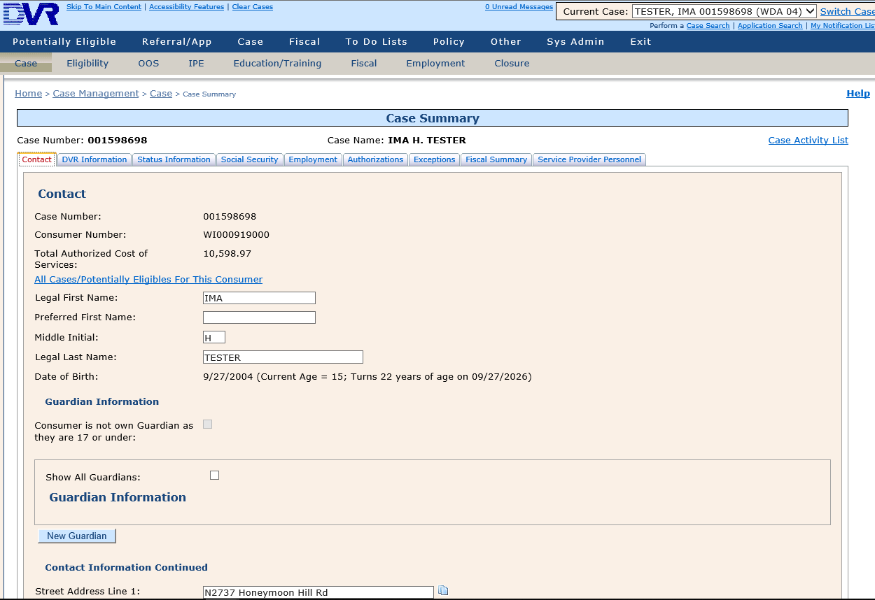
Case Management System IRIS
Notes:
This is one of those stories. It happens to be fiction Ima Tester is not a real person.
This is where it all begins, with data collection. Wisconsin utilizes a home grown case management system, Integrated Rehabilitation Information System (IRIS). The IRIS application and database is hosted on WI servers. This gives DVR access to the raw data and the ability to customize the application as necessary.

Slide 49
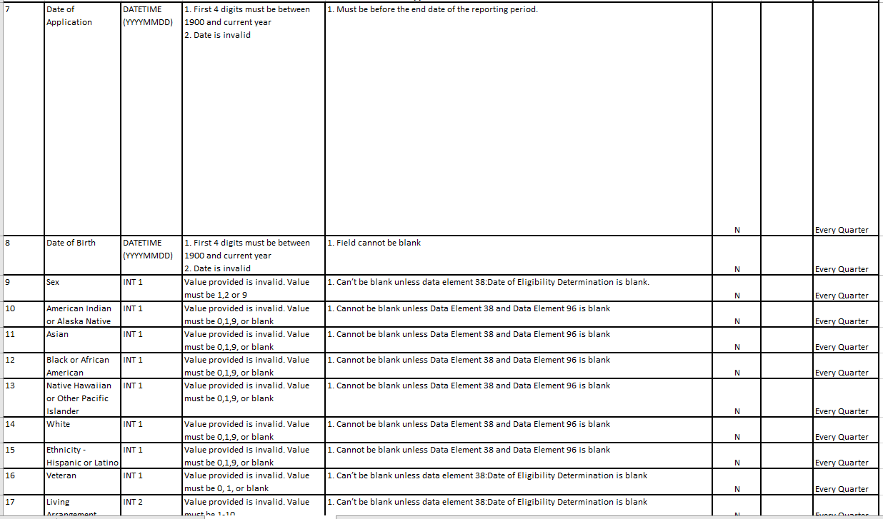
Data Validation
Notes:
As the saying goes garbage in garbage out. The data is only as good as the people that enter it so we have built data validation rules in the user interface.
These are the RSA edits. For most of these edits, if a user enters data that violates these edits they are not allowed to proceed to the next screen in IRIS without correcting their entry.

Slide 50
System Integration
SSA SSN verification
UI wage collection
PeopleSoft (STAR) fiscal
Financial Aid Office Portal
Service Provider Portal
Notes:
In addition to data entry by field staff, IRIS gets by with a little help from our friends.
IRIS has an automated process for receiving SSA and UI wage data.
It is integrated with our fiscal software so POs and Invoices entered into IRIS feed the accounting system,
And the system two portals for our external partners to access
WIBA – work incentive benefit analysis
ITW – internship temporary work
SI – Systematic Instruction
JD – Job development
SE – Supported Employment
VE – vocational evaluation
IPS – IPS Supported employment
CE – customized employment

Slide 51
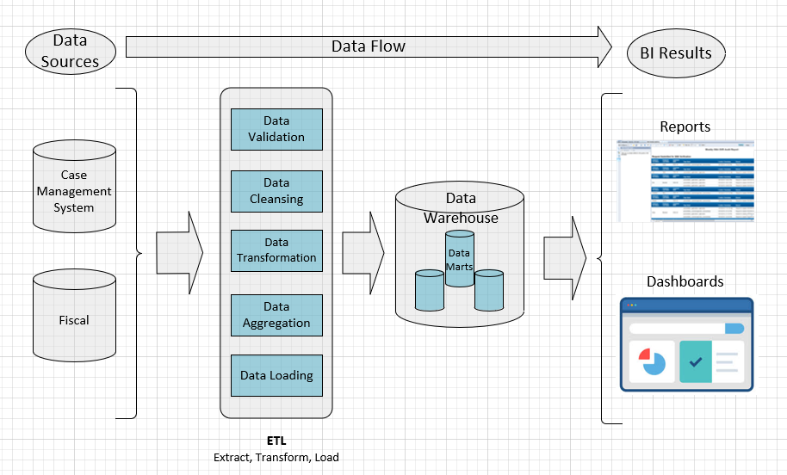
Extract Transform Load
Notes:
That is how the data is entered into IRIS then.
In a nightly ETL process data is pulled from our transactional CMS database, cleansed, transformed and aggregated and inserted into the data warehouse.
Data that is represented in the DVR dashboard is up to date as of last night.

Slide 52
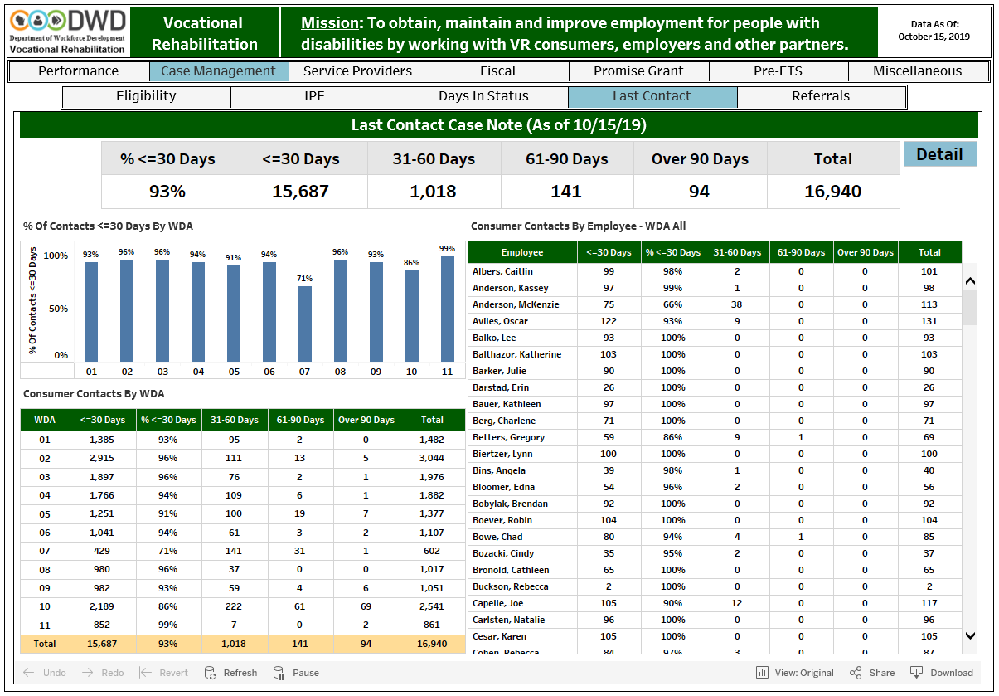

DVR Dashboard
Notes:
These dashboards are used for:
Counselor performance evaluation
Monitoring progress toward division and WDA goals
Ensuring that we meet program standards
Last contact – a point in time report – looks back from yesterday

Slide 53
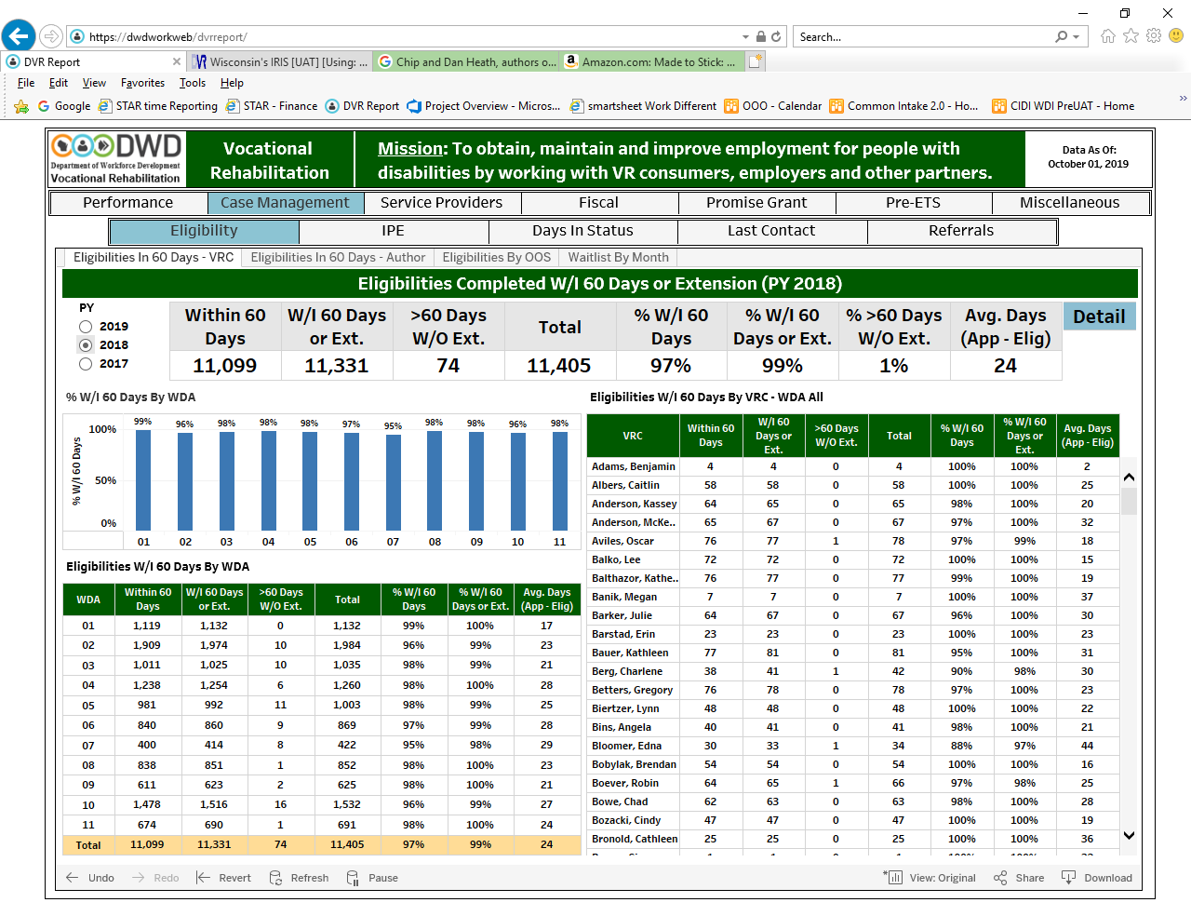
Case Management
Notes:
Eligibility with 60 days

Slide 54
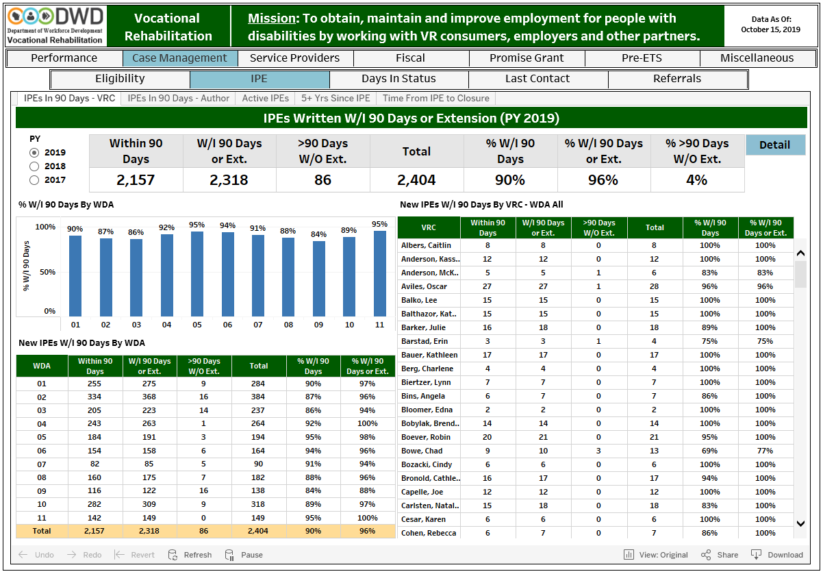
Case Management
Notes:
IPE within 90 days of eligibility

Slide 55
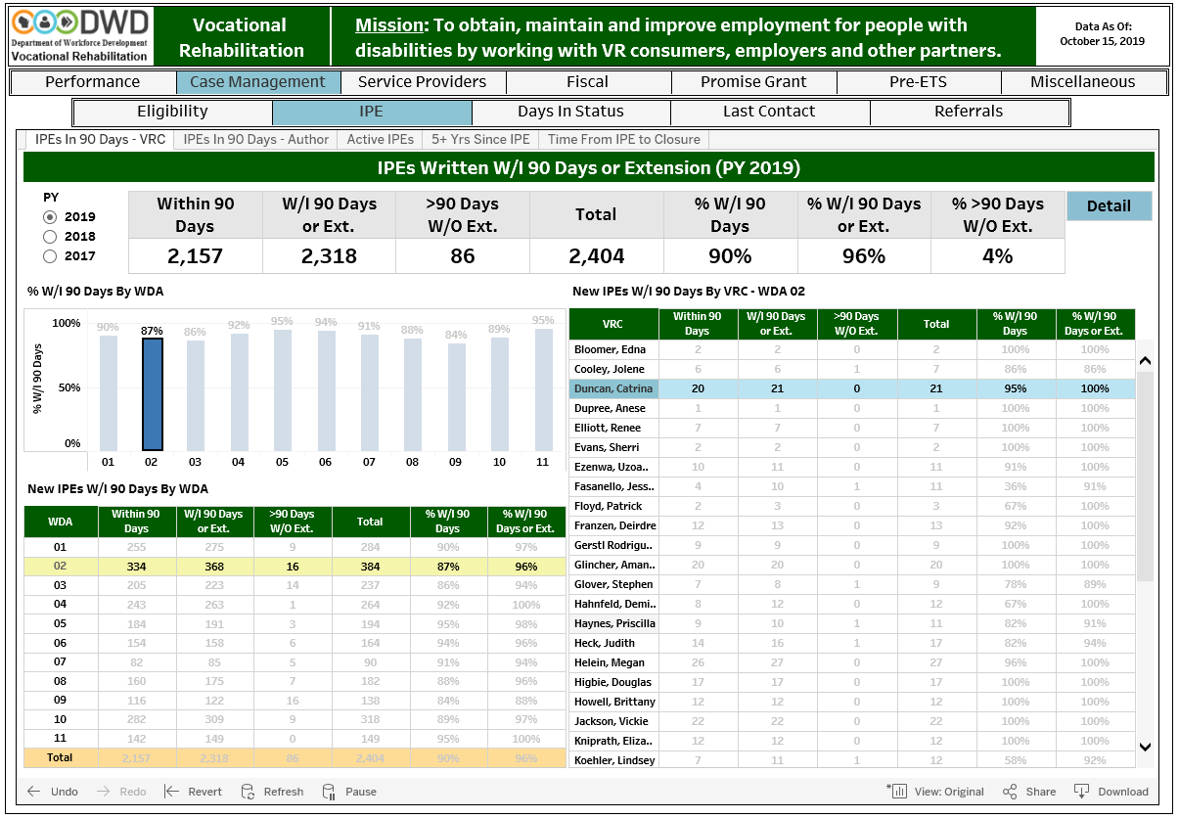
Drilling Down into the Data

Slide 56
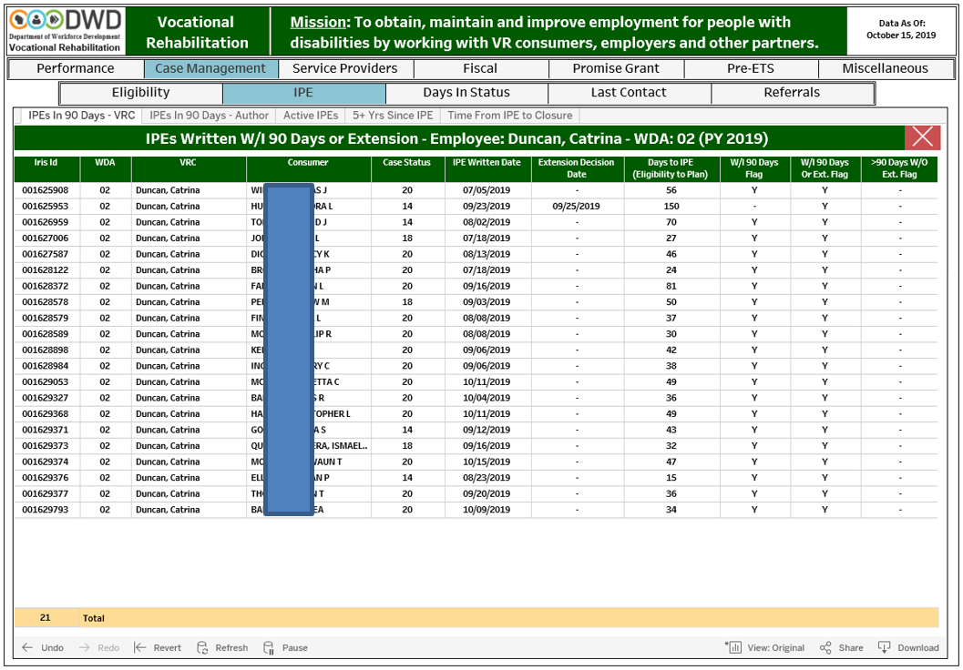
Details
Notes:
Counselor specific list

Slide 57
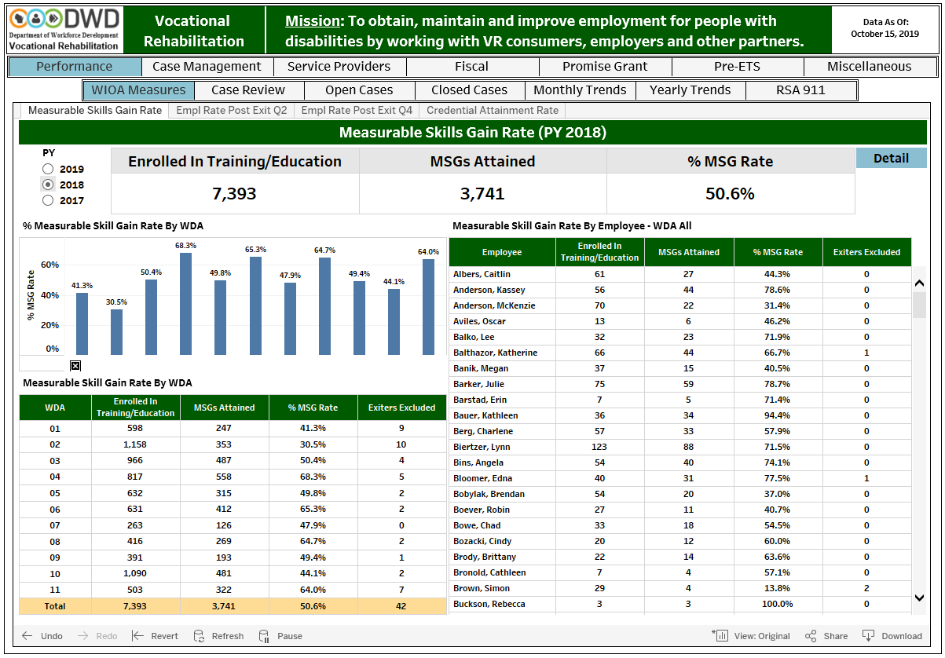
Performance Management
Notes:
Measurable Skills Gains

Slide 58
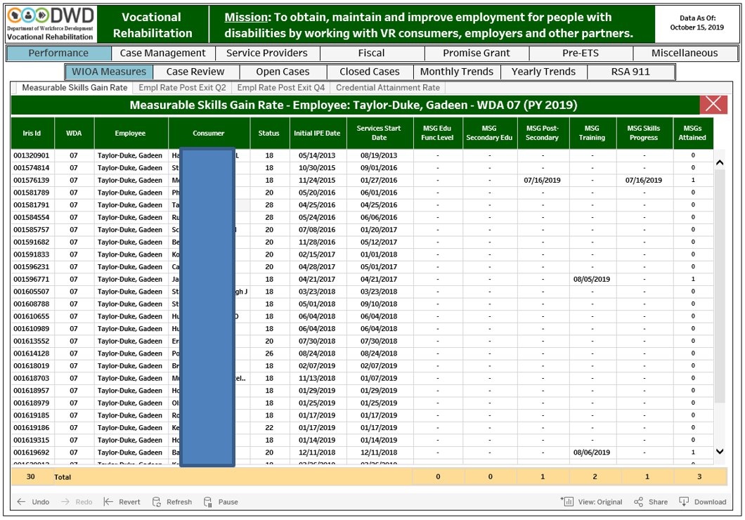
Case Level Details
Notes:
Performance measure QA audits at the local level
Ensure the appropriate documentation is attached

Slide 59
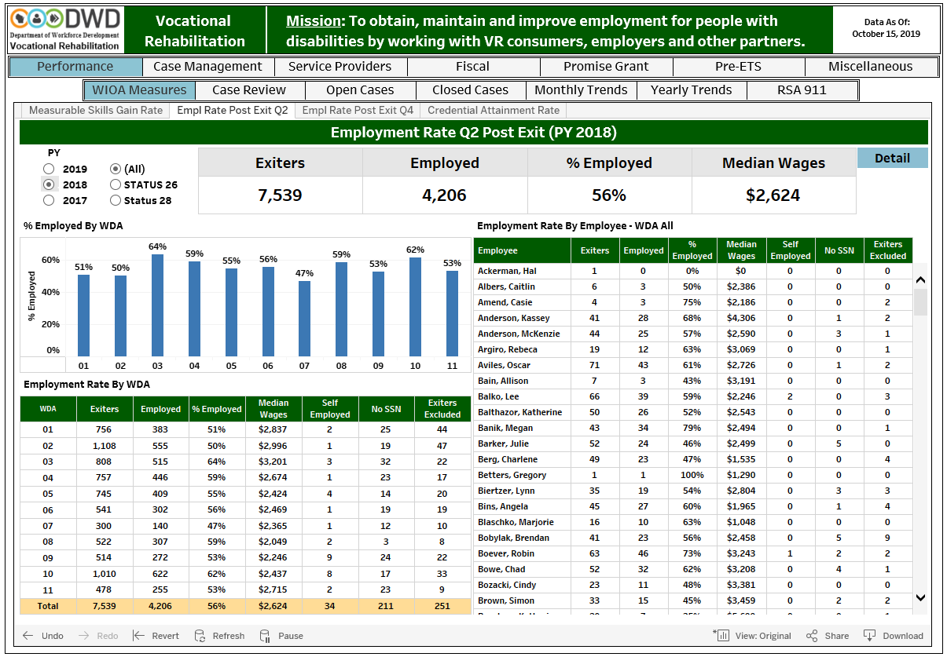
Employment Rate Q2
Notes:
26s successful closures 82%
28s closed unrehabilitated 27%
All 56%

Slide 60
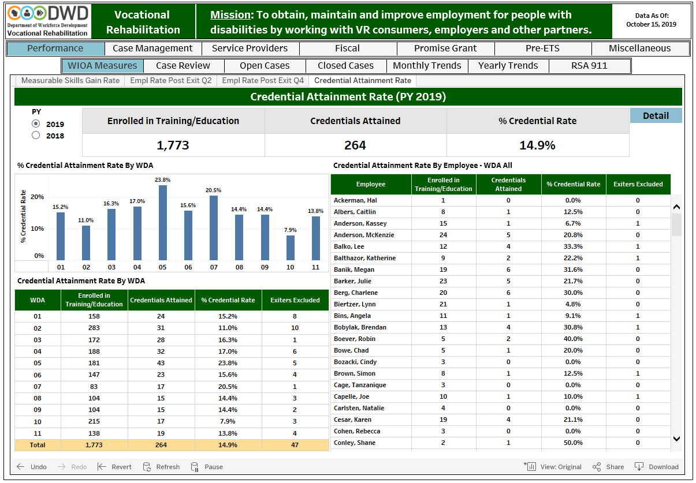
Credential Attainment
Notes:
This screenshot is from Oct 15 so we are only been capturing data for 9 months after exit.

Slide 61
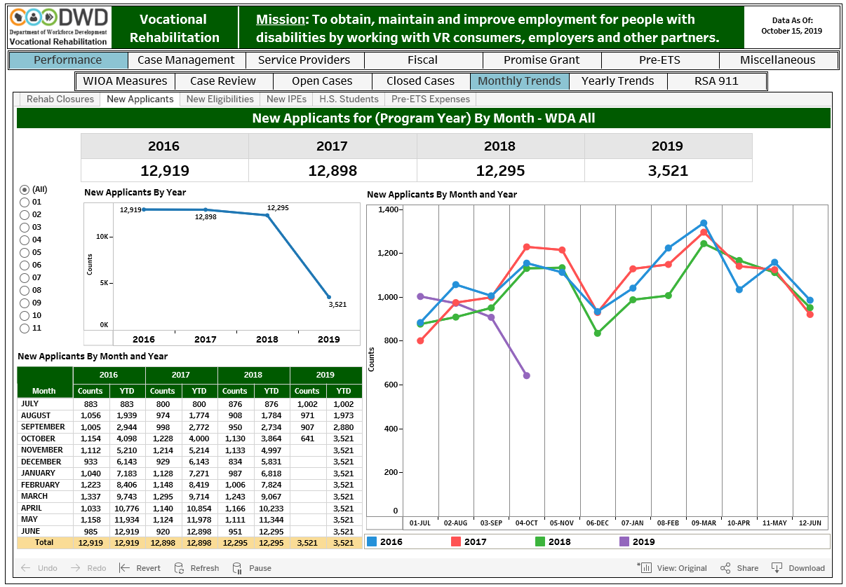
Trend Reports
Notes:
We have also built in trend reports to answer the frequently asked question “How are we doing compared to last year?”
Screen shot taken Oct 15th only half the month is reported

Slide 62
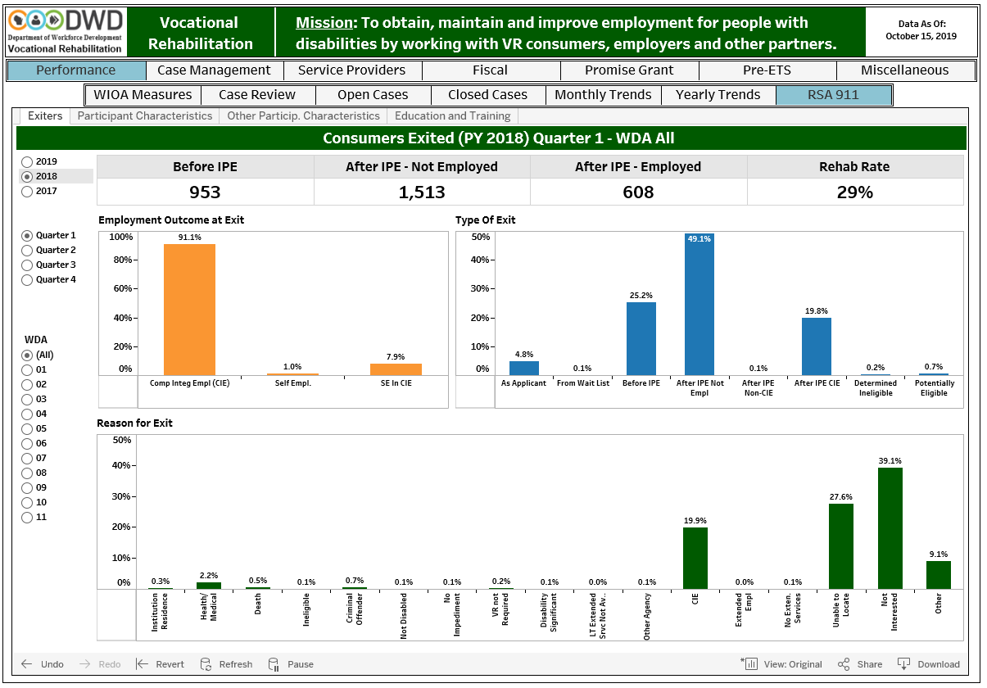
RSA Dashboards
Notes:
As we approach the end of the quarter we have a pretty good idea of how the RSA dashboard will look

Slide 63
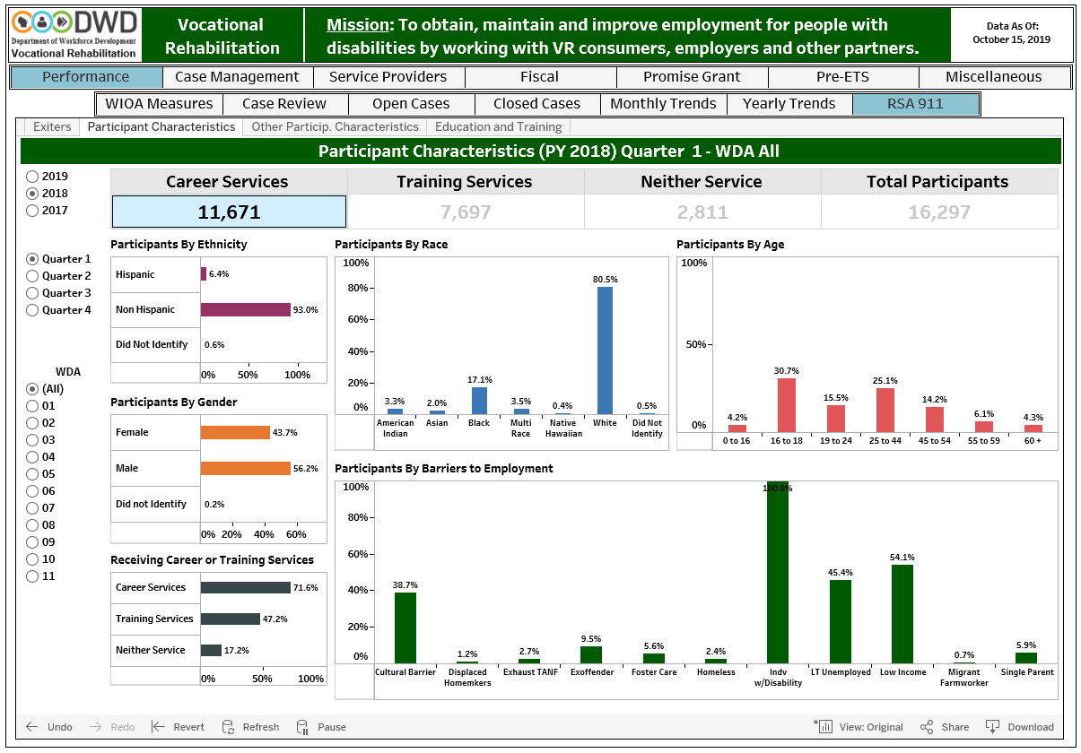
Participant Characteristics

Slide 64
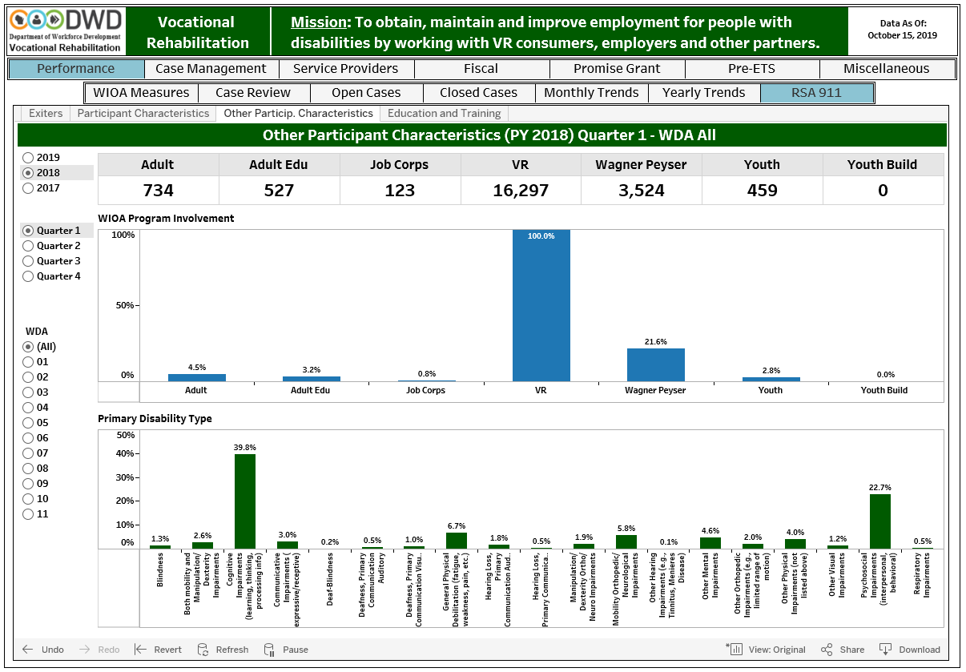
Other Participant Characteristics

Slide 65
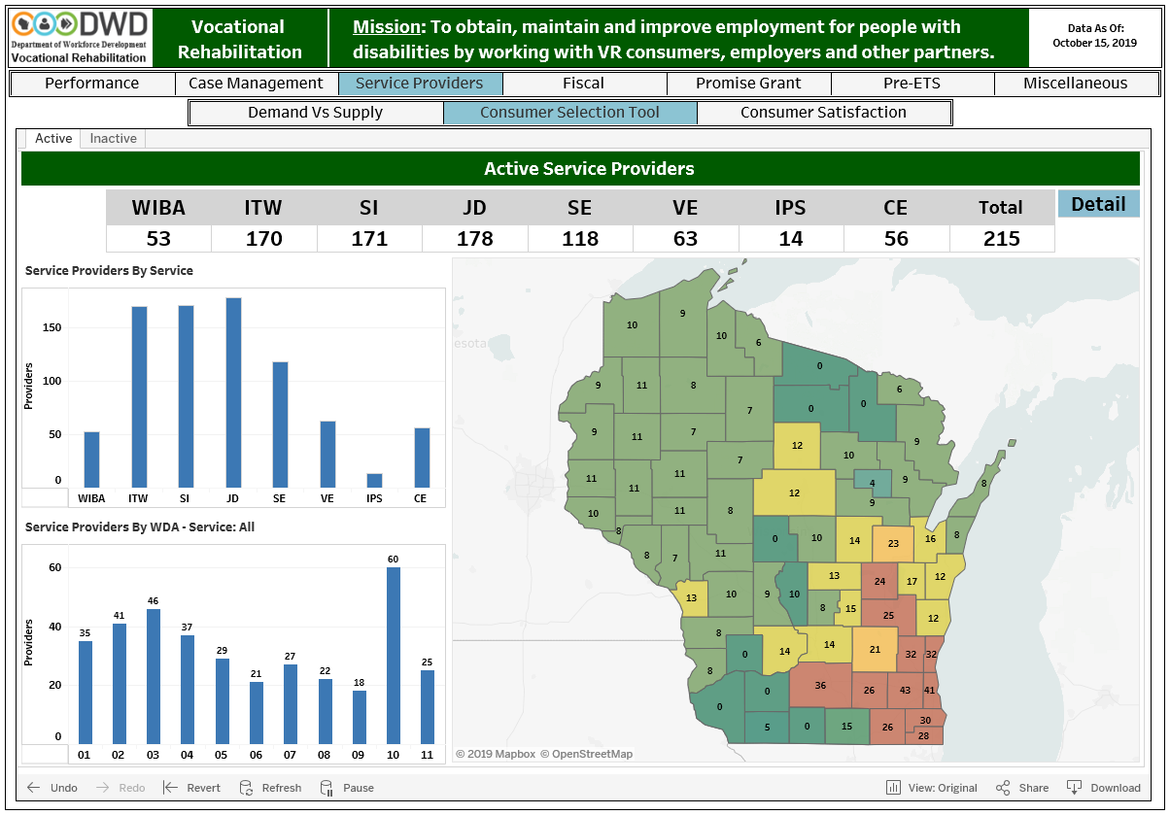
Service Provider Selection Tool
Notes:
We also visualize Service Provider

Slide 66
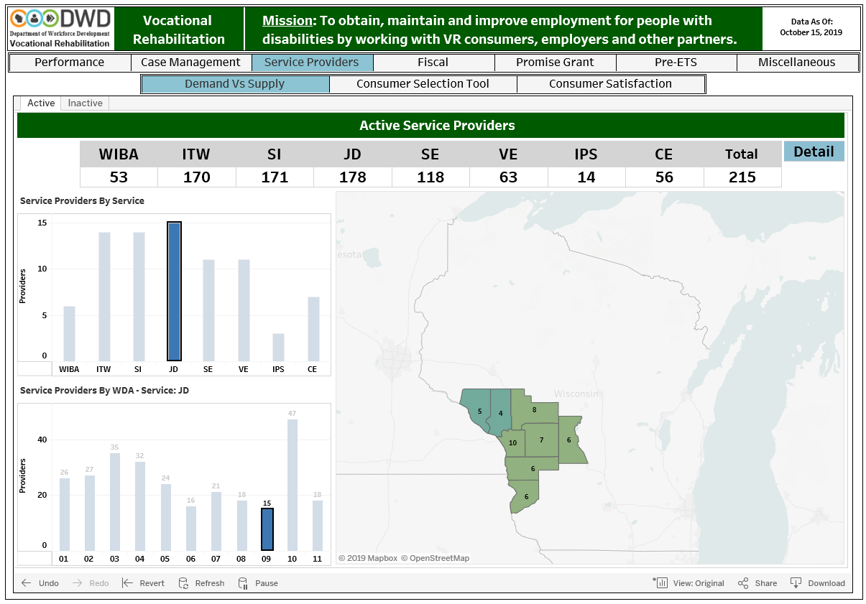
Sort by Service and WDA
Notes:
Buy selecting the service and the WDA we are able to see available service providers for the consumer to choose from.
Can be narrowed down further to county
WIBA – work incentive benefit analysis
ITW – internship temporary work
SI – Systematic Instruction
JD – Job development
SE – Supported Employment
VE – vocational evaluation
IPS – IPS Supported employment
CE – customized employment

Slide 67
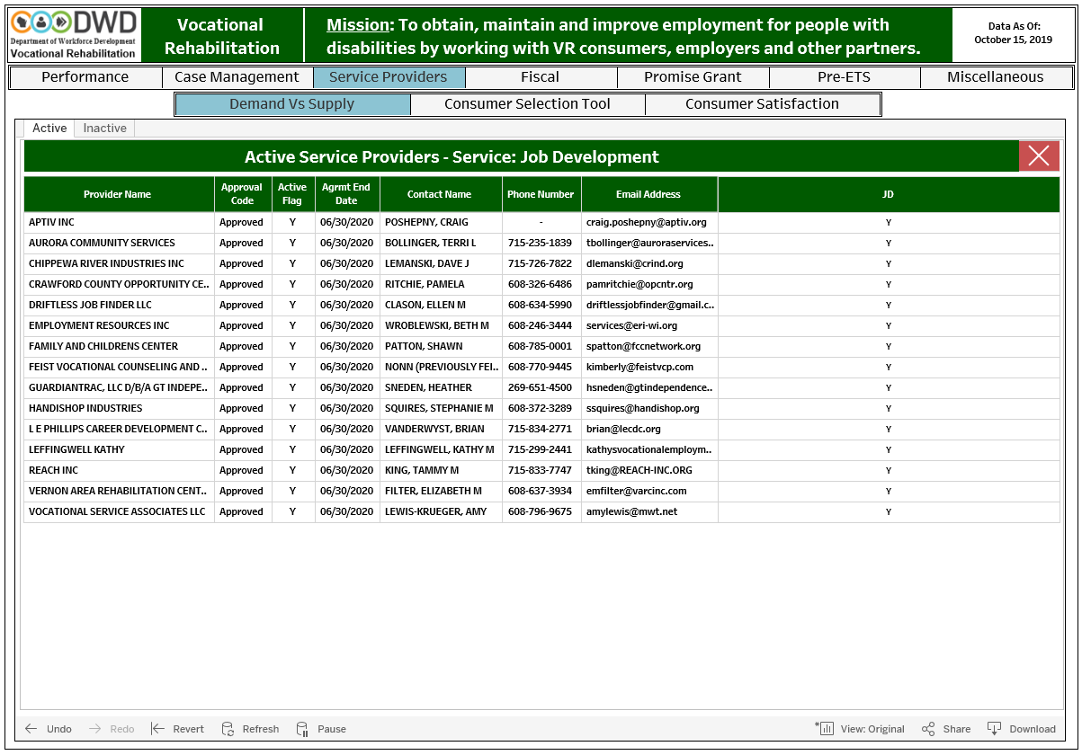
Service Provider Options
Notes:
Allows for informed choice

Slide 68
Lessons Learned
Better understanding of how RSA analyzes our data
Better understanding of our own data
QA efforts have uncovered process and system issues:
  Fields in the data warehouse not updating correctly
  Non-standard workflows in IRIS creating duplicate education entries
Notes:
The process of creating these dashboard reports we gained a greater understanding of how RSA analyses our data.
This also forced us to look deeply into our data in order to verify the accuracy of what we were displaying. Through these efforts we discover data issues that were not readily apparent. For fields that were not updating correctly in the warehouse when cases were merged. Or a non-standard workflow in data entry causing duplicate data.

Slide 69
Data Governance
Wisconsin DVR Data Governance is Emerging
  Technical, Business and Domain data stewards assigned
  WIOA Data Steward committee reviews data elements for semantic reconciliation between WIOA title programs
  DVR program data elements are defined, understood, and trusted
Dashboard Reports Workgroup
  Evaluates requests – should it be in the dashboard?
  Prioritizes requests
Support of QA Committee
Notes:
Evaluates requests – should it be in the dashboard?
Added to an existing report or new tab in the dashboard
Frequent utilization by multiple users

Slide 70
Next Steps
Development of a resource management dashboard
  Fiscal data for budget management
  Staffing / vacancy levels per WDA
  Caseloads per WDA
QA and Anomaly reports
Notes:
Resource management dashboard
ties two additional warehouses to DVR’s warehouse
Project management iron triangle
time
money
scope
QA and anomaly reports

Slide 71
Questions?
John Gelletta
Special Services Section Chief
(608) 261-0079
JohnJ.Gelletta@dwd.wisconsin.gov
http://dwd.wisconsin.gov
Notes:
If we don’t get to your questions today feel free to reach out to me with questions

Slide 72

Questions and Answers

Slide 73
RSA Contact Information
RSA State Liaisons
RSAData@ed.gov
rsa.ed.gov

