Slide 1

General Counselor Performance Evaluations
October 2018

Slide 2

Background
In August of 2017,
CT-General assembled a
workgroup that had representation from
counselors, supervisors, district directors, and
central office staff
The purpose of this group was to examine counselor performance evaluations as our program was shifting to align with WIOA performance accountability requirements.

Slide 3
Background
This workgroup, gave careful consideration to the general themes associated with WIOA
including;
  Helping consumers to achieve quality employment outcomes in a competitive labor market
  Promoting opportunities for training and upskilling of our consumers
  Helping consumers move into careers as opposed to jobs

Slide 4

Background
We spent time examining our current model for performance appraisal
  Identified which areas continued to maintain relevance under WIOA and which areas had become obsolete.

Slide 5
Background
Reviewed the WIOA Performance and Accountability Measures for Vocational Rehabilitation:
  Employment rate 2nd/4th quarters after exit
  Median earnings in the 2nd quarter after exit
  Credential attainment rate
  Measurable skill gains
  Effectiveness in serving employers

Slide 6

Background
Examined data being captured under WIOA reporting to determine what could be extracted for counselor performance.

Slide 7
What did previous performance evaluations look like?

Slide 8
Previous Performance Evaluations
Measured 5 primary areas
Quality
Quantity
Attendance
Dependability
Ability to deal with people

Slide 9
Previous Performance Evaluations
Attendance was based on HR policy related to number of occurrences
Dependability and
Ability to Deal with People are subjective
areas rated by supervisors

Slide 10
Previous Performance Evaluations
Quality and Quantity were developed more objectively using a points system to evaluate measures aligned with the Agency’s overall performance.

Slide 11
Previous Performance Evaluations
Quality: 100 points
Qualitative Measures
PSS Indicator 15
Rehab Rate 15
Minority Indicator 15
Consumer Wages 15
Supervisory Assessment 40

Slide 12
Previous Performance Evaluations
Quantity: 100 Points
Number of Plans 33.3
Number of Rehabs 66.7

Slide 13
New Counselor Performance Measures

Slide 14
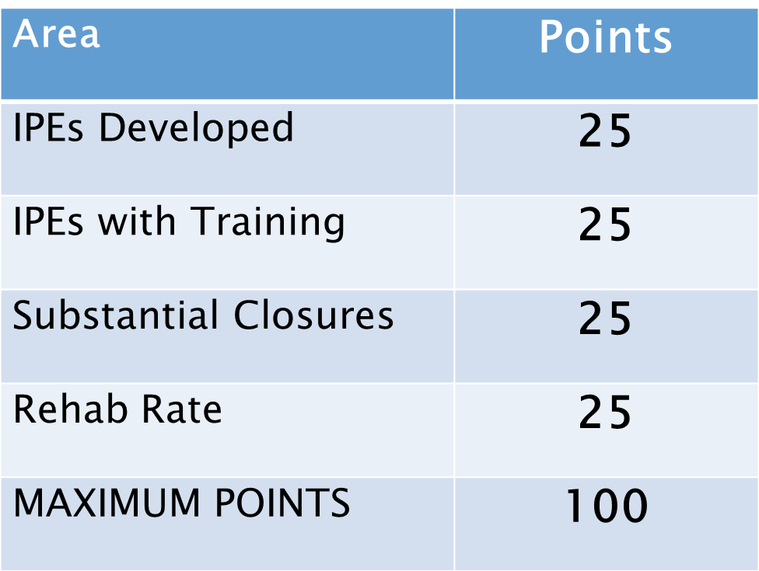
Quantity

Slide 15
Quantity
1. IPEs Developed
  Total Number of IPEs Written during rating period
  Numeric IPE goal standardly set based on level of job classification and adjusted by local management as appropriate based on individual circumstances
  Maximum Point Value = 25
  We kept this measure because there is still a value in effectively moving consumers in to plan development

Slide 16
Quantity
2. IPEs Developed with Consumers in Training
Total number of IPEs written for consumers to be enrolled in training as a result of IPE development
Maximum point value = 25
*Skill development is a focus of WIOA

Slide 17
Quantity
3. Successful Closures Substantially Employed
  Total successful (status 26) closures with weekly earnings >= $300
  Goal set by job classification (15, 12, 10) and adjusted as appropriate by local management for individual circumstances
  Maximum point value = 25
  This directly relates to the primary indicators of performance: 2nd and 4th Qtr Post Exit and Median Wages 2nd Qtr Post Exit

Slide 18
Quantity
4. Rehab Rate
Of all consumers who go into an IPE during a rating period, the percent who achieve an employment outcome
(26 + 28)/26 = Rehab Rate
Goal remains at 55.8%
Maximum point value = 25
Determined that this contributes to the primary Indicators of Performance: 2nd and 4th Quarter Post Exit and Median Wages 2nd Quarter Post Exit

Slide 20
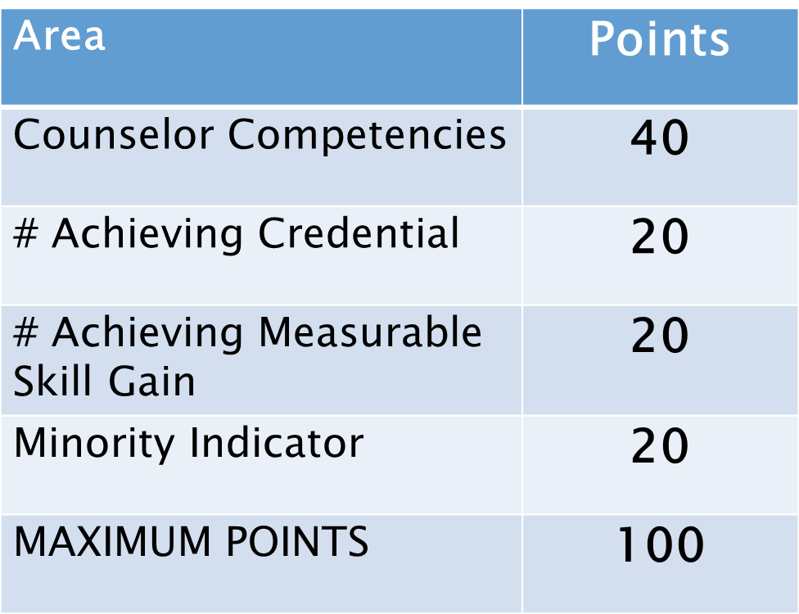
Quality

Slide 21
Quality
Counselor Competencies
Review of CORE competency areas including referrals to in-house and American Job Center programs
Supervisor discretion
Maximum point value = 40
No Change from previous model. Still relevant to look at quality of counselors work.

Slide 22
Quality
2. Number of Participants Achieving a Credential
The Number of participants who achieve a credential during a program year.
Derived from the RSA 911 extract
Goal is same for all counselors
Maximum point value = 20
Credential Attainment is a Primary Indicator of Performance under WIOA.

Slide 23
Quality
3. Number of participants achieving Measurable Skills Gains
The Number of participants who achieve a Measurable Skills Gain during a program year
Derived from RSA 911 extract
Goal is same for all counselors
Maximum point value = 20
Measurable Skills Gain is a Primary Indicator of Performance under WIOA

Slide 24
Quality
4. Minority Indicator
Service Rate of Clients from Minority Backgrounds
Goal - .80 (Same for all counselors)
Maximum Point Value = 20
Determined that serving individuals from minority backgrounds is still a priority of this agency.

Slide 26
Dependability
This was previously a subjective category. Added point value to section. We believed it was necessary to quantify caseload size to help demonstrate the importance.
Average Annual Caseload Size (measured as a 12-month average) = 25 points
Caseload Management (Supervisory Discretion) = 75 points
Maximum point value = 100

Slide 28

Questions

