Slide 1
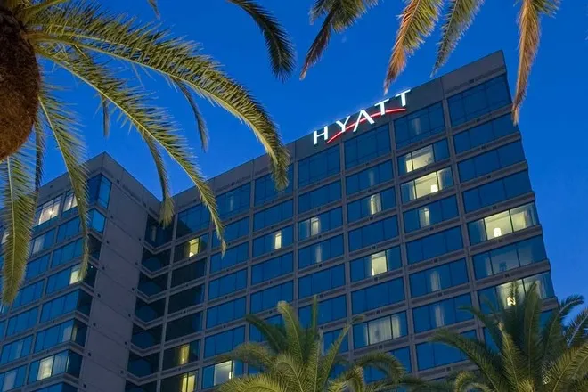
Accentuating the “I” in IEPs and IPEs

Slide 2
Hands On @Hyatt Hospitality training Program Providing WBLE’s since 1998

Slide 3
Program Description
State-Funded Alternative Training Program to prepare persons with disabilities for work in the Hospitality Industry
Started June 21,1998 at the
Hyatt Regency Westshore – Tampa, FL
Made possible through a unique partnership between Hyatt Hotels and Resorts,
Hands On Educational Services, Inc.
FL Division of Vocational Rehabilitation,
FL Division of Blind Services and
School District Transition Teams

Slide 4
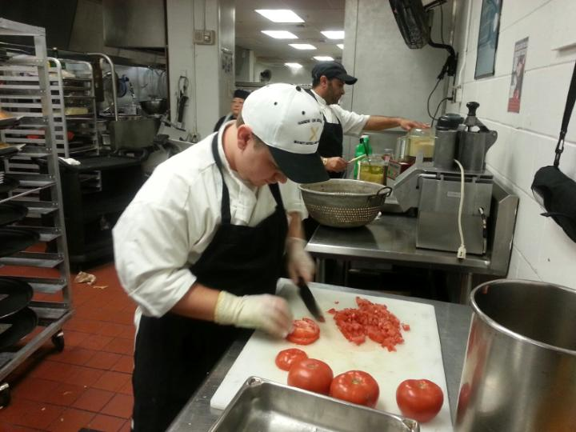
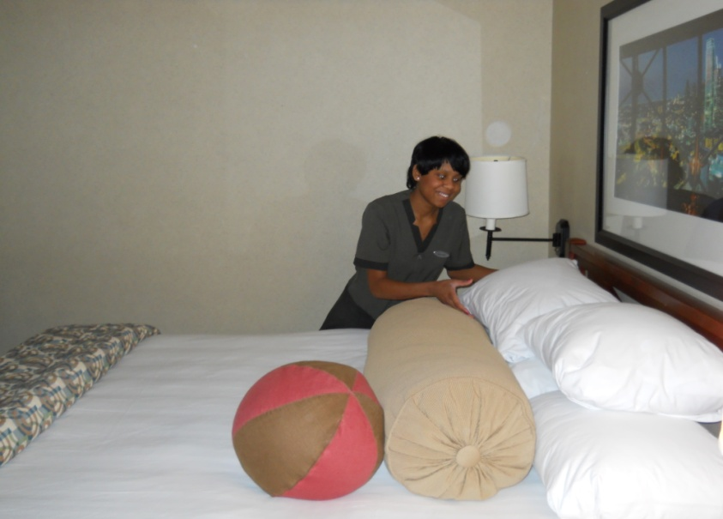
Training Departments
Culinary*
Housekeeping
Laundry
Storeroom Receiving
Engineering
Cafeteria Attendant
PBX Operator
* Denotes area where the majority of the students choose to train

Slide 5
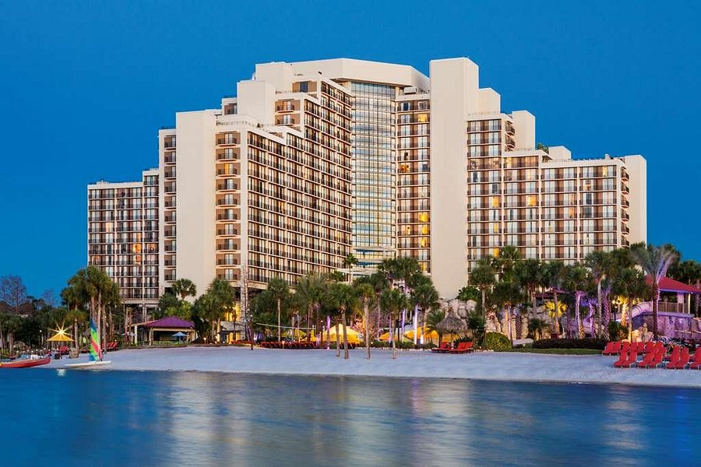
Current Hyatt Properties In Florida
Grand Hyatt Tampa Bay
Hyatt Regency Grand Cypress
Hyatt Regency Orlando Airport
Hyatt Regency Orlando
Hyatt Regency Miami
Hyatt Regency Sarasota
Hyatt Regency
Clearwater Beach
Hyatt Regency Jacksonville
Hyatt Regency Coconut Point
Hyatt Regency Coral Gables

Slide 6
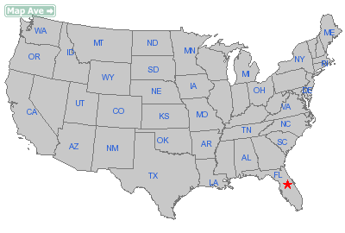
Currently partnering with 36 Hyatt Hotels and 15 State Vr Agencies across the US

Slide 7
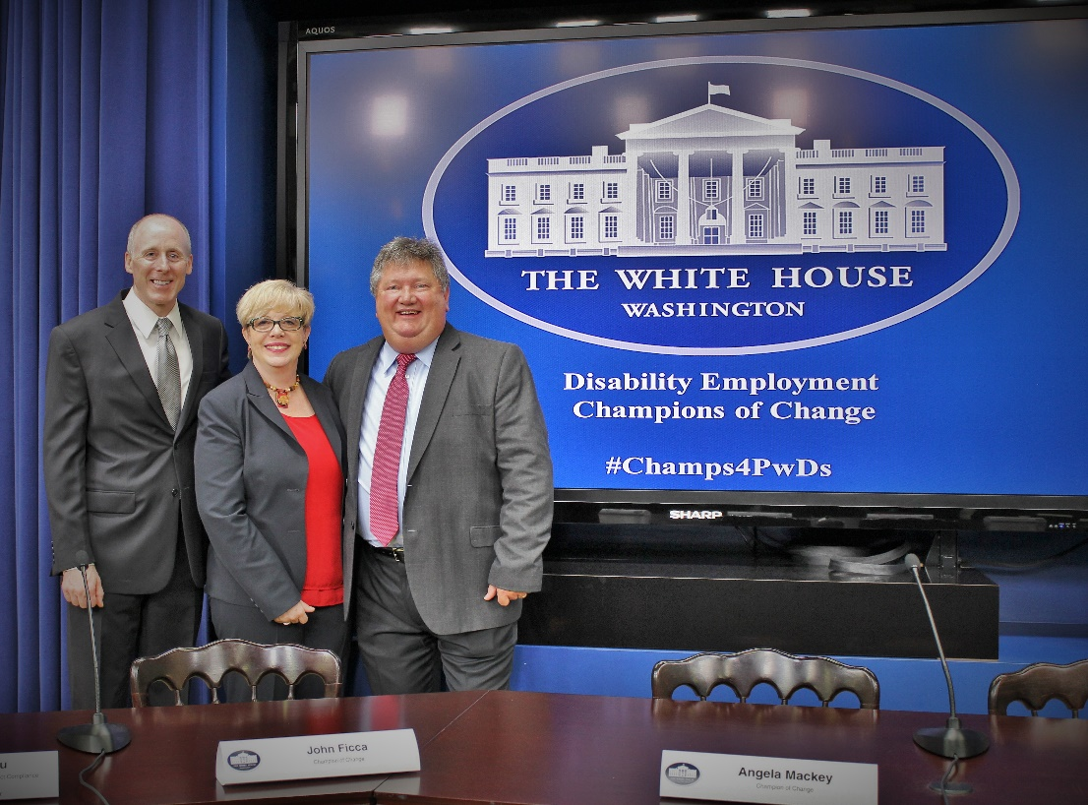
Employment Outcomes
>5000 graduates have obtained employment
Hyatt has hired over 1500 graduates
Opportunities for graduates in Hotels, Restaurants, Hospitals and Grocery Stores
Oct 2014 – Recognized as one of the top Training and Employment Programs for PWDs, by the White House Champions of Change Program
Notes:
Background Check: No felonies in the last 7 years (from time the case was CLOSED, not from when charged). No Misdemeanor charges related to theft, violence, or sex related crimes.

Slide 8
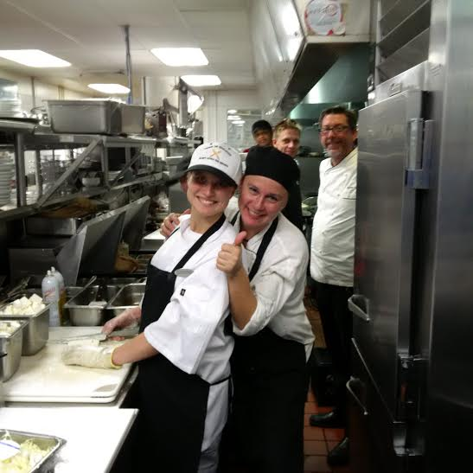
Applicant qualifications
Must be 18 years of age (some exceptions apply)
Must have documented disABILITY
Be able to perform functions of job
Background check completed for felonies or misdemeanors within past 7 years
A High School Diploma or GED is NOT required (because they are not required by the industry)
Notes:
Background Check: No felonies in the last 7 years (from time the case was CLOSED, not from when charged). No Misdemeanor charges related to theft, violence, or sex related crimes.

Slide 9
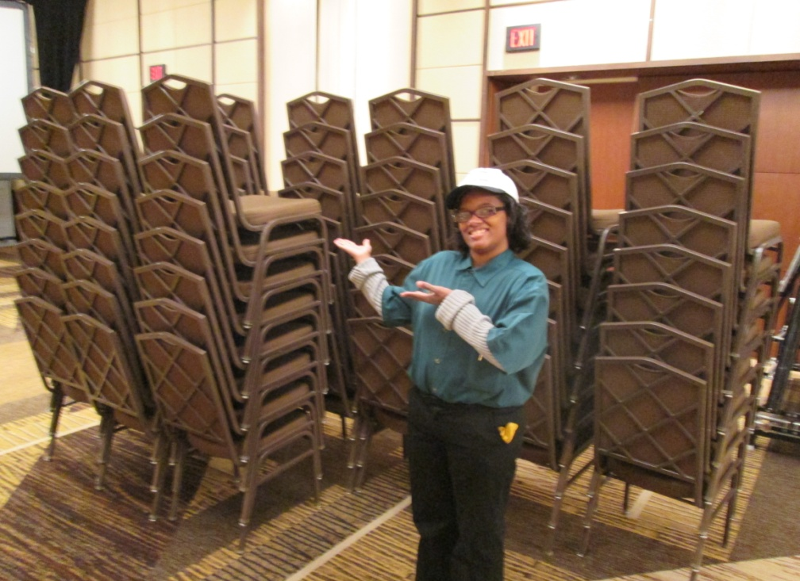
Features of Program
80-Hour Paid Internship over 2-8 weeks
Trainees are paid employees of Hyatt
Can list Hyatt as employment reference
Receive Certificates of Completion
Program includes uniforms, meals, etc.
Train with best professionals in industry
Notes:
Background Check: No felonies in the last 7 years (from time the case was CLOSED, not from when charged). No Misdemeanor charges related to theft, violence, or sex related crimes.

Slide 10
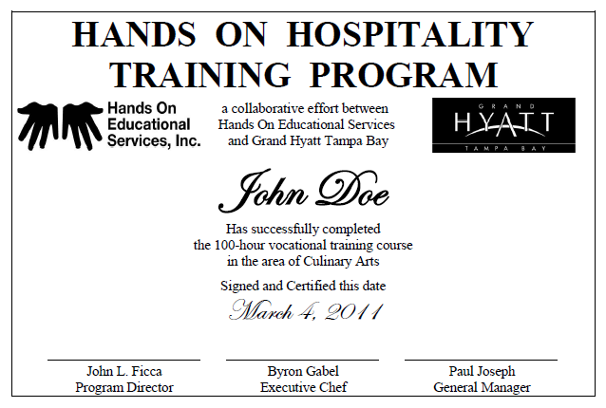
Certificate Example
Notes:
Background Check: No felonies in the last 7 years (from time the case was CLOSED, not from when charged). No Misdemeanor charges related to theft, violence, or sex related crimes.

Slide 11
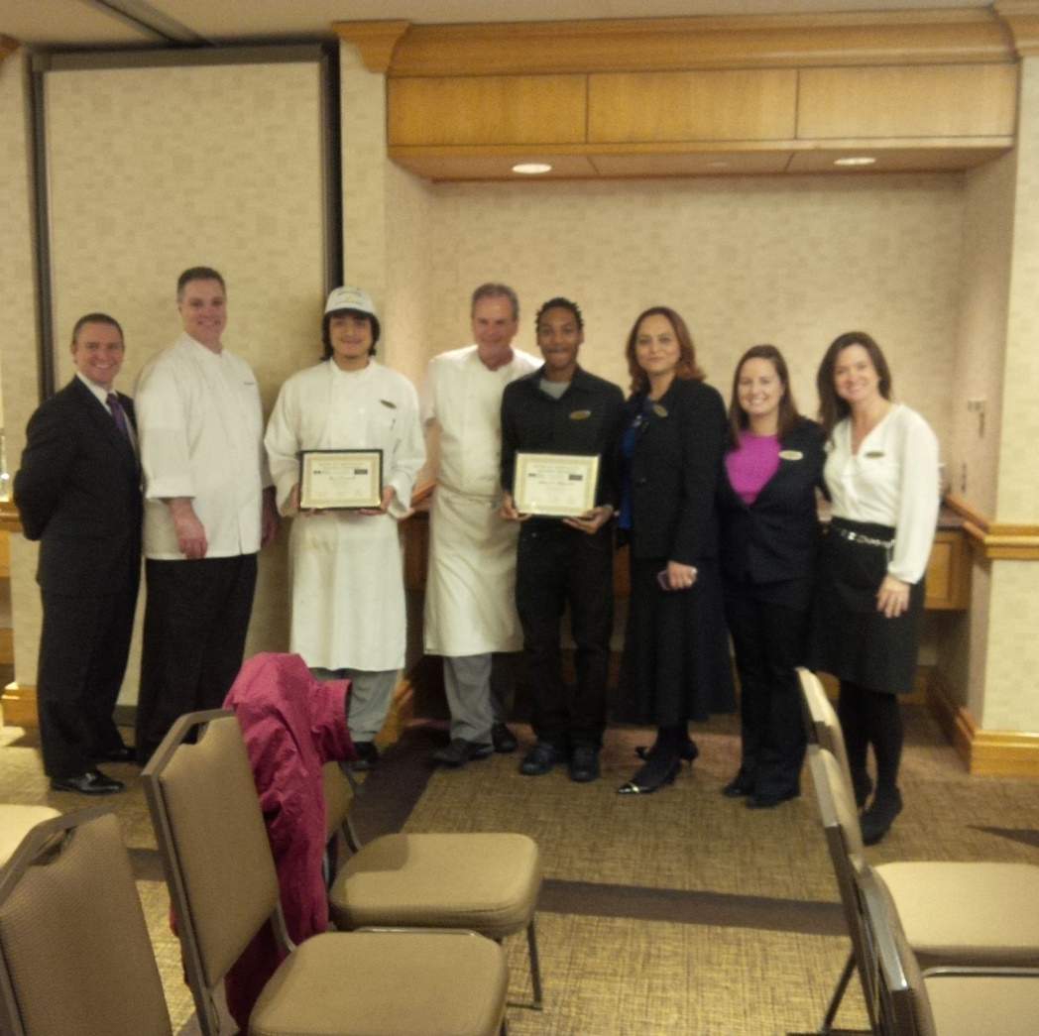
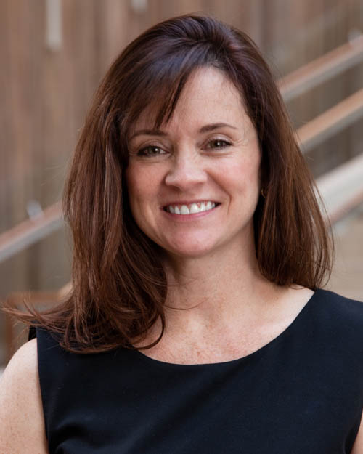
lori Nairne Director of Human Resources Grand Hyatt Washington DC

Slide 12
Hands On @ Hyatt 25th Anniversary Event – August 2023

Slide 13
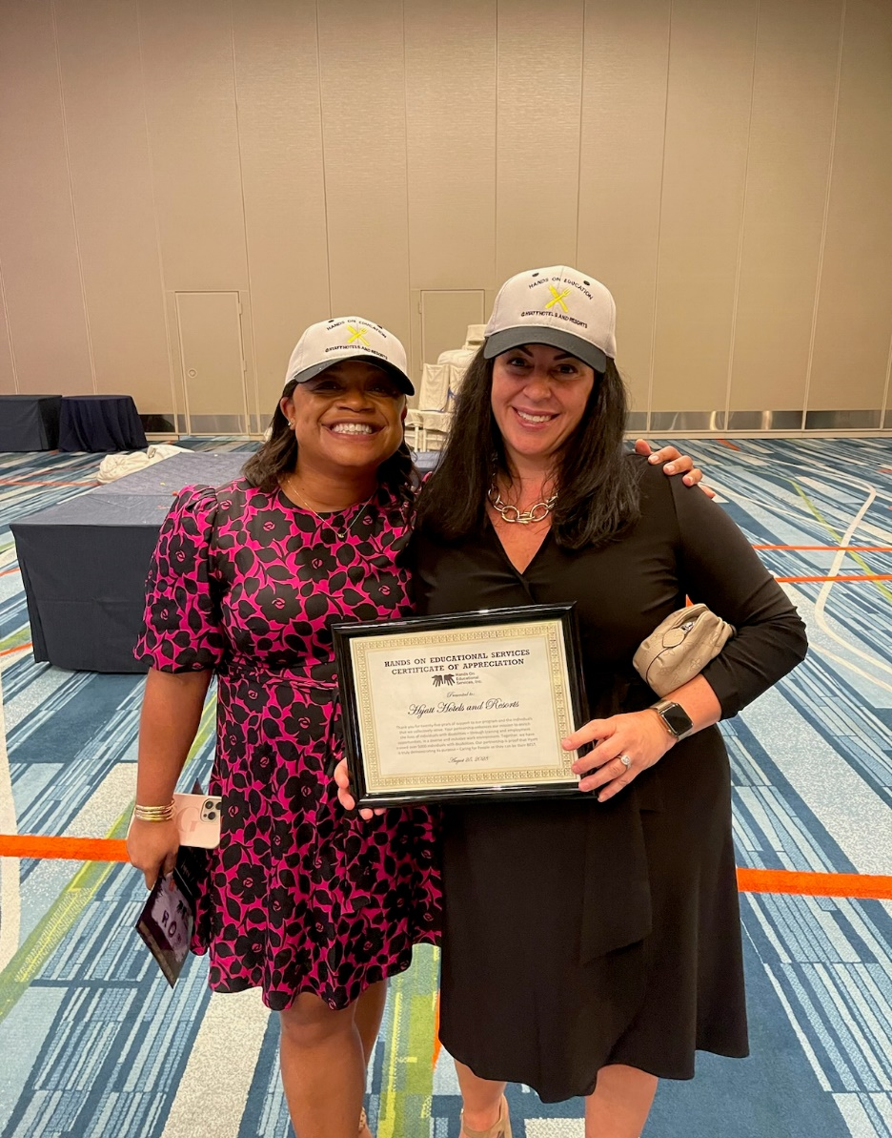
Hands On @ Hyatt 25th Anniversary Event – August 2023

Slide 14
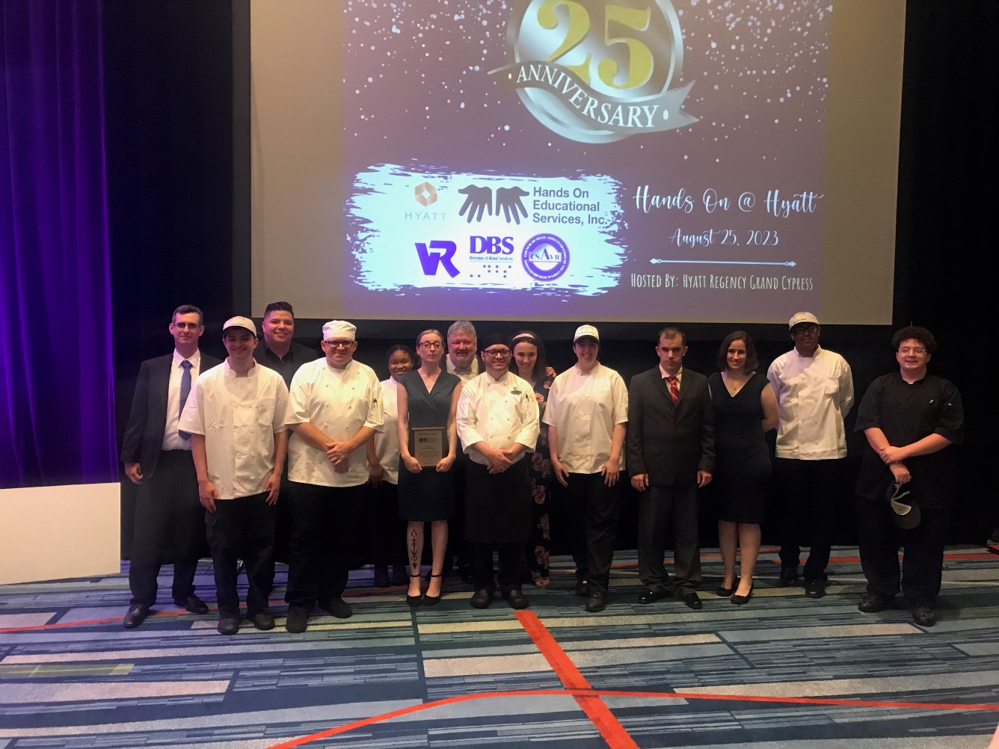
Hands On @ Hyatt 25th Anniversary Event – August 2023

Slide 15
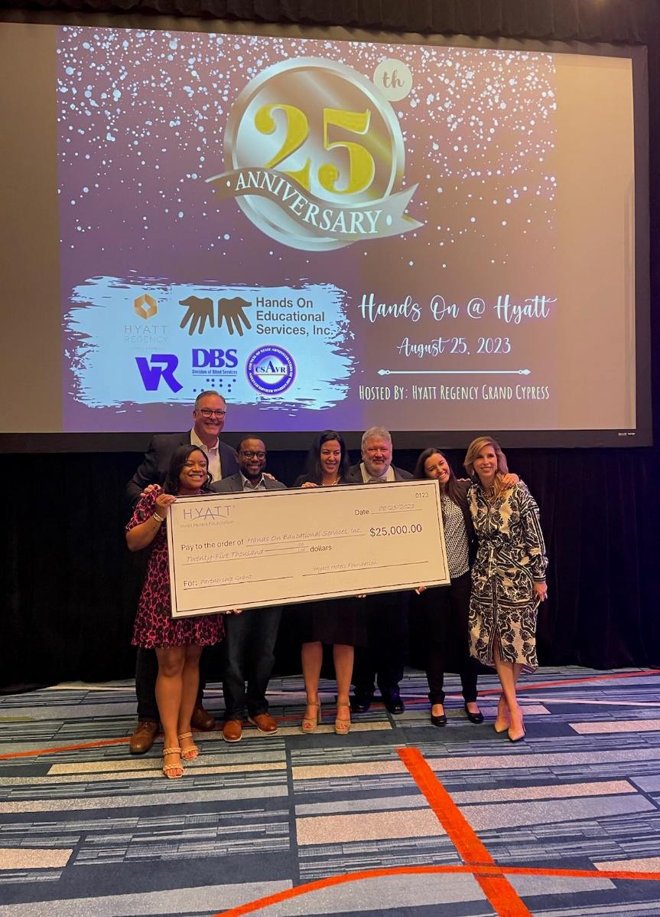
Hands On @ Hyatt 25th Anniversary Event – August 2023

Slide 16
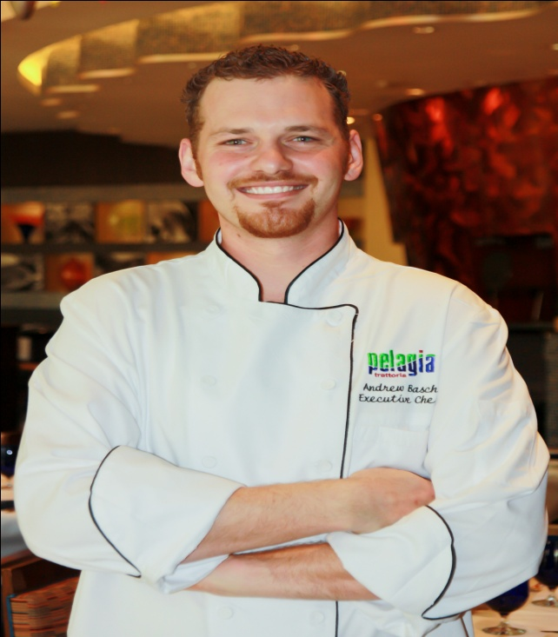
Hands On success Story
Andrew graduated Hands On @Hyatt in 2003
ESE Student w/ Special Diploma
Hired by Grand Hyatt Tampa Bay
2005 – left to help open a new local restaurant
2007 – landed at Renaissance Hotel (by Marriott)
2011 – Promoted to Exec Chef
Currently, Exec Chef at a beach resort in Clearwater,
with a 6 figure salary and benefits package

Slide 17
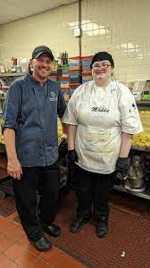
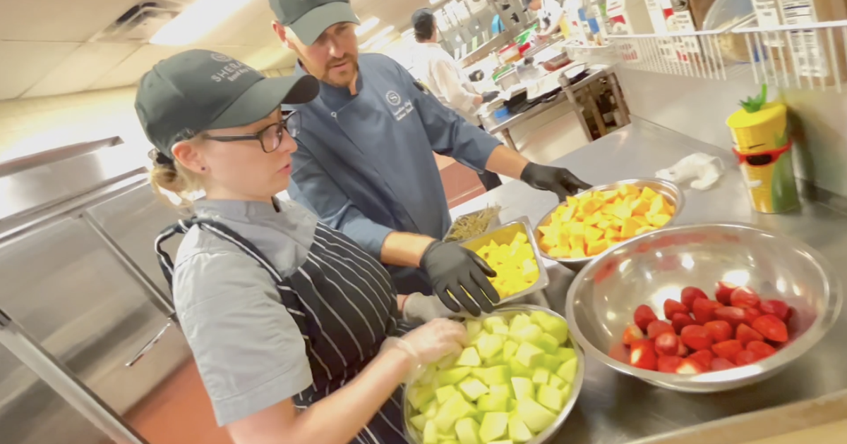
Executive Chef Andrew Basch

Slide 18
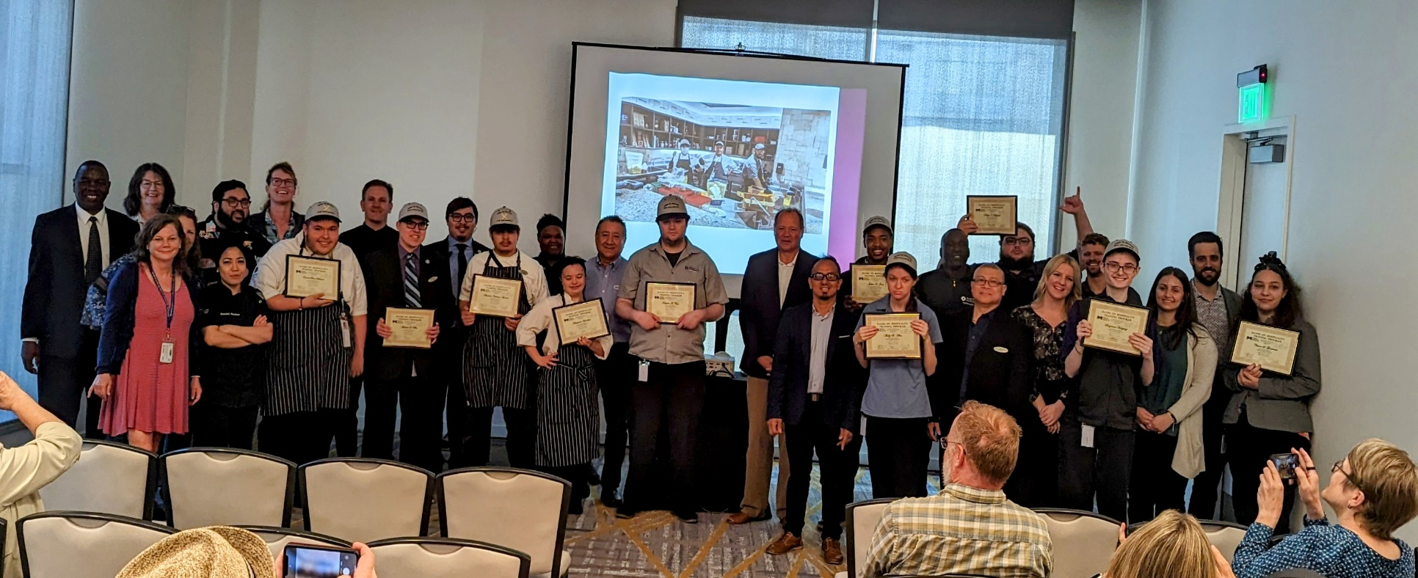
2023 Graduation at Hyatt Regency Seattle

Slide 19
WIOA Section 418 –TRAINING AND SERVICES FOR EMPLOYERS (2015)
(2) working with employers to
provide opportunities for work-based learning experiences (including internships, short-term employment, apprenticeships, and fellowships), and opportunities for pre-employment transition services;
recruit qualified applicants who are individuals with disabilities;
train employees who are individuals with disabilities
*Aligns perfectly with Hyatt’s Purpose and new RiseHY Initiative to hire 10K Opportunity Youth by 2025

Slide 20
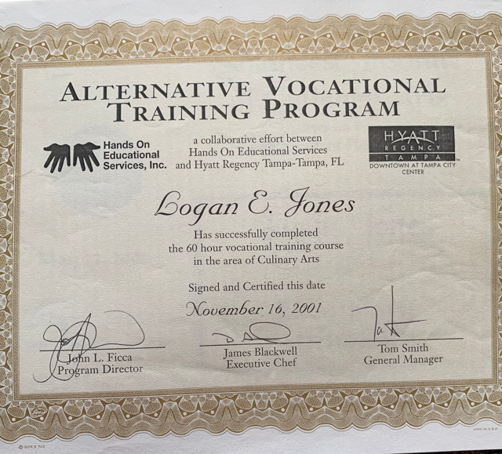

Slide 21
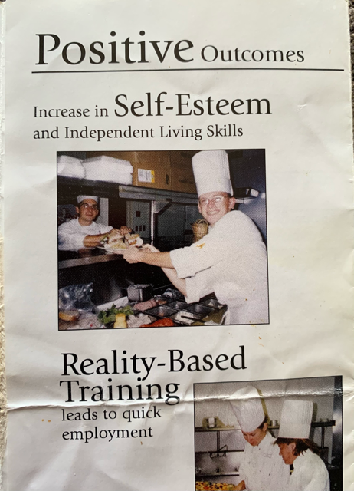

Slide 22
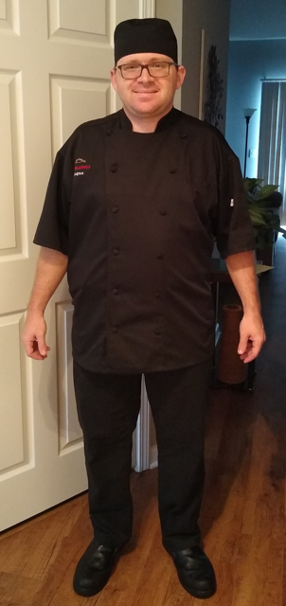
Logan Jones, Sous Chef
Magnolia Greens Golf Club - Leland, NC

Slide 23
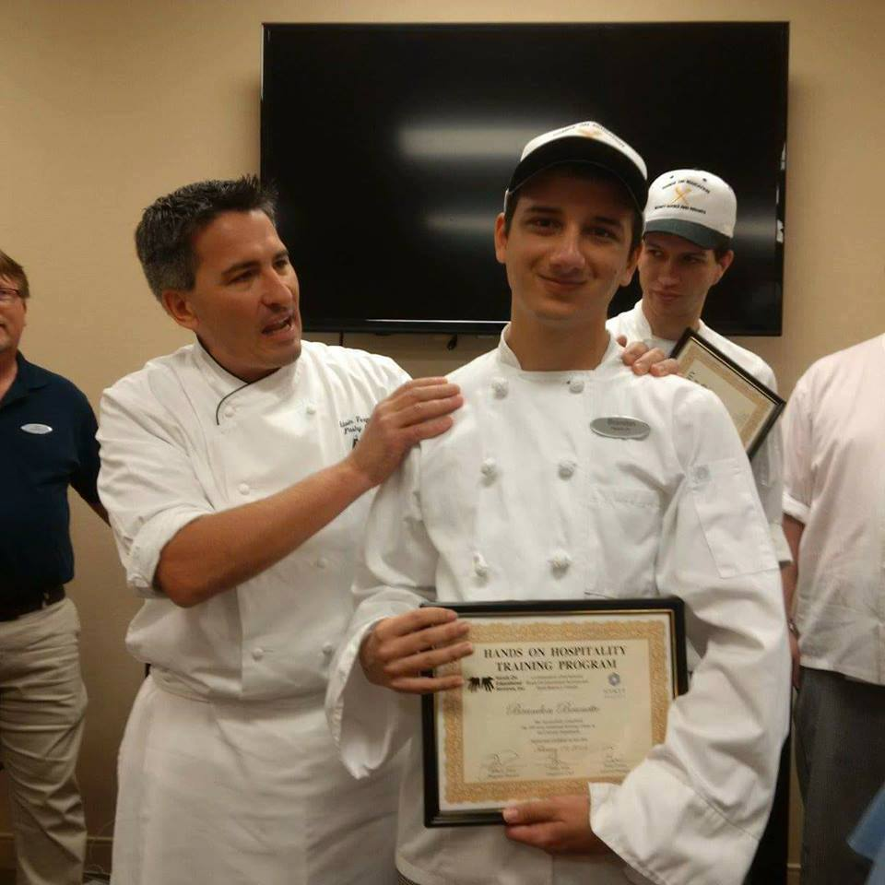
Accentuating the “I” in IEPs and IPEs

