Slide 1

WELCOME!
CSAVR Fall 2023 Conference
Wifi:
CSAVR2023
#CSAVRFall2023

Slide 2
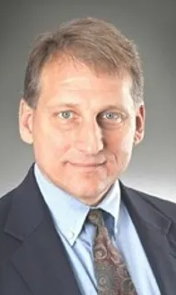
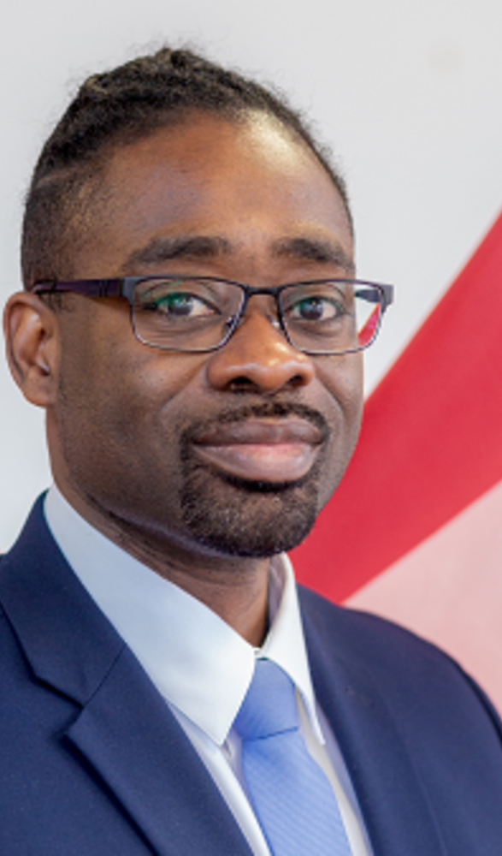
Welcome – First General Session
Dave Doukas - CSAVR President
CT-G
Chris Wells –Executive Director
GA-C

Slide 3
Announcements
Preconference events
New format – thank you
Room hosts – GA and CSAVR
EC members Presiding
Map
CRC – GWU (QR code)
Continental Breakfast – M,T,W
No AM or PM breaks
Reception - Harborside Ballroom
2023 monitoring COP – Tuesday 7am - Plimsoll 1st floor
Transition Committee – Tuesday cancelled
2024 monitoring COP – Wed 7am – Verelst 2nd floor
TAC tables
yesLMS partnership
Veterans
World events
Thank you – Proposal reviewers
Thank you - Georgia VRA
Thank you - EC and Officers
Thank you - CSAVR staff

Slide 4
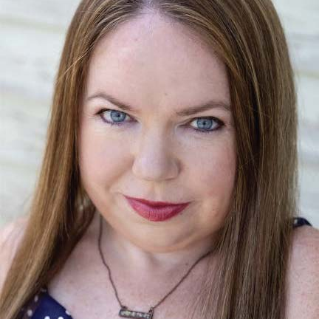
Cindy L. Otis
Previous CSAVR keynote
Former CIA intelligence analyst
Owner The Stacks Bookstore
Author At the Speed of Lies and True or False
Book signing – Monday night reception

Slide 5
Welcome New Directors
Cassi Villegas – WA-G
Lia Dias – HI-C
James Williams – IA-G

Slide 6
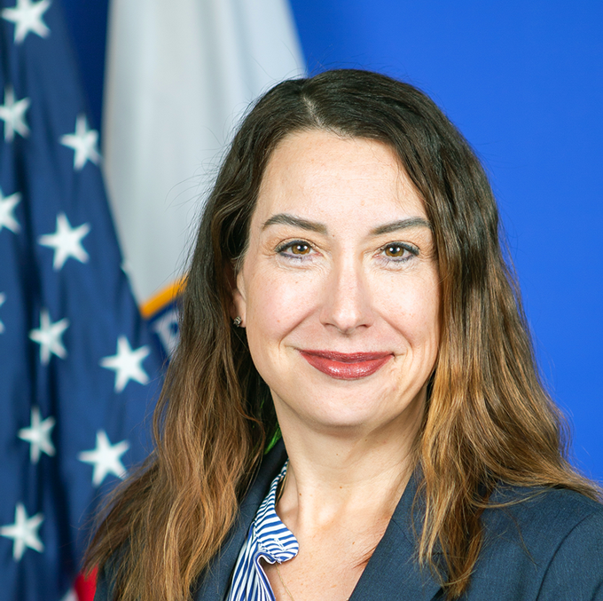
WELCOME
OSERS Assistant Secretary
Glenna Wright-Gallo
Classroom teacher and administrator
Utah state director of special education
Washington Assistant Superintendent of special education
Assistant Secretary of the Office of Special Education and Rehabilitation Services
BA and MS in special education
Masters of Business Administration

