Slide 1

CSAVR
October 22, 2024
Tribal & WA VR
Working Together to meet Customer Needs
Dana Phelps, Director WA-G
Michael MacKillop, Executive Director WA-B

Slide 2
Gov’t to Gov’t
In 1989, the Centennial Accord was established between the federally recognized Indian tribes of Washington signatory to this Accord and the State of Washington. The stated purpose is to better achieve mutual goals through an improved relationship between their sovereign governments.
In practice the Centennial Accord has led to clear protocols the state follows when working with tribes. This includes working government to government to serve people in VR. It ensures we respect each tribe as a sovereign nation.
For example, the Directors of WA-G and WA-B meet with TVR Directors directly. This is something we can not delegate to others in our organization.
Notes:
We must ensure that follow and respect established protocols or we are disrespecting the sovereign nations
We hold roundtable discussions with tribes to discuss policy or practice changes and receive consultation from tribal leaders on VR policies and our state VR plan

Slide 3
Cooperative Agreement
We have one cooperative agreement between the tribes with Tribal VR grants and the WA-G and WA-B agencies.
The cooperative agreement includes:
How we will train staff that work with tribes
Quarterly meetings between TVR Directors and the WA-G and WA-B Directors
How we will serve shared customers including how services are funded
Tribal participation in interview panels for VR leadership positions and tribal liaisons
In addition to the Cooperative Agreement, we have mutually developed plans with all the tribes in Washington to define how we will provide services to tribal members.
Notes:
There are 29 federally recognized tribes in WA.

Slide 4
Employment
Achieving employment outcomes for tribal members is our shared goal.
How to best achieve employment is customer led, and consultation from tribes is essential to ensure services are culturally appropriate.
Entrepreneurship and self-employment can be a preferred employment path.
Depending on the location of a tribe, there can be a limited number of employers which requires creativity by everyone on how to support a customer’s career goals.
Recent shared cases included career goals of: Vocational Rehabilitation Counselor; Fisher/Fishing Industry; Elementary School Teacher; Management Analyst; Customer Service
Notes:
Sometimes the first generation to work 9-5 job (Is Jana speaking to this?)

Slide 5
Tribal Liaisons
We have local tribal liaisons to support with each tribe.
This person (often a VR Counselor) works closely with the tribe, getting to know staff at the tribe and learning about tribal customs and practices.
This relationship is essential to building trust. The trust helps customers believe state VR services can be helpful.

Slide 6
Building State Staff Knowledge
Understanding tribal practices and customs are essential to successful services.
The relationships we have at the local level is critical.
When there is a positive relationship, tribal members are more likely to find the services offered by state VR to be helpful.
Notes:
Tribal liaisons and local staff are invited to events at the tribe. Through their attendance at these events, state VR staff demonstrate their commitment to supporting the tribe.

Slide 7
Consultation
Through both the Cooperative Agreement and policies, the state VR program has agreed to consult tribes on policy, practices, and the state plan.
Consultation occurs through meetings as well as a formal consultation model where policies are introduced for discussion.
The consultation model ensures that tribal sovereignty is respected and that feedback is incorporated into policy before it is enacted.

Slide 8
DSB Experience
DSB collaboration among Tribal VR programs deepened in early 2000’s
  Before then some strong collaboration on individual caseloads, but not coordinated at agency-level
  Individual counselors had built relationship and trust through success in shared services and respect for work of TVRs
At agency level, key was an individual State Rehabilitation Council member from Lummi Tribal VR
  Took active role in inviting agency leadership to join in quarterly meetings established for general agency
  Offered personal stories that provided context and awareness of value of TVR services
  Brought DSB into the conversation

Slide 9
DSB Key Factors
Showing up, consistently
Understanding our shared history, and reasons tribes might distrust state agencies
Understanding and respecting Government to Government relations
Building relationship through regular meetings, with shared food and stories
Understanding why tribal healing practices are critically important for those with tribal affiliation, particularly for trauma that can come with disability
Understanding inequity in funding, and taking on responsibility for funding all services that are allowable
Learning about cultural practices that might impact the timing or steady participation of a customer with tribal affiliation
Making space for elder’s blessing at start of meetings

Slide 10
Shared Challenges
Order of Selection – shared cases
Uncertainty of American Indian VR Program (AIVRP) funding
  Difficulty finding viable contingency plans in case a TVR program is left unfunded
    DVR/DSB request for state funding of passthrough grant dollars
  Education of broader partners of inequity and burden to AIVRP due to funding grant cycle
Coordinating customer plans
Taking initiative in connecting new customers with tribal affiliation
Keeping state agency Tribal Liaisons educated and relevant to role, staff churn
Maintaining communications and sharing opportunities and trainings
Maintaining relationship among leadership beyond annual MOU

Slide 11
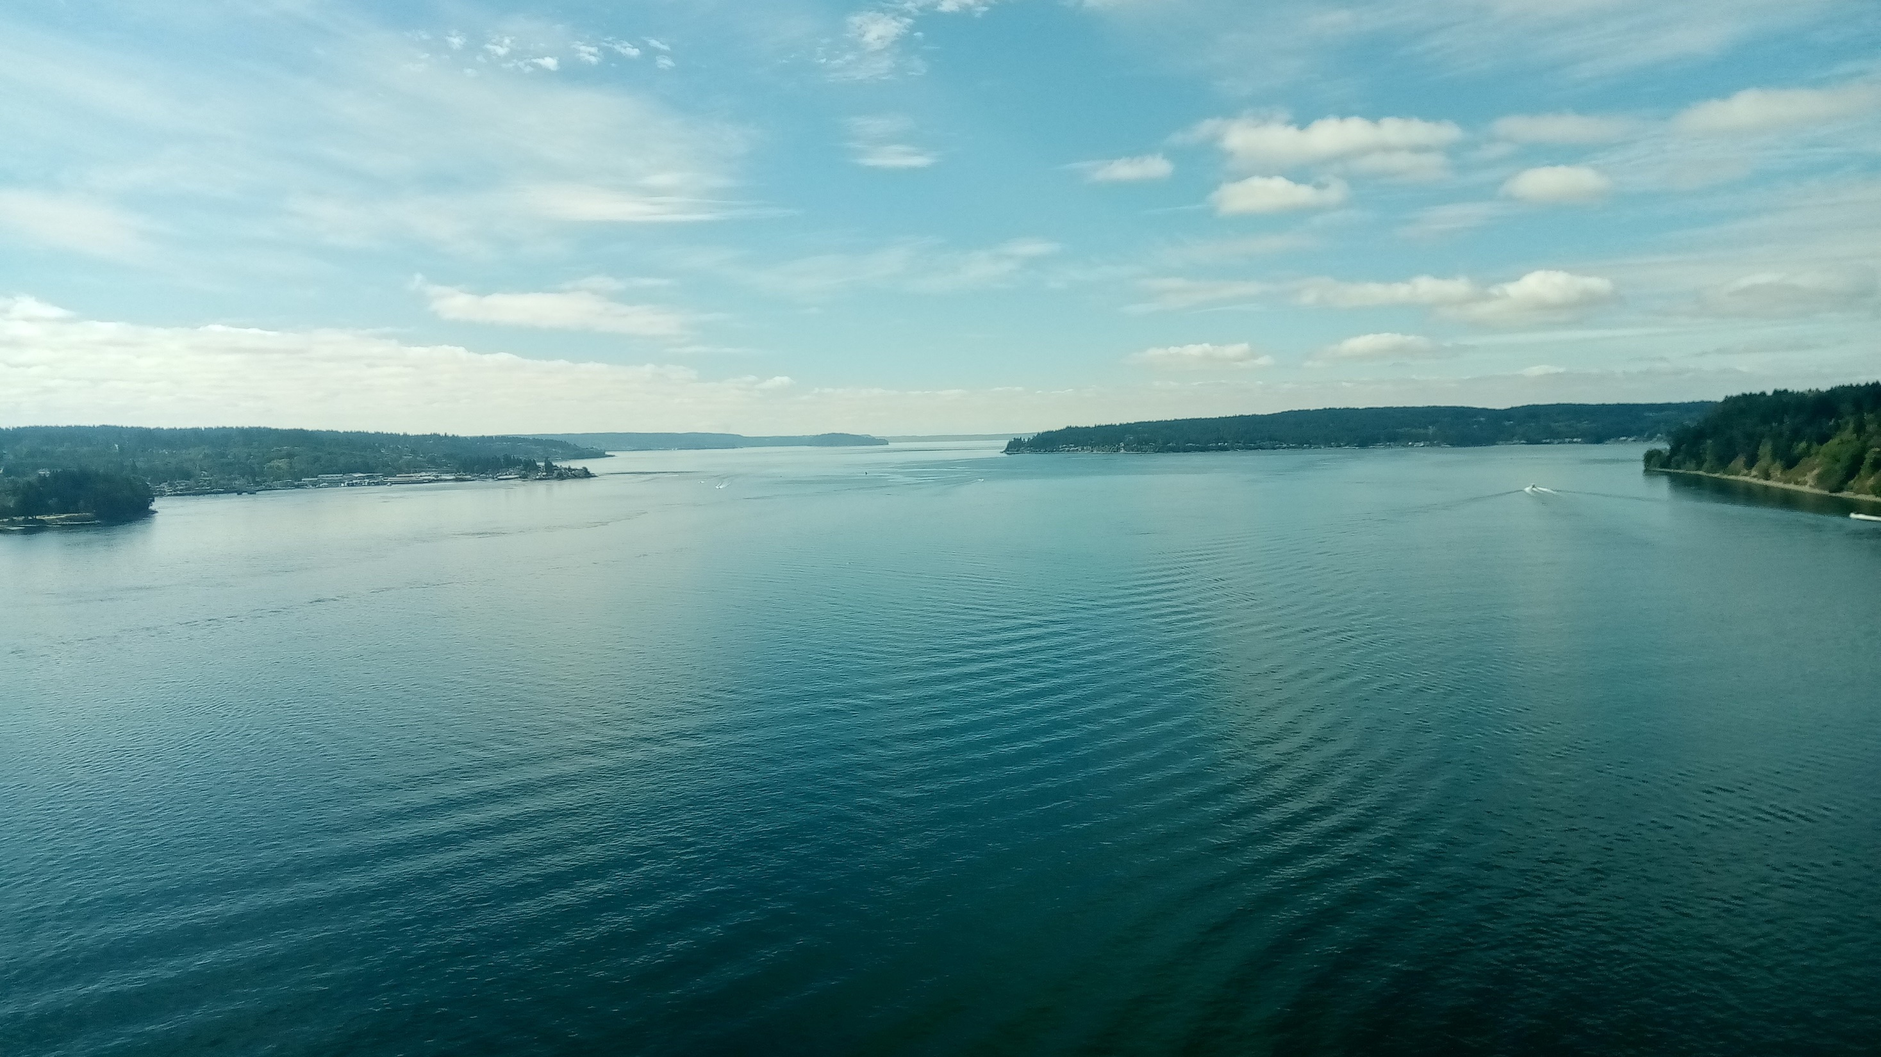
Questions

