Slide 1

Session 11:
Spending Strategy:
Strategic Thinking for Expansion of Program Expenditures
Charting Our Course: Maximizing VR Resources - Increasing Customer Outcomes
2023 CSAVR Spring Conference

Slide 2
Disclaimer
This content was developed by the VRTAC-QM, a project funded under #H264J200002; the VRTAC-QE, a project funded under #H264K200003; the NTACT:C, a project funded under #H326E200003, of the U.S. Department of Education (Department); and CSAVR, a member organization of State Vocational Rehabilitation Agencies. The information contained herein does not necessarily reflect the position or policies of the Department, and no official endorsement of any non-Federal product, service, or venture should be inferred.

Slide 3

Meet Your Presenters
Sarah Clardy
VRTAC-QM
Bill Robinson
Michigan Bureau of Services for Blind Persons
Brenda Simmons
VRTAC-QM and NTACT:C

Slide 4
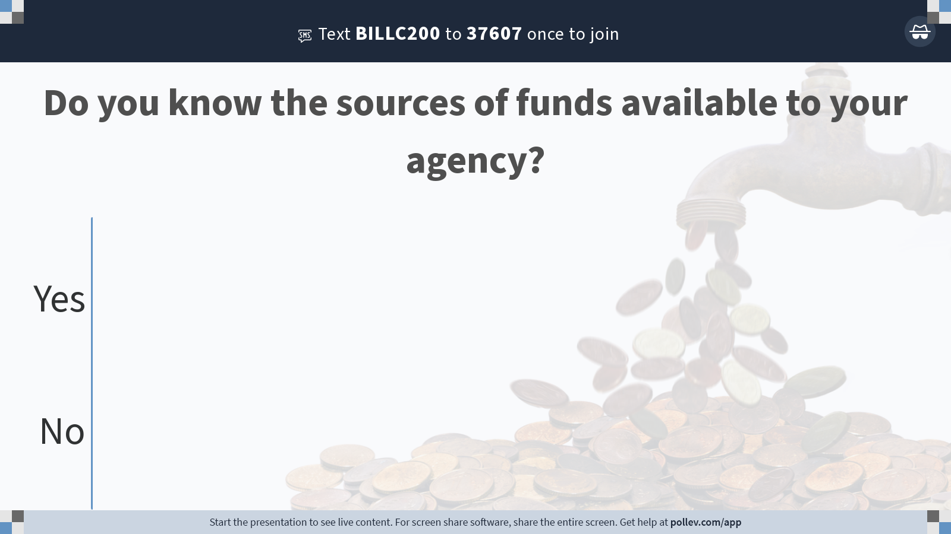
Notes:
Poll Title: Do not modify the notes in this section to avoid tampering with the Poll Everywhere activity.
More info at polleverywhere.com/support
Do you know the sources of funds available to your agency?
https://www.polleverywhere.com/multiple_choice_polls/ONSfD6Z4VY6XUMlAuRLyM?state=opened&flow=Default&onscreen=persist

Slide 5
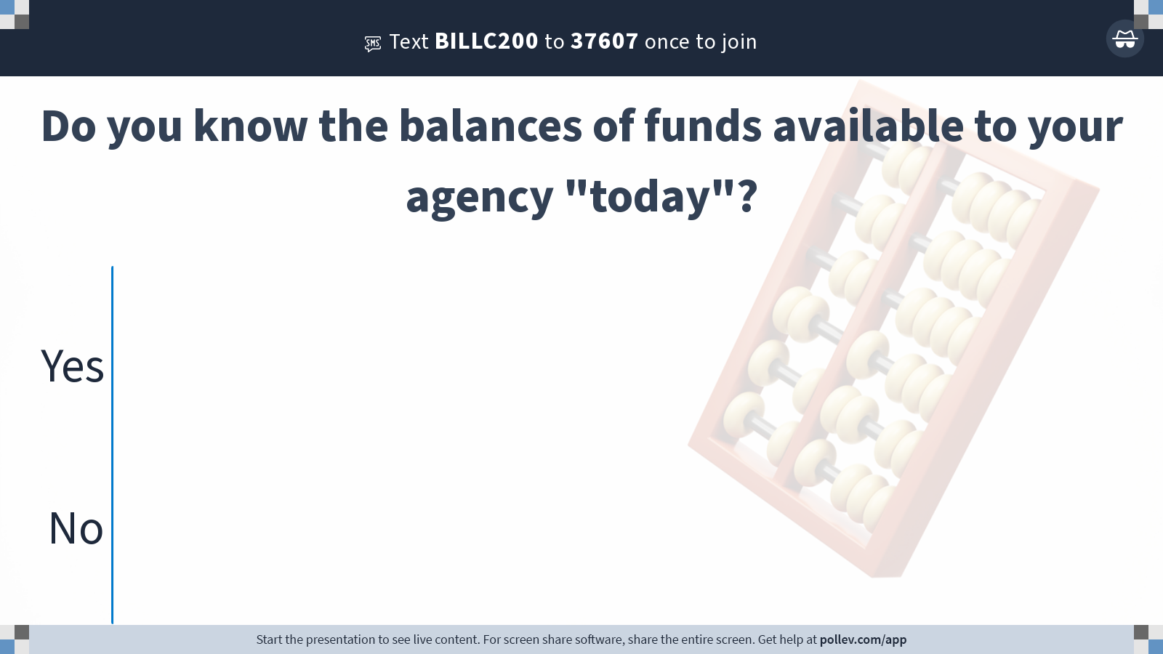
Notes:
Poll Title: Do not modify the notes in this section to avoid tampering with the Poll Everywhere activity.
More info at polleverywhere.com/support
Do you know the balances of funds available to your agency "today"?
https://www.polleverywhere.com/multiple_choice_polls/71NIgw8PGx9RNYc79j2YB?state=opened&flow=Default&onscreen=persist

Slide 6
Spending Strategy: The Navigational Beacon
A spending strategy orchestrates the various funds available to the program in coordination with the needs of the customers and Federal and state requirements. It is the program’s fiscal navigational beacon. It determines “what” is spent, “how”, and “when”.
The fundamental challenge is managing MULTIPLE sources of funds at a time.
For example, in the current FFY, an agency that has met the carryover requirements at 9/30/22 has FFY22 carryover dollars available in addition to their FFY23 grant award. The agency also has the non-Federal share “match” dollars associated with the grant award(s), potentially from various sources, in addition to program income.

Slide 7

The Period of Performance Connection
Proper management of Period of Performance requires a thoughtful spending strategy. An agency needs to know which source of funds they are obligating against and when, in addition to tracking and reporting obligations.

Slide 8

Match Matters
The non-Federal share or “match” is a driving factor in the plan.
Consideration must be given to the individual sources and the timing of availability.

Slide 9

Carryover Can Maximize Spending
To carry over Federal funds into the subsequent FFY for obligation and liquidation, grantees must –
Have an unobligated balance of Federal funds at the end of the FFY of appropriation; and
Have satisfied the applicable non-Federal share requirement by the end of the FFY of appropriation for the –
  Federal funds obligated or liquidated during the FFY of appropriation; and
  Unobligated balance of Federal funds to be carried over to the subsequent FFY.

Slide 10

Plan for Reallotment
Use of a spending plan can allow for an educated decision when it is time to make decisions regarding reallotment.

Slide 11
Spending Strategies for Students and Youth with Disabilities

Slide 12
Understand the Difference and Report Expenditures Appropriately
Group Transition Services
(34 C.F.R. §361.49(a)(7))
For groups of students and youth with disabilities
VR application and IPE are not required
Services are not individualized, but benefit a group. Participation in the VR program is not required. Services may include group tours, employer visits, career fairs, etc.
Pre-Employment Transition Services
(34 C.F.R. § 361.48(a))
Only for students with disabilities in a recognized educational program
VR application and IPE are not required
The 5 required Pre-ETS activities can be provided in a group setting or individually
Individualized Transition Services
(34 C.F.R. §361.48(b)(18))
For students and youth with disabilities
VR Application and approved IPE are required
Any allowable VR service, including pre-employment transition services, can be provided, such as job coaching, job placement, transportation, etc., under an IPE

Slide 13
Documentation and Reporting of VR Funds Expended on Transition Services Under the Groups Authority
Costs charged under this authority (transition services to groups of students and youth with disabilities in accordance with Section 103(b) of the Rehabilitation Act and 34 C.F.R. § 361.49(a)(7)), must be reported on the RSA-17, line 39, Services to Groups, g. Transition Services to Students and Youth.
Reminder:
These costs may not be charged to the funds reserved for the provision of pre-employment transition services; and
This is not where you record Pre-ETS services provided in a group setting, this is a separate authority.

Slide 14

Accurate Allocation of Staff Time is a Requirement
Fact
Agencies are required to accurately determine the authority in which they are able to expend funds and must document and report services and expenditures accurately consistent with the VR program regulations and Federal cost principles.
Myth
States can decide whether to document and allocate staff time or additional services that can be charged to the reserve based upon the Notice of Interpretation.

Slide 15

Costs for Additional VR Services that may be Charged to the Reserve Consistent with the NOI
The costs for additional individualized VR services that may be charged to the reserve, consistent with the Notice of Interpretation must also be allocated and reported accurately. This includes:
  Any auxiliary aids or services needed by potentially eligible or VR-eligible students with disabilities to participate in pre-employment transition services,
  Additional VR services when needed by VR-eligible students with disabilities, under an approved individualized plan for employment (IPE), to participate in pre-employment transition services required activities.

Slide 16
Authorized activities are not ongoing commitments. They can be a strategy that may be used when funds remain and as your planning Deems necessary
The movement between required and authorized is a fluid process.
It’s a supplement to improve services and build capacity.
It’s a determination of whether you have sufficient funds reserved to provide the required and coordination activities to then carry out one or more of the authorized activities.

Slide 17
Strategies
Accurate reporting: Pre-ETS services provided in a group setting is not the Transition “Services to Groups” authority
Allocate staff time spent providing or arranging for the provision of Pre-ETS required activities and the coordination activities (as well as authorized activities when appropriate)
For eligible students with disabilities, allocate costs of additional VR services provided in accordance with the Notice of Interpretation (NOI)
Move to authorized activities as soon as possible
Review your Pre-ETS expenditures on a regular basis and revise your strategy accordingly
Solicit feedback from stakeholders
Including students and families
Review your rates for services, including pre-employment transition services and revise accordingly.

Slide 18

Data should be Driving Planning and the Strategies You Implement
Analyze your Fiscal and Programmatic data to determine:
  What services you are providing and what you are spending on them?
  What you are getting for those services? Are they making a difference?
  Who is not getting served?
What is not getting provided?
  Validate the quality of the data you are using to make decisions.
The world is constantly changing and evolving - is your program?

Slide 19

Resources
Reserve Set-Aside Determination
Pre-employment transition services strategic planning guide
Time Allocation Guide
Policy Guide for Pre-employment transition services
Pre-Employment Transition Services: A Guide for Collaboration Among State Vocational Rehabilitation Agencies and Education Partners

Slide 20
Let’s Talk
FIELD SERVICES BUDGETS
OBLIGATION DIRECT SPLITS – 78.7%/21.3%

Slide 21

Vendor Cooperation
Managing an effective spending strategy requires strong internal controls around contracting, contract monitoring, and liquidation of obligations (payment process).

Slide 22

Administrative Needs
Is the agency structured to support this level of planning? Consider if the right people are on the bus. Are they in the right seat?

Slide 23

Continuously Evaluate
THIS IS YOUR NAVIGATIONAL BEACON!!!

Slide 24

State VR Agency Panel

Slide 25
Let’s hear from our State VR Agency Director
Bill Robinson – Director, Michigan Bureau of Services for Blind Persons, Office of Employment and Training, Labor and Economic Opportunity

Slide 26
Follow-Up Action Steps
The VR agency will develop and implement a strategic plan to expand allowable program expenditures.
Results
New strategies for expanding program expenditures are established and being implemented, increasing allowable expenditures, promoting increased services to customers, businesses, and quality employment outcomes.

Slide 27

Questions
Please direct questions to your RSA-SMPID state liaison.

Slide 28





Conference Partners

Slide 29
Thank You

