Slide 1
Navigating G5 and
RSA.ED.GOV
Presenters:
Sean Barrett, Financial Management Specialist
Rehabilitation Services Administration
U.S. Department of Education
Ken Schellenberg, Information Technology Specialist
Rehabilitation Services Administration
U.S. Department of Education

Slide 2
What is G5?
G5 (www.g5.gov) is the Department of Education’s grant management system. Grant Award information, including the Grant Award Notifications and terms and conditions (i.e. attachments) are accessed through G5.
Once awarded by RSA, the drawdown of funds, and potentially the return of funds (depending upon the State), is managed through G5.
RSA.ED.GOV and G5 are NOT electronically linked to permit direct data exchange.

Slide 3
How do I Obtain a User ID and Password to Access G5?
If you haven't registered for a G5 account, please go to www.g5.gov and click on the "New User" link under the G5 login box and following the instructions to complete the online registration.
RSA Financial Management Specialists cannot access G5 user accounts.

Slide 4
Who has Access to Award
Information in G5?
G5 allows for two roles that can be associated with any given award, Recipient State Director (RSD), and State Authorizing Official (SAO) .
In almost every case, the RSD is the individual who heads the DSA and signs the Unified or Combines State Plan, while the SAO is the head of DSU (There is an exception for accessibility and turnover).
Either of these roles can be designated to another person, but only by the person who initially held the role.
If the DSA has formally delegated authority to the DSU to sign the Unified or Combined State Plan, then the DSU director must be designated as the RSD, and the DSA director must be designated as the SAO in G5.

Slide 5
Who has Access to Award Information in G5? (cont.)
If the DSA is the DSU, then the DSA Director is listed as both the RSD and SAO in G5.
The DSU Director is the VR Director, and should be the individual identified as the primary State VR contact in public-facing areas like RSA.ED.GOV.
Only the RSD’s name is listed on the GAN.

Slide 6
How to Request a Change to the RSD or SAO for an Award?
Your RSA Financial Management Specialist or Program Liaison can assist in changing the RSA or SAO for a grant award(s).
Please send an email indicating which award numbers need to be changed and the individuals who should hold each role. Be sure to indicate if this is new staff taking the role or if the role is being delegated from the previous holder.
The email mail could include a scanned letter signed by individuals in the roles, or could include text in an email. Each person in the designated role should then reply to the email confirming their approval of the roles stated in the email.

Slide 7
Using the Information
Regardless of who is the RSD and/or SAO, RSA strongly encourages States to implement a policy and practice for downloading attachments and sharing that information with any staff responsible for assuring compliance with requirements included in the award.
Note: Each award includes not only award amounts, but often numerous pages of “Attachments”. These attachments represent the legal terms and conditions for implementing the award and should be reviewed, in total and made available to appropriate staff.

Slide 8
Special Considerations
To meet accommodation needs, G5 designations may vary somewhat from the above guidance. For example, if a VR Director who is blind has been delegated authority to sign the Unified or Combined State Plan, the VR Director may designate an individual other than the DSA Director to be listed as the SAO. In such cases, RSA staff should identify the specific arrangement in the notes column of the spreadsheet and update the grant file in G5 with documentation of the DSU’s agreement with the arrangement.
Please note that recent changes to G5 have ensured that the
Grant Award Notifications are accessible.

Slide 9
Who Should I Contact for Assistance?
If the question is related to accessing or using G5, please contact the G5 Hotline at 1-888-336-8930 (TTY Telephone: 1-866-697-2696). Grantees can also send questions and concerns via Email to: edcaps.user@ed.gov.
If the question relates to assignment of the RSD or SAO, please contact your RSA Financial Management Specialist or Program Liaison.

Slide 10
RSA.ED.GOV
RSA.ED.GOV collects information from RSA grantees regarding performance and expenditures under RSA grants to support a wide array of programs supported by:
  collecting and disseminating performance and financial reports for over a dozen RSA programs; and
  allowing Basic Vocational Rehabilitation (VR) grantees to upload data on the RSA-911 Case Service Report.

Slide 11
What's Available?
Policy Information
Fiscal Resources
Grant Award Information

Slide 12
Policy Information
Legislation
Regulations
Sub-Regulatory Guidance
  Policy Directives (PDs)
  Information Memoranda (IMs)
  Technical Assistance Circulars (TACs)

Slide 13
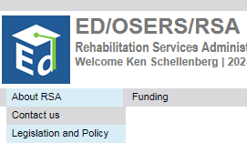
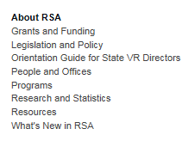
How to Find Policy Information
Available on the menu
  Click About RSA
  Click Legislation and Policy
Available on the footer

Slide 14
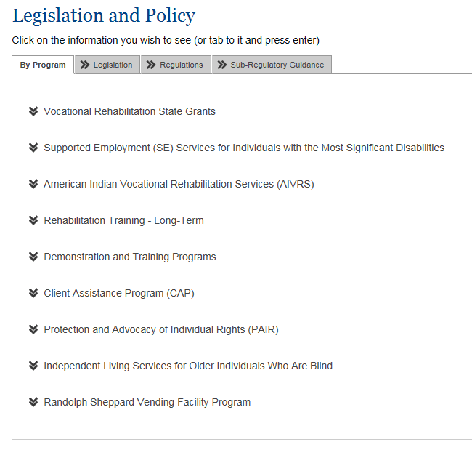
Legislation and Policy screen
The Legislation and Policy screen allows you to view legislation and policy by program, or by type.
By Program – on this tab, click on the program name to view policies related to that program
Legislation – on this tab you’ll find links to the Rehab Act and other RSA-related legislation
Regulations – on this tab you’ll find links to regulations published in the Federal Register
Subregulatory Policy – on this tab you’ll lists (by date and name) of
  All Sub-Regulatory Guidance
  Policy Directives
  Information Memoranda
  Technical Assistance Circulars, and
  Other Documentation Supporting RSA Programs

Slide 15
Fiscal Resources
RSA has developed a Fiscal Resources page with info about
General information
Technical Assistance on Pre-Employment Transition Services Expenditures
Frequently Asked Fiscal Questions—Pre–Employment Transition Services
Federal Financial Reports (SF-425)
Match
SMPID Formula Grant Programs—Minimum Award Calculations
State Vocational Rehabilitation Services Reallotment Data

Slide 16
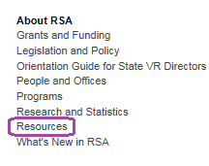

How to Find Fiscal Resources
Available on the Footer
  then select the tab Resources available on ED.GOV
Available on Search
In the Search box type Fiscal Resources and click the button

Slide 17
The Fiscal Resources Page
Fiscal Resources contains seven sections
General information
Frequently Asked Fiscal Questions
Federal Financial Reports (SF-425)
Match
SMPID Formula Grant Programs—Minimum Award Calculations
State Vocational Rehabilitation Services Reallotment Data
Notes:
I noticed the “Technical Assistance on Pre-Employment Transition Services Expenditures” section has been removed from this page. Just wanted to note that.

Slide 18
Fiscal Resources – General Information
The first section of the Fiscal Resources page contains information about
Due dates on SF-425s
Uniform Administrative Requirements, Cost Principles, and Audit Requirements for Federal Awards: Technical Assistance for ED Grantees
Accessing and Initiating Changes to Formula Grant Award Notifications
ED Memoranda & Guidance for Grantees, and
Email Updates.

Slide 19
Fiscal Resources - FAQs
The second section of Fiscal Resources contains links to Frequently Asked Questions (FAQs) about
Pre-Employment Transition Services and
Period of Performance

Slide 20
Fiscal Resources - Federal Financial Reports (SF-425)
The next section contains links to policies specifically related to Federal Financial Reports (SF-425)
PD-15-05—"Revisions to PD-12-06, instructions for completing the Federal Financial Report (SF-425) for the State Vocational Rehabilitation Services program"
PD-11-03—"Instructions for completing the Federal Financial Report (SF-425) for other formula grant award programs"

Slide 21
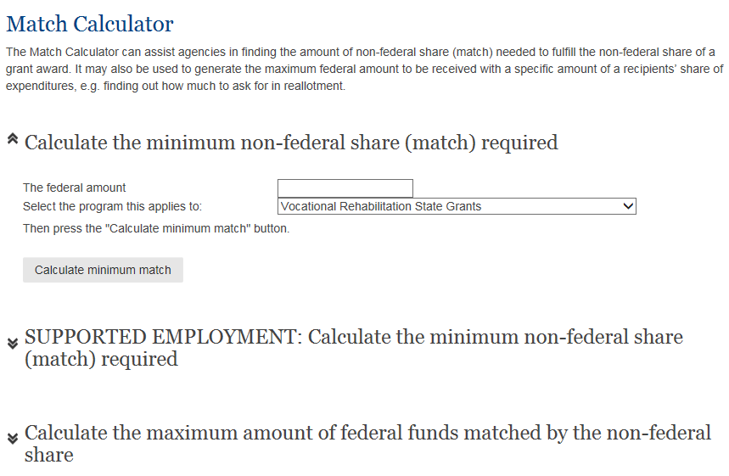
Fiscal Resources - Match
This section contains a link to the Match Calculator on rsa.ed.gov
(This is also available on the Tools menu in the footer.)

Slide 22
Fiscal Resources – Minimum Award Calculations
The next section contains a table of how minimum award amounts are calculated
Title | Program | State Min. | Territory- FAS Min. | Legal Citation
I | Basic VR - State Grants | $3,000,000 or 1/3 of 1% of appropriated amount, whichever is greater | None | Rehabilitation Act – Subsection 110(a)(3)
I | Client Assistance Program | $50,000 After appropriations exceed $7.5 million, States receive $100,000 | $30,000 After appropriations exceed $7.5 million, outlying areas receive $45,000 | Rehabilitation Act Section 112(e)
VII | Independent Living for Older Individuals Who Are Blind – State Grants | $225,000 or 1/3 of 1% of amount appropriated, whichever is greater | $40,000 | Rehabilitation Act Section 752(j)
VI-B | Supported Employment – State Grants | $300,000 or 1/3 of 1% of appropriated amount, whichever is greater | 1/8 of 1% (0.00125) of appropriated amount | Rehabilitation Act – Subsection 622(a)
V | Protection and Advocacy for Individual Rights | $100,000 or 1/3 of 1% of appropriated amount, whichever is greater | $50,000 | Rehabilitation Act-- section 509((c)(3)

Slide 23
Fiscal Resources – Reallotment Data
The final section contains a table of State VR Services Reallotment Data for the most recent Fiscal Year.

Slide 24
Grant Award Information
Information about Grant Awards can be found in three places on the RSA.ED.GOV site
The Program information page
The Grant Award page
Ad Hoc Query

Slide 25
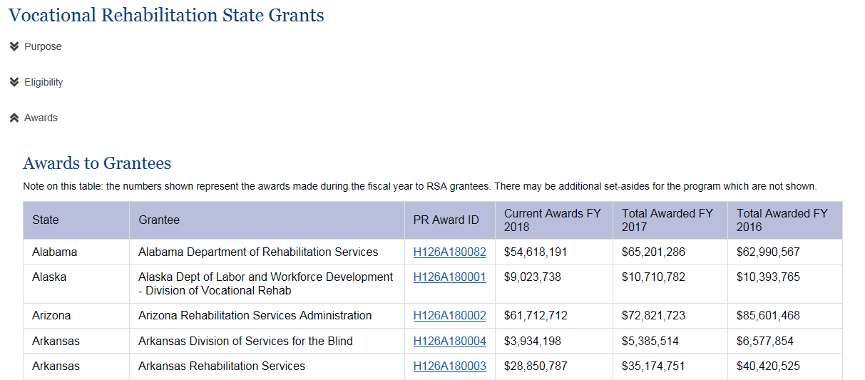
Grant Award Information on the Program page
Each RSA program has its own page (see About RSA then Programs)
Select the program, then click on the Awards dropdown
The system shows a table of awards by state

Slide 26
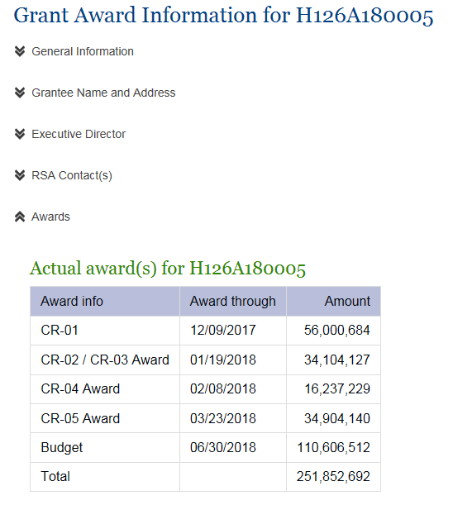
Grant Award Information on the Grant Award page
Each grant award has its own page which shows award details

Slide 27
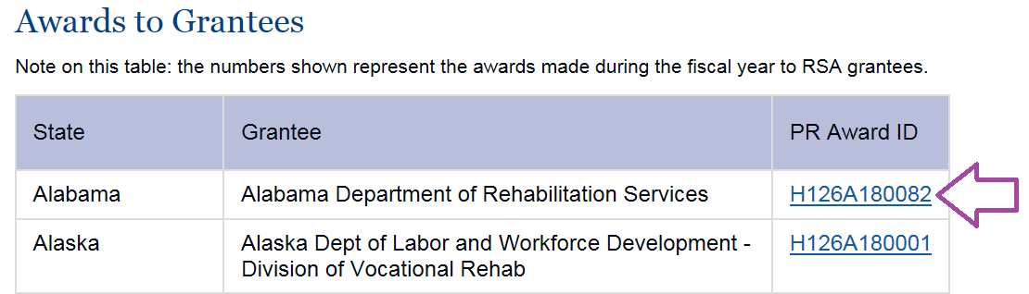

How to get to the Grant Award page
There are several ways to get to the page for your award
Click on your award number on the Program page
Type your award number in the Search box
TIP: for Basic VR awards, type your four character agency code in Search: i.e. CA-C or AR-G or CT-B

Slide 28
Grant Award Information in Ad Hoc Query
The Ad Hoc Query option is available under Tools in the menu or footer
The first AHQ option is Query Grant Awards

Slide 29
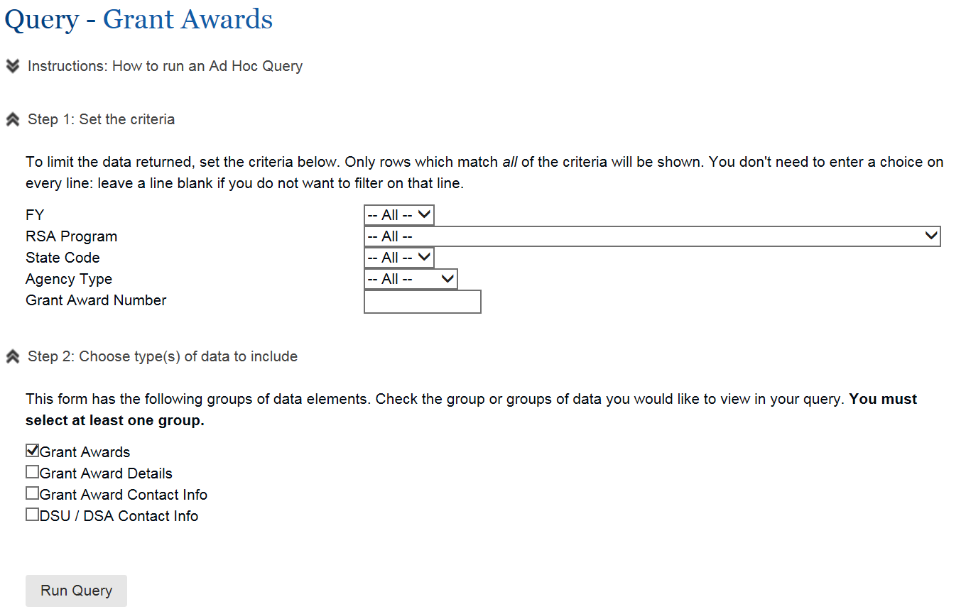
Grant Award Ad Hoc Query

Slide 30
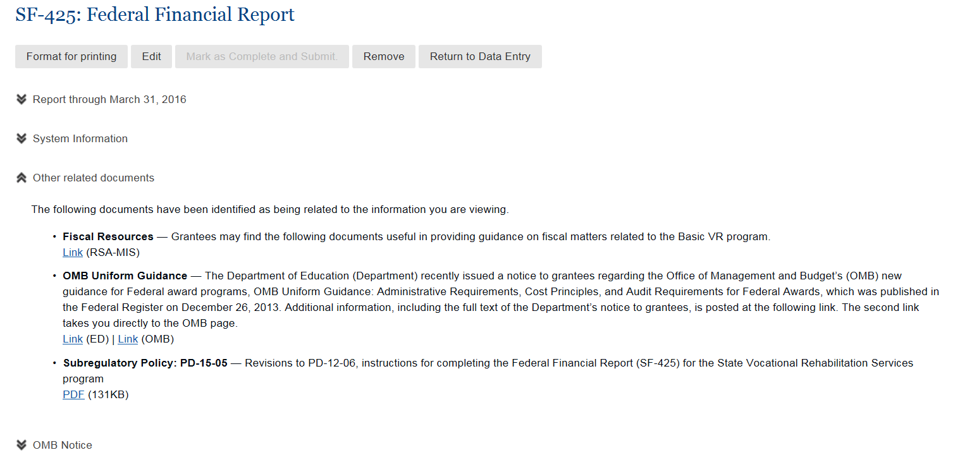
One more tip: Fiscal Info on Data Entry
Within Data Entry, there’s a spot on the SF-425 (and also on other forms) for Other related documents

Slide 31
Questions?
If you have additional questions, please email them to RSAfiscal@ed.gov.

