Slide 1


The POWER of V.R.
The Journey – The Connection – The Outcome

Slide 2
The journey

Slide 3
“A person's life is not of lessER value because they have a disability. Every human life is worth the same, and worth saving.”

Slide 4
“Living with a disability is challenging, there are a lot of changes and in the beginning when you're trying to figure things out there are not many things to laugh about but that doesn't mean that life is over. It just means that you're going to have to work harder to build the life that you want.”

Slide 5
“Many of us, after becoming disabled, lose the people that we love, we're left without family support and become lost in a system that can't give us the support that we need. But that’s not the end of the world, because there are others out there who care And organizations such as v.r. that can give us the support that we need.”

Slide 6
The World Health Organization (WHO) provides us with a sense of direction. They define quality of life as “an individual's perception of their position in life in the context of the culture and value systems in which they live and in relation to their goals, expectations, standards and concerns”

Slide 7
“Quality of life isn't determined by whether you have a disability or not; it's determined by the perspective that you have about your situation, the goals that you set, the expectations that you have and the standards that you create for yourself.”

Slide 8
The connection

Slide 9
“When the right connections are made, the road to recovery can begin. A person living with a significant disability, in a difficult situation without family support, not only needs to believe in themselves but they need others who believe in them also. They need a partner that has the knowledge to assist them with navigating the challenges, a partner with the resources to invest in them and give them the support that they need to learn to live again and a partner that simply cares. V.R. is that partner to people living with disabilities!”

Slide 10
“The right connection pushes you to discover the potential inside of yourself that you didn't know that you had, CHALLENGES YOU TO DREAM IN WAYS YOU’VE NEVER DREAMED BEFORE AND AWAKENS A HUNGER INSIDE OF YOU TO CHASE THOSE DREAMS.”

Slide 11
“the right connection HAS A WAY OF MAKING YOU FEEL COMFoRTABLE, LOVED AND WANTED, HELPS YOU DEAL WITH THE STRUGGLES OF LOW SELf ESTEEM, HELPS YOU BATTLE WITH THE DARKNESS OF DEPRESSION AND HOLDS YOUR HAND WHILE GRADUALLY GUIDING YOU THROUGH THE TRAUMA THAT LIFE HAS CAUSED, BEFORE LETTING GO OF YOUR HAND.”

Slide 12
THE OUTCOME

Slide 13
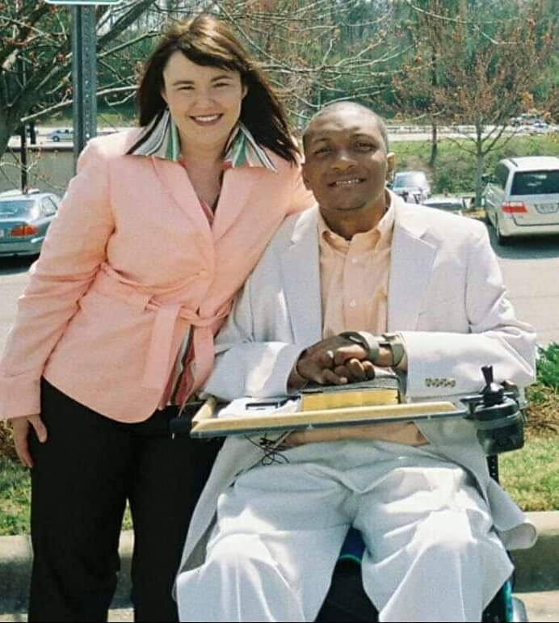

Slide 14
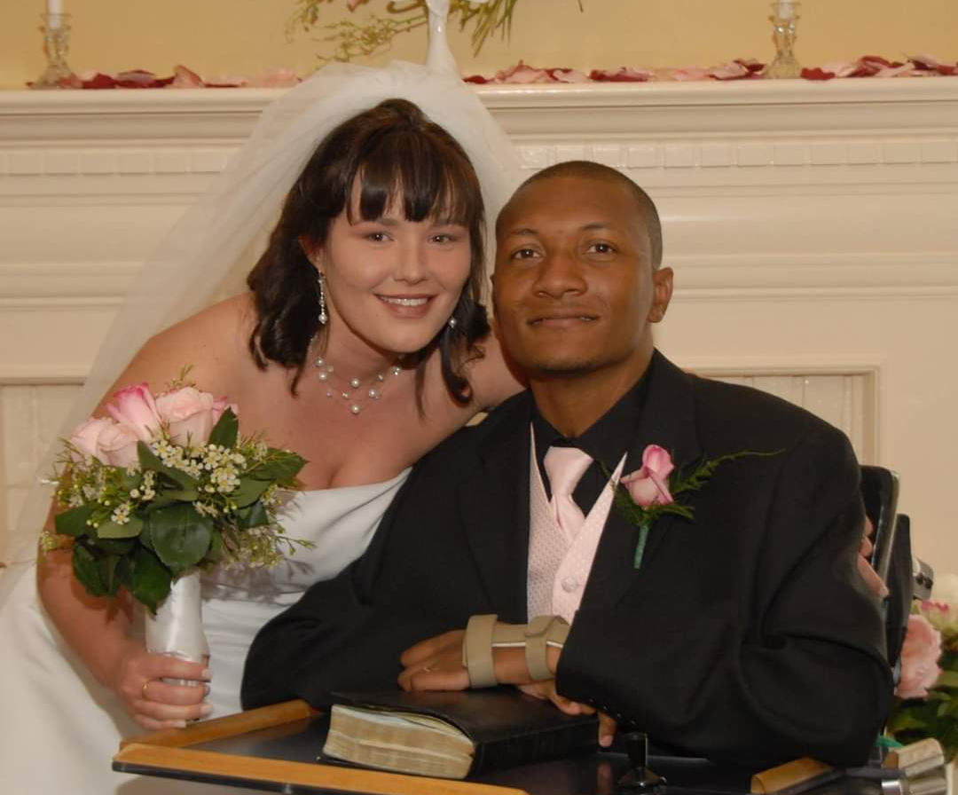

Slide 15
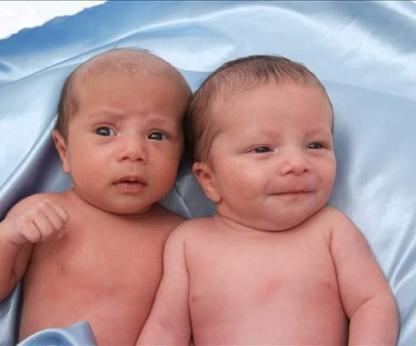

Slide 16
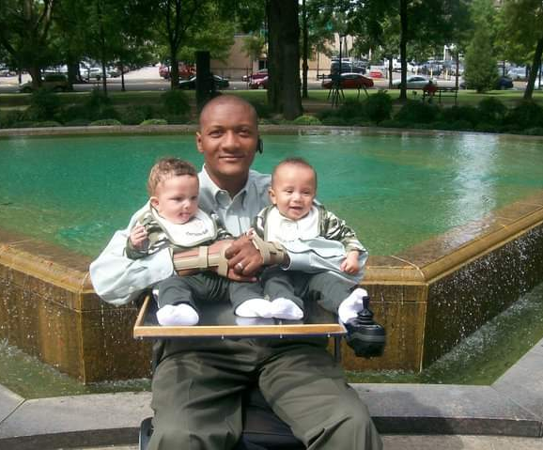

Slide 17
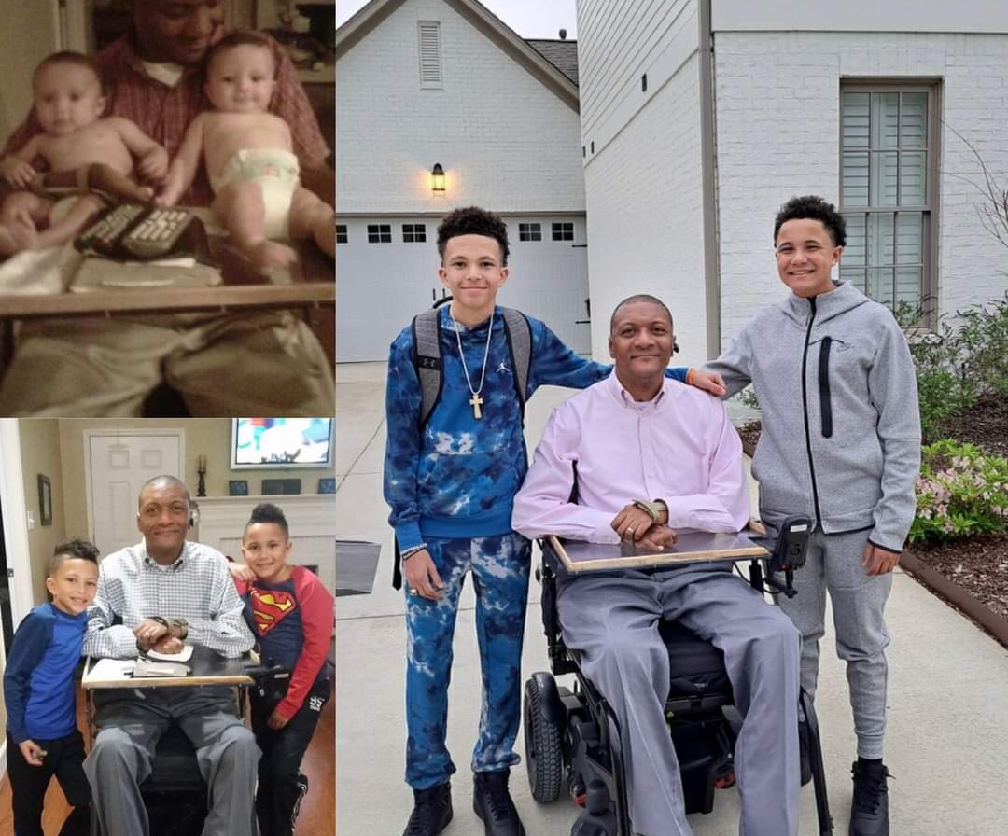

Slide 18
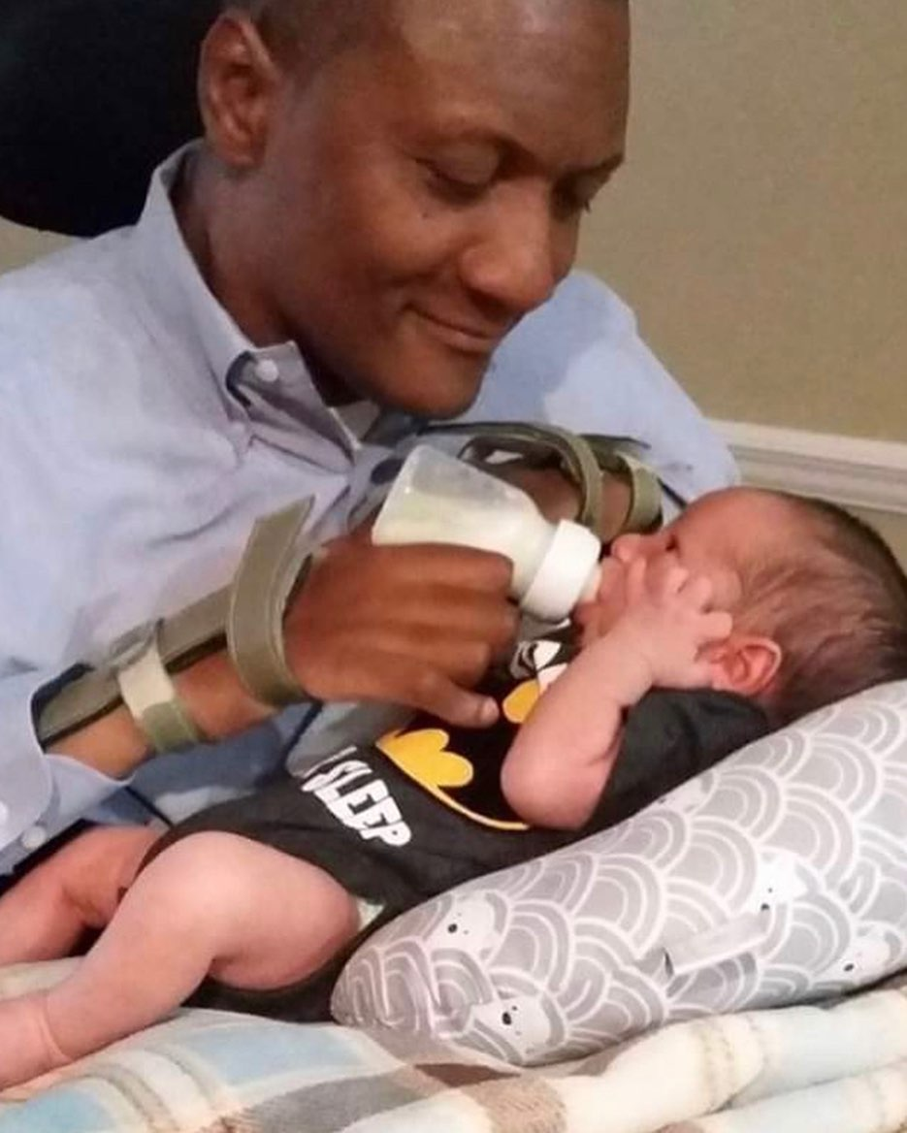

Slide 19
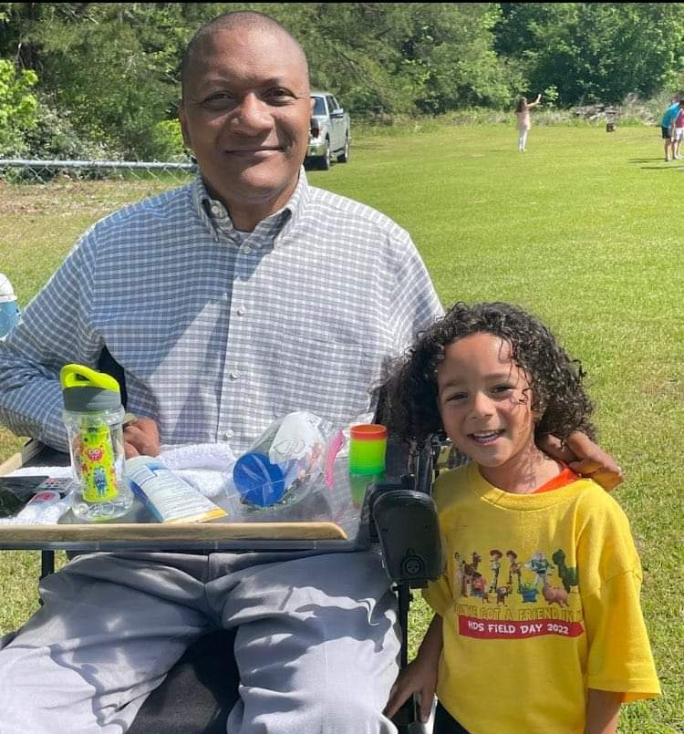

Slide 20
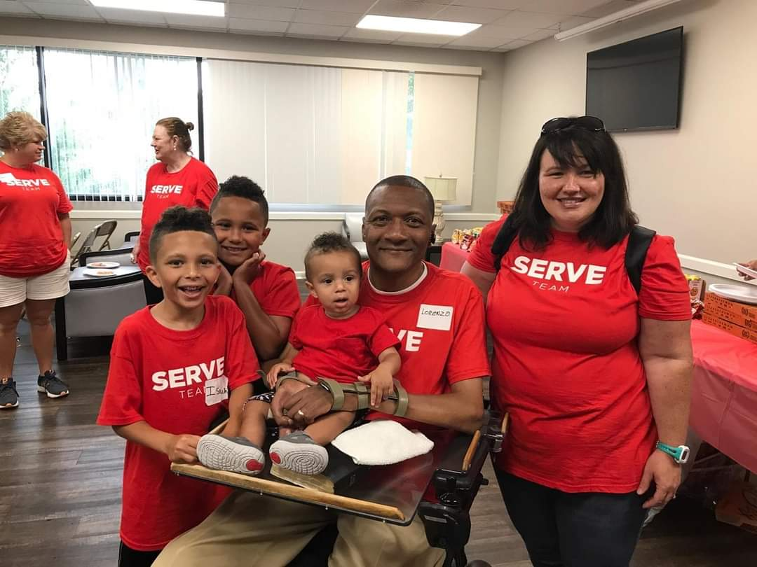

Slide 21
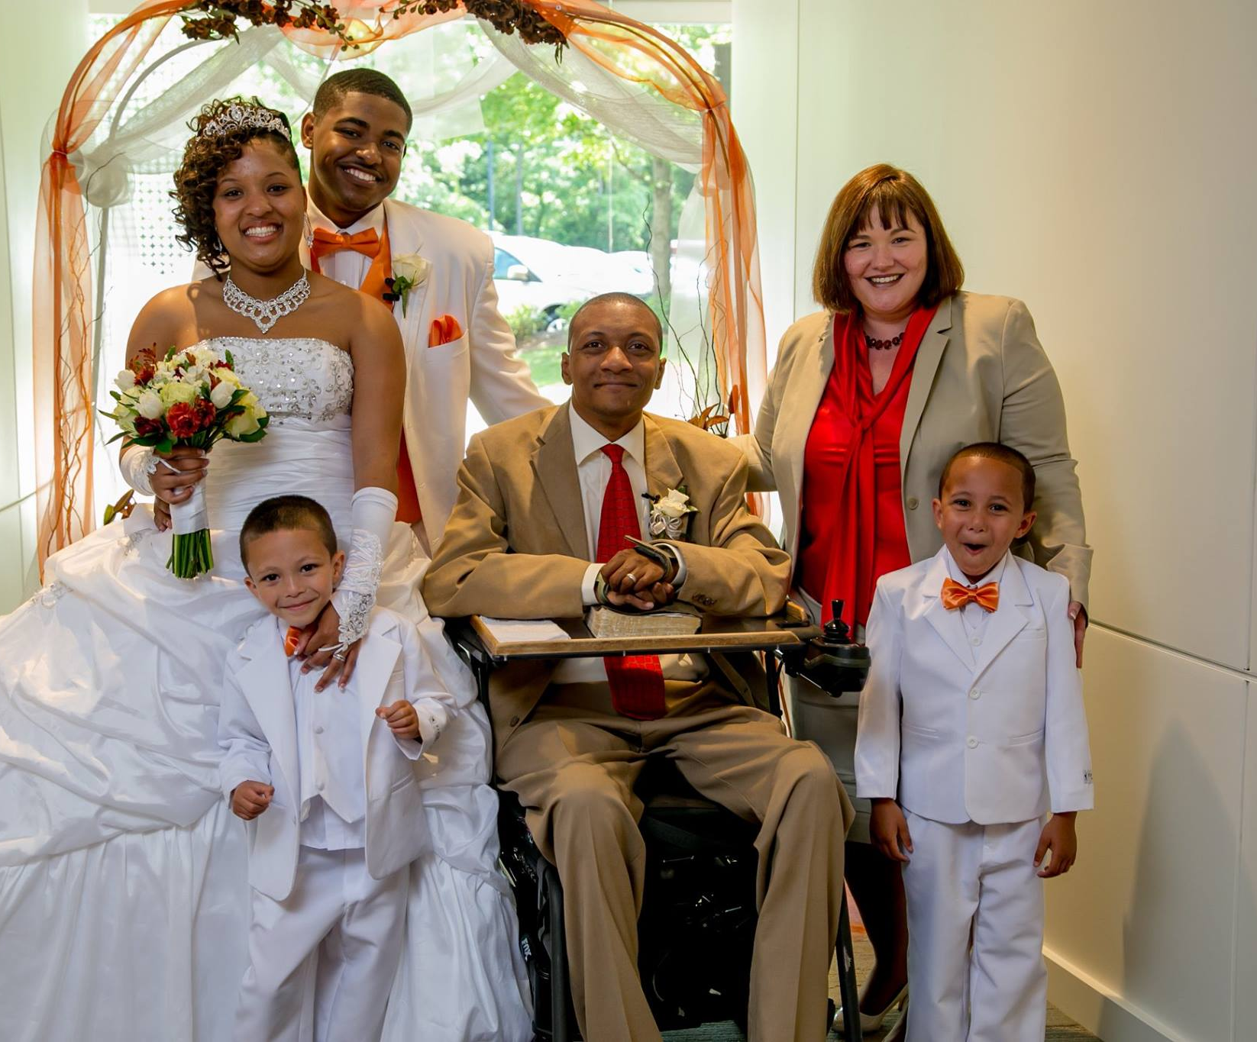

Slide 22
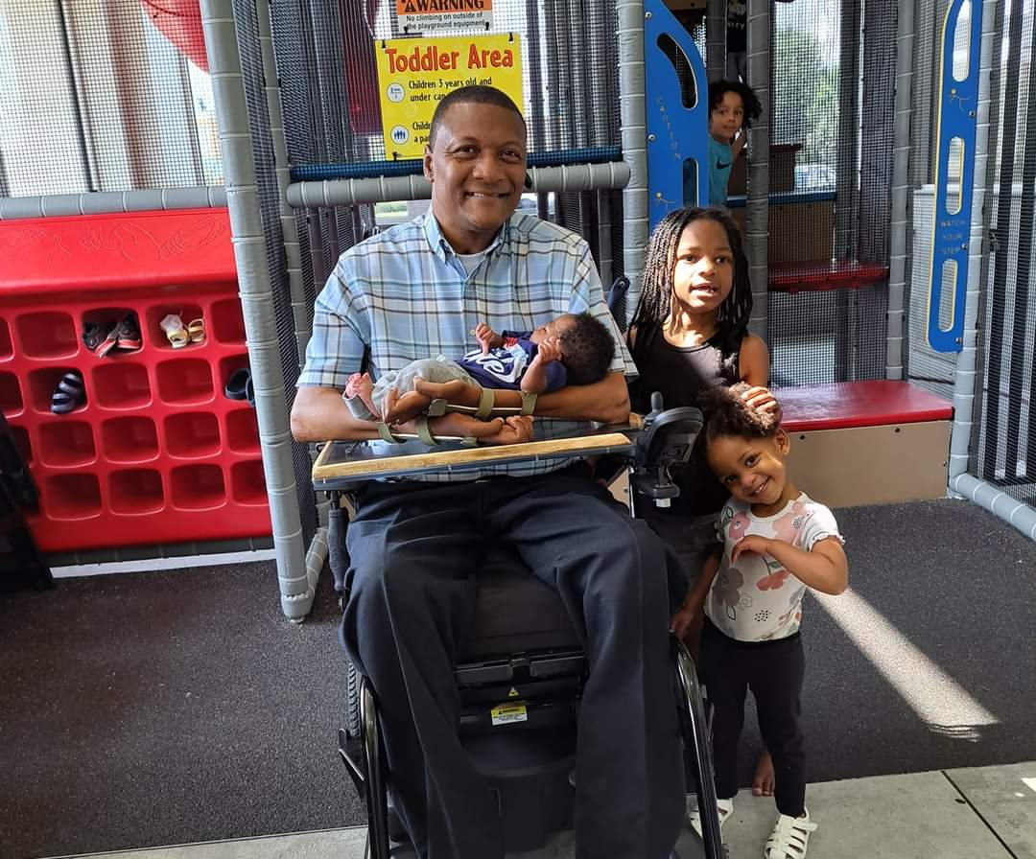

Slide 23
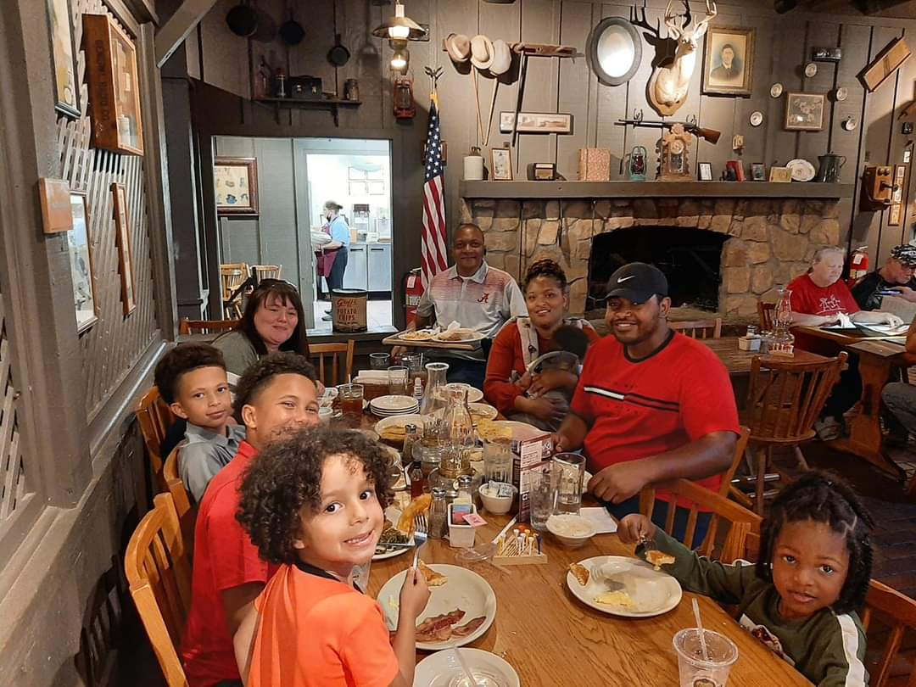

Slide 24
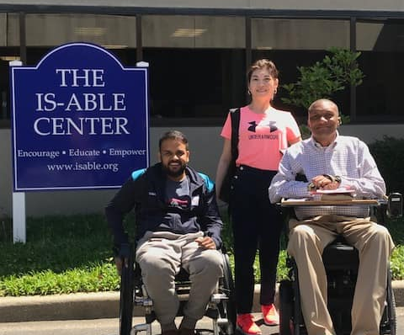
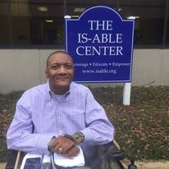

Slide 25
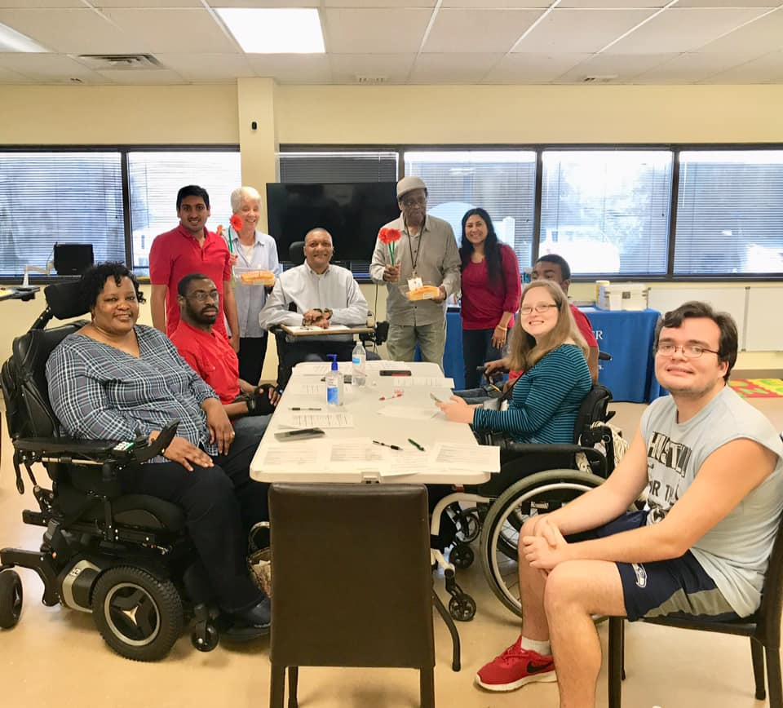

Slide 26
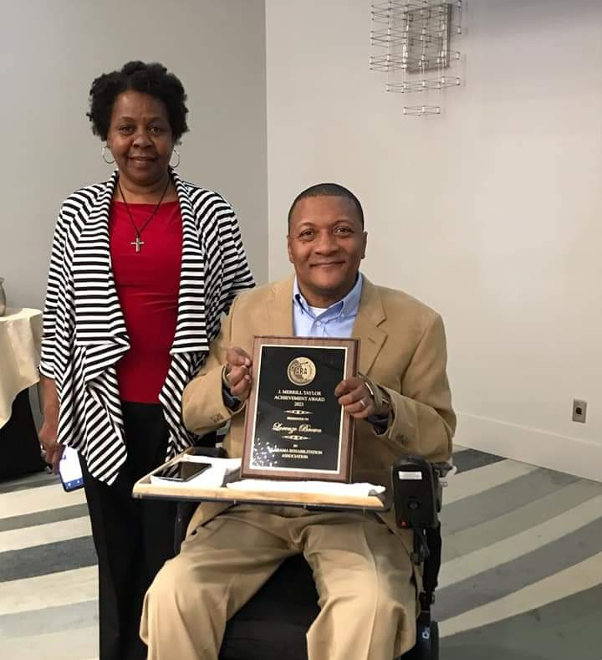

Slide 27
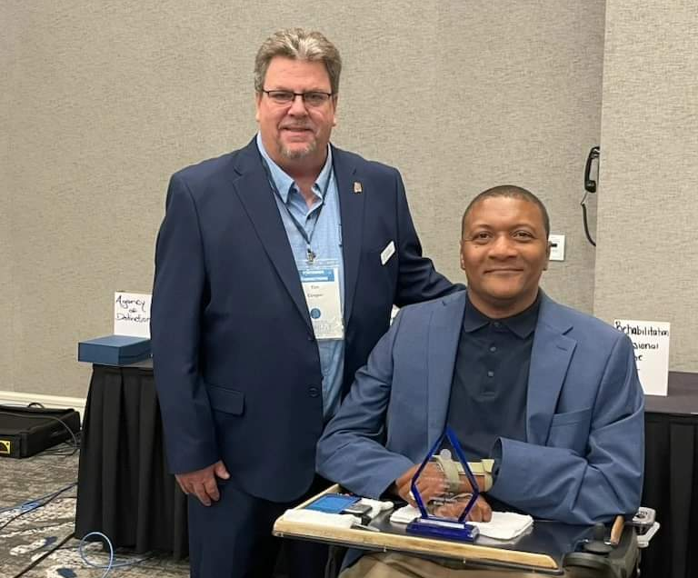

Slide 28
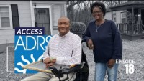

Slide 29
“V.R. gave me the tools that I needed to build the life that I wanted. That is what V.R. does FOR people living with disabilities. They equip them with the tools that they need the build the live that they want. THAT’S THE POWER OF V.R.”

