Slide 1
Workforce Initiatives
Abilities
Erika Bailey, Associate Manager
Stacey Butler, Senior Manager
Dave Lee, Lead Director
9/20/2023

Slide 2


Workforce Initiatives:
Our aspirational goals
We enable our purpose of bringing our heart to every moment of your health™ by building non-traditional talent pipelines through the power of partnerships. In doing this we develop strong loyalty with our community partners, customers, clients and patients.
As we attract new talent to CVS Health®, we also help break the cycle of poverty for people who may otherwise continue down the road of dependency, which often spans generations.
We recognize each person’s value and help individuals unlock their full potential through creative partnerships.

Slide 3

Workforce Initiatives
Through Workforce Initiatives, CVS Health® cultivates skilled workers and quality partners aligned with our mission and values, invested in continued success and positioned to make a difference in their communities.
With decades of recognized leadership in workforce development, Workforce Initiatives is uniquely positioned to help unlock potential, overcome barriers and enable opportunity.
Our team’s holistic approach to workforce development engages longstanding partners, potential partners and future employees across equitable and collaborative lines of effort.
Notes:
The CVS Health® Workforce Initiatives team develops traditionally untapped and underserved sources of talent to connect potential with opportunities for meaningful employment.
We initiate, manage and grow innovative programs, dynamic partnerships and inclusive collaborations to effectively support the CVS Health enterprise and the communities we serve.
The diverse talent pipelines we create are pathways to meaningful employment and deliver transformational impact, especially for underrepresented and disadvantaged workers.

Slide 4
Our Four Pillars of Purpose
Building
non-traditional Talent Pipelines by partnering with a network of organizations.
Leveraging
Strategic partnerships & opportunities at the national, state and local levels to creatively meet business talent needs.
Fostering
Diversity and Inclusion to build a workforce reflective of our customers, patients and communities we serve.
Delivering
Monetary Value through training and hiring business incentives to fill our labor needs and reduce cost.
Notes:
Types of organizations we partner with (target populations):
Educational Institutions: HS, CC, Technical Schools
Government Affiliations: DOL (Apprenticeship), Workforce Agencies
Workforce Development
Faith-based and Second Chance Community Organizations
Youth (Pathways to Health Care Careers)
Abilities In Abundance
Military Community
Mature Worker
WITCs

Slide 5
Building talent pipelines through strategic partnerships
By working with state/local agencies, Department of Labor, workforce boards and community colleges, we attract and build a talent pipeline of qualified candidates based on our workforce needs. We have established more than 1,700 partners nationwide to:
    Utilize pre-employment and placement and post placement services to increase job retention.
    Access labor market trends and job matching services to increase our labor pool.
    Utilize job readiness, education and training programs to ensure the employer needs are understood and candidates are prepared to fill positions.
    Support education, curriculum development to match talent with current and future workforce skills requirements.
    Collaborate within Government led efforts at the state and local levels to establish hiring agreements and customized training opportunities.

Slide 6
Building talent pipelines through workforce programs
  WI created an organizational structure that enables our workforce teams across the country to carry out workforce programs that build talent pipelines within the focus areas of Abilities programs, Apprenticeship, Faith-based community impact, Mature workers, Military community, Second Chance population and Youth.
  Our pipeline development programs include:
    Simulated Store Training Programs
    Apprenticeship Programs
    Customized Trainings
    Externship and Internship Programs
    Incumbent Worker programs
    On-the-job Training Programs
    Workforce Innovation & Talent Centers (WITC) and Career Skills Labs (CSL)

Slide 7

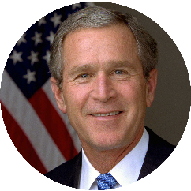
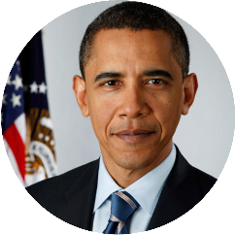

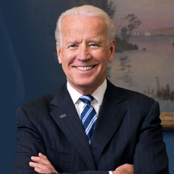
Our historical significance
Bill Clinton
1993 – 2001
Transition ~5,000 people off from public assistance each year.
Established the first public/private/government/ corporate one-stop in the country.
One of the original business partners for the nation's welfare-to-work initiative.
George W. Bush
2001 – 2009
Awarded a $1.7 million health care apprenticeship program grant, piloted in Detroit and replicated in Atlanta, Chicago, Dallas, and Indianapolis.
Began building successful partnerships with faith communities across the country.
Received the 2006 New Freedom Initiative Award from the U.S. Department of Labor.
Barack Obama
2009 – 2017
Recognized by President Obama at the 2015 State of the Union Address.
Exposed 1M+ youth to pharmacy careers.
Managed ~1,400 Public/Private Partnerships.
Opened CVS Health® Fort Bragg Talent Connect Center (TCC).
Donald Trump
2017 – 2021
Worked with U.S. Department of Education on process simplification.
Renewed commitment to hire 5,000 more apprentices by 2022.
Initiated discussions on the integration of ex-offender population as a target area for CVSH.
President Joe Biden
2021 – Present
Appointed to DOL’s Apprenticeship Ambassador Initiative
Advised on the Dept. of Commerce Quality Jobs Framework
Notes:
Partnered at the national level to launch several White House Jobs Initiatives, which established CVS Health as the distinguished model for innovative workforce programs. The Workforce Investment Act, Jobs for 21st Century, Rehabilitation Act, and the establishment of Apprenticeship USA, set the stage for the continuation of numerous award-winning workforce partnerships and alliances across the country.

Slide 8

Abilities
At CVS Health®, our Workforce Initiatives team helps to break down the barriers to employment that far too many in the disability community face. These barriers include limited access to skills training, lack of opportunity, unfounded stigmas and too often, unfairly low expectations.
We believe that skilled, productive workers with disabilities can make extraordinary contributions to our company, our economy and our society.
That’s why we offer specialized skills development programs, job training, and placement opportunities to help people with intellectual, developmental or physical impairments to access employment.
Notes:
Nearly one in four Americans has some type of disability. You may know somebody who has one and may not even realize it. People with disabilities can be highly capable contributors to our workforce. Unfortunately, the unemployment rate for Americans with disabilities is twice that of the U.S. rate overall, and it’s even higher for women and minorities with disabilities. These disparities are a detriment to our workforce at large.
Building diverse, inclusive talent pipelines that engage workers with all kinds of abilities is the right thing to do, and it makes good business sense. Our Workforce Initiatives team has spent the past two decades forging and strengthening relationships that secure meaningful employment opportunities for people with disabilities. We help individuals build a path to better health, discover new career prospects, foster independence and create a more promising future for themselves.

Slide 9

Abilities
We work with vocational rehabilitation agencies, nonprofits, government organizations and educational institutions to develop and deliver effective programs, tools and placement opportunities for job seekers, including:
Innovative Training
Resource Development
Mentoring and Job Coaching
Community-based assessments
Notes:
Innovative training: Through simulated training facilities, individuals with disabilities can get valuable, hands-on experience to prepare for real-world job experience. In collaboration with the National Consortium of State-Operated Comprehensive Rehabilitation Centers (NCSOCRC), we operate mock CVS Pharmacies that are stocked to look like the real thing. Program participants work closely with trained staff to learn about roles and responsibilities of retail and pharmacy technician positions and receive training in life and job skills like providing customer service, stocking shelves and working at the cash register.
Resource development: We pursue partnerships and innovations that make it easier for people with certain kinds of behavioral disabilities to read cues and more comfortably interact with others in a work environment.
Mentoring and job coaching: Sometimes, people with disabilities simply need perspective and support from a fellow team member who can offer encouragement and guidance.
Community-based assessments: Understanding individual needs is a strong first step in determining the best pathway to employment for many of our program participants. We work closely with community partners to identify and assess the approach that will successfully connect prospects with opportunities that work best for them. We also ensure that support systems are engaged to train, hire and retain this underutilized talent

Slide 10
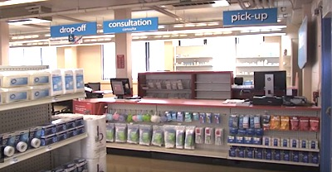
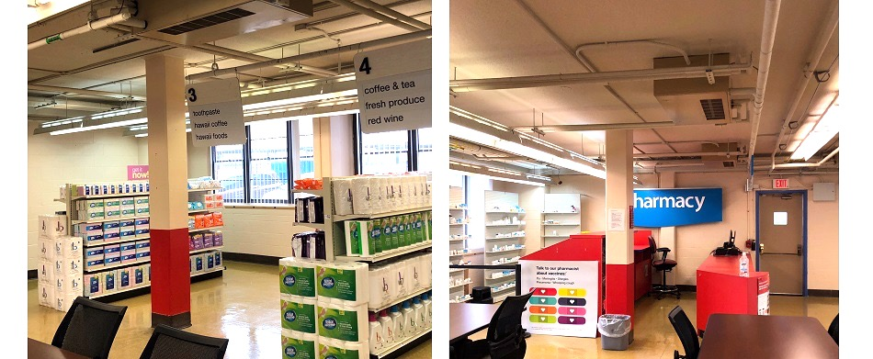
National Consortium of Rehabilitation Centers
We have a unique partnership with the National Consortium of State-Operated Comprehensive Rehabilitation Centers (NCSOCRC), A consortium of eight (8) rehabilitation centers operated by the vocational rehabilitation agency in its respective state.
The centers provide comprehensive rehabilitation services including training and employment services. Vocational training is offered onsite and/or in collaboration with a local community college and local/regional businesses.

Slide 13
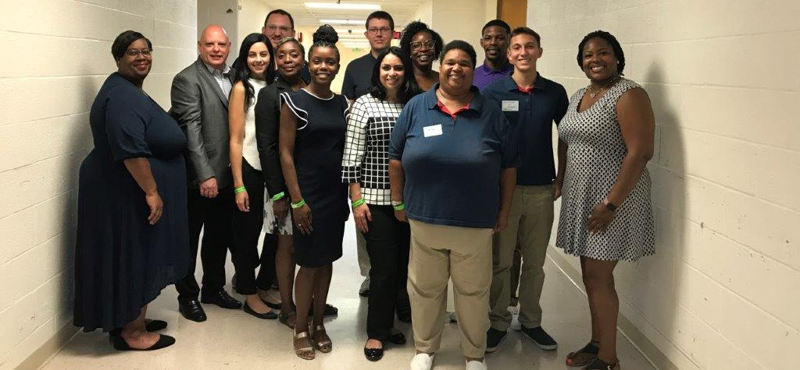
Abilities in Abundance Video Team

Slide 14
Q & A

Slide 15
THANK YOU

Slide 16
CVS Health logo on white background
  Accessibility guidance
  A title is included at the top of this slide outside of the frame.

