Slide 1



Change Through Establishing Higher Education Partnerships
April 8, 2024
PRESENTERS:
Sriram Narayanan, Professor, Michigan State University - Eli Broad Business School
Faculty Director, Center for Ethical and Socially Responsible Leadership
Supply Chain Management Department
Kathleen West-Evans, CSAVR Director of Business Relations
National Employment Team @CSAVR
Jenny Piatt, Division Director
Michigan Rehabilitation Services

Slide 2




:
Learning Objectives:
Increase partnership knowledge and cross-training opportunities between postsecondary institutions/business schools and state vocational rehabilitation.
Demonstrate collaborative projects synchronistic to mutual stakeholders ~ Our Dual Customers
Understand the value of intersectionality when building and supporting teams within VR and the business community.

Slide 3

Michigan State University-Broad College of Business
& the VR Partnership Journey
Beginnings and Benefits
Strategic partnership
Unified voice to business
Respective expertise

Slide 4
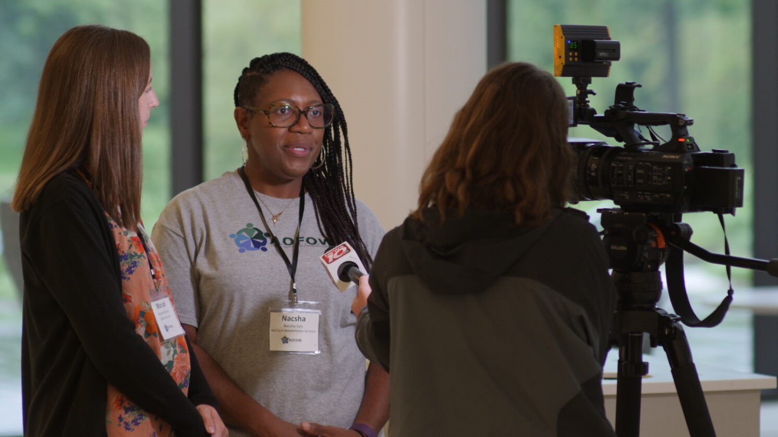
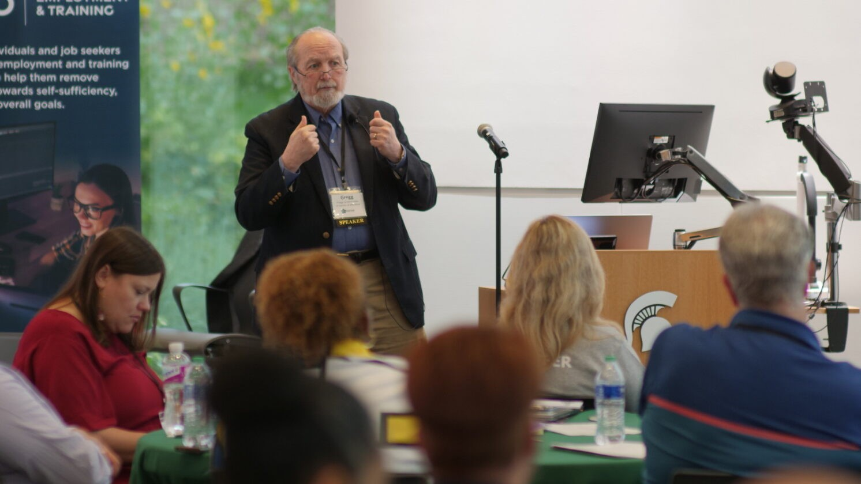
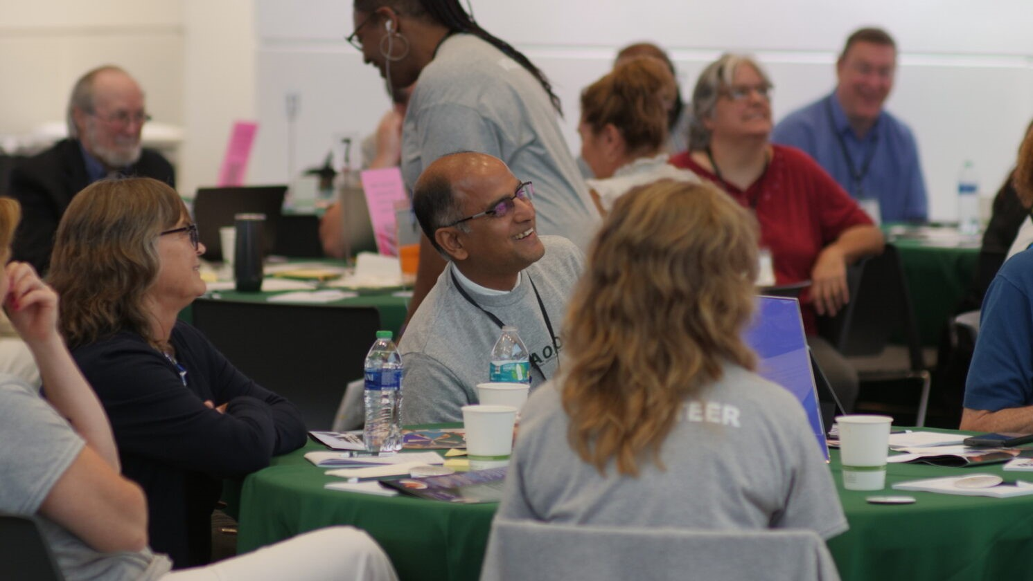

Strategic Collaboratives
CENTER FOR ETHICAL & SOCIALLY RESPONSIBLE LEADERSHIP
  Industry engagement
    Abilities, Opportunities & Future of Work (AOFOW)
  Research collaboration
    Evidence based practices
  Influencing & engaging students

Slide 5


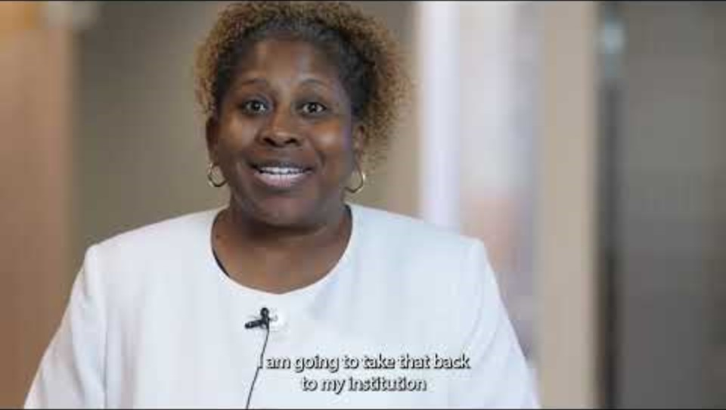
AOFOW
2023 Conference
AOFOW Conference White Paper Link: Microsoft Word - Complete White Paper Version 1 (aofow.org)
Notes:
Video: AOFOW Conference Recap – YouTube
AOFOW White Paper: Microsoft Word - Complete White Paper Version 1 (aofow.org)

Slide 6

AOFOW Podcast
AOFOW Podcasts Site
Collaboration between the Department of Supply Chain Management in the Eli Broad College of Business at Michigan State University and Michigan Rehabilitation Services
Intended to showcase best-in-class practices on burning issues related to disabilities and employment.
Conversations with employees, employers, firms, community organizations, not-for-profits and other state organizations that are doing outstanding work in integrating IWD into the workforce.
Notes:
AOFOW Apple Podcasts site: Abilities, Opportunities, and the Future of Work on Apple Podcasts

Slide 7

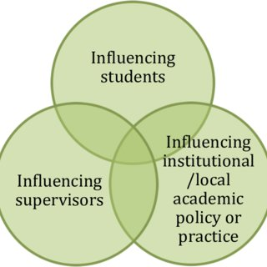




End in Mind: Building Out Your Teams

Slide 8


Questions/Thoughts/Ideas??

Slide 9

Contact Us
Kathy West Evans
Business Director
CSAVR
kwest-evans@csavr.org
Sriram Narayanan
Professor
MSU Broad College
narayanan@broad.msu.edu
Jenny Piatt
Division Director
Michigan Rehabilitation Services
248-763-6491
PiattJ@michigan.gov

