Slide 1

“Key Considerations for Maximizing Your State Plan”
Aaron Thompson, MRC, CRC
Asst. Director, Utah Combined
October 2024

Slide 2

Overview
Engage Stakeholders
Leverage Staff
Partner Collaboration
Incorporate Feedback
Monitor Progress
RSA Engagement
Financial Factors
Align with CSAVR Strategic Priorities
Key Reminders

Slide 3
Stakeholder Engagement
Engage stakeholders early and consistently, as their involvement is crucial for successful plan implementation.
Identify key informants, including:
  State Rehabilitation Council (SRC) members
  Client Assistance Program (CAP) representatives
  State and local workforce board members
  Core WIOA partners
  Community Rehabilitation Programs (CRPs)
  CSPD-related training providers
  Participants from your most recent needs assessment
  Agency staff

Slide 4
Staff Engagement
Communicate the plan's purpose across all levels of your organization, from frontline staff to leadership.
Include staff in the goal development process to increase buy-in.
Activities to consider:
  Share and discuss the results of your CSNA with staff.
  Solicit feedback from staff on potential goals and priorities.
  Determine if a staff focus group would be beneficial.
  Identify opportunities for local staff to directly contribute to meeting the goals and priorities.
  Develop work groups to support implementation and follow-up activities.
  Utilize this as a professional development opportunity for interested staff

Slide 5
Gathering & Incorporating Stakeholder Feedback
Host Public Meetings or Virtual Town Halls
Collect Feedback through Surveys
Engage the State Rehabilitation Council (SRC)
  Dedicate meeting(s) to plan development activities
Incorporate Input from the Client Assistance Program (CAP)
  Review trends and issues identified over the last two years
Conduct Focus Groups or Meetings with Providers/CRPs
Facilitate Staff Feedback Sessions or Small Focus Groups
Use Iterative Feedback Loops
  Share drafts with key stakeholders for further review and refinement

Slide 6
Coordinating with WIOA Partners
Collaborative Planning Committees:
  Engage early in the process to identify overlap and align goals and strategies.
  Schedule regular meetings to discuss shared priorities, challenges, and coordination throughout the year.
Data and Resource Sharing:
  Share data and resources to support integrated service delivery and informed decision-making.
Joint Stakeholder Engagement:
  Collaborate on stakeholder engagement activities to gather unified feedback across WIOA programs.
Coordinate Draft Reviews:
  Share drafts with core partners for review to ensure alignment and avoid working in isolation.
Incorporate Partner Feedback:
  Actively include feedback from WIOA partners to shape the final plan.
VR Representation on Workforce Boards:
  Ensure VR representation in local and state workforce development board meetings for continuous coordination.

Slide 7
Following-Up on Feedback & Questions
Summarize Key Feedback
  Share feedback at SRC meetings to ensure transparency and understanding.
Offer Follow-Up Opportunity
  Provide stakeholders a chance for further discussion if specific concerns or questions arise.
Clarify Next Steps
  Inform stakeholders how or if their feedback will be incorporated
  Public Comments: may or may not influence final decisions
Distribute Final Plan
  Ensure the final plan is broadly shared with stakeholders.
Maintain Open Communication
  Keep communication channels open updates

Slide 8
Tracking and Monitoring Progress
Assign Staff/Teams to Each Goal
  Allocate specific staff members to each goal for focused accountability.
Establish Metrics and Benchmarks
  Define clear, measurable indicators for tracking progress.
Provide Quarterly Updates
  Use a shared tracking document for ongoing updates and transparency.
  This will also simplify the process of completing the two-year update.
Conduct Regular Progress Reviews
  Schedule consistent evaluations to assess advancement toward goals.

Slide 9
Tracking and Monitoring Progress
Evaluate Progress and Barriers
  Analyze achievements and identify obstacles to success.
  What are your one-year milestones?
Share Updates Widely
  Communicate progress at SRC and workforce board meetings.
  Identify opportunities to staff updates with staff
Highlight Accomplishments and Successes

Slide 10

Your State Plan & RSA Engagement
Schedule a Virtual Meeting
  Set up a virtual meeting to discuss any questions or feedback from RSA.
Align with Corrective Action Plans
  If you were recently monitored, identify how your state plan goals or activities align any CAP activities
Review MTAG
  If you are scheduled for monitoring, assess how your plan aligns with the Monitoring and Technical Assistance Guide (MTAG).

Slide 11
Your State Plan & RSA Engagement
Highlight Innovative Practices
  Identify any innovative practices or initiatives in your plan that you want to showcase during your onsite visit.
Identify Technical Assistance Needs
  Determine any technical assistance that RSA or a Technical Assistance Center (TAC) could provide to support your agency in achieving your state plan goals.

Slide 12
Other Considerations: Financial
Increased Costs for Goals & Priorities
  Are there additional costs tied to your goals and priorities?
  Do they require technology additions or enhancements?
Costs for CSPD Plan
  Staffing Cost Projections: What are the projected costs to meet staffing needs over the next five years?
  Training and Development Costs: Are there costs for staff training and professional development?

Slide 13
Other Considerations: Financial
Are you requesting Title VI funds for supported employment services?
Do your annual estimates accurately reflect referral trends?
Are you validating service cost estimates based on disability priority categories?
If considering an Order of Selection, do you have the necessary policies and procedures in place?

Slide 14

Alignment with CSAVR Strategic Priorities
Priority 01: Recruitment and Retention Goals & Priorities
Strengthen the Comprehensive System of Personnel Development (CSPD).
  Build connections with educational institutions, professional associations, and utilize technology and social media to attract individuals to the profession.
  Address the training and professional development needs of both new and existing staff.
Explore available and allowable resources to support staff compensation and retention efforts,

Slide 15
Alignment with CSAVR Strategic Priorities
Priority 02: Redesign and Streamline Internal Processes
Goals, Priorities and Strategies
  Ensure goals include improving processes that may hinder eligibility determination and rapid client engagement.
  Incorporate activities aimed at enhancing provider capacity and skill levels.
  Identify opportunities to leverage technology to achieve organizational goals.
Innovation & Expansion
  Consider utilizing funds reserved for innovation and expansion activities to support these efforts.

Slide 16
Alignment with CSAVR Strategic Priorities
Priority 03: Increase Public Awareness of VR Services
Goals, Priorities and Strategies
  Do any of your goals focus on increasing access to services for underserved populations?
Coordination with Education Officials, Employers and Other Agencies
  Can your partners help expand outreach and visibility of VR services?
  Do you have an effective SEA agreement that supports these efforts?
  Are you maximizing your business relations network?

Slide 17
Lessons Learned and Reminders
Involve staff across various levels
Assign leads to ensure accountability
Engage stakeholders from the beginning
Align with existing priorities and initiatives
Set measurable, skill-based objectives
Schedule regular check-ins throughout year
Consistently track progress and challenges; be prepared for the two-year modification

Slide 18
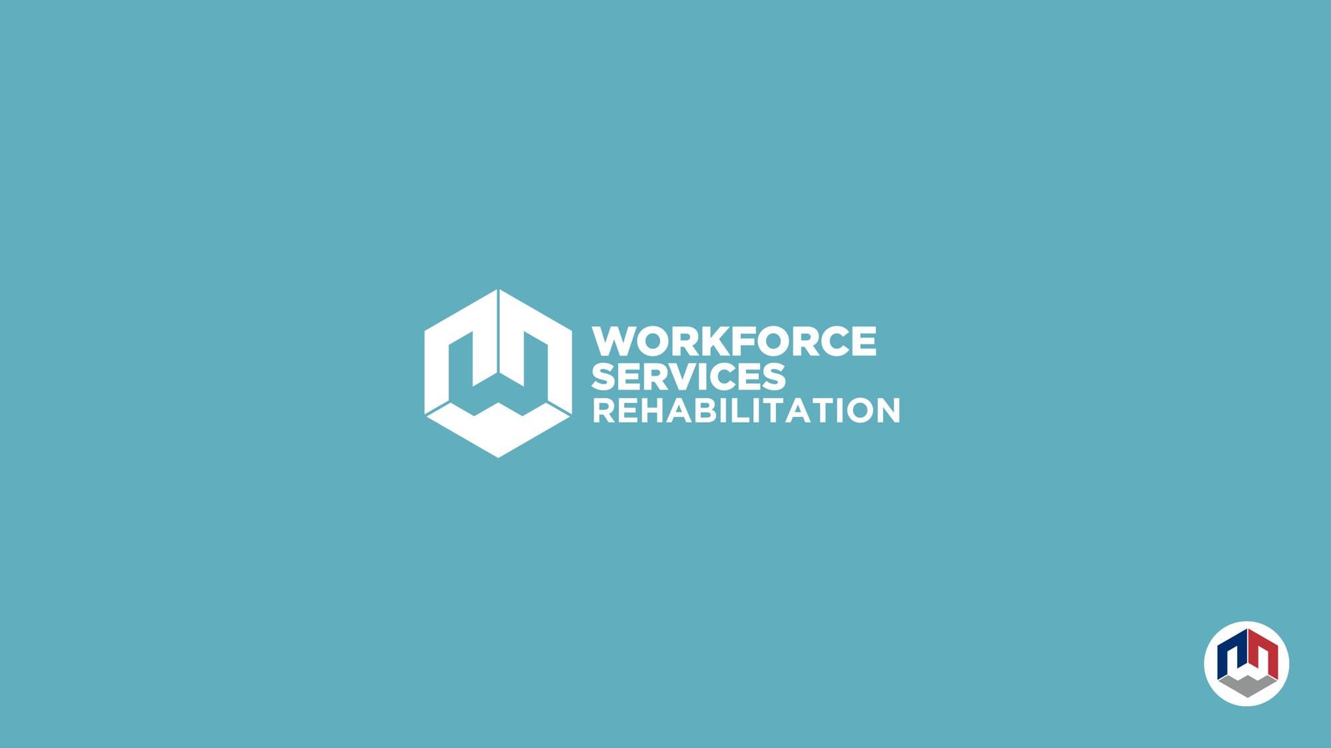
Aaron Thompson, Assistant Division Director
Utah State Office or Rehabilitation
athompson@utah.gov
801-887-9511

