Slide 1
Reducing Burden on Direct Service Staff
Kristen Mackey, Director, Arizona, Presiding

Slide 2
Panel Members
  Joe Xavier, Director, California Combined
  Mark Erlichman, Deputy Director, California Combined
  Kelly Hargreaves, Chief Deputy Director, California Combined

Slide 3

WHERE TO BEGIN in reducing burden

Slide 4


Slide 5
2 Minutes X 5 Days X 52 Weeks X 200 Staff = One Full Time Position

Slide 6
Reducing Administrative Burden
Administrative burden is work that is required by laws, regulations, policy or established procedure that doesn't contribute to the output of a business.
Administrative burdens can be a distraction, cost, delay and source of uncertainty, risk and stress.

Slide 7




Expedited Enrollment
recognize the counselor as “expert”
avoid unnecessary evaluations
collection of information we will never use
Avoid additional appointments
Reduce maintenance of highly confidential records (medical records)

Slide 8
Specialization/ Internal resources
Counselors specialize but still have direct access needed resources.
  Work Incentive Planners: Consumers are clear on the impact on their benefits from earned income. Make informed decisions.
  Business Specialists: Job search/preparation before authorizing and having to do authorizations, etc., for individuals who might not be ready, or only need some limited support.
  Service Coordinators: Request services determined necessary by counselor and input RSA required data at times

Slide 9
Electronic Signature
Identify and put out policy for e-signatures, but then go further,
find a way to eliminate unnecessary signatures, and better yet,
eliminate forms that we really don’t need

Slide 10
Projects and Initiatives
Automated Information By Phone
  Example of methods of providing information/ more self-directed/ after-hours
  Student services teams- Time keeping easier, training for a few rather than for every unit, simplify documentation/case management

Slide 11
System Navigator
Systems Navigator- Assists applicants and consumers obtaining the support and resources they need to succeed and address needs that could keep them from effectively participating.
Intended to:
  reduce unsuccessful closures
  conserve VR funds for employment-services (Child-care, health care, financial support (GA), housing assistance, reduced transit fares..etc.)
  Staff do not have to authorize those services, and don’t have to spend time to support “emergency” needs

Slide 12
Portals – Vendor and Consumer
Working on Vendor and consumer portals- Paperless expedites procurement and payment
Made a compelling case and received state funding from our DOF
Notes:
Paperless, expedites procurement and payment (no mail, no extra data-entry, vendors and consumers can check the status of their authorizations/services, automates verification of receipt of goods and services, clear communication and information sharing- no emails no copy/paste)
We provided enough evidence of the negative impact of current burden to get 100% state funds. Almost unheard of.

Slide 13


Slide 14
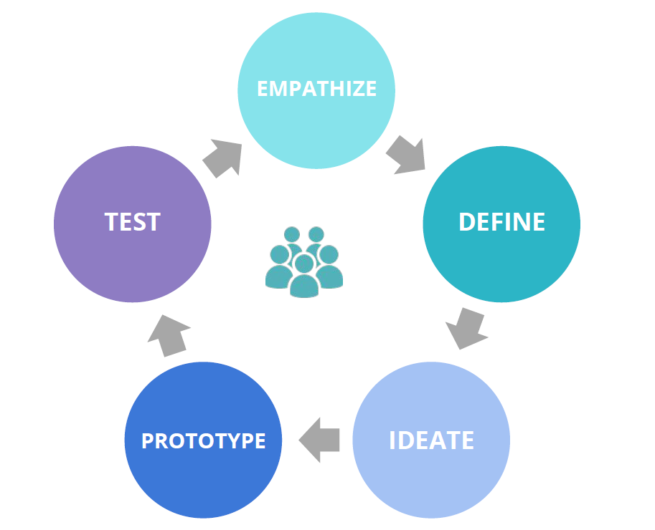
Our Innovation Engagement Model
Notes:
The engagement model is based on a human centered design approach. Team members come together to participate in several fast-paced workshops intended to explore current challenges and ideate possible solutions. The goal is for every team member to have a voice and to contribute from their individual perspective. It is critical to begin the journey by understanding the internal and external customer experience through empathy and compassion.

Slide 15

Engaging With Your Staff for Solutions
Discovery Based on Problem
  Data dive
  Policy research
Workshop 1: Discovery
  Empathy Mapping
  Break Out Interviews
  Journey Mapping
  Persona Brainstorming
Workshop 2: Ideation and Solutioning
  Discovery Review
  Sketching solutions
  Dot voting on solutions
Notes:
In response to this significant delay in the intake process, team members from the Strategic Initiatives Office (SIO) and Program Policy Implementation (PPI) were asked to engage Inland Empire staff to determine the causes of the intake delays and identify innovative concepts that may help address the service delays. Additionally, the San Diego District DOS team manager and a team manager from Orange/San Gabriel District joined the core engagement team.

Slide 16
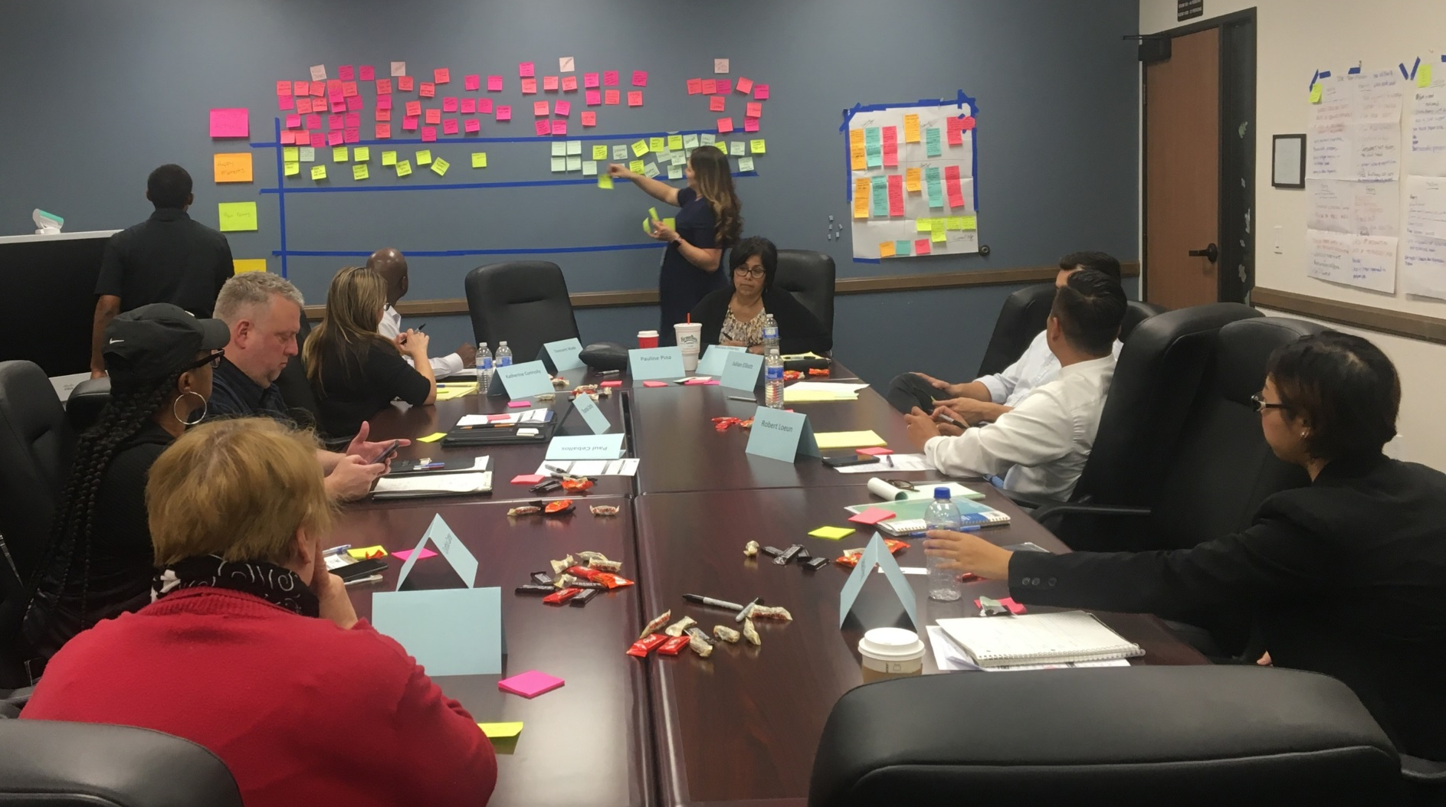
Discovery: Journey Mapping
Notes:
Team members visited the IE District in December 2018 and January 2019 to discuss the challenges being experienced and brainstorm potential opportunities to address the service delivery challenges. IE staff mapped out the journey interested individuals experienced from indicating an interest in receiving services to a point of enrollment.

Slide 17
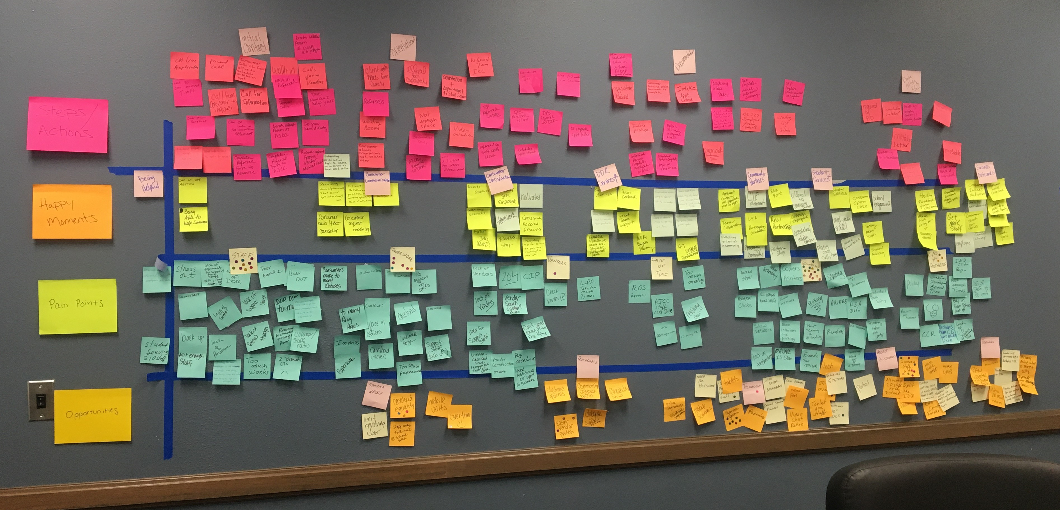
Discovery: Journey Mapping
Work flow, happy moments, pain points, and opportunities
Notes:
The team identified several pain points and happy moments in the service delivery process.

Slide 18
Empathy Mapping
How Do Consumers Feel?
frustration
Ignored
Overwhelmed
Anxious
Confused
Angry
Frustrated
Don’t care
Poor customer service
Emails/calls ignored
Don’t understand

Slide 19
Pain Points: VR Service Delivery
Technology
Lack of and outdated
Slow network connectivity
Lack of mobile capability – access, printing
AWARE isn’t user friendly – slow, time consuming
Need e-signatures
Staff
Lack of management capacity/ability to manage resources
District boundaries/region
Lack of support staff
Lack of proper training
Inconsistent processes
Uneven caseload sizes
Poor morale/staff burnout
Paperwork/Outdated Processes
Paperwork intensive and redundant
Policy lacking clarity / too many grey areas
Revolving door of consumers
Lack of consumer financial participation

Slide 20
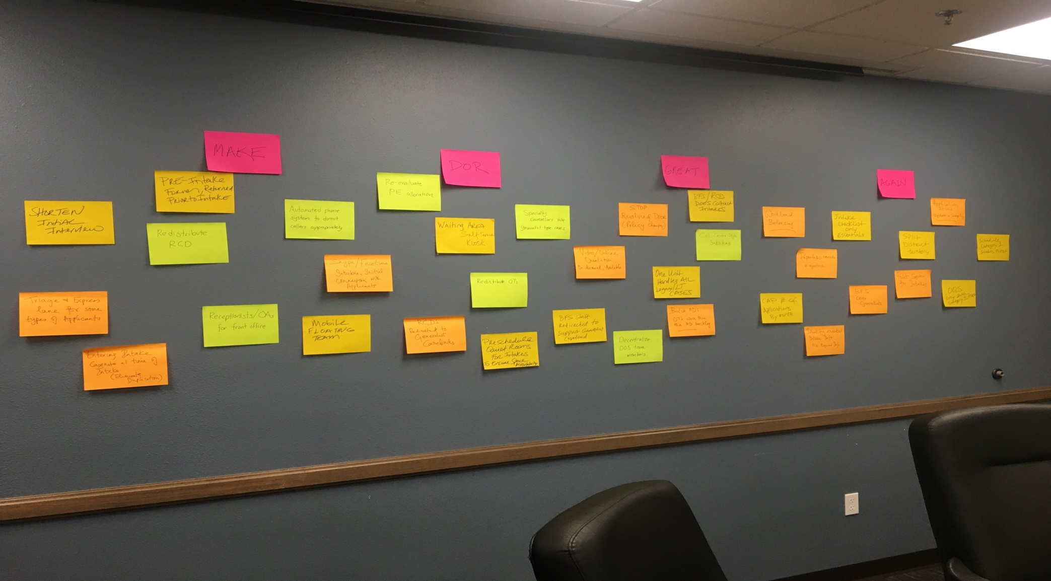
Next Step – Ideation
Some Great Ideas from the Team
Notes:
IE staff brainstormed ideas as potential solutions to diminish service delays and prevent a backlog from happening again. Some ideas included using tele-counseling instead of in-person meetings, automating DOR’s phone system, and a portal to provide status updates of application, orientation, and intake repository for files.

Slide 21
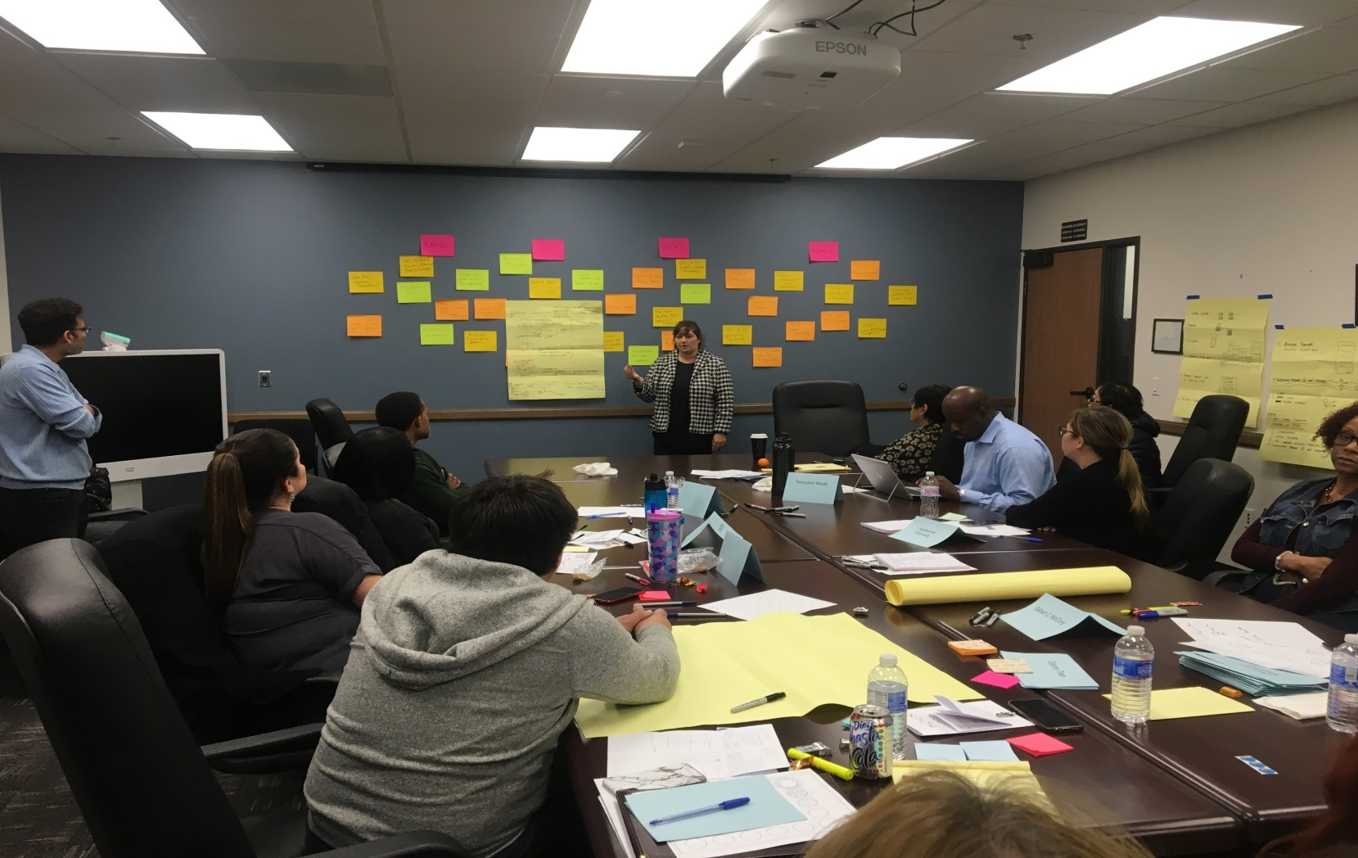
Solutioning
Notes:
The team worked in groups to narrow down the variety of possible solutions and visually depict what some of the solutions would look like if implemented.

Slide 22
Questions?
Notes:
Some questions for the moderator to ask us:
Q: What kind of obstacles do you face when trying to foster and support innovation?
A: Entrenchment- want to maintain the status quo. People like change, unless it is happening to them. Secondly, fear of negative consequences (take away from consumer services), and Risk aversion- want to “feel” safe.
Q: How do you mitigate the fact that most people do not want risk?
A: Be willing to accept the risk for them- demonstrate that leaders take credit for nothing except the mistakes/failures. Call “failures” learning opportunities; and celebrate failure. Easy to celebrate wins, but that’s not when staff need the encouragement or support, it’s when things didn’t work.
Q: Ask the audience for examples of things they have done or are planning to do

