Slide 1

Omar and the Fork in the Trail

Slide 2
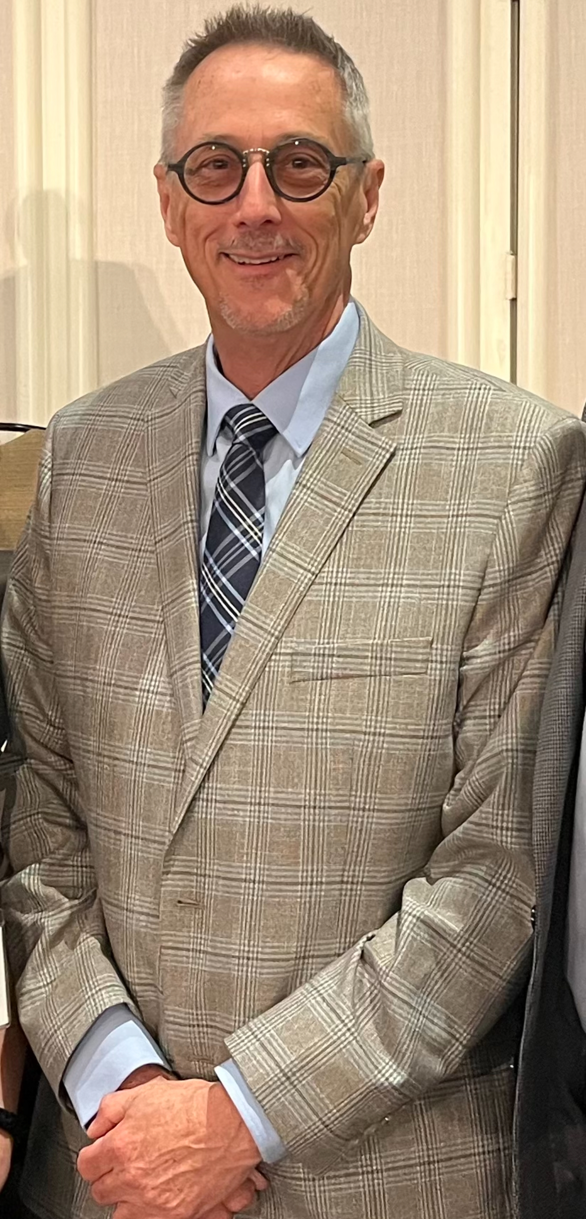

Slide 3


Slide 4
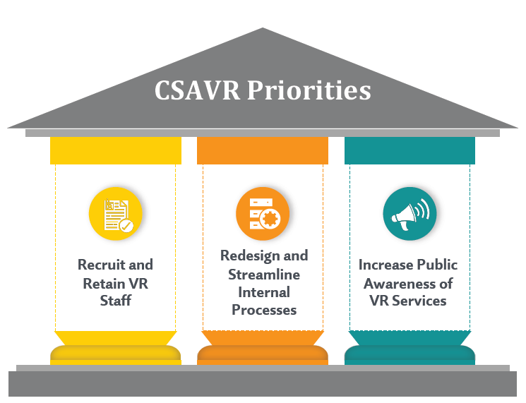
Strategic Priority Workplan
Theme:
“Increase Capacity and Reduce Complexity”

Slide 5
Workplan: Increase Capacity and Reduce Complexity
Successful Fall Conference
RSA published TAC 24-01
Mark Schultz: Workplan Framework
Added resource: Antoinette Williams
Partnership with Harkin Institute
CRP Survey
Mathematica/Transcend study

Slide 6
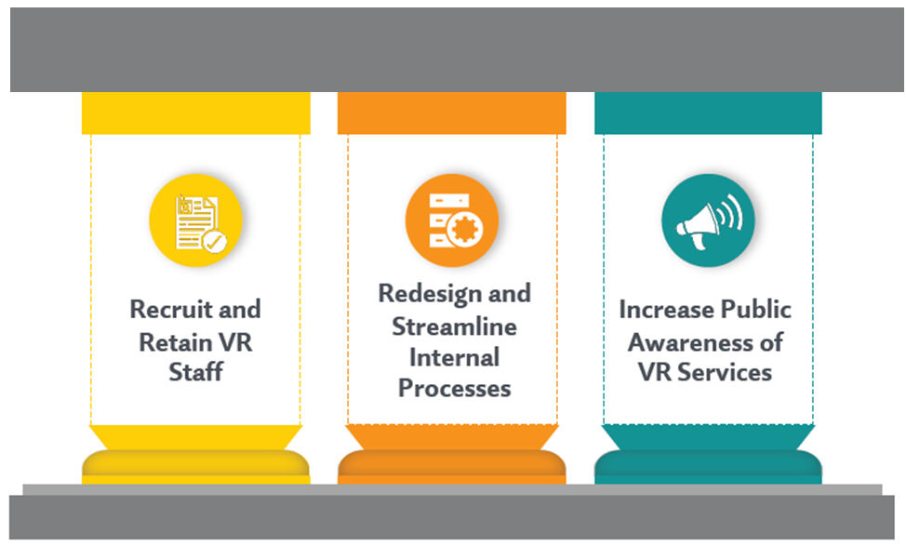
The Three Infrastructure Pillars
Consumer Services
Employers
Partnerships
Stakeholder Perceptions

Slide 7


Slide 8
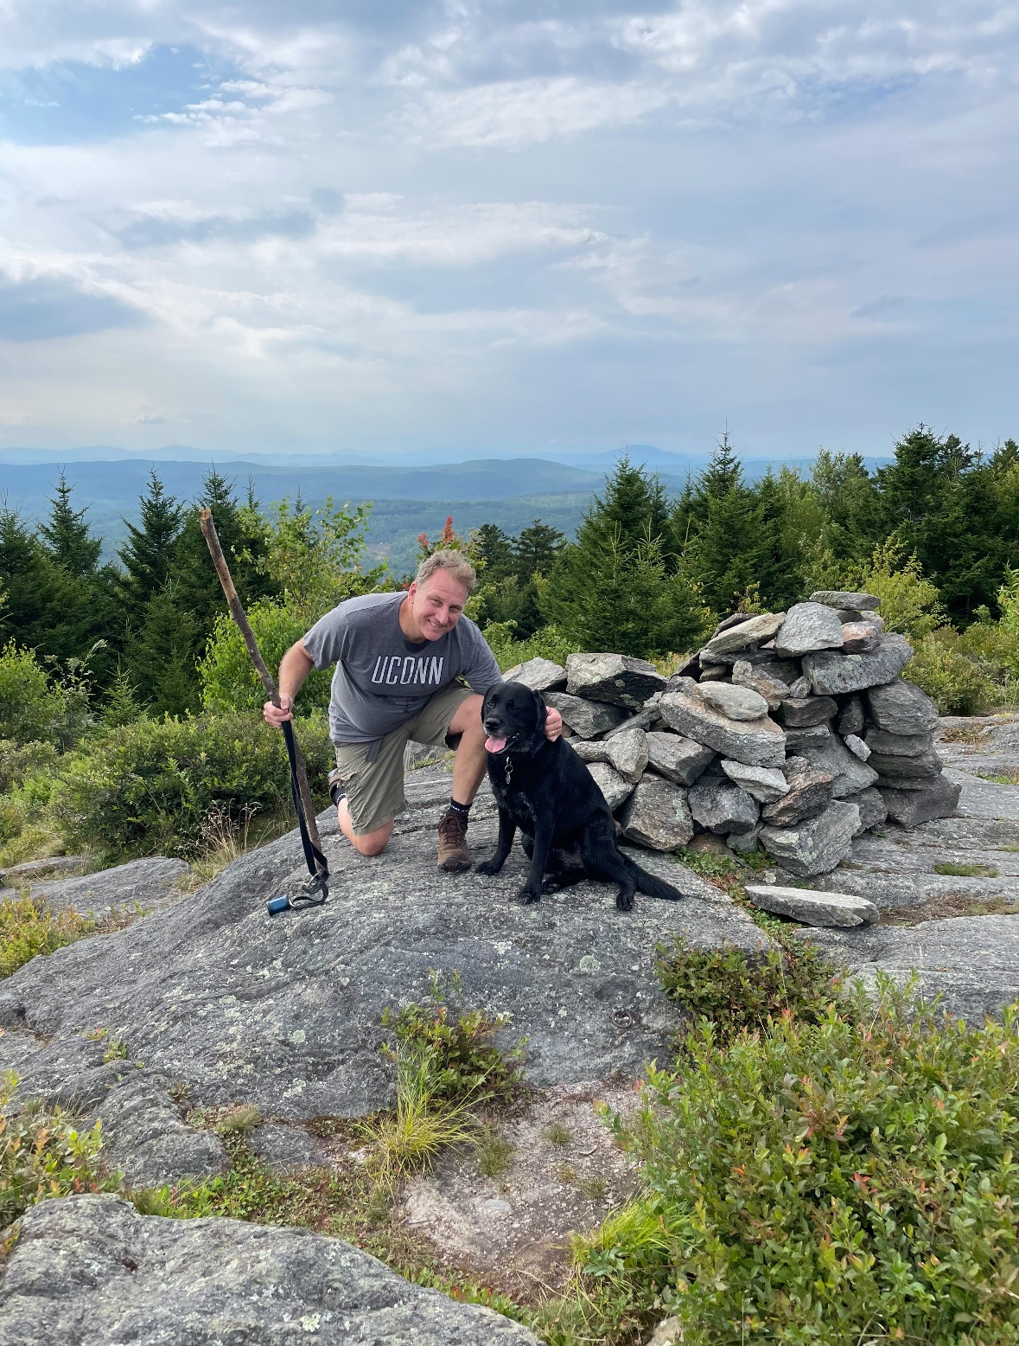

Slide 9


Slide 10


Slide 11
Vision
What drives our work?
We believe in people. Everyone has the ability to work and contribute to our economy.

Slide 12
Message 1
What is exactly that you say the program does?
Vocational Rehabilitation helps people get their first job, maintain their current job, and earn the job of their future.

Slide 13


Slide 14
Message 2
How did you go about accomplishing such a lofty objective?
  Vocational Rehabilitation scales its impact and drives results through collaboration and partnerships

Slide 15
Message 3
Why is your program a good investment for the future?
Vocational Rehabilitation futureproofs the workforce in a complex economy by ensuring businesses have their talent needs met.

Slide 16
Call to Action
OK, so now what?
Get prepared to tell your program’s story.
What are your proof points?

Slide 17
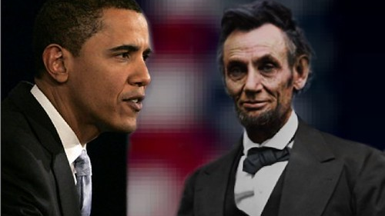

Slide 18
