Slide 1
ReDefining Apprenticeship
Apprenticeship Overview
Examples of VR led models:
Maine Bureau of Rehabilitation Services
Iowa Department for the Blind
Missouri Vocational Rehabilitation
Notes:
Nikki

Slide 2
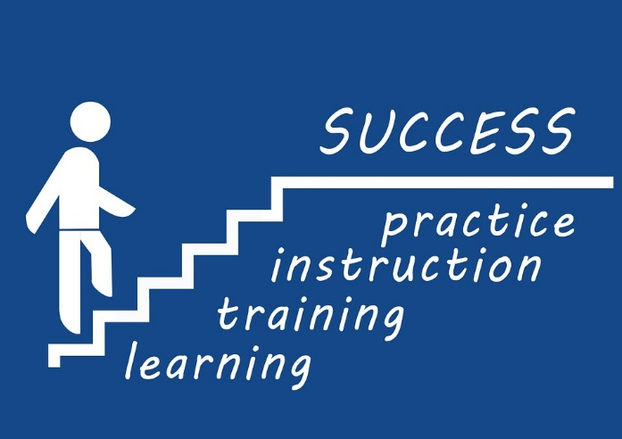
What is Apprenticeship?
Apprenticeship: A structured occupational training program that combines on-the-job training and related instruction in which workers learn the practical and conceptual skills required for a skilled occupation, craft or trade.
Notes:
Registered Apprenticeship is a proven model of job preparation that combines paid on-the-job training (OJT) with related instruction to progressively increase workers’ skill levels and wages. It is also a business-driven model that provides employers a way to recruit, train, and retain highly skilled workers. It allows employers to develop and apply industry standards to training programs, thereby increasing productivity and the quality of the workforce.

Slide 3
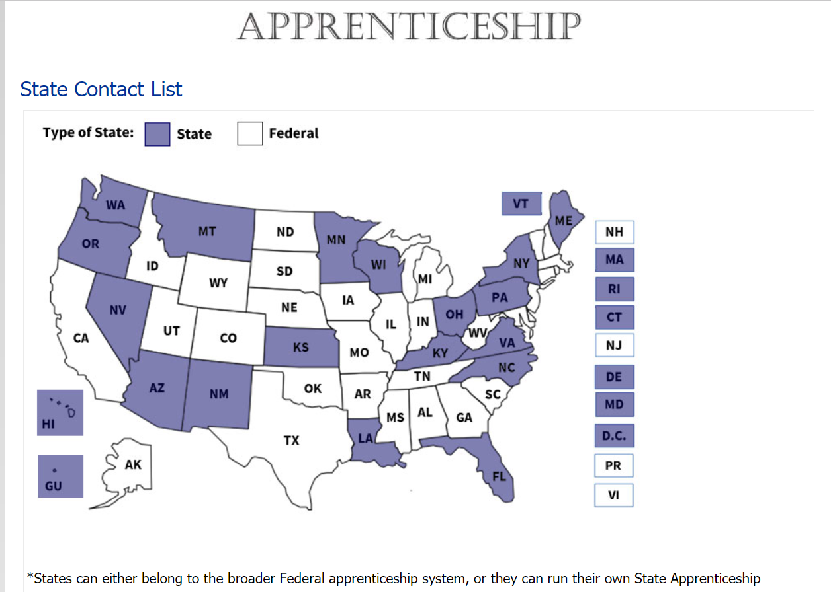
State or Federally Run Programs
Programs can be registered by the US Department of Labor or by State Apprenticeship Agencies that are recognized by the Department of Labor.

Slide 4
Registered Apprenticeship: A Proven Strategy for Success
Registered Apprenticeship (RA) is a proven workforce strategy that can help SVRAs meet the needs of businesses and workers and fully achieve the vision of WIOA.
The critical strategies that are called for in WIOA, such as sector strategies and career pathways, are at the heart of the apprenticeship model.

Slide 5
Win-Win on Performance
Registered Apprenticeship is a win-win for all of the WIOA Primary Indicators of Performance.
Employment Rate 2nd Quarter after Exit
Employment Rate 4th Quarter after Exit
Median Earnings 2nd Quarter after Exit
Measurable Skill Gains
Credential Attainment
Effectiveness in Serving Employers
Notes:
Registered Apprenticeship is employment and registered apprentices earn a wage from day one. Registered Apprenticeship programs include skill gains throughout the process that can be applied to the Measurable Skill Gains indicator. The Registered Apprenticeship Completion Certificate is a recognized post-secondary credential that supports the Credential Attainment indicator. As previously stated, registered apprenticeship is a business driven model so provides for effectiveness in serving employers.

Slide 6
Promoting Inclusion of Individuals with Disabilities in Registered Apprenticeship
Apprenticeship EEO Final Rule:
The updated EEO regulations are designed to open more doors to apprenticeship for all workers, including women, minorities and individuals with disabilities.
29 CFR 30.7: Establishes utilization goals for individuals with disabilities.
(a) Utilization goal. The Administrator of OA has established a utilization goal of 7 percent for employment of qualified individuals with disabilities as apprentices for each major occupation group within which the sponsor has an apprenticeship program.
Sponsors will invite apprentice applicants and hires to self-ID as having a disability, use this data to measure its outreach and recruitment efforts.
https://www.doleta.gov/oa/eeo/
Notes:
Apprenticeship sponsors must:
Refrain from discrimination, including new protected bases
Update, post, and disseminate the Equal Employment Opportunity (EEO) pledge
Post information about how to file complaints of discrimination with the appropriate apprenticeship registration agency
Begin universal outreach and recruitment efforts, including creating a list of organizations that can be sources of referrals of a diverse pool of apprenticeship applicants
Implement anti-harassment measures, including provide anti-harassment training
Use any selection procedures they choose, as long as those procedures are not unlawfully discriminatory

Slide 7
Myth Busters!

Slide 8
Myth #1
Myth: Registered Apprenticeships (RA) are only for the construction industry and are Union based.
Fact: There are more then 1,400 Federally recognized apprenticeable occupations. Most RA programs are non-union
The industry sectors are diverse:
Healthcare
Advanced manufacturing
Aerospace
Information Technology
Cybersecurity
Law enforcement
Education
Business Services

Slide 9
Examples of Federally Recognized Apprenticeable Occupations
Biomedical equipment technician
Butcher
Cable splicer
Dairy technologist
Tool and die maker
Veterinary Technician
Glass Eye Maker
Floral designer
Arson Investigator
Animal Trainer
Laboratory assistant
Machinist
Engraver
Able seaman
Chef
Child care development specialist
Dental assistant
Dog Groomer
Over 1,400 occupations

Slide 10
Myth #2
Myth: Registered Apprenticeship is just training -- it isn’t a real job.
Fact: Apprenticeship is employment from day one.
Apprentices earn competitive wages, a paycheck from the first day of employment and incremental raises as skill levels increase.
https://www.apprenticeship.gov/

Slide 11
Myth #3
Myth: Apprentices can’t earn college credit.
Fact: Apprenticeship opportunities combine on-the-job training and job-related instruction, provided by apprenticeship training centers, technical schools, community colleges, and other educational institutions. Apprenticeship sponsors often work directly with two and four-year colleges to structure the program so apprentices earn college credits.

Slide 12
Myth #4
Myth: Registered Apprenticeship is a time-based system that is too rigorous for many VR participants.
Fact: There are competency-based programs, and combination or “hybrid” programs that combine competency-based and time-based. Competency-based programs provide opportunities for special populations who perhaps need additional time to attain proficiency in an area.

Slide 13
Myth #5
Myth: Apprenticeship doesn’t benefit the employer.
Fact: There are NUMEROUS benefits to employers who have registered apprenticeship programs. It is a flexible training strategy that can be customized to meet the needs of any business. Apprentices can be new hires or current employees. Documented benefits include reduced turnover, increased productivity and safety, lower costs for recruitment and increased diversity.
The return on investment (ROI) is impressive.
[The first ROI study for employers was conducted by the Canadian government; the Canadian apprenticeship system is similar to that in the United States. However, that study was replicated by Houston Community College (in 2016), and the results were replicated (i.e., for every $1 spent by employers, there was a $1.50 return).]

Slide 14
Maine Bureau of Rehabilitation Services
Peter Diplock Assistant Director Division for the Blind and Visually Impaired

Slide 15
Maine: Why Apprenticeship?
Historically Underutilized
Not well understood within ME BRS
Maine BES received Federal Grants to expand apprenticeship
Maine BES able to register Apprenticeships
WIOA 7% persons with disabilities requirement
Recognition that apprenticeship vs traditional training has significant benefits for our clients

Slide 16
Maine: Getting Started
WINTAC: One of four areas we identified as needing technical assistance
WINTAC Training March 29: Combined BRS leadership and BES Apprenticeship Staff
Lewiston Pilot: Hospitality/Food Service. Monthly Meetings
Hospitality Maine
Apprenticeship Cross-State Peer Phone Conferences
Internal training

Slide 17
Maine: Progress to Date
Resource Sharing BES/BRS
SharePoint
Schedule of Work/Regional Registered Apprenticeship Sponsors
Competitive Skills Scholarship Program
Passports
Procedural Directive
Defined roles, processes, timelines
Statewide Rollout

Slide 18
Maine: Pros and Cons
Challenges
Apprenticeship is not well understood
Staffing at BRS/BES and within Apprenticeship Team
Lack of available registered apprenticeship in some regions
Employers understanding of disability and BRS
Successes
Strengthened BES/BRS collaboration
Learning from other states
Increased apprenticeships
Increased employer understanding of disability/BRS

Slide 19
Maine: Partners
WINTAC
Pennsylvania, Iowa, Vermont VR Programs
Hospitality Maine
Maine Community Colleges
Employers
Maine Apprenticeship Program

Slide 20
Maine: Shared Learning
No need to reinvent the wheel -- many states have great tools/processes.
VRC’s role is to provide talent -- the team takes it from there.
Employers are learning as they go just as we are.
A lot was learned through use of pilot.
Communication with partners is key.
Time and staff commitment

Slide 21
Iowa Department for the Blind
Emily Wharton, MFA CPM Director, Iowa Department for the Blind

Slide 22
Why Apprenticeship?
More viable earn-and-learn work options
More options to long-term employment and careers

Slide 23
Getting Started
Met with Region 10 in Cedar Rapids to discuss this potential partnership
Iowa Department for the Blind
IowaWORKS
Registered Apprenticeship Program Coordinator
Title I Director and Case Manager
Title III Operations Director and Business Marketing Specialist
WINTAC
Great fit with American Job Centers and employers
Created a plan and outline of expectation, determined roles and responsibilities that would set us up for success

Slide 24
Challenges and Successes
Challenges:
Ensuring technology is in place prior to start of training
Thought we had what was needed, but on the day of training, the screen reader did not work properly
Successes:
Having businesses willing to listen to what client’s needs are and how to make them work in their business model
New collaboration for IDB
Goal = 3 clients in a registered apprenticeship by June 2020

Slide 25
Voices from Iowa
Link to Video from Iowa; https://zoom.us/recording/share/jH7mtVgjtys0tQrfsqiNXTKzFH3v5X__wAbA8u-o_QewIumekTziMw?startTime=1571951898000
Amy Beller – IowaWORKS - Statewide Registered Apprenticeship Coordinator
Kochell Weber – Iowa Department for the Blind – Employment Specialist

Slide 26
Missouri Division of Vocational Rehabilitation
Kimberly Gee, MS, CRC, LPC Assistant Field Operations Manager Missouri Vocational Rehabilitation

Slide 27
Missouri’s Story
Link to Missourri video: https://zoom.us/recording/share/QOK6Pf_dXEVcplIHYuK3tSihgobiOVgXesOcn2VBcwGwIumekTziMw?startTime=1571678976000
Kim Gee, Assistant Chief of Field Services Missouri VR
Notes:
Link to video: https://zoom.us/recording/share/QOK6Pf_dXEVcplIHYuK3tSihgobiOVgXesOcn2VBcwGwIumekTziMw?startTime=1571678976000

Slide 28
Questions

Slide 29
Resources
Apprenticeship Sponsor database by location
JDVRTAC guide to pre-apprenticeship
Step-by-Step Apprenticeship Implementation Guide for VR agencies
Apprenticeship Works Video Series
Fact Sheet on updated EEO regulations that pertain to Apprenticeship
ApprenticeshipUSA Toolkit
Apprenticeship and VA benefits
Leveraging partners: WIOA authorized use of Title I funds for apprenticeship
WINTAC Career Pathways Community of Practice
Apprenticeship Fact Sheet
Notes:
Nikki

Slide 30
Contact
Nikki Powis, WINTAC
National Disability Institute
(907) 957-4702
npowis@ndi-inc.org
www.wintac.org
Notes:
Introductions

