Slide 1
Vermont Response to WIOA Requirements: Pre Employment Transition Services
CSAVR Conference
November 3, 2015

Slide 2
What Will Be Covered
The scope of the challenge
The overall strategic approach to PETS
Programmatic design
Initial Implementation
Where we are now

Slide 3

Pre-Employment Transition Services

Slide 4
Pre-Employment Transition Services
Most dramatic shift in VR program in 30+ years
Requires VR agencies to spend 15% of their federal award on PETS required and authorized services
15% does not include administrative costs so actual financial impact is greater
Effective immediately in FFY 15

Slide 5
Impact of Pre-Employment Transition Services Requirement in Vermont
Total VR Title I award for FFY16 = $14.8 million
Total that can only be used for PETS = $2.2 million
Prior to FFY15 Vermont VR only spent about $0.5 million on PETS services primarily through the VR Transition Counselors (who served both in-school and out-of-school youth)
So we knew we had to shift about $1.7 million in service dollars…and we had to do it right away

Slide 6

So we were a little freaked out

Slide 7
Vermont Strategic Approach
Embrace the Congressional intent: try to build the best possible Pre-Employment Transition Services program possible
Be strategic about reassignment of resources to support the best possible outcome
Be transparent with our staff and partners about the change
Acknowledge that there are winners and losers involved with such a dramatic shift in resources

Slide 8
Vermont Strategic Approach
Lifespan Specialization in Services
If we were going to invest 15% or more of our resources in high school students, we wanted to make sure when they graduated there was VR capacity to serve them
Therefore, Vermont invested an equivalent amount of resources in youth post high school exit… otherwise the investment in PETS would be wasted
We recognized that youth/young adult VR services are qualitatively different and we needed to design the program accordingly

Slide 9
Vermont Strategic Approach
Lifespan Specialization in Services
20% of VR counselor capacity assigned to PETS serving exclusively high school students
20% VR counselor capacity assigned to youth or young adult services after high school exit (18-27)
60% of VR counselor capacity serving adults (27+) including Rehab Counselors for the Deaf

Slide 10
Vermont Strategic Approach
Lifespan Specialization in Services
Community Rehabilitation Services (CRP)
We assigned CRP capacity to match our counselor capacity
  Youth Employment Specialists partnered with In-School VR Transition Counselors
  Young Adult Employment Specialists partnered with Youth and Young Adult VR counselors
  Adult Employment Specialists partnered with Adult VR counselors

Slide 11
PETS and Supported Employment
VR ended a 30-year funding commitment to Adult Mental Heath supported employment.
VR shifted those resources to youth supported employment in the children's mental health system (JOBS Programs)

Slide 12
PETS and Supported Employment
DVR has a more than 30-year commitment to SE for adults with developmental disabilities ($1.3 million)
Reassigned 15% of the individual contracts to Developmental Services providers to PETS services
Our goal is to have SE capacity in the schools to create a better “on ramp” for students with developmental disabilities to the Developmental Services System

Slide 13

Implementation

Slide 14
Implementation: Empowering Staff to be Part of the Process
Leadership made the big strategic decisions because this was a mandate not a choice
However, we aggressively involved staff in how to implement. To do this we:
  Over-communicated with VR staff and partners: used video conferencing, webinars, hard copy memos, in-person meetings
  Complete transparency about the plan, provided multiple avenues for feedback around implementation
  Caseload reassignment to Transition, Young Adult and Adult was driven by counselor’s expressed preferences

Slide 15
Implementation:
Building on Existing Strengths
Focused on our strengths and built on what was already working:
  We had a strong transition program with dedicated Transition counselors already serving youth 16-24. We built on that infrastructure and body of expertise to implement PETS services
  We had a model of the Youth Employment Specialist. We expanded that model in particular to develop the real work based learning experiences required under PETS

Slide 16
Implementation:
Building on Existing Strengths
Focused on our strengths and built on what was already working:
  We had an effective supported employment program serving youth with psychiatric disabilities (JOBS). We expanded the program to serve in-school youth. This was something schools had advocated for
  We had an effective benefits planning program with a history of serving high school students. We expanded the in-school focus of these staff

Slide 17
Implementation: Reached Out to New Partners for New Work
VR had a limited role in summer youth employment prior to PETS
  We reached out to new partners within the non-profit sector (Youth Conservation Corps) to experiment with expanded summer youth options
VR did not fund self-advocacy services prior to PETS
  We reached out to the Independent Living Center and Parent Information Center to explore how to provide these services and develop pilots

Slide 18
Implementation: Project Management
We identified 10 discrete projects involved in implementing PETS for example:
  Statewide caseload reassignment
  Expanding the JOBS programs
  Ending the Adult MH Supported Employment Program
  Developing Summer Youth Experiences
It was not possible to manage this much change within our normal structure
Therefore we used Project Management Tools with assigned leaders to manage implementation

Slide 19
All decisions were guided by the 5 PETS-approved activities in the law and other requirements
1. Job exploration counseling
2. Work-based learning experiences
3. Counseling on opportunities for post-secondary training or education
4. Workplace readiness training to develop social skills and independent living
5. Instruction in self-advocacy

Slide 20
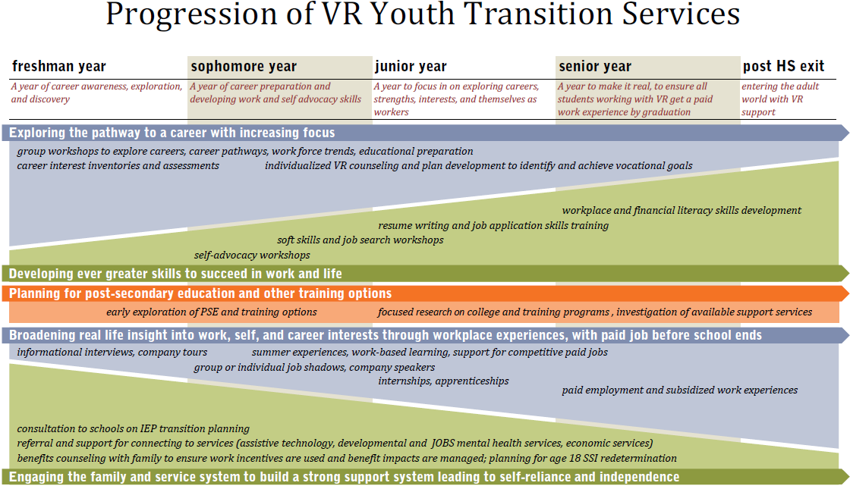
Developed a Vision of PETS Services

Slide 21

Where are we now?

Slide 22
Building the Practice
Now that the infrastructure is in place, we have to develop the practice
  Transition Counselors and Youth Employment Specialist meet monthly as a learning collaborative
  Contract with Trancen to provide training and TA
  Develop policy and guidance based on the real experience of staff
  Deal with challenges, such as unwilling schools, transportation issues, consent, liability, etc.

Slide 23
Hoped for Outcomes
Students will be better prepared for employment, career and, therefore, adulthood upon leaving high school through having had a variety of pre-employment experiences, setting of career goals and exploring various career pathways
Increased partnerships and collaborations between special educators, 504 Coordinators, adult service providers
Increased focus on the importance of pre-employment experiences while still in high school

Slide 24
Hoped for Outcomes
Development of best practices to be used by all people working with students to lead to more successful career goals
Increased parent engagement in their student’s career opportunities
Increased advocacy for students with disabilities to have their voices heard

Slide 25
Contact Information
Renee Kievit-Kylar
Renee.Kievit-Kylar@vermont.gov
802 871-3040
James Smith
James.Smith@vermont.gov
802 871-3031

