Slide 1
Cross Agency Collaboration that Promotes Business Partnership and Enhances Work Experience for Students with Disabilities
CSAVR Fall 2019 Conference
Hyatt Regency Jacksonville
225 East Coastline Drive
Jacksonville, FL
October 29, 2019

Slide 2
Presenters
Carline Geiger, CRC, LMSW, Deputy Division Director for Program Policy & Support, Texas Workforce Commission, Vocational Rehabilitation Division
Tara Howe, MA, MS, Transition Program Director, VocRehab Vermont
Richard Tulikangas, M.Ed, Director, Linking Learning to Careers, VocRehab Vermont
Jacque Hyatt, M.Ed, Senior Research Associate, TransCen, Inc., NTACT
Ruth Allison, Senior Research Associate, TransCen, Inc. NTACT
Brenda K. Simmons, MS, Senior Research Associate, The George Washington University, WINTAC
Notes:
Introductions

Slide 3
Welcome
Brief Overview from TA Centers Perspective
Texas and Vermont will share their strategies:
for expanding programs and partnerships that drive and support cross system collaboration and innovation around work experiences
on how VR and Education can partner with business to meet their workforce needs and prepare and engage students with disabilities for CIE.
for what worked, lessons learned, and next steps moving forward
Highlight any tools/resources/checklists that have been effective to use in implementation

Slide 4
What TA Centers Have Learned From States
Work based learning experiences are most effective when developed in coordination with one or more of the other four required pre-employment transition services.
Meaningful work experiences are typically developed around a career pathway and provide opportunities for students to stack or layer skills.
Successful collaboration promotes business partnership when employers understand how providing a work opportunity for students with disabilities can help meet current workforce needs, a better prepared future workforce, and improved community engagement.
Cross-agency collaboration is most effective when it is out-come driven.
States are still young in evaluating and determining what the data is telling us – much of our data is anecdotal (share Blake’s story)
Notes:
Each of the five required Pre-ETS activities (job exploration counseling, work-based learning experiences, counseling on opportunities for enrollment in comprehensive transition programs or other post-secondary education programs at IHE, workplace readiness training, instruction in self advocacy) help support the student’s successful work experience, and creates an opportunity for the student to build skills upon a career pathway that has multiple on and off ramps toward careers that align with labor market trends, industry recognized credentials, and business needs.
The success of linking students with work, and linking student work experience programs with employer partners, is as much about meeting employers’ needs as it is about meeting the collective goals set by VR and education. Unless employers gain from the collaboration, they are not likely to become or stay involved. Many VR state agencies are successfully using their business specialists to connect with employers and enhance work-based learning experiences.
Collaboration between schools, VR, students, families, employers, provider agencies, and other partners is effective only to the extent it is outcome driven. When collaboration is directly focused on outcomes for students and the systems that serve them – rather than merely referring them for a “hand off” to the next responsible party - higher school completion and employment rates are likely.
The intent of expanding transition services, to include pre-employment transition services in WIOA was to increase opportunities for students with disabilities, including those with significant disabilities to practice and improve workplace skills in competitive integrated work settings before HS exit, and explore post-secondary training options leading to more industry recognized credentials, and meaningful post-secondary employment, which may in turn lead to more meaningful post-secondary employment and training goals in the IEP, and provides increased opportunities for VR to share post-school employment and training outcomes with schools, which may in turn positively affect district level reporting outcomes for all Transition Indicators (1, 2,13, 14)…and vice versa. So this is a win-win for VR and education, and business, but most importantly, for the student.

Slide 5
Blake’s Story (Welder)
First Step – Pre-ETS: Through job exploration counseling Blake learned he is really interested in hands-on manufacturing types of jobs like welding, the pay seems pretty good, he likes the work environment because you can move around a lot and work with your hands, there is a high demand for welders nationally, and there are three shops in his hometown that hire welders.
Blake doesn’t want to go to college, but is open to the idea of more training after HS if it helps him get a better job and make more money. Blake has a learning disability in math and reading, but welding requires he master certain math skills, and he cannot pass the reading required to get into the welding program through the local CTE program.
One of the VR business specialists reached out to the local welding shops and helped Blake set up some informational interviews with welders in all three shops. Through WBLE activities, Blake was able to job-shadow a welder in two of those businesses, and participate in a paid work experience for six weeks over the summer at one of the businesses that rented U-Hauls, and hired welders to fix broken hitches, etc.
Notes:
Let’s take a look at Blake’s story….although the names have been changed, this is a true scenario.

Slide 6
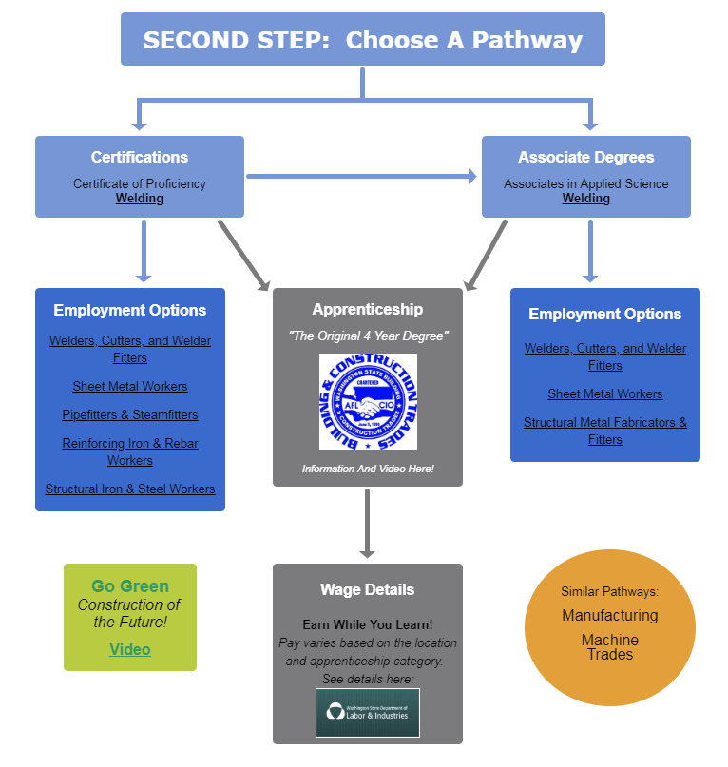
Blake's Story (Welder) continued
Blake choose the manufacturing career pathway so that he could become a certified welder.
Blake only had to get certified in two basic types of welds to perform the job tasks required for the position at Simmons U-Haul Company, and they wanted to hire him.
VR coordinated services with Blake’s HS, goals and objectives were written into his IEP that focused on learning those math skills needed to perform the job tasks, and the CTE instructor agreed to teach Blake skills required to become certified welder in two areas.
Blake graduated HS, worked at Simmons U-Haul for a year, and then started an apprenticeship program in welding.
Notes:
Diagram taken from http://washingtoncareerpathways.org/c/published/2732/lcc-welding.html.

Slide 7
SUMMER EARN AND LEARN (SEAL)

Slide 8
Vocational Rehabilitation Program Transfer
On September 1, 2016, the VR program was transferred from legacy Department of Assistive and Rehabilitative Services (DARS) to the Texas Workforce Commission (TWC) as mandated by SB 208, 84th Texas Legislature (2015).
In addition, the two designated state units (DSUs) Blind Services and General Rehabilitation Services were mandated to combine into one DSU by October 1, 2017.
Lastly, the Legislature directed TWC to integrate local VR offices into local Workforce Solutions Offices (aka workforce centers).

Slide 9
TWC Organizational Structure
Three Governor-appointed Commissioners representing the Public, Labor, and Employers provide policy direction and oversight.
The TWC Executive Director oversees agency operations and directs staff.
The Workforce Development Division oversees programs administered by the 28 workforce Boards.
The Vocational Rehabilitation Division administers the VR, OIB and Randolph Shepard programs.
Other TWC divisions include Unemployment Insurance, Child Care, Civil Rights, Operational Insight, and multiple administrative divisions.

Slide 10
Pathways to Careers (PCI)
PCI is a statewide TWC VR initiative to expand pre-employment transition services (Pre-ETS) to Texas students with disabilities.
PCI includes eight strategies:
Summer Earn and Learn (SEAL)
Charting the Course: Planning for Life after High School
Explore science, technology, engineering and math (STEM)!

Slide 11
Pathways to Careers (Cont.)
Pre-ETS Tools for Students
Pre-ETS Elective Curriculum
Capacity Building
Advise Texas
Student HireAbility Navigators

Slide 12
Summer Earn and Learn (SEAL)
When: Launched in summer of 2017
What: Work readiness training, worksite placement, and paid work experience for students with disabilities.
How: Contracts with each of the 28 workforce Boards
Funding: VR funds reserved for Pre-ETS
Role of VR: Coordinate, Recruit, Assist, Support

Slide 13
SEAL Requirements
SEAL participants must meet the following criteria:
Student with a disability between ages 14-22.
Enrolled in secondary or postsecondary education.
May be a VR participant with an IPE or potentially eligible for VR.

Slide 14
Seal Requirements continued
Students must:
Exhibit behavior that is appropriate for a work setting. If the student has, at times, displayed behaviors that are not work-appropriate, the student should be able to be redirected with minimal intervention.
Be receptive to counseling and guidance about the importance of appropriate workplace behavior.
Be motivated to participate in the work-based learning program.

Slide 15
SEAL Program Components
1
Planning, Coordination, Recruitment & Registration
2
Work Readiness Training
3
Worksite Identification & Placement
4
Worksite Monitoring & Reporting

Slide 16
SEAL Program Timeline
August-September
Teacher/Parent information sessions by VR counselor (VR Overview & SEAL)
January- March
March- April
SEAL information sessions & Registration Drives
Work Readiness Training &
HR requirements e.g. Drug tests, background checks, etc.
May-June
SEAL Placements begin
July- August
SEAL Employer Recruitment
Local Development Board Area & Employer Orientation
SEAL Concludes

Slide 17
SEAL Results
2017
2018
2019
2017:
1,524 participants
765 worksites
2018:
2,430 participants
1,052 worksites
2019:
2,868 participants
1,329 worksites

Slide 18
Examples of SEAL Employers
CVS
Crane County Senior Center
City of Wichita Falls Library
City of Lubbock
Anytime Fitness
Cinemark
Chick-Fil-A
Pep Boys
Great Clips
Marriott
MD Anderson
Sam’s Club

Slide 19
SEAL Success Stories
Kumori Sushi & Teppanyaki
Trevor- Rockin R River Rides
Fatima- Pine Tree Preschool

Slide 20
Lessons Learned
Need sufficient time to launch
Need for communication between all partners
Increase collaboration by establishing a joint planning committee at the local level

Slide 21
Lessons Learned
Sufficient notice for worksite placements
Allow time to schedule interpreters and job skills trainers
Allow time for transportation arrangements

Slide 22
Tips for Replication
Allow a generous planning runway
Honest conversations early in the planning stage
Invest in training
Build capacity

Slide 23
Vermont transition services: collaborating for student success Tara Howe, VR Transition Program Director Rich Tulikangas, VR Linking Learning to Careers Director
CSAVR ~ October 29, 2019
Notes:
NOTE:
To change the image on this slide, select the picture and delete it. Then click the Pictures icon in the placeholder to insert your own image.

Slide 24
Objectives of this Session
Overview of Transition Program and Linking Learning to Careers
Structure for Defining Roles within Transition Youth Teams
Collaboration with Schools – Roles and Responsibilities
Collaboration with Employers and other Community Partners
Linking Learning to Careers – Enhanced Services including Work-Based Learning

Slide 25
Overview of Transition Program and Linking Learning to Careers

Slide 26
VT Vocational Rehabilitation Transition Services
Before there was the Linking Learning to Careers Grant… There was Pre-ETS!
Who provides Pre-ETS:
Fourteen (14) VR Transition Counselors work with secondary students within the schools across the state to provide Pre-ETS services.
Fourteen (14) VABIR Youth Employment Specialists (YES) staff work in partnership with the Transition Counselors to provide a progression of work experiences and create a link to the business community.
Partnerships with Vermont Center for Independent Living to provide self-advocacy groups, and Vermont Family Network to assist with family engagement.

Slide 27
VT Vocational Rehabilitation Transition Services (continued)
Local and Statewide Core Transition Teams:
Twelve (12) local Core Transition Teams facilitate effective partnerships between schools and community partners.
Annual Interagency Core Teams Collaboration Event pulls together both active members of the teams as well as those interested in learning more for:
Professional development
Networking
Identification of Local Core Transition Team goals for the next year and highlight past year’s successes

Slide 28
Linking Learning to Careers
Goal: To develop and implement a model that provides work-based learning experiences and postsecondary access for secondary students and otherwise enhances their progress on a successful career path.
To get there, LLC will deliver:
Career development support via classroom, small group, & one-on-one services resulting in an individual LLC Plan.
A continuum of work-based learning experiences.
Access to postsecondary education, including dual enrollment & more.
Intensive individualized Assistive Technology support.
Transportation for WBL, employment, & college activities.
Evaluation design: Randomized control trial recruiting 800 high school students with disabilities in 12 VR district offices statewide – half assigned to ‘core services’, half to ‘enhanced services’.
Resource: LLC Issue Brief

Slide 29
Structure for Defining Roles Internally within Transition Youth Teams

Slide 30
Structure for Defining Roles Internally within Transition Youth Teams
Regular statewide meetings to ensure consistent communication with all youth team members:
Enrollment
Implementation of services
District Youth Team Meetings supported by managers/supervisors to ensure clear communication and role responsibilities.
Transition program manual and LLC Implementation Guide utilized internally to define roles, documentation process, and collaboration with schools.
TransCen fidelity monitoring process supports role clarification.
Data Collection and Comprehensive evaluation highlights and defines roles and responsibilities – entering information into case management system and RAPTER data management system.
Internal Transition Charter work provides clarity for staff and supervisors – RACI (Responsibility, Accountability, Consultation, Information) and Process Mapping.
Resource: LLC Roles and Responsibilities Chart

Slide 31
Collaboration with Schools –Roles and Responsibilities

Slide 32
Regular Communication with Agency of Education Staff
Consistent meetings occur between VR Transition Program Director and AOE Post-Secondary Transition Coordinator, and LLC Director with AOE Work Based Learning Coordinator.
Collaboration in Transition-related events, such as Interagency Core Team Collaboration Event and Work-Based Learning Coordinator Series.
Shared investment supports effective Core Transition Teams across the state.
Quarterly Agency of Education meetings occur with Division of Vocational Rehabilitation, Developmental Disabilities Service Division, Department of Labor, VT Assistive Technology, and Division for the Blind and Visually Impaired– now being expanded to create a Statewide Core Transition Team.

Slide 33
Regular Communication with Local Education Staff
Transition Youth Teams meet with school staff at the beginning of school year to clarify roles and establish plan for the year around visits, referrals, services, communication plan.
Collaborative activities occur within the schools- Transition Fairs or Open Houses.
Groups that occur during the school day are in collaboration with school staff.
Visits to local VR office at the end of the school year for graduating students are encouraged (can be done in collaboration with Department of Labor and/or Developmental Services).
Local Core Transition Team meetings clarifies roles of VR and Community Partners.
Resources:
Start of school year checklists with TransCen (VR and schools documents)
Best Practice from meetings with TransCen and schools

Slide 34
Why Core Transition Teams ?
Strategy for Pre-Employment Transition Services accessibility statewide and alignment with Interagency Collaboration;
Increase capacity at the local level to develop, provide, and manage an effective transition process for students;
Share resources and information, make connections with providers, and provide training to encourage the use of best practices;
Provide input and information to local and regional school and policy boards regarding broader transition issues;
Collectively problem solve transition challenges for students with complex needs; and
Liaison with the other transition initiatives.

Slide 35
Design of Core Transition Teams
12 local teams across the state that align with Vocational Rehabilitation/Agency of Human Services offices
Monthly, bimonthly, or quarterly meetings, depending upon identified needs of the team
Representation from (not an exhaustive list):
Schools (Special Educators, Work Based Learning Coordinators, 504 Coordinators, School Counselors, Special Education Directors)
College programs: Community Colleges, State and Private colleges, Transition College programs (College Steps, THINK College, SUCCEED, Project Search)
Designated agencies (both Developmental Services and Mental Health Services) and Specialized Service Agencies
Department of Labor
Adult Learning
Employment partners (VABIR)
Vermont Family Network
Department of Health- Children with Special Health Needs
Any local program that is working with youth!
Parents and students (future plan)
Agency/Organization statewide leaders support and reinforce importance of the local Core Transition Team meetings; Annual Core Team Event is funded at the state level.

Slide 36
Collaboration with Employers and other Community Partners
Close partnership with the Vermont Association for Business, Industry, and Rehabilitation
Creative Workforce Solutions– System of sharing and coordinating employer information, resources, and relationships locally
Progressive Employment:
The purpose of Progressive Employment is to provide candidates with opportunities to explore careers, build skills, develop recent work experience, and establish relationships that will help them secure jobs in the community.
PE also provides employers with a method to evaluate potential employees in an informal, low risk way.
Core Transition Teams—Employer panels
Career/Transition Fairs in collaboration with community partners and employers
Wide range of Work-Based Learning Opportunities/Integrated Competitive Employment

Slide 37
Linking Learning to Careers – ENHANCED SERVICES INCLUDING Work-Based Learning

Slide 38
Transition Work-Based Learning Model Demonstrations
5-year research project
Funded by: U.S. Department of Education, Rehabilitation Services Administration – Disability Innovation Fund Grants
Awarded to: California, Massachusetts, Maine, Maryland, Vermont

Slide 39
Linking Learning to Careers– Work Based Learning
LLC delivers a continuum of work-based learning experiences including:
At least one formally prepared and evaluated job shadow
At least one formally prepared and evaluated unpaid internship and/or volunteer experience
At least one employer-paid job in a competitive, integrated setting
Other WBL activities such as career guest speakers, work
site visits, and informational interviews are incorporated
Resources:
Unpaid Work Experience Training Plan
Unpaid Work Experience Student Evaluation

Slide 40
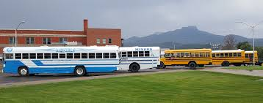
Additional Enhanced Services
Post-secondary Exploration Options - Partnership with Community College of Vermont
Introduction to College & Careers
Dual Enrollment Courses
Contract Courses
Assistive Technology Supports
Two full time LLC AT Specialists
Loans and purchases of needed devices
Transportation to and from WBL and post-secondary activities

Slide 41
Current Status & Interim Outcomes
LLC is designed to achieve these outcomes:
High school completion
Competitive, integrated employment
Postsecondary education and training enrollment
Confidence and motivation to achieve career goals
Interim Outcomes:
802 students enrolled; 413 assigned to treatment (enhanced) group
61.2% of enhanced group received at least one long term unpaid WBL or paid employment; 23.1% for control (core) group
33.3% enhanced with paid competitive employment; 14.7% for core
18.1% enhanced receiving assistive technology supports; .8% for core
50.3% enhanced post-secondary exploration; 30.6% for core
84.6% enhanced students with open VR case

Slide 42
Additional Resources

Slide 43
Resources
Workforce GPS Resources to Support Work based Learning
https://www.workforcegps.org/resources/2019/10/02/13/27/Resources-to-Support-Work-Based-Learning
A Guide to Developing Collaborative School-Community Business Partnerships
https://transitionta.org/sites/default/files/Partnership_Guide.pdf
Workforce Innovation Technical Assistance Center (WINTAC)
http://www.wintac.org/
National Technical Assistance Center on Transition (NTACT)
https://www.transitionta.org/

Slide 44
Contact Information
Carline Geiger
Deputy Division Director
VR Program Policy & Support
carline.geiger@twc.state.tx.us
Tara Howe
Transition Program Director
VocRehab Vermont
Tara.Howe@vermont.gov
Richard Tulikangas, Director
Linking Learning to Careers
VocRehab Vermont
Richard.Tulikangas@vermont.gov
Jacque Hyatt
Senior Research Associate
TransCen, Inc., NTACT
jhyatt@transcen.org
Ruth Allison
Senior Research Associate
TransCen, Inc. NTACT
rallison@transcen.org
Brenda K. Simmons
Senior Research Associate
The George Washington University, WINTAC
bksimmons@gwu.edu

Slide 45
Thank You

