Slide 1
Department of Human Services
Vocational Rehabilitation
Re-allotment – Pros & Cons
Fall 2015
Judy Barker, DHS Budget Analysts
Trina M. Lee, Director, Vocational Rehabilitation

Slide 2
VR Mission
Assist Oregonians with disabilities to achieve and maintain employment and independence
VR Objectives for 2015-17
Support and accelerate customer experience to be empowering, effective and efficient
Rethink and implement inclusive, dynamic statewide youth programs
Create and implement an employer engagement model
Create shared commitment and ownership among all staff to maximize program goals
Respond proactively to federal and state requirements and initiatives by creating an agile and sustainable program
Increase program policy alignment and consistent application
Formalize and continue to update our business practices
Create and implement a formal approach to managing our changes

Slide 3
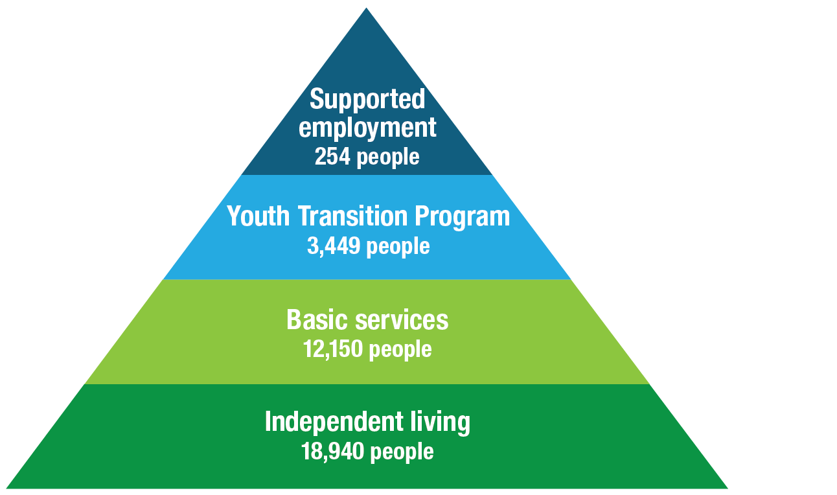
Types of consumer services (2014)
3
Notes:
This slide represents the types of consumer services in Oregon - Vocational Rehabilitation services are shaped to individual needs.
We will be discussing each individual “Type” of service
Who does it serve
What does it provide
During this presentation, You will see this visual used multiple times with an indicator (arrow) of which area of the pyramid we are covering
Highlights:
Notice number of people served in each service type – FY14 & statewide
Services moving up the continuum increase in intensity of service
Decrease in the numbers being served
The base of the pyramid represents the variety of services provided at the Centers for Independent living (will cover in a future slide)
Let me introduce you to a few of our consumers in Oregon

Slide 4
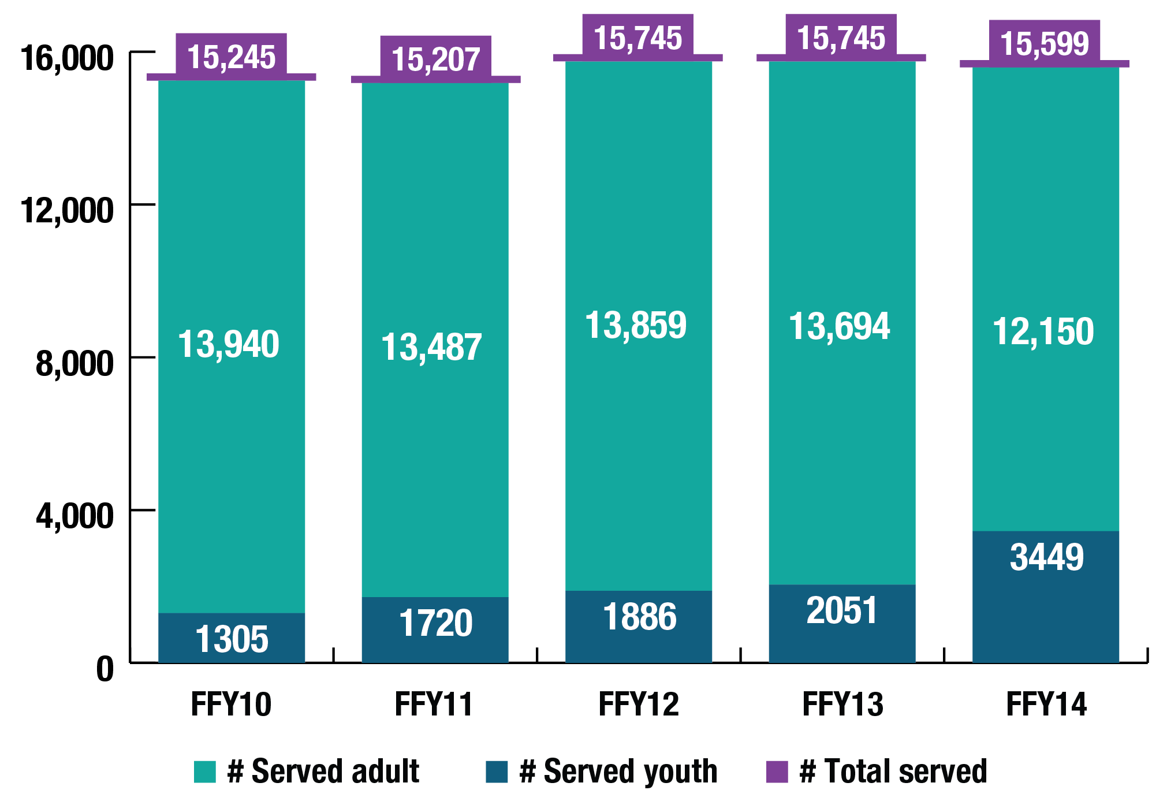
Oregonians served
Notes:
This slide represents the total number of adults and youth and the combined number for FFY10 – FFY14. If the pyramid diagram were listed, it would point to the top three services – doesn’t include the Centers for Independent living.
Highlights:
The number of youth served (Dark blue color) has gradually increased. The number of adults have begun to decline
Why? – multiple faceted answer:
We have seen the total number of applications drop each year
FFY13: 7,811 to FFY14: 7,660 (Difference of 146 applicants)
Self-Referral & Referred by family and friends (top two referral sources) numbers have not recovered to pre-waiting list days
Order of Selection with a waiting list – began January 2009 until Fall 2010: Staging
Worked through the list but the “inflight” numbers have not recovered
Still down 18% from SFY08
Self Referrals SFY08—3205 to SFY14—2564
Family & Friends: SFY08—1175 to SFY14—658
Self referrals account for over 33% of the way consumers get in the door
Economy – Why would people come in if there is a feeling that jobs are not available (our assumption)
Youth Outreach has caused the numbers to increase for youth
As a point of reference – in FFY14 VR served 15,599 Oregonians, but that isn’t the total numbers of individuals with disabilities in Oregon

Slide 5
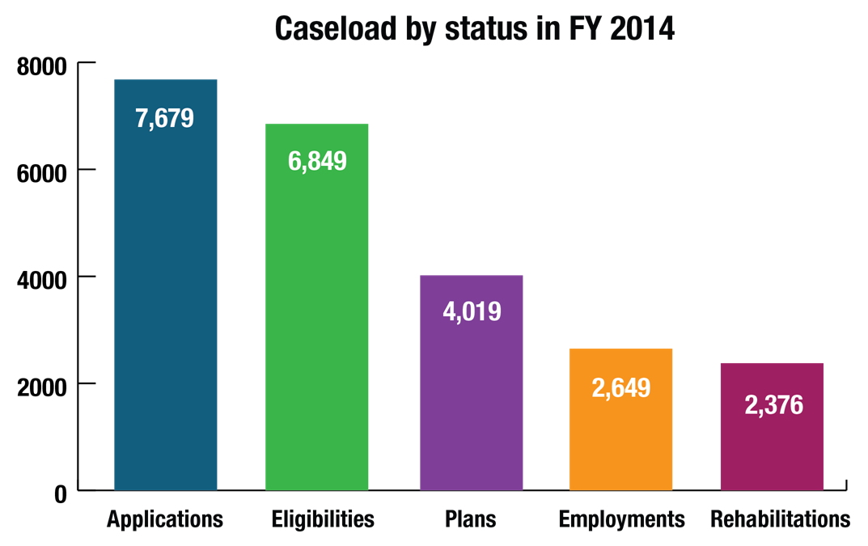
VR Caseload along the Service Continuum
5

Slide 6
History – How Oregon has the ability to request re-allotment $$
Preparing for a federal audit
Discovered dollars that had not been reported as State only expenditures in support of the program
Reclassed those dollars making our MOE $2.1M over the required match on the odd years.

Slide 7
History Continued…….
In FFY09 applied for re-allotment dollars to help fund us at a level that would allow us to work our way out of active waiting list Order of Selection
In January of 2014 went to the Legislature and requested $2.2M in state funds to support the increased cost of services to clients
Based on mix of disability types and forecasted cases.

Slide 8
History - 2014
Selling point:
The increased $2.2M would manage MOE year to year & at similar levels
Allows us to request re-allotment dollars on a yearly basis.
Caution:
Requesting re-allotment dollars do not guarantee we would receive them.

Slide 9
Oregon’s Requests…..
FFY14:
Received $10.1M
Ensure we would not run short of funds and needed to enact the Order of Selection
FFY15:
Received $10.9M
Allowed us to increase caseloads due to Executive Order (Employment First) and proposed legal settlement while remaining out of the Order of Selection

Slide 10
Re-allotment: Pros and Cons
Pros
Cons
Allows to manage funds to serve all clients
Increase PETS services striving for early employment
Legislature reluctant to provide state funding
Maintain MOE – or risk losing federal dollars (1-1)
Continual education:
Use of MOE and re-allottment dollars
Makes the PETS set aside larger so need to be managed to ensure don’t revert funds

Slide 11
Contact Information……..
Judy Barker
DHS Budget Analyst
503-945-8832
Judy.A.Barker@dhsoha.state.or.us
Trina M. Lee
VR Director
503-990-9039
Trina.M.Lee@dhsoha.state.or.us

