Slide 1
CSAVR Strategic Priorities
How We Got Here and Where We Need to Go Now

Slide 2
Growing Awareness of the Need for System Change
2017 – 2019

Slide 3
Vision 2020
Launched in 2017
Near-Term Strategies + Enduring Principles

Slide 4
Vision 2020 Aimed to Develop A System Response to Our Changing Reality
How do we prepare VR for the future?
How do we adapt the national VR program to a rapidly changing environment and evolving customer expectations?

Slide 5
Environmental Scan
CSAVR conducted an internal/external assessment that included soliciting broad feedback about the state of VR:
VR Staff Survey (55 agencies participating, 1,000 responses)
Stakeholder meetings
Business roundtables
Consumer roundtables

Slide 6
CSAVR Operating Principles & Strategies
The environmental scan led to development and adoption of four operating principles
A fifth operating principle was developed and adopted in 2020
Initial strategies were identified and implemented for each principle

Slide 7
CSAVR Operating Principles: Elevator Speech Version
We create innovative solutions to improve access and outcomes
We are part of the talent solution for business
We are the experts with customized services that help our customers achieve their goals
We are proactive system-builders and collaborative partners
We promote diversity, equity, inclusion and accessibility

Slide 8
2018 Survey of State Directors
Q1: What do you want from CSAVR?
Q2: What do you need from CSAVR to optimize your engagement?
Q3: If we are building an engagement model into the future, what should it look like?

Slide 9
2018 Survey Responses
Facilitate resource sharing
Be the voice of VR on the national level
Provide networking opportunities to learn from other states
Have a robust website with easy to access resources
Have committees and conferences with relevant topics that address current issues and opportunities
Design learning collaboratives/communities based on current trends, recent issues – more flexible

Slide 10
2019-2020 CSAVR Organizational Alignment
Committee and professional network restructure
Operational Committees
Core Committees
Learning Networks and Communities
Improved website content and navigation
This Photo by Unknown Author is licensed under CC BY-SA

Slide 11
2018-2019: CSAVR and RSA Collaboration
Looking at trends in national performance
Considering questions about how we collectively need to change
What do we need to do differently?
How do we need to think differently?
How can we work together?
RSA’s ReThink VR Performance Initiative
This Photo by Unknown Author is licensed under CC BY-ND

Slide 12
ReThink VR Performance Initiative - 2019
Collaboration between RSA, CSAVR, NCSAB, 8 VR Agencies
Aligned with the OSERS ReThink Initiative
Objective: Rethink the way we look at the performance of the VR program, improving results, and maintaining high expectations of both the VR program and individuals with disabilities.
Objective: Use data in our decision making to identify strategies to foster continuous improvement, collaboration, and maximize high-quality employment opportunities for customers served by the VR program.

Slide 13
ReThink VR Performance
Priorities
Performance data
Flexibility and reduction of burden
Knowledge gap (among State directors and agencies)
Technical assistance
Turnover of VR staff
Messaging the VR program
Monitoring

Slide 14
2020 Onset of COVID 19 Pandemic
VR Programs Respond, Adapt and Innovate
Preexisting Trends Are Magnified
This Photo by Unknown Author is licensed under CC BY

Slide 15
Performance of the VR System: Honing our Focus, Aligning for Action
2021 – current
This Photo by Unknown Author is licensed under CC BY-SA-NC

Slide 16
2021: Honing Our Focus – Executive Committee & Core Committee Work
July 2021 Summer Executive Committee:
Core Committee brainstorming, initial recommendations shared with RSA.
Discussed key trends and factors affecting performance
2021 and ongoing, Core Committee Work:
Operations and Personnel
Performance and Accountability

Slide 17
October 2021: Honing Our Focus – Director’s Forum
Prioritized key themes from July Executive Committee
Counselor and Staff Attrition
Sluggish Internal Processes
Employer Engagement and Business Relations Strategies
Branding and General Public Awareness

Slide 18
2022: Aligning for Action –Officers & Executive Committee
Identified the Outcomes and Key Results Framework (OKR) as a structure within which CSAVR can pursue alignment and focus on the top priorities identified by membership
Engaged a facilitator to validate/refine key issues and strategic priorities and facilitate Directors’ Forum work session

Slide 19
The Three CSAVR Strategic Priorities

Slide 20
April 2022: Aligning for Action – Directors’ Forum
Identified possible success measures for each strategic priority
How will we know if we are making progress?
How will we see our progress in improved customer outcomes?
Identified possible implementation strategies
What can we do, individually and collectively, to achieve that success?
This Photo by Unknown Author is licensed under CC BY

Slide 21
2022: Aligning for Action – Executive Committee Summer Meeting
Began with a draft OKR framework and draft actions (implementation strategies)
prioritized actions, Identified lead Core Committee/Officer, timeframes, resource needs

Slide 22
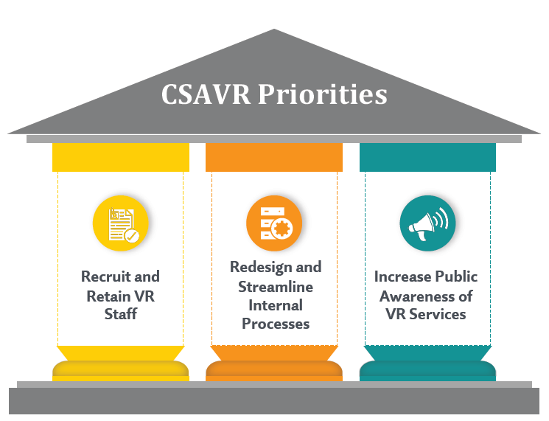
2022: Aligning for Action – Strategic Priority Leads
Priority 1: Recruit and Retain VR Staff
Cheryl Fuller, CSAVR President
Operations and Personnel Committee, Co-Chairs Cynthia Speight and Kristen Mackey
Priority 2: Redesign/Streamline Internal Processes
Dave Doukas, CSAVR President-Elect
Performance and Accountability Committee, Co-Chairs Bill Robinson and Theresa Koleszar
Priority 3: Increase Public Awareness of VR Services
Dacia Johnson, CSAVR Past-President
Committees, TBD

Slide 23
The Future is Now: Aligning for Action
2022: Aligning for Action – CSAVR Fall Conference “The Future is Now”
This Photo by Unknown Author is licensed under CC BY-SA-NC

Slide 24
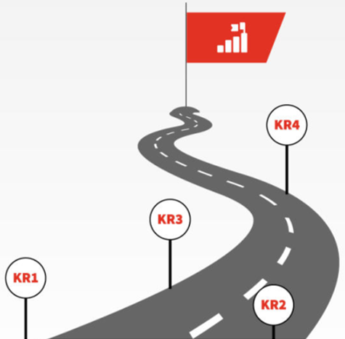
What Are Objectives and Key Results (OKRs)?
A management methodology that helps an organization ensure that its efforts are aligned and focused on the same important issues
An Objective is what you want to accomplish
Key Results are how you plan to accomplish it
What Matters: OKR: Definition & Examples of Objectives & Key Results

Slide 25
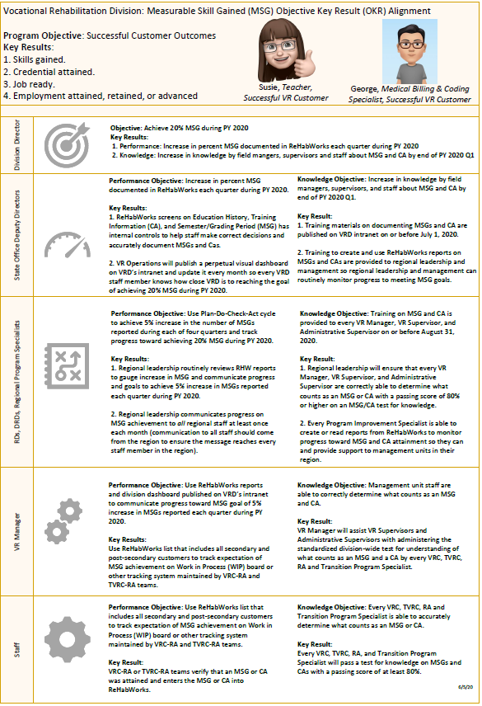
OKR Example: Achieving Organizational Alignment on Measurable Skills Gains

Slide 26
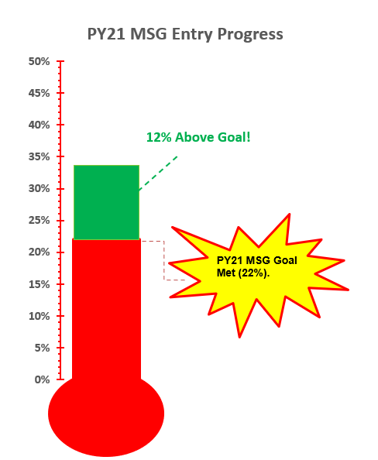
OKR = Alignment = Results!
Measurable Skills Gains | PY 21 Performance
PY21 MSG Target | 22.0%
PY21 MSG % Achieved | 33.6%
PY21 MSG Remaining Target | 0.0%
PY21 MSG Above Goal | +11.6%

Slide 27
OKRs for CSAVR Priorities: A Work in Progress
Identify priorities
Develop and refine objectives
Identify key results (measures)
Identify actions that CSAVR and VR agencies can take to achieve the key results

Slide 28
Priority 1: PY 2023 Actions
Operations and Personnel Committee Objective 1: Recruitment – Candidate pipeline
Engage the National Council on Rehabilitation Education (NCRE), including participating in Fall 2022 conference, to increase the pipeline of rehabilitation counseling graduates employed by public VR
Collaborate with RSA and long-term training grant recipients to populate and use job boards now required under the current grant award

Slide 29
Priority 1: PY 2023 Actions (2)
Operations and Personnel Committee Objective 2: Retention – VR professionals’ pay
Engage a contractor to update, refine and enhance 2021 Salary Survey and prepare a summary report
Operations and Personnel Committee Objective 3: Retention – Employee satisfaction
Continue collaboration with Penn State and University of Iowa on studies about minimum qualifications for VR counselors, employee satisfaction, and recruitment and retention

Slide 30
Priority 2: PY 2023 Actions
Performance and Accountability Committee Objective 1: Identify top 3 processes that constrain staff capacity and/or impede productivity
Examine the VR Customer Service Continuum to identify inefficiencies and outdated processes that interfere with or interrupt effective customer service and outcomes:
Gather key stakeholder feedback (counselor, customer, business)
Identify and prioritize the most impactful inefficiencies and outdated processes.
Identify and showcase the work in process, strategies and solutions being implemented by VR agencies.

Slide 31
Priority 2: PY 2023 Actions (2)
Performance and Accountability Committee Objective 2: Establish and support a VR Process Improvement Community of Practice (PICoP):
Identify the vision, mission and core values for the PICoP
Recruit a facilitator and SVRA subject matter experts.
Set annual meeting schedule and initial meeting themes/agenda.
Establish a CoP and hold an initial CoP meeting prior to the 2023 CSAVR Fall Conference.

Slide 32
Priority 3: PY 2023 Actions
Objective 1: Improve awareness of oversight authorities regarding VR program value, challenges and opportunities
CSAVR is committed to being part of the solution to the under-expenditure of VR formula grant funds with thoughtfulness and a strong sense of urgency
Increasing public awareness of VR Services begins with awareness of the current challenges in the national program and the policy and structural changes needed to address them

Slide 33
Priority 3: PY 2023 Actions (2)
Objective 1 continued:
CSAVR will engage an independent research organization to conduct a review, collect information from VR agencies, and propose changes in policy, structure and practice, including:
Considering whether there are structural issues or systemic barriers affecting states’ ability to maximize VR formula grant awards
Identifying opportunities to remove barriers and implement new strategies to support full expenditure of VR formula grant awards by states

Slide 34
Priority 3: Future Actions
Objective 2: Promote our national brand as a public VR system
Make sure that our actions are aligned with CSAVR DEI&A Initiatives
With an intentional focus on equity and unserved, underserved populations
Emphasis on transition- both youth and students with disabilities

Slide 35
Priority 3: Future Actions (2)
Objective 3: Perfect our brand and know our market
We are a national system- we need to be experts in the customers of the public VR system- both job seekers and business
What do our customers value?
What are we currently doing right?
What do we need to improve?

Slide 36
The Future is Now: We Need You!

