Slide 1


Access in Action: Removing Systemic Barriers to Successful VR Outcomes
Dr. Jennifer Jackson, Mississippi Department of Rehabilitation Services
Rebecca Treadway, The Arc Northwest Mississippi

Slide 2
Advancing Pre-ETS Access and Outcomes
WIOA elevated this work
Early access matters
Partnerships drive impact
Employment remains the goal
Notes:
WIOA made clear that early, intentional engagement with students with disabilities is essential. For VR agencies, the question is no longer whether Pre-ETS matters, but how we design and deliver it in ways that increase access, strengthen engagement, and lead to better employment outcomes.
In our state, that work requires a very intentional strategy. We currently have 13 Pre-ETS providers covering 82 counties, so expanding access depends heavily on strong coordination, effective partnerships, and flexible service delivery. That has pushed us to think carefully about how we build provider capacity, strengthen outreach, and maintain meaningful access for students across the state.
It also reinforces an important point: Pre-ETS success is not just about offering services. It is about designing a system that allows those services to be delivered in a way that is accessible, responsive, and connected to real employment outcomes.

Slide 3
Barriers Still Shape Participation
Complicated referral pathways
Unclear information for families
Low expectations for students
Limited access to opportunities
Transportation and support gaps
Notes:
Even with strong commitment to Pre-ETS, students and families still encounter barriers that affect participation. Those barriers are often not about motivation or potential. They are about whether services are easy to enter, easy to understand, and responsive to real-life needs.

Slide 4
What Strengthens Engagement
Earlier outreach
Clearer communication
Better partner coordination
Family understanding
Connection to real work
Notes:
What strengthens engagement is not complexity. It is clarity. When students and families understand the purpose of Pre-ETS, when schools and providers are aligned, and when services connect to real work opportunities, participation becomes more meaningful and more sustainable.
To support that effort, we added a Program Coordinator position to enhance outreach to schools and provide staff training on how to conduct successful school-based outreach. That role helps ensure our staff are better prepared to build relationships, communicate clearly, and engage schools in ways that strengthen access to Pre-ETS. The coordinator also serves as a point of contact during staff vacancies so that outreach remains consistent and schools continue to have support even when there are staffing gaps.

Slide 5
What Improves Outcomes
Trusted community relationships
Flexible service models
Inclusive access points
Intentional business partnerships
Work-based learning experiences
Notes:
Improved outcomes are typically tied to strong implementation. That includes trusted partnerships, flexible delivery, inclusive design, and employer engagement that gives students meaningful exposure to work. These are the conditions that help Pre-ETS function the way WIOA intended it to.

Slide 6
Bringing the Framework to Life
Relationships that build trust
Services shaped by real life
Families engaged as partners
Employers connected early
Pathways that lead to work
Notes:
These priorities become most meaningful when they are brought to life through strong community partnerships. That is where provider collaboration is so important. The Arc’s work offers a practical example of how relationship-driven, flexible, and employment-focused services can expand access and strengthen outcomes for students and families.

Slide 7
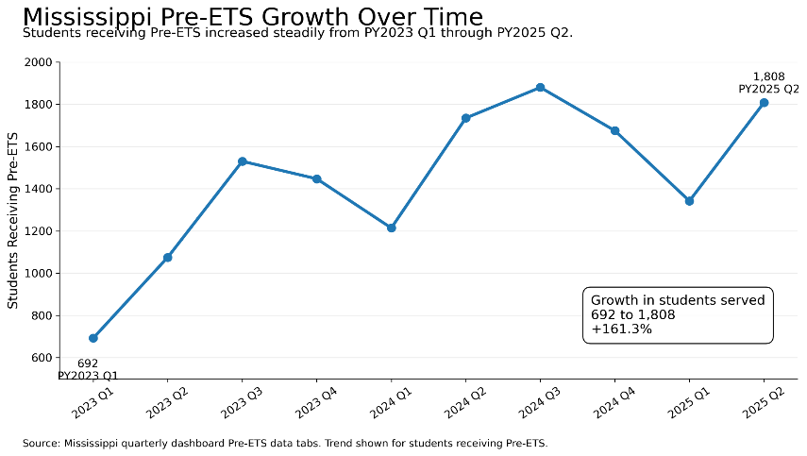
Impact in Mississippi
Notes:
The data show clear growth over time. Mississippi is reaching more students, delivering more Pre-ETS services, and increasing the proportion of students with disabilities who are benefiting from those services.

Slide 8
Impact in Mississippi
Mississippi’s Pre-ETS activity has increased substantially over time.
Students receiving Pre-ETS increased from 692 in PY2023 Q1 to 1,808 in PY2025 Q2.
Total Pre-ETS services increased from 1,764 in PY2023 Q1 to 5,637 in PY2025 Q2.
The share of students with disabilities receiving Pre-ETS increased from 29.4% to 45.3%.
PY2025 Q2 represents the highest level of Pre-ETS activity in the data reviewed.
Notes:
The data show clear growth over time. Mississippi is reaching more students, delivering more Pre-ETS services, and increasing the proportion of students with disabilities who are benefiting from those services.

Slide 9

MISSION GUIDED SERVICE
An advocacy organization for individuals of all ages with intellectual and developmental disabilities
and their families.
Create events and programs
Connect families to critical services
Educated the community about the people that we serve
LIVE THEIR BEST LIVES

Slide 10
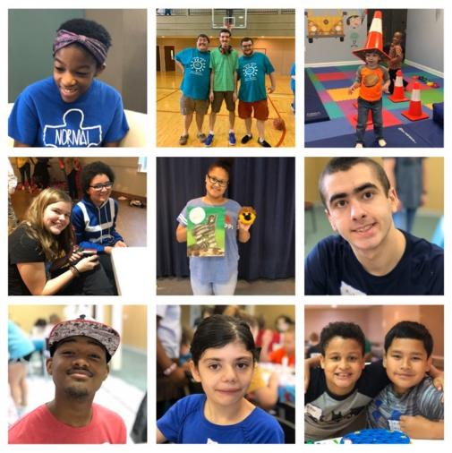
Camp BOLD
Social Clubs
Arc Art Masters
Parent Support Group
Glow & Grow Studio
Garden Guardians
SuperABLE Fitness
Cookin’ with The Arc Classes

Slide 11
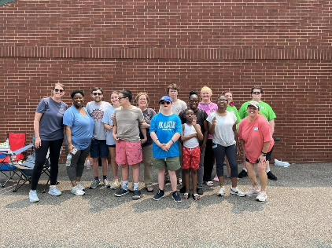
PRE-ETS AT THE ARC NWMS
Our curriculum is presented on 2 levels: Community Based and Inclusion
Classes take place in local schools, virtually, at our office, and in the community
Inclusion students have assigned career coaches
Secret to Success #1:
Start as Young as Possible

Slide 12
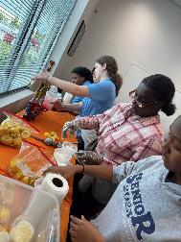
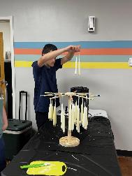
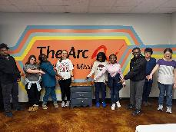
WORK CLOSELY WITH YOUR SCHOOLS
Community Based Classes meet at our local school during the school day
Project Connect - True Partnership 50/50 Partnership
Teach real world skills along with classroom soft skills
Secret to Success #2:
Building Rapport is Job #1

Slide 13
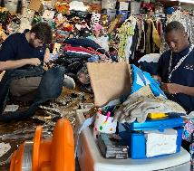
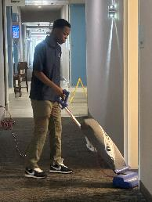
WORK BASED LEARNING EXPERIENCE IS KEY
Secret to Success #3:
Hire High-Quality School Teachers
Over 30 work locations in our community
Work teams of 2 to 5 depending on the needs of the business
Shifts of 2 to 3 hours
Secret to Success #4:
Pay Clients Whenever Possible

Slide 14
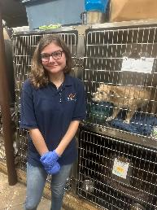
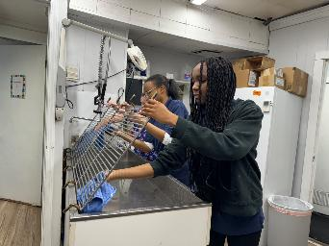
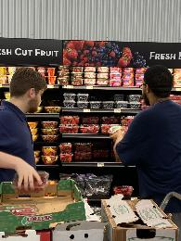
MORE WBLE - “SAY CHEESE”
Secret to Success #5:
Support Your MDRS Counselors

Slide 15
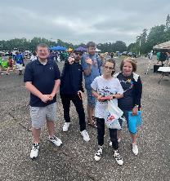
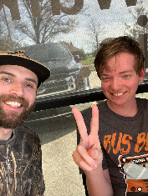
ARCWORKS - SE PROGRAMMING
14 Months
14 SE clients
5 Moved to employment
Business development is key
Hire excellent employment specialists
Have thorough training
Secret to Success #6:
Growing and Changing is Essential

Slide 16
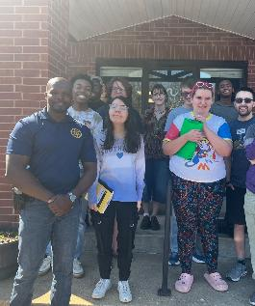
BARRIERS
Client transportation
Parent support
Business support for Interns but not hiring
Only so many hours in the day

Slide 17
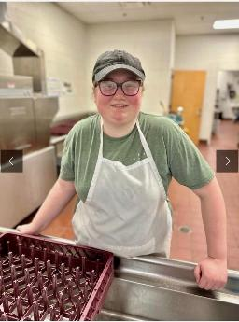
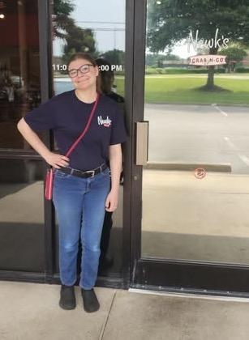
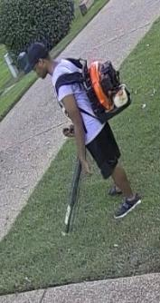
SUCCESS STORIES: ELLA, MILES, AND KATIE

Slide 18
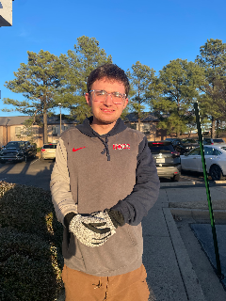
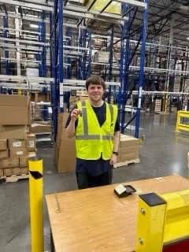
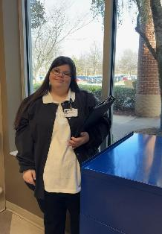
SUCCESS STORIES: ETHAN, TREY, AND JENNA

Slide 19

THANK YOU FOR ATTENDING
Dr. Jennifer Jackson
jjackson@mdrs.ms.gov
Rebecca Treadway
rebecca@thearcnwms.org

