Slide 1
Business Relations & Career Development Breakout
CSAVR Spring Conference
Rick Laferriere
Stacey Butler
Duane Rohr
Erika Bailey
March 30, 2026

Slide 2
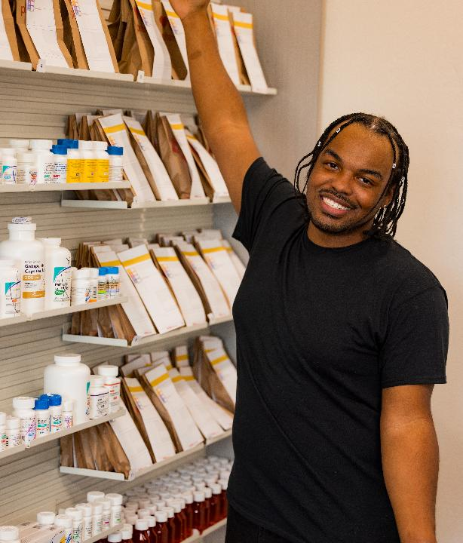
Workforce Initiatives at
CVS Health
Who we are
Our Workforce Initiatives team collaborates with organizations in our priority markets to support workforce advancement opportunities.
What we do
We collaborate with local organizations nationwide to break down barriers to employment and provide resources that support healthier futures. We believe that helping people find career opportunities in their communities can improve their overall health. We work closely with federal, state and local agencies, as well as nonprofit organizations, to create meaningful job opportunities.
Why we do it
Research shows that creating pathways to career opportunities within communities helps individuals focus on their health. This motivates us to continue working with local organizations to eliminate barriers to employment and offer resources that encourage proactive steps toward a healthier future.

Slide 3
Workforce Initiatives at CVS Health®
Workforce Initiatives is dedicated to creating opportunities for individuals in underserved communities by providing access to meaningful work experiences. Our initiatives focus on bridging social gaps by cultivating skilled workers and fostering quality partnerships that contribute to community development.
North Star
Foster innovative community partnerships that create effective pathways to employment, build non-traditional pipelines that deliver talent to the enterprise and measure our meaningful outcomes to better enable the growth of our business and a positive impact on the communities we serve
Our Pillars
Support Communities
  Partner with community-based organizations, educational institutions and government agencies in diverse, underserved communities to support people on their path to employment
Drive Business Results
  Build talent pipelines in non-traditional ways by helping individuals gain skills they need to support work that CVS Health wants to accomplish
Measure Impact
  Measure a positive impact to the business and to the communities we serve
Notes:
Rick

Slide 4


2025 impact metrics and achievements
^{4,982}
Our Workforce Initiatives team at CVS Health has made significant strides in supporting communities and driving business results.
With 1,344 active partnerships, we showcasing the extensive reach and impact of our collaborative efforts. These partnerships enable us to connect with a diverse range of participants, providing them with valuable resources, support and opportunities for career development and education.
These metrics highlight our commitment to fostering meaningful employment opportunities and creating a positive impact in underserved communities.
Career Track Participants focus on career development, externship experiences and work experiences to enhance professional skills and provide real-world job exposure.
31%
^{2,201}
of WI program completers move on to careers at CVS Health®, highlighting the success of our Workforce Initiatives in fostering career development and strengthening our talent pipeline.
Education Track Participants focus on community-based skills, observational job shadows and educational programs, demonstrating our commitment to supporting communities and building talent pipelines.
1,284
WI program participants hired into roles across the CVS Health enterprise, demonstrating the strong impact our team has in delivering exceptional talent to the business via our programs and partners.
¹⁷⁷
VR candidates hired at CVS Health in 2025, as reported by 22 of the 78 agencies.
Notes:
Greg
Numbers on this slide reflect 346 partners contributing to program participants (998 support campaigns and direct referrals)
Avg approx. 10 participants per partner

Slide 5
CVS Health’s Abilities in Abundance (AIA)
  AIA is a collaboration between the CVS Health Workforce Initiatives team and a community partner.
  The goal of our AIA programs is to find exceptional talent that will win competitive employment & thrive in our business.
  Each AIA program is customized to meet the specific and local needs of the partner, the participant and the business.
  Our programs are designed to help overcome common barriers to employment, such as completion of job applications, interviews and the possession of required skills.
  A blend of job-related skills, job readiness and hands-on experience is included in each program.

Slide 6

Our roadmap to success
Align talent objectives that empower communities
Conduct market analysis and needs assessment
Engage community partnerships
Develop & nurture community partnerships
Design customized training programs
WITC training (where available)
Live experience in CVS facility
Position specific training
Population specific training
Education track programs complete
Career track programs continue
Application support , VJT training, interview prep
Program participant may transition to employment
WI and CBO provide post-hire support to promote retention
Notes:
Populations specific training - We believe that helping people find career opportunities in their communities can improve their overall health. We bridge gaps in employment opportunities, health care access, and education for the most vulnerable populations
Position specific training - These structured programs are designed to meet the unique demands of health care environments, ensuring participants are prepared for success in positions such as pharmacy technicians and retail associates
Live experience on-site - These programs immerse participants in real-world work environments, helping them develop practical skills and readiness for the workforce
WITC Training (where available) - Participants receive comprehensive, hands-on training in a mock setting that prepares them for successful careers

Slide 7
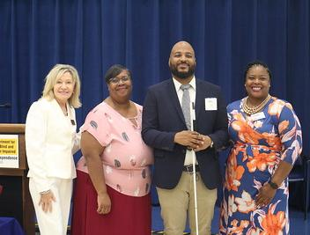
Models of success
Our team works closely with partnering agencies and organizations to develop workforce training and solutions that meet consumers where they are.
Examples:
Customized classroom training
Work-based learning
Virtual training/remote learning
Enhancement of existing programs
External SMEs/training providers
Summer youth programs

Slide 8
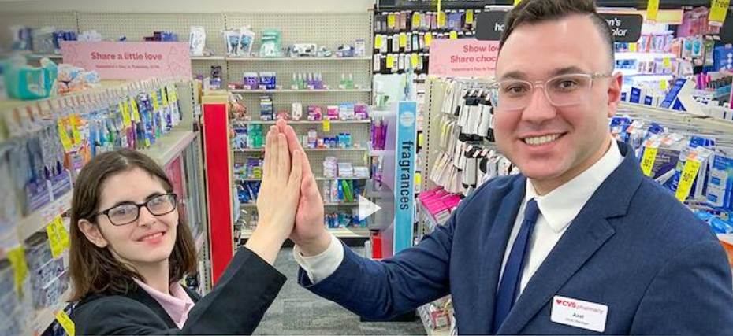
Celia’s Story
DeShawn
https://youtu.be/utwub38Evg4?si=4Z1NeMkl9AMdYkhC
Notes:
https://www.ivymount.org/ivymount-celebrates-autism-acceptance-and-advocacy-month/

Slide 9
Open Discussion & Q&A

