Slide 1

Getting to Yes:
Negotiating WIOA Performance Levels

Slide 2


Let us introduce ourselves…
Crystal Garry
Senior Technical Assistance and Research Analyst
George Washington University
Vocational Rehabilitation Technical Assistance Center
Bill Colombo
Program Coordinator
San Diego State University
Vocational Rehabilitation Technical Assistance Center
Notes:
Website

Slide 3

What we aim to accomplish today:
Review the Federal guidance governing the negotiation of WIOA performance levels.
Share ten practical strategies (Ten for the Win) to prepare for negotiations with the Rehabilitation Services Administration.
Learn effective strategies, practices, and lessons from colleagues who have achieved successful negotiation outcomes. Audience participation is encouraged!
Notes:
What we aim to accomplish today – Answer some of the 5w’s and how.
First, we want to review the federal guidance that shapes the performance negotiation process, highlighting RSA-TAC-20-02, Negotiations and Sanctions Guidance for the WIOA Core Programs, issued on January 6, 2025.
This is the holy grail on the topic.
In addition, because a overview would feel incomplete without it, we’ll spend a little time on performance scores & assessments.
Next, we will share…Ten for the Win… these are ten practical strategies to help you prepare for negotiations with RSA.
Last, we’ll learn effective strategies, practices, and lessons from peers who have achieved successful negotiation outcomes.
You all are the real subject matter experts. So…audience participation is highly encouraged!
Thank you to Kathie Smith the Director at NC-DVRS who graciously agreed to jump start the conversation. (Cynthia)
.

Slide 4
Fast/Facts
WIOA Performance Negotiation Overview

Slide 5

Key Guidance and Data Sources
Federal Guidance  RSA’s Sub-Regulatory Guidance webpage
  TAC-20-02 Negotiations and Sanctions Guidance
  TAC-26-01 Modification Requirements for WIOA State Plans for PYs 2026 and 2027 (see Attachment I)
Negotiation Resources  RSA’s Accountability webpage
  PYs 2026 and 2027 Statistical Adjustment Models (SAM)
  PYs 2026 and 2027 Negotiations Tool
Performance Data  RSA’s Accountability webpage
  Review of PY 2024 VR Program Performance
  WIOA Performance Assessments (All Core Programs)
  Program Year 2024 WIOA Performance Assessment Results (VR)
Notes:
Key federal guidance that informs this work.
Federal Guidance  RSA Sub-Regulatory Guidance webpage
TAC-20-02 (1/6/25), this is the primary sub-regulatory guidance on WIOA negotiations and sanctions.
It your negotiations and sanctions owner's manual.
TAC-26-01, Modification Requirements for WIOA State Plans for PYs 2026 and 2027
Specifically, Attachment I, which covers WIOA performance accountability instructions for the core programs and includes the Effectiveness in Serving Employers, or ESE, indicator.
Negotiation Resources  RSA Accountability webpage
The main tools available to support negotiations.
PY 26 and 27 Statistical Adjustment Model, or SAM.
It includes the estimated performance levels for each indicator, six years of actual performance data, and summary data for all states.
PY 26 and 27 Negotiations Tool earlier this week.
It builds on the SAM and provides a more robust, searchable datasets by indicator, state, and agency type.
It accounts for 3 of the 4 required negations factors.
Performance Data  RSA Accountability webpage
Other performance data resources you may find useful:
Review of PY 2024 VR program performance – (PY-ReviewTables-Final) While some of this information is included in the negotiations tool, there’s additional data that provides more context and useful callouts…especially when considering the role participant characteristics play in the SAM.
The WIOA Performance Assessments for all core programs – Similar, under the state drill-down option there is a Model Data Table that shows how each SAM variable contributed to the adjustment factor for each indicator in PY24.
The PY 2024 WIOA Performance Assessment Results for VR

Slide 6

Which Performance Indicators Are Negotiated?
Negotiated with RSA
  Employment Rate  2nd Quarter After Exit
  Employment Rate  4th Quarter After Exit
  Median Earnings  2nd Quarter After Exit
  Credential Attainment
  Measurable Skill Gains
Baseline Only (not negotiated)
  Effectiveness in Serving Employers¹
¹ A baseline indicator is one for which states do not propose expected levels or negotiate levels of performance because there is insufficient data.
Notes:
What up with Effectiveness in Serving Employers indicator?
For PYs 2026 & 2027, the Departments used their transition authority to designate it as a “baseline” indicator.

Slide 7

Negotiation Milestones (1 of 2)
✓ March 3
Expected levels of performance for the first two years of a State Plan were due with the initial Unified or Combined State Plan submission. RSA 😁
✓ March 10
RSA provided VR agencies with the estimated levels of performance for PYs 2026 and 2027 in the fourth Statistical Adjustment Model (SAM⁰).
✓ March 23
RSA shared the Negotiations Tool used to establish negotiated performance levels with State VR programs for PYs 2026 and 2027.

Slide 8
Negotiation Milestones (2 of 2)
Early April
RSA will email each state VR program director to propose negotiated levels of performance.
Mid-April
RSA will ask state VR programs to either accept the proposals or request further negotiation. If further negotiation is requested, the RSA State Team will schedule a follow-up meeting.
By June 30
Once agreed upon, the state must incorporate the negotiated levels of performance into the Unified or Combined State Plan before the plan is approved.

Slide 9
Key Terms and Definitions (1 of 3)
Expected levels of performance
  The targets proposed by the state in its initial Unified or Combined State Plan submission for each primary indicator.
Estimated levels of performance
The targets generated by the Statistical Adjustment Model (SAM⁰) and shared before negotiating.
Negotiated levels of performance
The targets mutually agreed to by the state and RSA.
Notes:
Expected levels of performance - The targets proposed by the state in its initial Unified or Combined State Plan submission for each primary indicator.
Fact – For the PY 24-25 negotiations RSA accepted 43 percent of the expected levels proposed by states.
Estimated levels of performance - The targets generated by the Statistical Adjustment Model (SAM⁰) and shared before negotiating.
Negotiated levels of performance - The targets mutually agreed to by the state and RSA.

Slide 10
Key Terms and Definitions (2 of 3)
Adjusted levels of performance
The negotiated levels revised at the end of the program year to reflect actual participant characteristics and economic conditions using the SAM¹.
Adjustment factor
A positive or negative difference added to the negotiated level of performance to determine the adjusted level of performance.
Actual level of performance
The outcome reported by the state on the Statewide Performance Report (ETA-9169) for each primary indicator.
Notes:
Adjusted levels of performance - The negotiated levels revised at the end of the program year to reflect actual participant characteristics and economic conditions using the SAM¹.
Adjustment factor - A positive or negative difference added to the negotiated level of performance to determine the adjusted level of performance.
Actual level of performance - The outcome reported by the state on the Statewide Performance Report (ETA-9169) for each primary indicator.

Slide 11
Key Terms and Definitions (3 of 3)
Individual indicator score
The percentage obtained by dividing the actual performance level by the adjusted performance level.
Overall state program score
The average of the individual indicator scores for a single WIOA core program.
Overall state indicator score
The average of the individual indicator scores for a single indicator across WIOA core programs.
Notes:
Individual indicator score - The percentage obtained by dividing the actual performance level by the adjusted performance level. Pass/Fail threshold 50%
Overall state program score - The average of the individual indicator scores for a single WIOA core program. Pass/Fail threshold 90%
Overall state indicator score - The average of the individual indicator scores for a single indicator across WIOA core programs. Pass/Fail threshold 90%

Slide 12
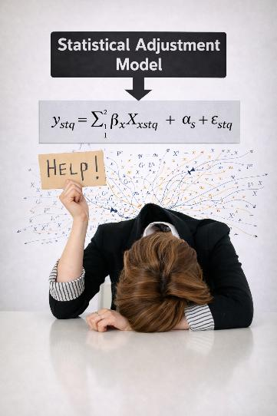
Factors Considered in the SAM
Statistical adjustment model is an objective regression model, used to estimate levels of performance (SAM⁰) and calculate the adjusted levels of performance (SAM¹) based on participant characteristics and economic conditions.
  Characteristics of participants include but are not limited to indicators of poor work history, lack of work experience, lack of educational or occupational skills attainment, dislocation from high-wage and high-benefit employment, low levels of literacy or English proficiency, disability status, homelessness, ex-offender status, and welfare dependency.
  Economic conditions include but are not limited to differences in unemployment rates and job losses or gains in particular industries.
  Other empirically supported factors that affect state outcomes may also be considered.
Notes:
Fact: the PY24 average adjustment factor were:
MSG 4.4%, ERQ2 -1.1%, MEQ2 $96, ERQ4 1.4%, CRED -4.5%
Economic conditions in 12 industry sectors
“Statistical adjustment model” = required by law
“Regression model” = how department chose to implement it
Federal agencies (DOL, ED, RSA) implemented the requirement using: multivariate regression models
Why?
They can quantify relationships between:
Economic conditions (e.g., unemployment rate)
Participant characteristics
Outcomes

Slide 13
The Four Negotiation Factors
Consider how the levels involved compare with the negotiated levels of performance established for other states.
Ensure that the levels involved are adjusted using an objective statistical adjustment model provided by the RSA.
Consider the extent to which the levels involved promote continuous improvement in performance accountability measures by the state and ensure optimal return on the investment of Federal funds.
Consider the extent to which the levels involved will assist the state in meeting the performance goals established by the Secretaries of Education and Labor in accordance with the Government Performance and Results Act of 1993 (GPRA).
Notes:
As with the PY 2024 and 2025 negotiations tool, the new tool includes:
Estimated levels of performance produced by SAM;
States proposed expected levels of performance; and
Data tied to the other negotiation factors, including continuous improvement and comparative performance.
Departments acknowledge that there are many ways to define continuous improvement
An increase from the levels of performance previously attained;
Increases in percentile rankings of levels of performance either nationally or among similar states;
A change in service strategy and delivery, including more progressive or innovative approaches designed to better meet participants’ needs;
A change in the intensity or comprehensiveness with which individuals are served; or
A maintenance of previous performance for the top performing states.

Slide 14
Performance Assessment: Individual Indicator Score (1 of 2)
Employment Rate 2nd Quarter after Exit
Adjustment Factor 4.9%
Indicator Score
97.1%
63.9%
62.1%
= Actual Level / Adjusted Level
59.0%
Negotiated
Level
Adjusted
Level
Actual
Level
Notes:
Remember an Individual indicator score is the percentage obtained by dividing the actual performance level by the adjusted performance level.
Verbally explain

Slide 15
Performance Assessment: Individual Indicator Score (2 of 2)
Credential Attainment
Adjustment Factor 10%
Indicator Score
47%
41.0%
= Actual Level / Adjusted Level
31.0%
19.3%
Negotiated
Level
Adjusted
Level
Actual
Level
Notes:
Verbally explain

Slide 16
Performance Assessment: Overall State Program Score
Example | ERQ2 | MEQ2 | ERQ4 | Cred | MSG | Overall Program Score
VR 1 | 103% | 128% | 94.5% | 114% | 79.2% | 103.7%
VR 1 - No performance failure because the Overall State Program Score was 103.7%, which is above the 90% threshold for a single core program.
VR 2 | 70% | 105.5% | 72.4% | 62.2% | 81.1% | 78.2%
VR 2 - Performance failure because the Overall State Program Score was 78.2%, which is below the 90% threshold for a single core program.
Notes:
Overall state program score is the average of the individual indicator scores for a single WIOA core program.
(2 VR failures)

Slide 17
Performance Assessment: Overall State Indicator Score
Indicator | Adult | Disloc. Worker | Youth | Adult Ed. | Wagner-Peyser | VR | Overall IndicatorScore
ERQ2 | 99.3% | 100.5% | 101.4% | 107.5% | 109.1% | 103% | 103.5%
ERQ2 - No performance failure because the Overall State Indicator Score was 103.5%, which is above the 90% threshold for that single measure.
MSG | 109.3% | 78% | 116.7% | 88.2% | NA | 52% | 88.8%
MSG - Performance failure because the Overall State Indicator Score was 88.8%, which is below the 90% threshold for that single measure.
Notes:
The overall state indicator score is calculated as the average of the individual indicator scores for a single indicator across the WIOA core programs.
You may be wondering why only these two overall state indicator scores were assessed?
The reason is that Adult Education was not yet ready to be assessed. They were not sufficiently comfortable with their Statistical Adjustment Model to assess Credential Attainment, Employment Rate in the 4th Quarter, or Measurable Skill Gains.

Slide 18
10 for the Win
Effective Strategies for Negotiating Performance

Slide 19
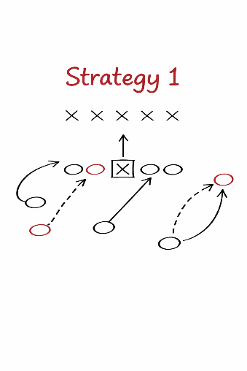
Strategy 1 - Embrace Performance Accountability
Develop agency policy, procedure, and internal control.
Build staff capacity.
Strengthen systems and technology.
Ensure staff understand performance indicators and reporting requirements.

Slide 20
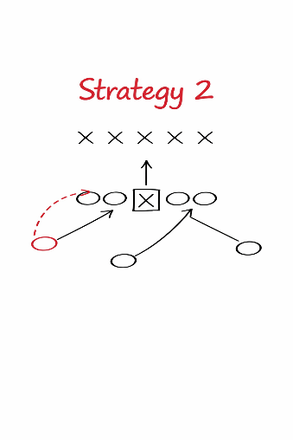
Strategy 2 - Know Your Data
Meet regularly with your agency’s statistician or data analyst to review and understand performance data.
Monitor and identify trends and fluctuations in performance.
  Monthly
  Quarterly
  Annually
Evaluate data validity and accuracy.
Coordinate with field staff to track, interpret, and improve performance.

Slide 21
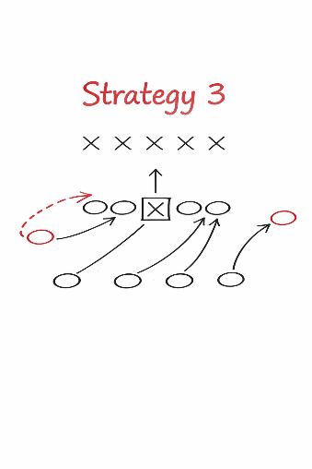
Strategy 3 - Consider Influential Factors
Performance exemptions.
Participant characteristics.
Economic conditions.
Other factors that may affect outcomes and negotiations.

Slide 22
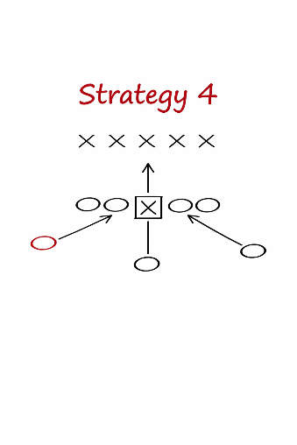
Strategy 4 - Build a Negotiation Binder
Prior performance by indicator and year
  Negotiated, Adjusted, and Actual
SAM estimates
Continuous improvement rationale
  Evidence-based narrative
  Planned changes
GPRA alignment
  Support of federal goals
  Required measures

Slide 23
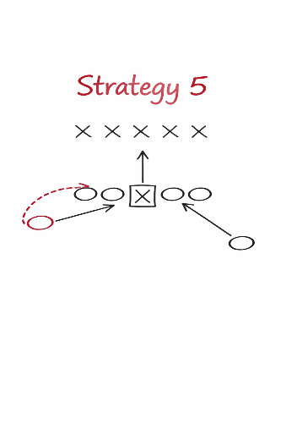
Strategy 5 - Consider SAM Estimates as Baseline Inputs
Use SAM estimates as the starting point for negotiations.
When proposing a target different from SAM, document:
  The gap between the proposed target and the SAM.
  The rationale for the difference (evidence, operational changes, timing, and expected effect).

Slide 24
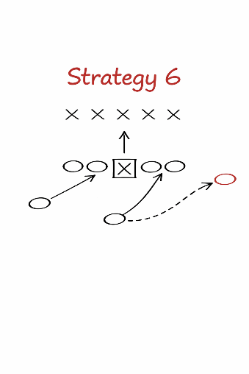
Strategy 6 - Develop a Continuous Improvement Narrative
For each indicator, document:
  What changed: policy, staffing, training, service design, partnerships, technology, eligibility/flow, etc.
  What is expected to improve first (leading metrics): outreach, referrals, time-to-service, retention supports, placement rate, credential attempts, etc.
  Why and how those changes support the proposed target.

Slide 25
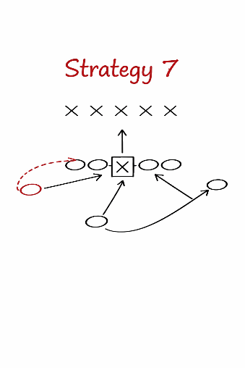
Strategy 7 - Benchmark Targets
Compile and include in the binder:
  State model benchmark summary.
  Peer state comparisons.
  RSA negotiation tool outputs.
Use benchmarks to show that targets are reasonable, evidence-based, and aligned with negotiation factors.

Slide 26
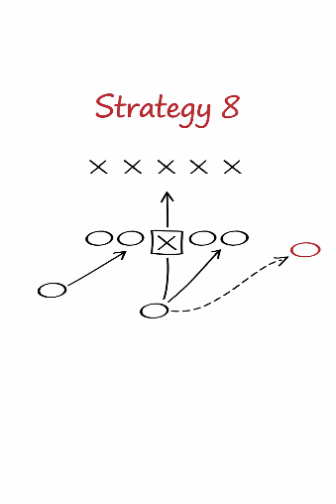
Strategy 8 - Prepare an Extension Playbook
For extenuating or exceptional circumstances, define:
  Notification triggers and timelines.
  Escalation path (who approves, who contacts federal agencies).
  Pre-drafted templates for notice, extension request, and supporting documentation.

Slide 27
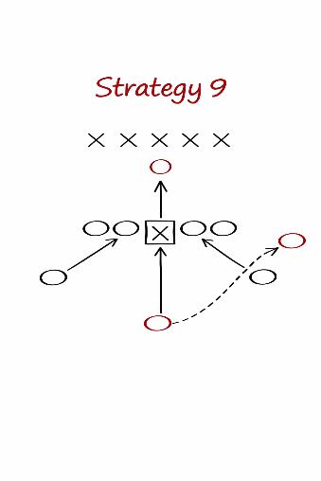
Strategy 9 - Model Downside Risk
Across every negotiation cycle,
  Maintain a rolling two-year risk register for each indicator.
  Flag scenarios in which two consecutive years could trigger sanctions, even across different 2-year negotiation cycles.
  Pair each identified risk with mitigation actions across operations, data, and partnerships.

Slide 28
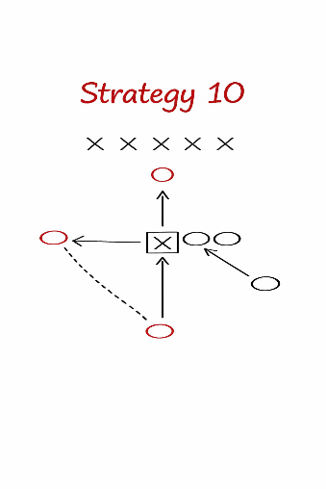
Strategy 10 - Coordinate Across VR Agencies
If applicable, hold a pre-negotiation planning meeting to:
  Agree on starting negotiation levels by indicator.
  Define targets and boundaries.
  Align messaging.

Slide 29

Group Discussion: Effective Negotiation Strategies
What is one strategy that made the biggest difference in your state’s negotiation preparation and outcome?
When your proposed target were different than the SAM estimate, what evidence or rationale was been most persuasive?
What have you included in a negotiation binder or prep packet that proved especially useful?
What is one lesson you learned the hard way about negotiation timing, coordination, preparation, messaging…?
What is one practice or tool you would recommend other agencies adopt right away?

Slide 30
Questions?

Slide 31

Our Contact Information
Crystal Garry
csanderson@gwu.edu
Bill Colombo
wcolombo@sdsu.edu
www.vrtac.org

Slide 32
Thank you!
The content was developed under a U.S. Department of Education grant H264L250001 and does not necessarily represent the policy of the Department.

