Slide 1
Increasing Wage Outcomes for Our Customers:
Where does Missouri-G Stand?
$6,860
14% of closures > $21.67/hour
Notes:
PY24 Data (typically 14%-17% each year)

Slide 2
What’s driving our wage outcomes?
Missouri Minimum Wage:
Emphasis on Training Services:
4-year, Graduate, & Jr/Community College
Occ/Voc. Training
Registered Apprenticeships
WBLE (non-Pre-ETS version)
$13.75/hour

Slide 3
Why do We Emphasize Training as a VR Service?
  The Rehab Act challenges us to maximize the potential of the people that we serve.

Slide 4
Why do We Emphasize Training as a VR Service?
Training is one powerful way that VR can influence the labor force participation rate gap.
Labor Force Participation Rate:
  People with a disability:
    16-64- 42.4%
  People without a disability:
    16-64 = 77.9%
Source: Current Population Survey, Bureau of Labor Statistics, August 2025

Slide 5
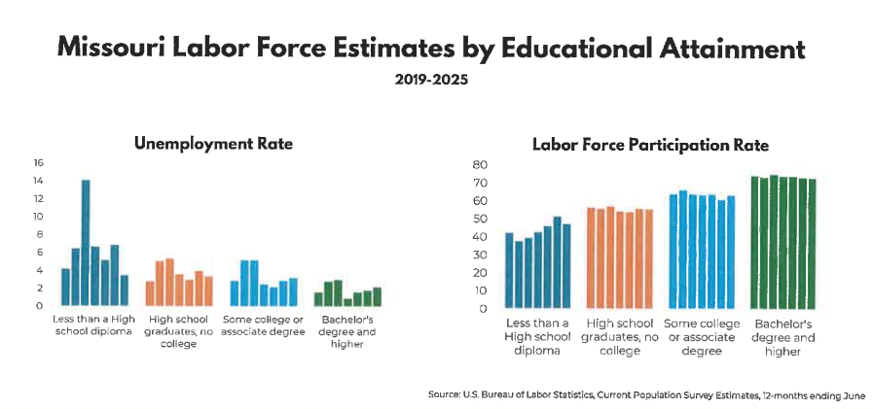
Notes:
X-axis clustered by year 2019-2025

Slide 6
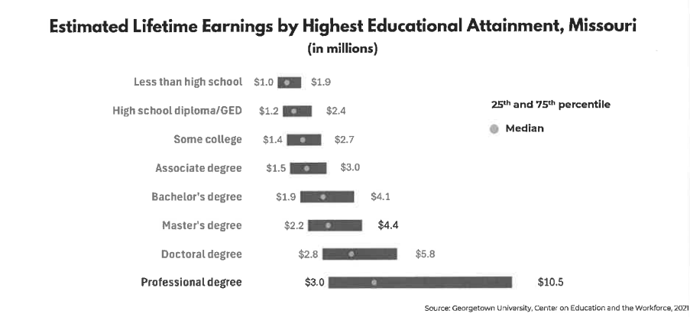

Slide 7
How do We Emphasize Training as a VR Service?
We talk about it
We plan for growth
LMI
Local Relationships
Notes:
M/V/Values and focus on purpose of Rehab Act
We watch spending closely and build in growth expectations into our budget projections
We train use of LMI within GNC context and operationalize it as a part of programs like PE
Focus on local relationships with IHEs and other training programs; view the relationship as a partnership vs. transactional.

Slide 8
Training Participation Trend
Notes:
Does include Secondary AND post-secondary, and especially 21 and 22 are inclusive of a post-COVID recovery period.

Slide 9
Training Participation Trend
Notes:
You can also look at it from an authorization perspective. Y axis is the number of participant's associated with each of four service categories.

Slide 10
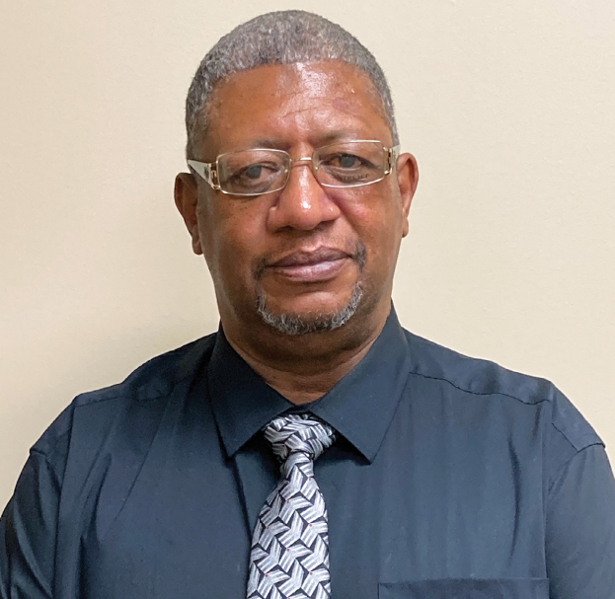
Ansur Adams

