Slide 1

Welcome!
Our Capitol Hill Educational Lunch and Learn will begin shortly

Slide 2

Capitol Hill Educational Lunch and Learn
March 31, 2026

Slide 3
Meet Your Facilitators
Jane Elizabeth Burdeshaw, Director, Alabama Combined Agency
Ryan Alford, Self-Advocate, Alabama Combined Agency

Slide 4



Today We Have Speakers From:

Slide 5
Vocational Rehabilitation as a Cross System Workforce Strategy
Dr. Erikk Bonner, Director, Maryland Combined Agency
Kathie Smith, Director, North Carolina General Agency

Slide 6
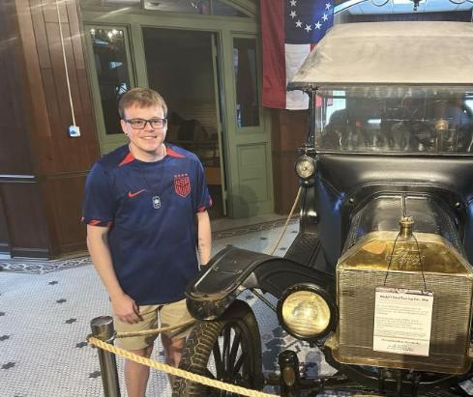
NC Partnerships for Success with Local Employers
VR Career Training & Internships
“Kai’s inspired us ...People make assumptions about what people can contribute, but what Kai brought to the museum has been wonderful – it’s been amazing to have him here.”

Slide 7
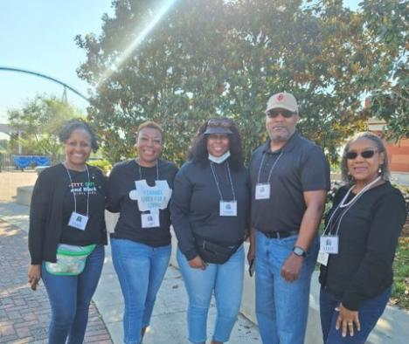
Community Partnerships
Job fair brings EIPD staff together with NCWorks and SCWorks to connect jobseekers, students with local employers.
Notes:
Members of Gastonia’s EIPD staff participated as volunteers at the Job Fair of the Carolinas on Tuesday, May 6 at Carowinds.
The free job fair was a partnership between NCWorks and SCWorks to connect jobseekers with employers from North and South Carolina. This was the seventh JFOTC event and the sixth time the Gaston County office volunteered at the event.
The public came out in big numbers as almost 600 jobseekers – including 90 high school students – came out to attend this event.
Pictured are VR Counselor Alisa Kennedy, Business Relations Representative Deborah Ervin, VR Counselor Charlene Forteau, Unit Manager Lyndon Robinson and Processing Assistant Marsha Danner.

Slide 8
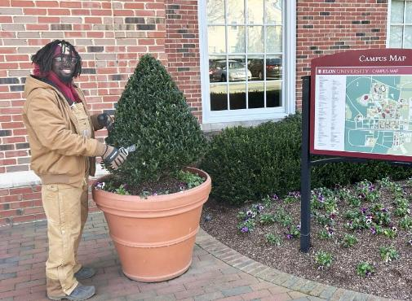
NC Partnerships for Success with Schools & Universities
VR Transition Services:
Thanks to the VR partnerships with the local high schools and the NC University System, Cevion was able to achieve his career goal… and the Elon University campus has never looked better!

Slide 9
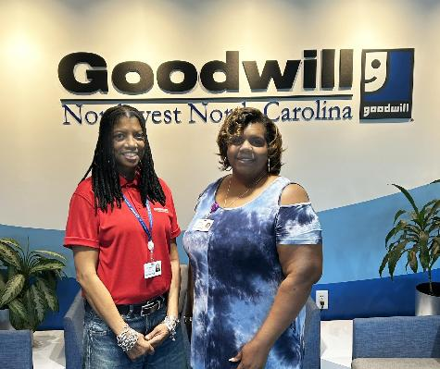
Business Partnerships
Local EIPD unit office partners with Goodwill Industries of Northwest North Carolina for a successful job outcome.
Notes:
Pictured are Goodwill Career Navigator Altomese Jones and Goodwill Forsyth County District Director Kaisha McDermott-Carter.
EIPD makes wise use of its partnerships. One especially productive partnership in Winston-Salem is between the local unit office and Goodwill Industries of Northwest North Carolina.
“When a client approached me and said her goal was to work in a clerical role for a non-profit I thought of Goodwill right away,” Business Relations Representative Allison Garner, of the Winston-Salem Unit Office said. “I went to them and suggested an internship, and they were open to it.”
Altomese Jones’ internship went well. Because Goodwill was motivated to hire Jones, they reworked the position and turned it into two part-time jobs to accommodate her requirements.

Slide 10
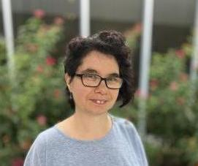
NC Partnerships for Success with Community Rehabilitation Programs
VR Supported Employment and Job Placement Services
“When I was getting older, I was wondering how the whole job thing was going to work. I was able to go to work because I had the right supports from VR. They helped me find the right fit, and they supported me in finding jobs.”
Notes:
Brittany has returned to VR whenever needed and has grown in her career from daycare to retail to now training others to be peer mentors and achieve their own career goals!

Slide 11
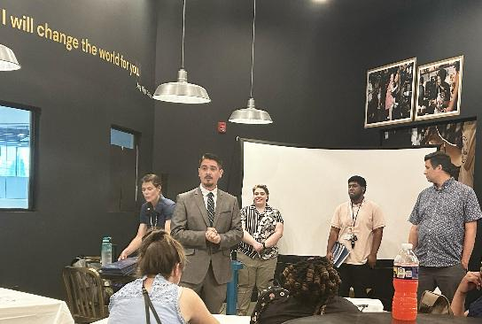
Supporting Workforce and Job Retention
EIPD team members help individuals prepare for community employment at transition workshop.
Notes:
Pictured are Winston-Salem Business Relations Representatives Allison Garner and Troy Chavez.
About twenty former Bitty & Beau’s employees, along with their friends and family members, attended the transition workshop where Vocational Evaluator Sara Rock, along with the EIPD team, assisted them in completing their intake paperwork. The former owner of the Winston-Salem Bitty & Beau’s franchise, Kelli Balash, was on hand to help her former employees take their first steps toward their new futures.

Slide 12
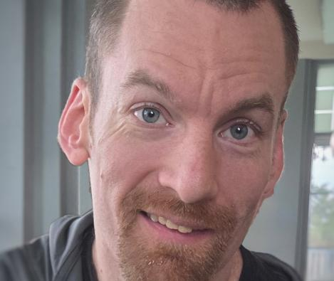
NC Partnerships for Success with Councils and Advocacy Groups
VR Services and Supports
Through a partnership with the Council on Developmental Disabilities, Brendon helped to develop a new Peer Mentor Service and Career Training Program to help others with I/DD achieve their career goals!
Notes:
Brittany has returned to VR whenever needed and has grown in her career from daycare to retail to now training others to be peer mentors and achieve their own career goals!

Slide 13
Employer Perspective: Manufacturing & Skilled Trades Workforce
Steve Sukup, CEO, Sukup Manufacturing

Slide 14


Slide 15

Sukup Video 2
Access Video here alternatively

Slide 16
Sukup Video
Access Video here alternatively

Slide 17
Self Employment and Entrepreneurship
Beth Keeton, Principal Investigator, Center on Self Employment
Em Hillman, Owner, Em’s Coffee Co.
MyKenzie Meiki, Business Coach, Em’s Coffee Co.

Slide 18

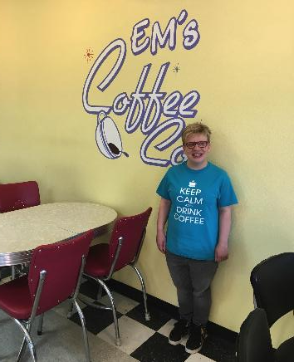
The story of Em’s Coffee Co.

Slide 19
It takes a team
Medicaid – Home and Community Based Wavier (self directed)
Networking in the community
Iowa Vocational Rehabilitation
Iowa Work Incentive Planning and Assistance (WIPA)
Em
Parents, Friends and Family
Iowa Dept. of Natural Resources
Notes:
Iowa VR Self Employment program provided grants
Donated coffee machines form previous coffee shop owner in town
Iowa Department of Natural Resources grants – use local honey for tea and nuts for baking
Parents purchased the building

Slide 20
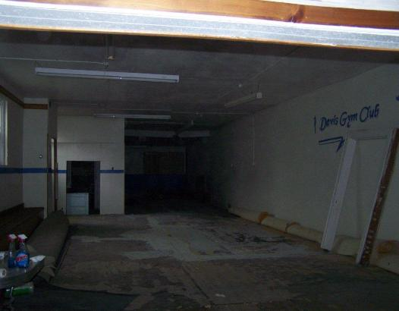
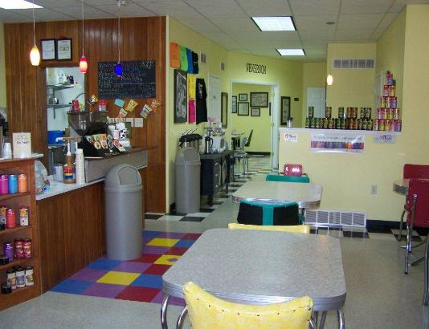
Em’s Coffee Co.
Before
After
Notes:
Building was an old insurance building and gymnastics studio
Start to finish – left the workshop in February of 2009 and opened her coffee shop in December of 2009
Celebrating 10 years in 2019

Slide 21
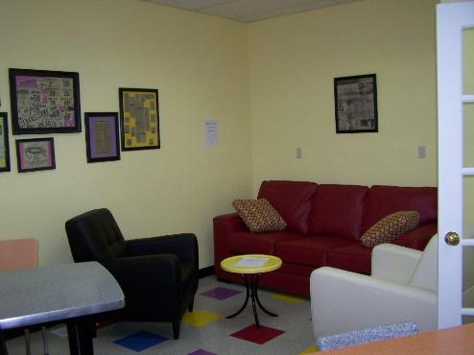
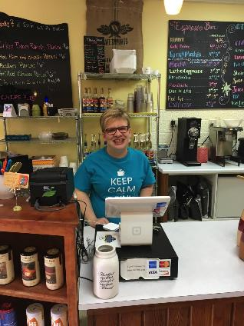
Em’s Coffee Co.

Slide 22
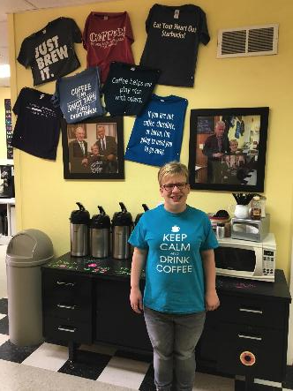
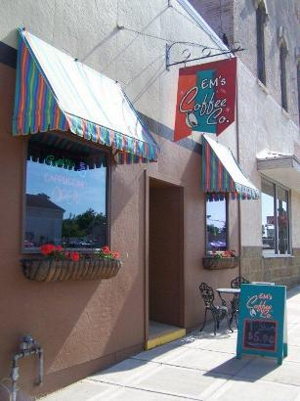
Em’s Coffee Co.
Front of Coffee Shop
T-Shirts

Slide 23

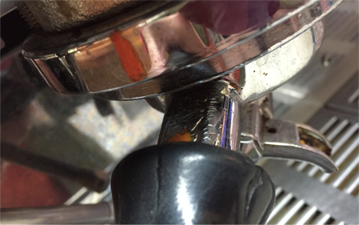
Espresso Machine

Slide 24
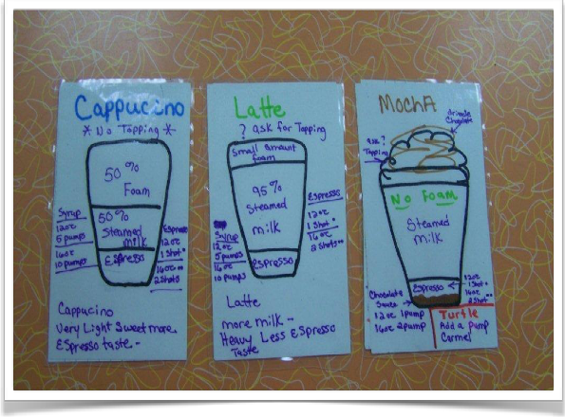
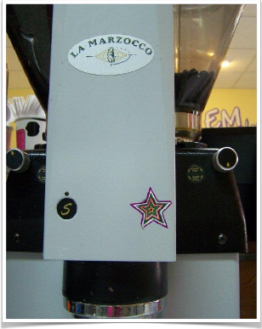
Grinder/flash cards

Slide 25
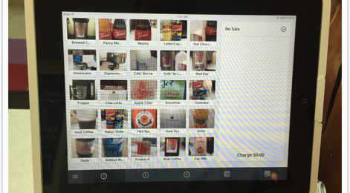
Cash Register

Slide 26
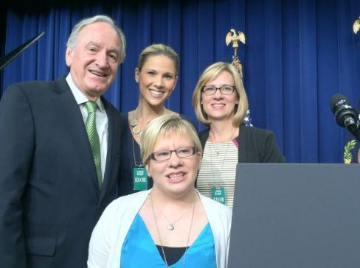
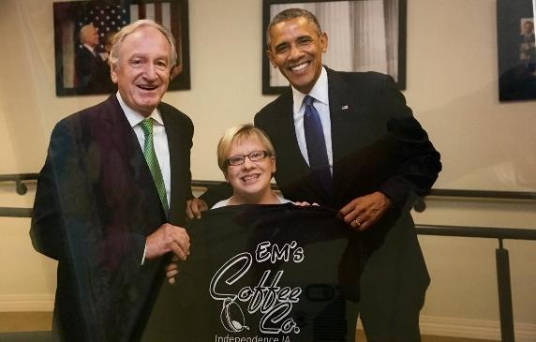
Em goes to the White House for signing of WIOA

Slide 27
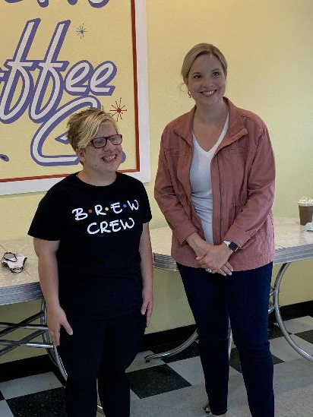
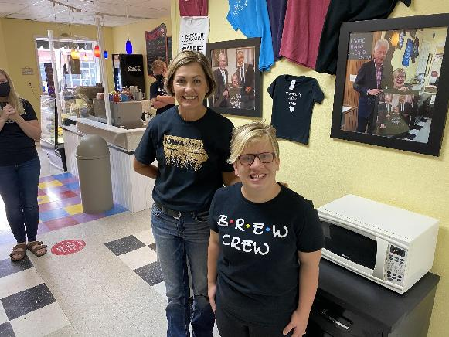

Slide 28
Financial: ABLE Accounts
Sara Hart Weir, Executive Director, KS DD Council
Whit Downing, Vice President of Policy and Programming, KS DD Council

Slide 29


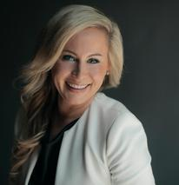
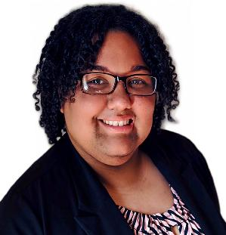
Sara Hart Weir
Executive Director
Whit Downing
Vice President
Policy & Programming

Slide 30
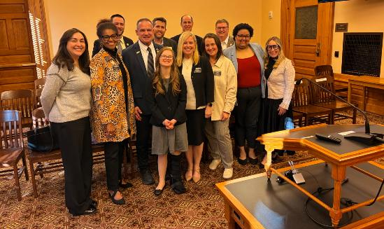

Our Mission: Empower individuals with intellectual and developmental disabilities (I/DD), families and caregivers to lead systems change, build capacity, and advocate for inclusive, integrated, accessible communities where everyone belongs and thrives throughout Kansas.
Picture of KCDD Staff (Whit, Lola & Sara) with Members of the Kansas State House Social Services Committee and Kansas State Treasurer after a hearing on ABLE Accounts on 3/2/26
Notes:
SARA

Slide 31
Meet Sara
Professional background
  Former CEO of the National Down Syndrome Society
  Led passage of the ABLE Act
  Executive Director of KCDD
Served as a co-guardian to a woman with Down syndrome
Experience navigating federal and state policy and leadership spaces
Headshot of a Sara smiling blonde woman wearing a white blazer over a black top, photographed against a dark background

Slide 32

Meet Whit
Role at KCDD
  Vice President of Policy and Programming
Self-advocate with lived experience
  Autism
  PTSD
  ADHD
Why this work is personal, not abstract
Passions
Headshot of Whit Downing. She is smiling, wearing glasses, has brown skin, and chin length hair. Wearing a black blazer.

Slide 33
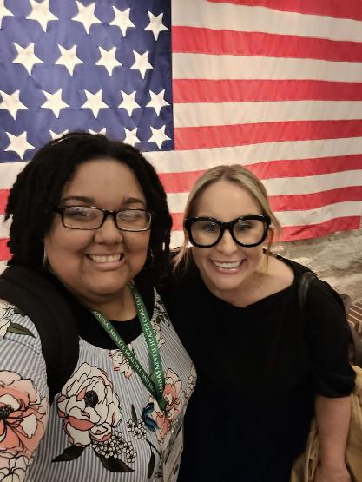

The Future We Can Build
Imagine a Workforce Where:
Support is normal
Leadership is expected
Disability is not disqualifying
Growth is accessible to everyone
That future is already being built!
Sara and Whit smiling with the US Flag in the background.
Notes:
Whit:
You don’t just change one career.
You strengthen families. You strengthen organizations. You strengthen communities.
The talent is already there.
The potential is already there.
We just have to build systems brave enough to welcome it.

Slide 34
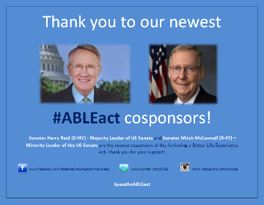
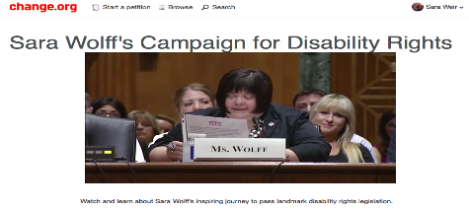
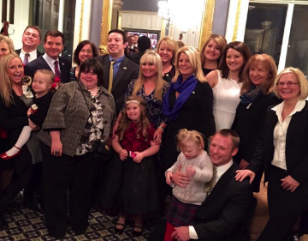
The “ABLE Act” Story
85% of the entire US Congress supported the ABLE Act
  381 out of 435 in the US House of Representatives
  78 out of 100 in the US Senate
ABLE is one of the most significant pieces of disability legislation since the Americans with Disabilities Act (ADA) was enacted in 1990
Almost 50 state ABLE laws since 2015
ABLE Act has been improved by Congress 4 times since 2015

Slide 35


What is an ABLE Account?
ABLE accounts are savings and investment tools, built specifically for people with disabilities, that allow them to save money without impacting public benefits. ABLE accounts are offered under Section 529A of the U.S. Tax Code.
Notes:
TOM

Slide 36
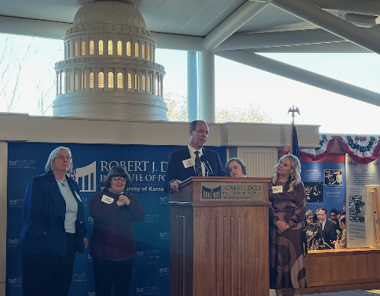


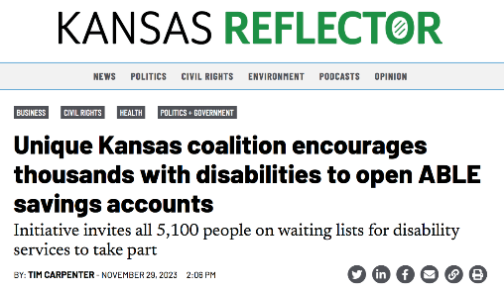
A Partnership to Help Kansans with Disabilities to Save & Invest for the Future

Slide 37




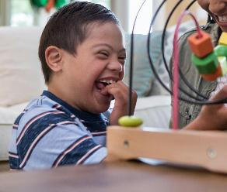

IDD Waiver Waitlist Campaign & Roadshow
Financial Literacy & ABLE Education for Foster Youth with Disabilities
Invest from the Start - Trump Accounts & ABLE Accounts
Notes:
About 1,050 babies are born each year in Kansas with a birth defect — that’s a structural or functional disability present at birth.

Slide 38
sara@kcdd.org whit@kcdd.org

Slide 39
Artificial Intelligence and VR
Felicia Johnson, Director, South Carolina General Agency
Jason Colson, Chief Information Officer, South Carolina General Agency

Slide 40

South Carolina Vocational Rehabilitation Department
AI Chatbot System
Jason Colson
Chief Information Officer
Felicia W. Johnson
Commissioner

Slide 41
Identifying the Opportunity…
Leadership Direction
Commissioner Johnson directed exploration of how AI could enhance SCVRD operations.
Exploration
IT staff reviewed AI chatbot capabilities, identifying an opportunity to develop an internal tool for fast, clear summaries.
Operational Need
Staff retirements and turnover have created critical knowledge gaps. An AI chatbot can accelerate onboarding and support knowledge transfer.

Slide 42
Value to SCVRD
“VRONICA: VR Online Information Chatbot Assistant”
VRONICA represents a scalable, sustainable solution to improve how SCVRD delivers services statewide.

Slide 43
What does VRONICA support?
Internal Agency Resource
Knowledge
Transfer
Quick Access Guide
Agency Memos
Fees & Codes
Policies & Procedures
Improve Training & Onboarding
Increase Productivity
Acronyms, Terms & Definitions

Slide 44
Key Project Partnerships
Microsoft solution architects partnered with SCVRD IT team to assess available resources and security measures.
Collaborated with the SC Department of Administration to review use cases, plan implementation, and secure system approval.
SC Department of Administration supported onboarding and provided foundational training for platform management and maintenance.

Slide 45
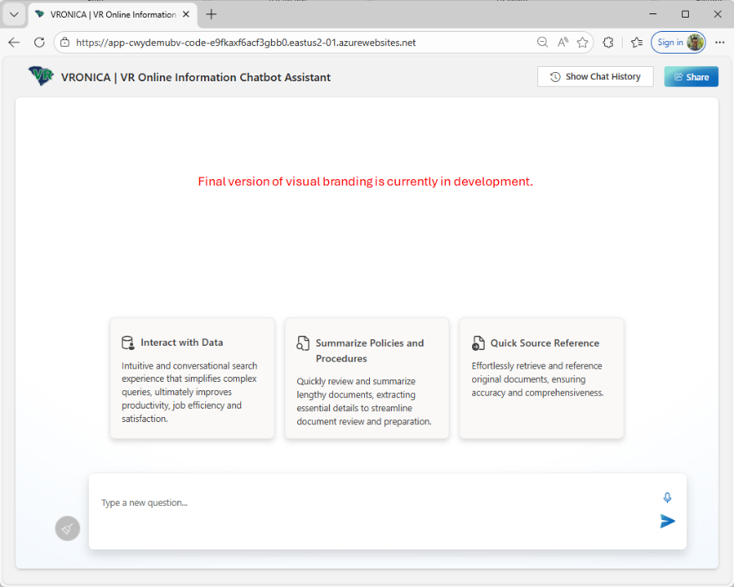

Slide 46
Challenges and Considerations
Data Quality & Grounding
  Ensuring content is accurate, current and well-structured
Retrieval Relevance
  Improving search relevance across large volumes of content
Prompting & Guardrails
  Preventing hallucinations and ensuring source-based answers
Evaluation & Quality Assurance
  Measuring accuracy, monitoring drift, and analyzing user feedback
Content Lifecycle Management
  Maintaining, updating, and governing content to ensure long-term accuracy and relevance

Slide 47
Key Outcomes and Impact
Increased Operational Efficiency
Improves counselor to
consumer interactions
Knowledgebase Improvement
Continuous improvement driven
by real user questions and trends
Strong Quality Control
Identifies outdated
or conflicting content
Better Content Organization
Simplifies updates and improves search accuracy
Human-in-the-Loop
Ensures continuous monitoring and oversight for long-term success

Slide 48

Next Steps
Building the Face of Our AI Chatbot
We are actively developing a visual identity that reflects SCVRD’s mission and enhances user engagement.
Focus Areas:
Brand alignment (SCVRD look and feel)
Accessibility and clarity for all users
Consistency across digital tools

Slide 49
Wrap Up
Thank you for attending our Educational Lunch and Learn event!

