Slide 1




Building Smarter Systems
How Quality Data Enables Responsible AI in VR

Slide 2
Welcome and Introductions
Speakers & Team

Slide 3

Notes:
Worldwide spending on artificial intelligence (AI) was projected to approach $1.5 trillion in 2025 and exceed $2 trillion in 2026.
Adoption is everywhere.
https://www.gartner.com/en/newsroom/press-releases/2025-09-17-gartner-says-worldwide-ai-spending-will-total-1-point-5-trillion-in-2025

Slide 4

The GenAI Divide: STATE OF AI IN BUSINESS 2025
  Adoption is high, but positive disruption remains low
  “Despite GenAI’s visibility, only two industries (Tech and Media) show clear signs of structural disruption, while seven others remain on the wrong side of transformation.”
Notes:
The GenAI Divide: State of AI in Business 2025, MIT NANDA, July 2025. chrome-extension://efaidnbmnnnibpcajpcglclefindmkaj/https://mlq.ai/media/quarterly_decks/v0.1_State_of_AI_in_Business_2025_Report.pdf

Slide 5

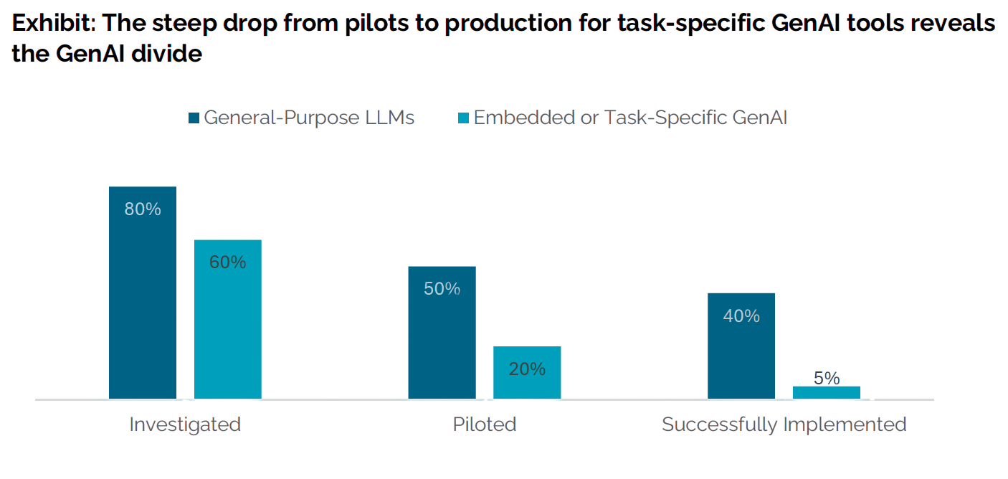
The GenAI Divide: STATE OF AI IN BUSINESS 2025
Notes:
The GenAI Divide: State of AI in Business 2025, MIT NANDA, July 2025. chrome-extension://efaidnbmnnnibpcajpcglclefindmkaj/https://mlq.ai/media/quarterly_decks/v0.1_State_of_AI_in_Business_2025_Report.pdf

Slide 6


01.
RECOGNIZING DATA LIMITATIONS
02.
SYSTEMS-LEVEL COMMITMENT TO QUALITY
03.
DATA AND AI LITERACY
Responsible AI

Slide 7

Data Limitations

Slide 8

AI is Only As Good as Its Data
“The importance of data quality in AI cannot be overstated: poor data quality is one of the most common reasons AI initiatives fail.”
Notes:
https://www.ibm.com/think/topics/ai-data-quality

Slide 9

“While less flashy than cutting-edge algorithms or ambitious use cases, this foundation of structured, accessible, high-quality data represents the essential precondition for sustained AI success.”
Notes:
https://www.ibm.com/think/topics/ai-data-quality

Slide 10
Defining Quality in AI
  Data Accuracy
  Completeness
  Data Integrity
  Consistency
  Timeliness
  Relevance
Notes:
https://www.ibm.com/think/topics/ai-data-quality

Slide 11

The State of Quality Data in VR
  What was provided?
  How much of it was provided?
  What was the impact of what was provided?

Slide 12

Insights From Pre-ETS
  What was provided?
  How much of it was provided?
  What was the impact of what was provided?

Slide 13

Case Study
Notes:
https://www.ibm.com/think/topics/ai-data-quality

Slide 14


01.
ACCURACY & RELEVANCE
02.
CONSISTENCY & TRANSFERABILITY
03.
FEASIBILITY
TRT & Quality Data
Notes:
Project helped us "dream" a little bit about what could be in terms of seeing quality. Team, especially state leads helped us see data in a new way- helping us see what was missing in what is currently available.

Slide 15










Workplace
Soft Skills
Counseling on
Post-Secondary Enrollment
Job
Seeking
Write your topic
or idea
What Was Provided? And When?
Job Exploration Counseling
Job Exploration Counseling
Independent Living
Write your topic
or idea
Write your topic
or idea
Instruction in Self-Advocacy
Financial
Literacy
Work-Based Learning
Communication & Social Skills
Notes:
Critical parts of our process that helped us get to quality:
We needed to define (first listen and identify, then find consensus)
We needed to identify what might be changing
We needed measure the primary change

Slide 16

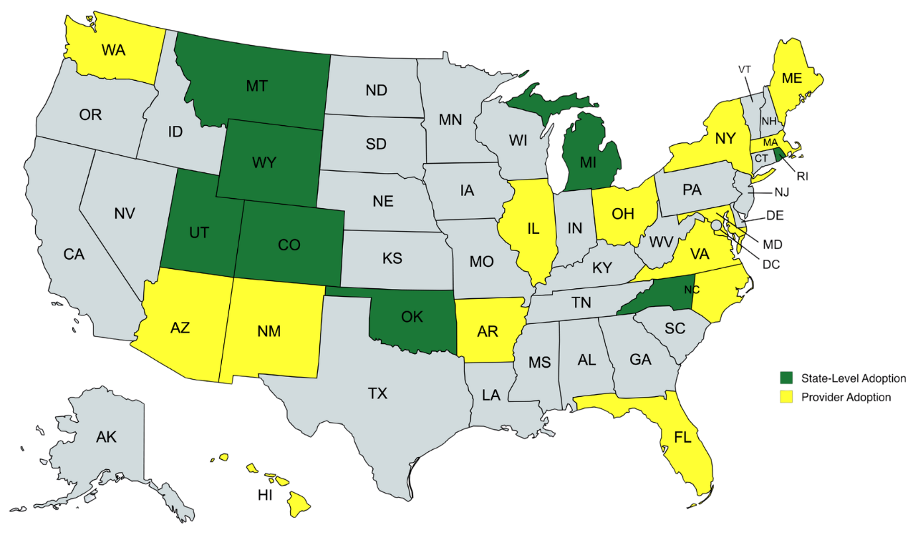
CURRENT USERS
  Arkansas
  Best Buddies
  Colorado
  Michigan
  Montana
  North Carolina
  Oklahoma
  Pennsylvania
  Rhode Island
  Utah
  Wyoming
Notes:
Case study is built on this current group of users. Critical team members in implementation, helped us understand and adjust to what is needed by providers if they are going to be able to successfully implement.
The data from this case study is built from a survey administered to these states.

Slide 17

To date, more than 80,000 responses from 17,000 students!

Slide 18
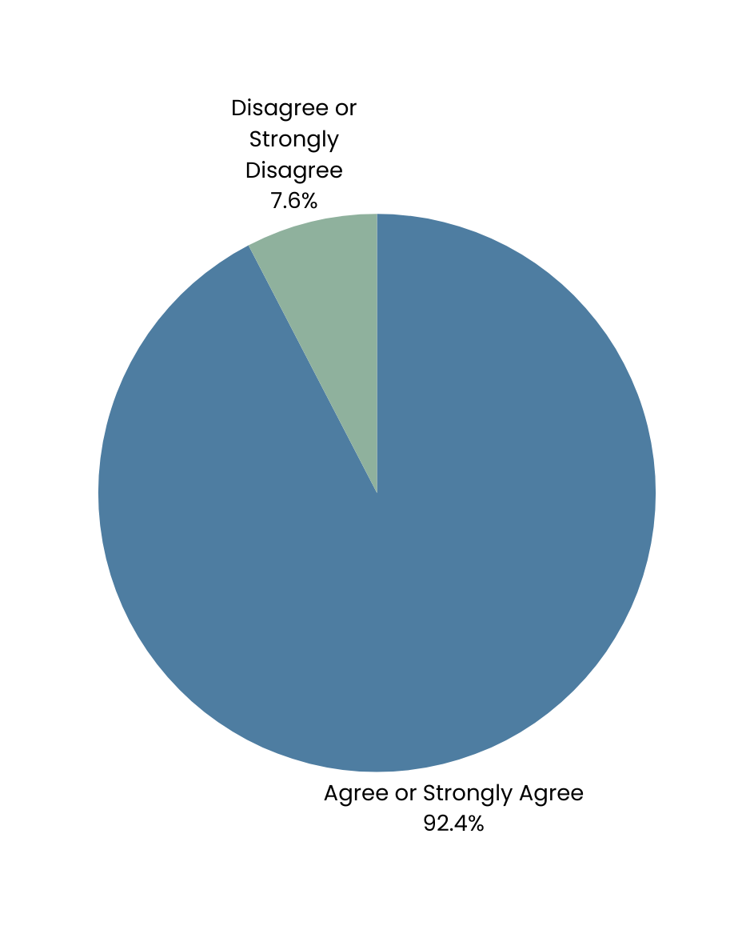
Easy to Administer
*Based on a user survey (N = 155)
Notes:
We had to meet the providers where they were. This included:
Flexible administration
Brief
Accessible
Multiple languages

Slide 19
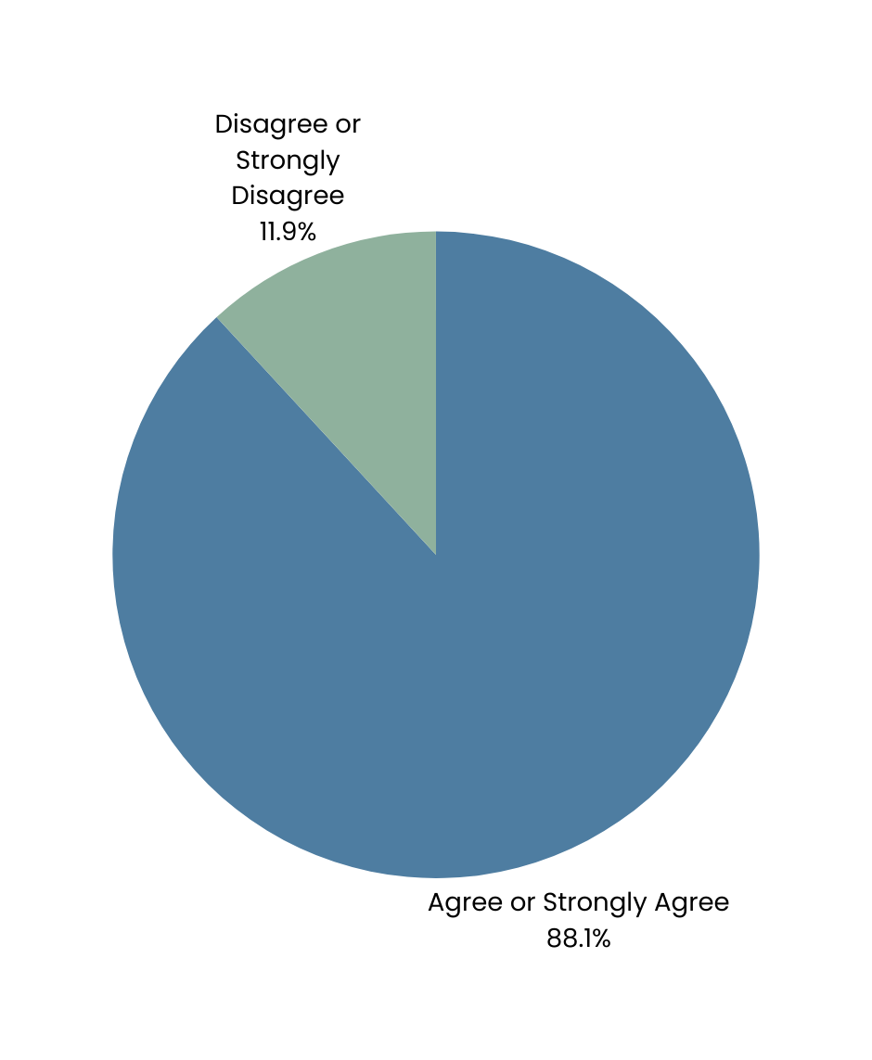
Quick to Complete
*Based on a user survey (N = 155)

Slide 20


Garbage in Garbage Out
Compliance in Compliance Out
Quality in Quality Out

Slide 21

Systems Level Commitment to Quality

Slide 22

Motivation is High
The Rehabilitation Services Administration’s Monitoring and Technical Assistance Guide (U.S. Department of Education, 2023) uses the word quality a total of 43 times. A direct quote from page 13 of this guide states,
  RSA will assist VR agencies with the provision of technical assistance to promote continuous improvement in the VR and Supported Employment programs, maximizing the provision of quality of services, including pre-employment transition services for students with disabilities, ensure quality employment outcomes for VR participants, and improve the validity and reliability of program data to assist the VR agency in making data-driven and strategic program management decisions.

Slide 23

Culture of Data & Evaluation
  There are 414 required elements in the RSA 911 System
  Approximately 316 of these Require Active Data Entry by State Agencies.

Slide 24


Slide 25
Case Study
Notes:
https://www.ibm.com/think/topics/ai-data-quality

Slide 26
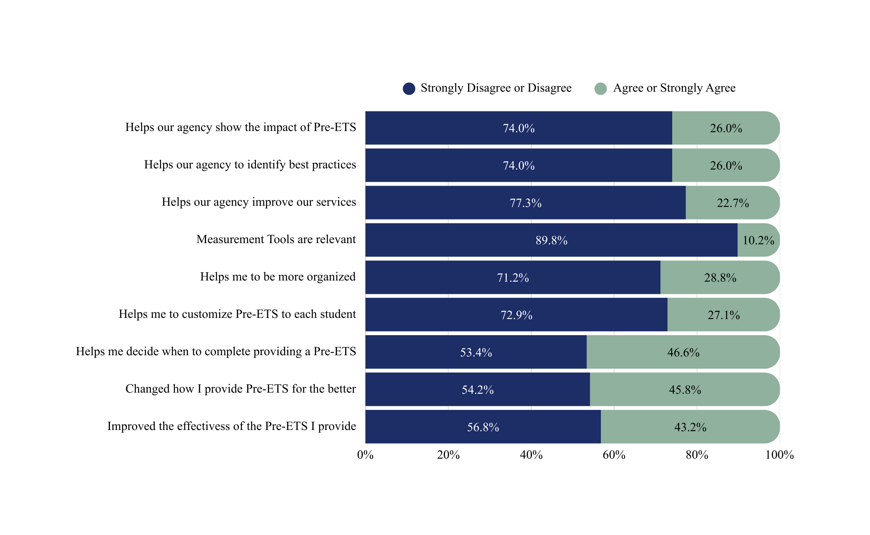

Slide 27

It is difficult to say that we are serious about measuring quality of services until we are measuring the change resulting from those services.

Slide 28

Current Levels of Data and AI Literacy

Slide 29

Data and AI Literacy
  Multiple studies have reported on challenges with Data Literacy among VR Counselors
  A recent unpublished study showing limited AI literacy
Notes:
https://www.ibm.com/think/topics/ai-data-quality

Slide 30

Shifting Tides in Technology Require Fresh Eyes
Notes:
https://www.ibm.com/think/topics/ai-data-quality

Slide 31


Slide 32
Case Study
Notes:
https://www.ibm.com/think/topics/ai-data-quality

Slide 33


Notes:
https://www.ibm.com/think/topics/ai-data-quality

Slide 34

  Improving Services
  Sequencing Services Based on Clinical Data
  Customizing Services Based on Clinical Data
  Monitoring Services Based on Clinical Data
  Creating more efficient services without sacrificing quality
Quality Data + Quality AI = Endless Possibilities

Slide 35


Don’t Be Shy

Slide 36
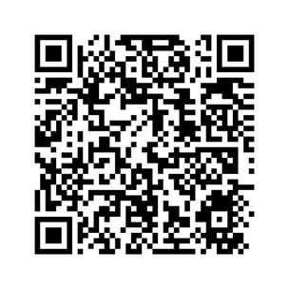

More on the TRT and Quality data:
Thank you
Have any questions?
brian.phillips@usu.edu
apf5208@psu.edu

