Slide 1

Reducing Systemic Friction to Advance Competitive Integrated Employment
CSAVR Spring Conference, DC
March 31st, 2026
Alberto Migliore, Suzzanne Freeze, Russ Thelin
University of Massachusetts Boston
Institute for Community Inclusion

Slide 2
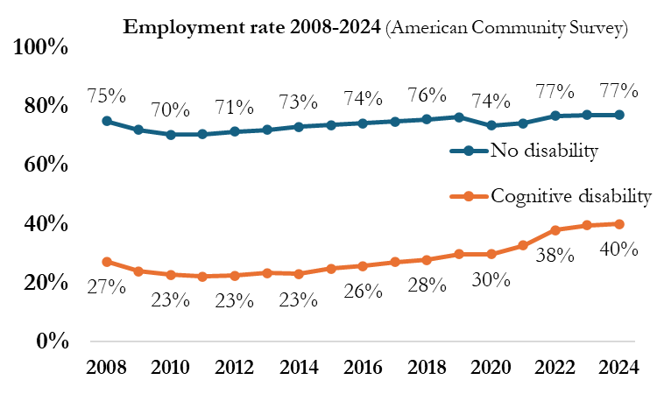
Is the service delivery system working as it should?
Legislation prioritizes competitive integrated employment.
However, current outcomes do not yet reflect these national priorities.

Slide 3
Medicaid-funded Day Services (IDD)
Winsor, J., et. Al., (2025). State Data: The national report on employment services and outcomes .University of Massachusetts Boston, Institute for Community Inclusion.

Slide 4
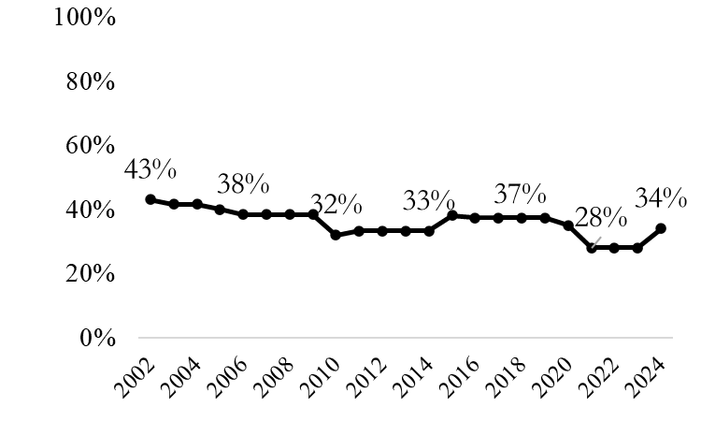
Vocational Rehabilitation Outcomes (RSA911)
Percentage of people with ID exiting VR with employment (Tot N=~30,000)
https://www.thinkwork.org/statedata/chart-builder

Slide 5
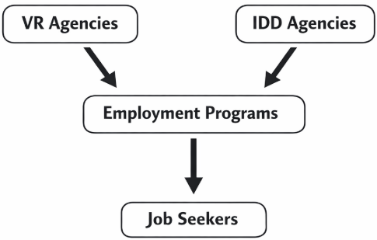
Introducing a Key Player: Employment Programs
Employment programs are community-based organizations, primarily non-profit, from which VR and IDD agencies purchase services. They are often referred to as ‘vendors.’
They are an essential infrastructure of the employment service delivery system.

Slide 6
Key questions
What challenges hinder employment programs from scaling outcomes faster?
What state-level barriers emerge in multi-funder systems (e.g., VR/Medicaid) that can affect scaling up outcomes faster?
What role can transformational leadership play in this context?

Slide 7
Part 1
What challenges hinder employment programs from scaling outcomes faster?
Understanding these challenges is a key first step toward reducing friction in the service delivery system and improving competitive integrated employment outcomes.

Slide 8
A Fragmented Landscape: The Source of Systemic Friction
The Funding Maze: Navigating a "braided" maze of funding (VR, IDD/Medicaid, Mental Health, Counties, other).
Misaligned Models: Reconciling divergent reimbursement structures (Fee-for-Service vs. Milestones vs. Outcomes).
The Compliance Burden: Managing distinct reporting and compliance requirements for every funding stream.

Slide 9
The Unintended Consequences of Fragmentation
Operational Friction: Authorization delays and administrative overhead slow down service delivery.
Human Capital Crisis: Systemic frustration fuels staff turnover, stalling the implementation of best practices.
ROI: When employment programs struggle, VR’s effectiveness is diminished—as is the entire service delivery system.

Slide 10
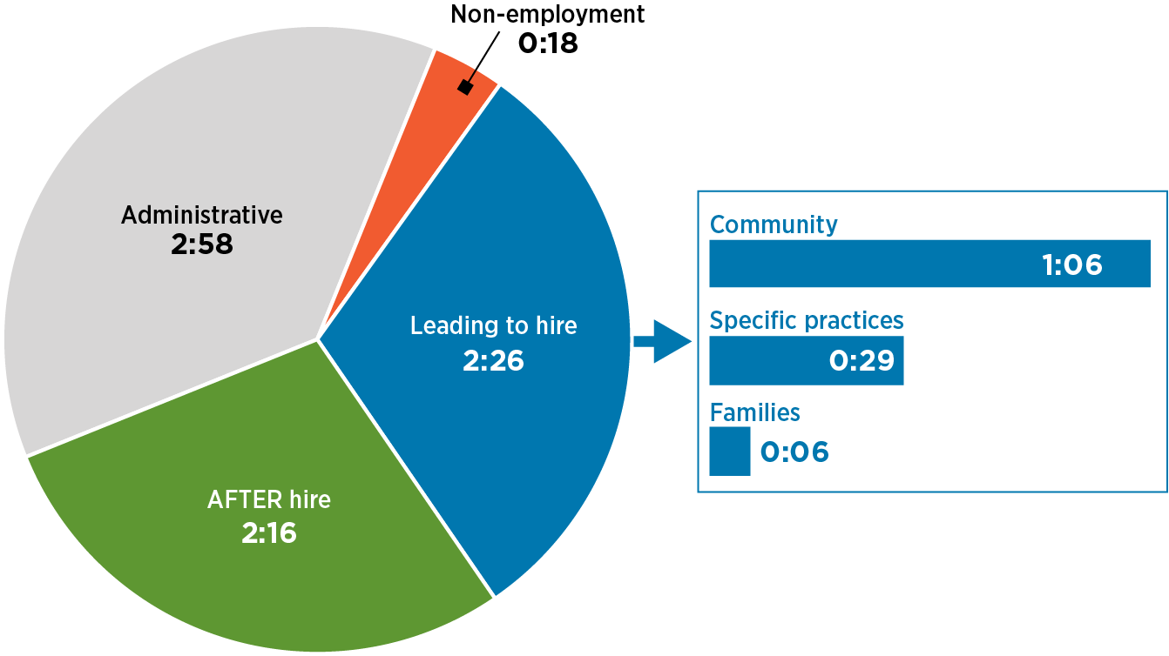
Inside the Workday of Employment Consultants (EC)*
Hours and minutes per day dedicated to key activities and best practices
(N=13 employment programs, 96 EC, over 12-month, 2023-25)
*Employment consultants (EC) are the frontline professionals in employment programs who manage the end-to-end process from intake to post-hire support. They are also referred to as employment specialists, job developers, job coaches, etc.
Migliore, A., Wedeking, R., Healey, S., Eastman, J., Mahoney, D., & Winsor, J. (2026). Inside the workday of employment consultants: New insights on strengthening employment services. Journal of Vocational Rehabilitation. 64(1), 61-72.

Slide 11
Employment Consultants’ Feedback
… If I had the resources, I would hire staff to work with businesses. Finding clients to serve isn’t the problem; the real goal is expanding our reach and influence within the business world…#518
… many clients are moving straight into a job search. While this is faster, it skips a critical step in the process, creating a high risk of poor job matches and ultimate failure for the client… #100
…Staff may block out several hours and drive to a meeting location, but if the client doesn't show up, the agency cannot bill for that time, despite staff's wages and travel cost...#205
… There is no standard for how information is shared. Sometimes, I get a referral that only lists their name, age, location, and diagnosis. Other times, I get a comprehensive report covering everything. Inconsistency makes it difficult to prepare…. #313

Slide 12
Employment Consultants’ Feedback
… my dream is to have a single digital platform that all service providers share. It would be a huge help if I could see how they [clients] are doing at home. Having one place for all relevant information would give us a "holistic" view of what is working and what isn't…. #795
… Many job seekers keep coming back for help because their previous jobs weren't a good fit. If we focus on finding the right job match from the start, we would free up providers to help more people. … #220
… if you find a job before the authorization paperwork has caught up, you aren’t reimbursed for the outcome… #240
… residential staff have a huge influence over job seekers we serve, especially when jobs don't fit a standard 9-to-5 schedule… #231

Slide 13
Family Members’ Feedback
… If you aren't already signed up for a county waiver, Vocational Rehabilitation, or a school transition program, there is no clear "front door." People don't know who to call or which step to take first. While there are plenty of websites out there, they are scattered and confusing…. #900
… Just because you work in social services doesn’t mean the families understand the system—it’s actually very confusing for them. Making sure everyone understands the process and the support available is the most important first step… #920
…I’m not sure the provider really takes the time to see if a job is a good fit before trying to place someone. I was very frustrated recently: my son finished his training and checked in with his employment consultant in April, but then he didn't hear a word for months… #850

Slide 14
Tentative Solutions
Typical solution: More frontline staff training and certification.
Edwards Deming’s principle: “…85% of the problems in organizations are problems beyond the control of the frontline service providers. Only 15% are problems that the frontline persons, in fact, can change by themselves to improve the quality of service delivery…” (Albin, 1992, p.vii)
Albin, J., M. (1992 Quality improvement in employment and other human services: Managing for quality through change. Baltimore, MD, Paul Brookes Publishing Co.

Slide 15
Questions, Comments?
Given Deming’s 85/15 principle—outcomes depend on systems, not staff—what structural system change(s) would you tackle to support employment programs scale Competitive Integrated Employment (CIE) faster?
What structural system change is needed to disentangle the funding maze (Medicaid, VR, MH, Counties, others) so employment programs can focus on scaling CIE faster?
Family feedback highlights a confusing 'front door' to services. What would make the pathway to employment clearer for the families in your state?

Slide 16
Part 2
What state-level barriers emerge in multi-funder systems
(e.g. VR/Medicaid)?

Slide 17
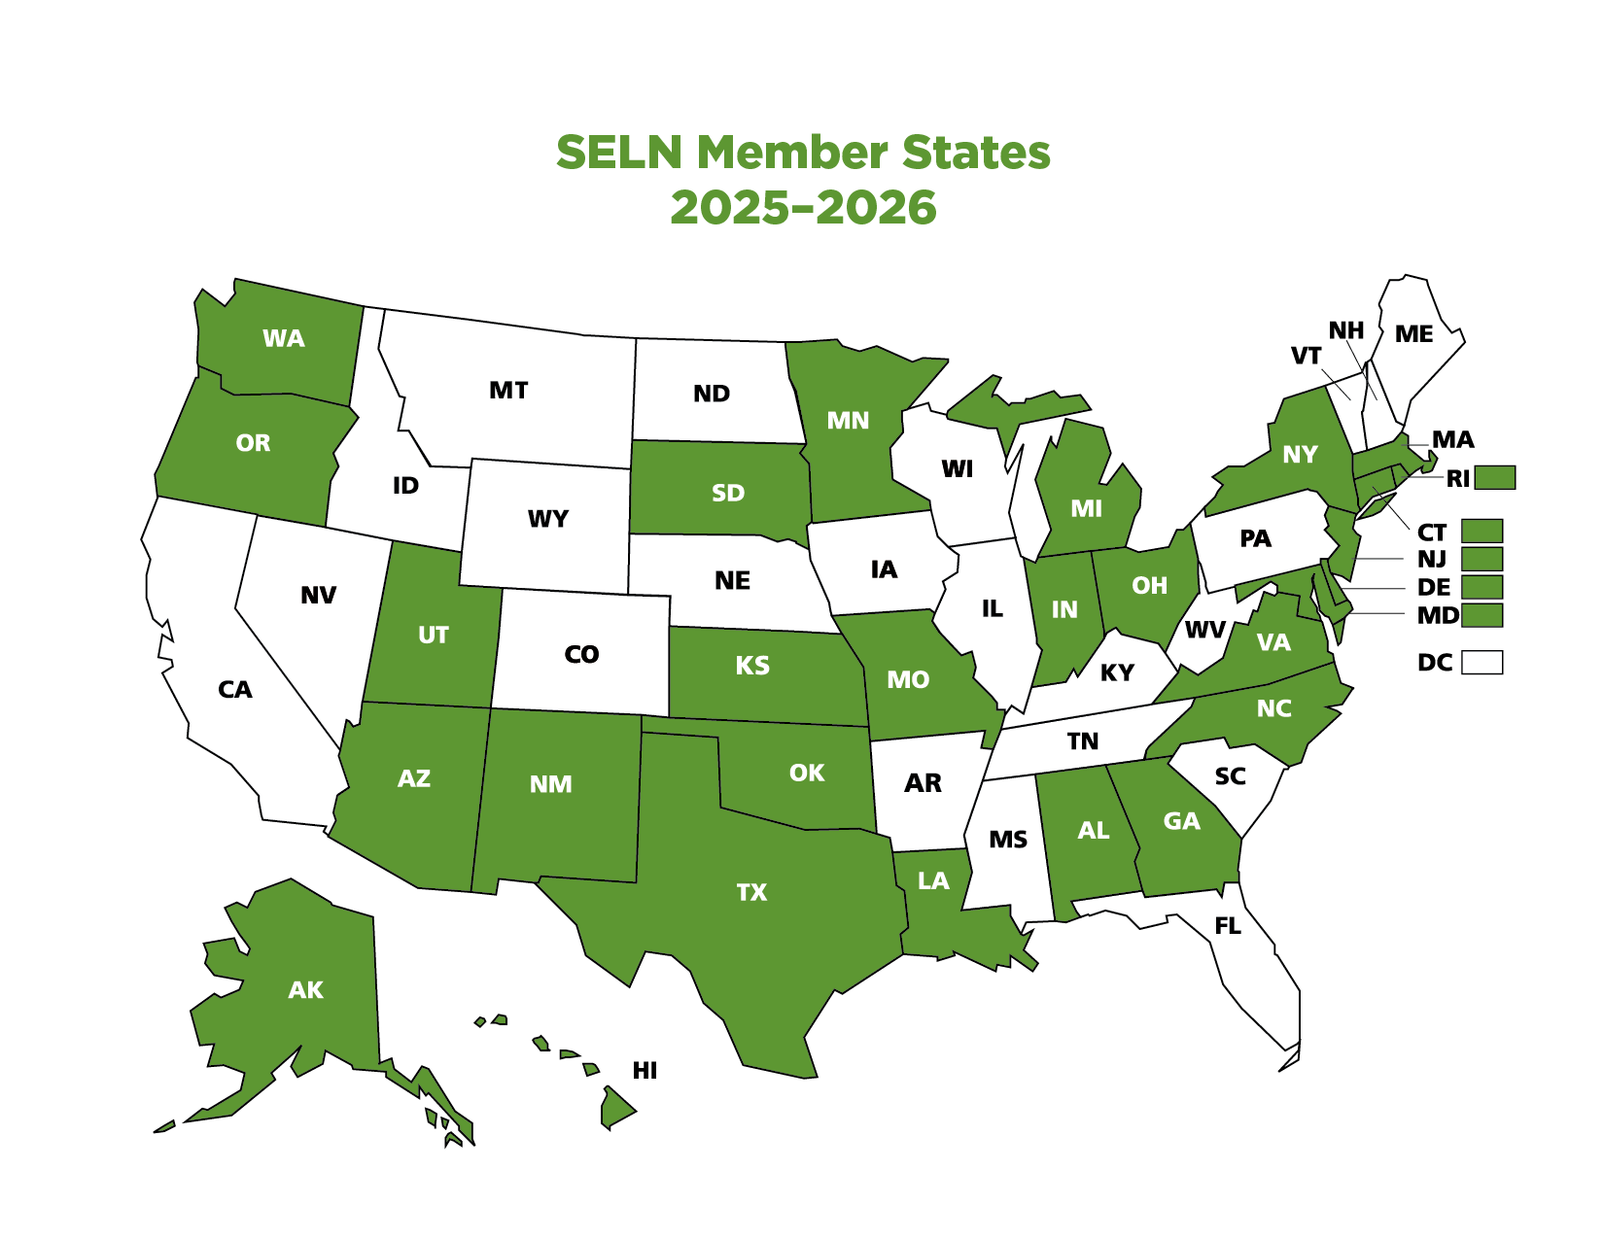
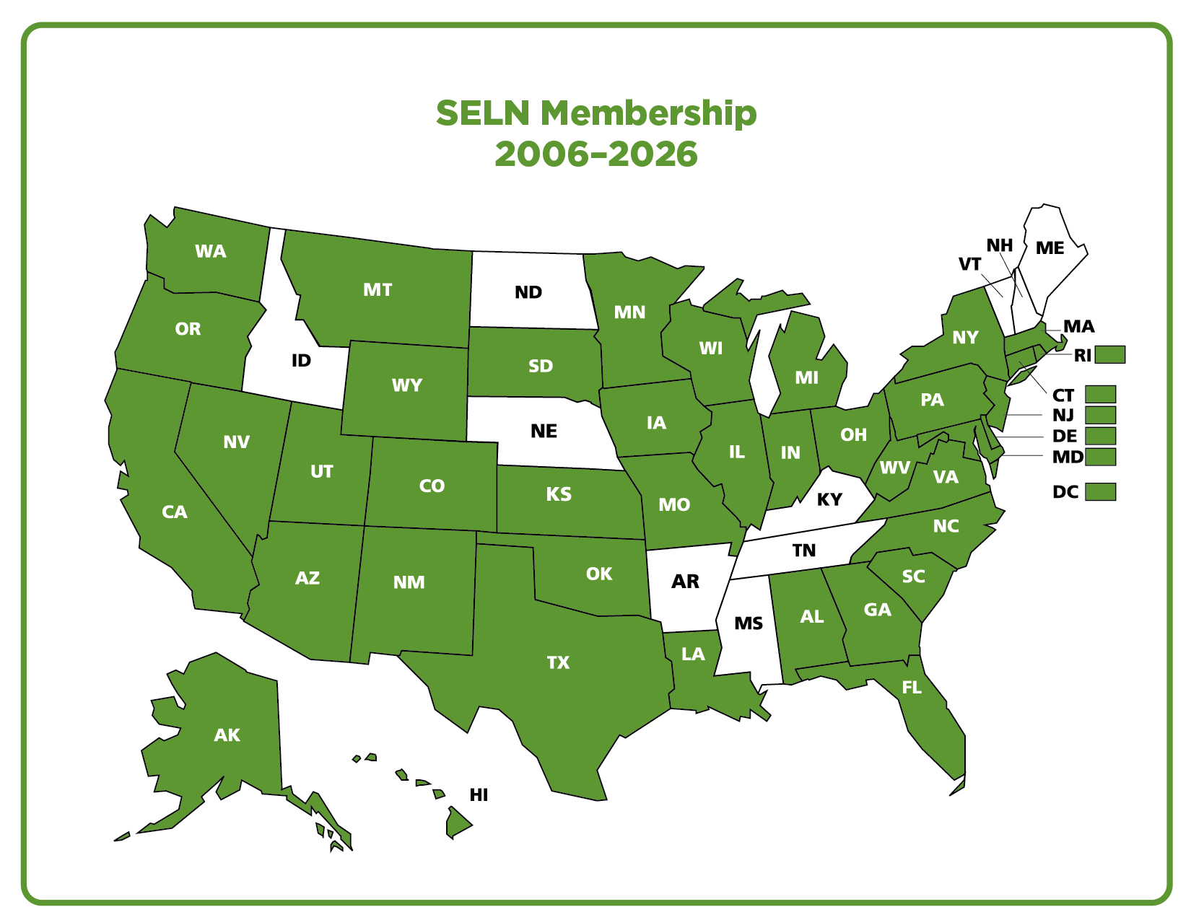
Notes:
Let’s talk about insights shared by states invested in the State Employment Leadership Network (SELN). Current map reflecting 28 member states in the 2025-2026 membership year. Smaller picture is of all states that have been members since our inception in 2006.

Slide 18

"Life always involves friction either positive, negative, or neutral. When friction stops, life stops." — Garry Fitchett
Notes:
Friction prevents entropy or stagnation. In systems-thinking, especially human services, it is never ‘set it and forget it’.

Slide 19
Mastering the Interplay Across Systems
Who funds what?
What do the requirements dictate?
What happens in reality?
Where do the issues arise?
What is the impact of these and related decisions?
Notes:
Invested in the shared conversations for over 20 years

Slide 20
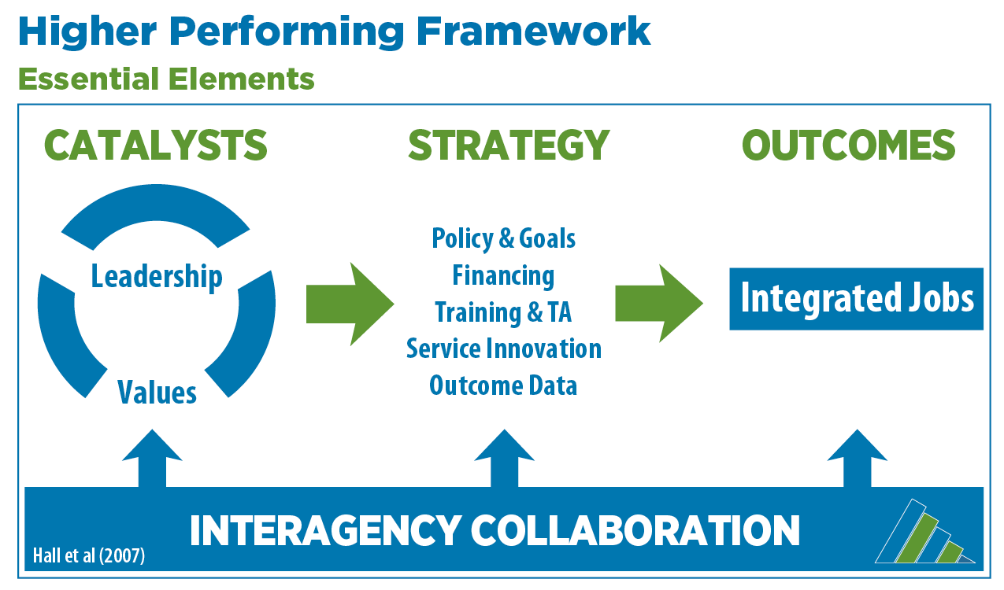
Bringing Order to the Inherent Complexities
Notes:
Invested in the shared conversations for over 20 years, how research has informed practice, describe the HPF

Slide 21
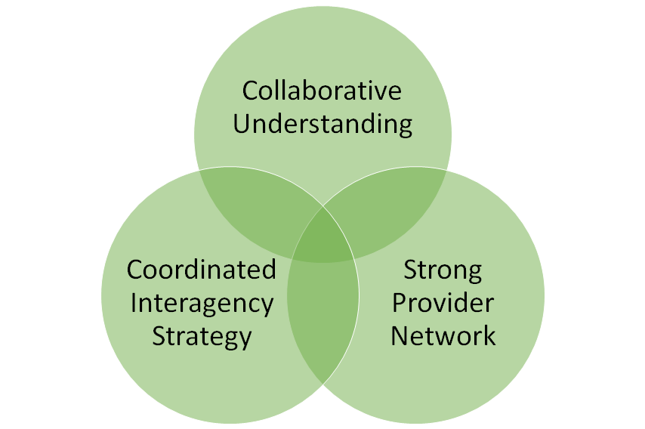
Common Observations
Notes:
Collaborative understanding: who needs to understand when to tap your services, how do you know how that is going, etc.
Coordinated interagency strategy: how is this cultivated, how do you know the health of this strategy, how often is that assessed, who contributes feedback, etc.
Strong provider network: are dual vendors a goal, how often are shared funding discussions held, etc.

Slide 22
Getting from A to B to M, back to G to W to…
Formal agreements
Routine meetings
Communications
Relationship building
Competency development
Advocacy roles
Family engagement
Legislative connection
Notes:
What tools are states using to establish order in these complex systems?
Must have mechanisms that connect the systems. How many systems? Depends on your state: VR, IDD, Education, Workforce, Substance Abuse, Aging, others?
Common elements in the intersystem collaboration and partnerships:
MOUs or IAs, Regular meetings, Communications, Relationship building, Competency development, Advocacy roles, Family engagement, Legislative connection.

Slide 23
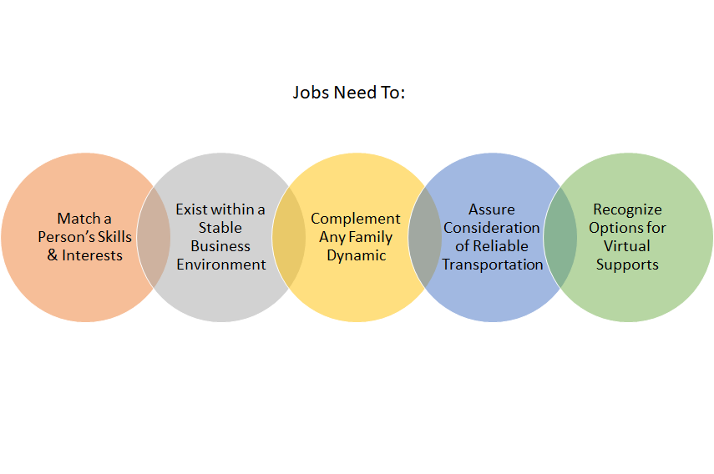
Remember! Our work impacts people.
Notes:
There are formal performance metrics, regulations, funding requirements, all of the formalities that we have discussed. But at its core, this is about the people we support, and we can simplify processes for them and ourselves, or we can stay stuck in the complexities. Without striving to get it right we risk alienating the very people we work to support.

Slide 24
Questions, Comments?
The Multi-Funder Maze
In your experience with sequenced, braided, or blended funding (VR, Medicaid, other), what is a barrier that, if removed, would reduce the burden on both your agency and the providers?
What current activities between your systems are high value and high return? And how do you know?

Slide 25

Part 3
Transformational Leadership Approach to
Addressing a Fragmented Landscape

Slide 26

So. . .
  You’ve seen the national data and feedback.
  You’ve seen the state-level barriers.
  We likely agree that expectations at both levels is for greater CIE for individuals with ID.
Where do you go from here?

Slide 27

The Path Forward: We want to hear from you
What we hope to do is to give you some transformational leadership prompts to help you find your own answers.
Over the next several slides, make notes of what comes to your mind in how you can take leadership action to make transformational change

Slide 28
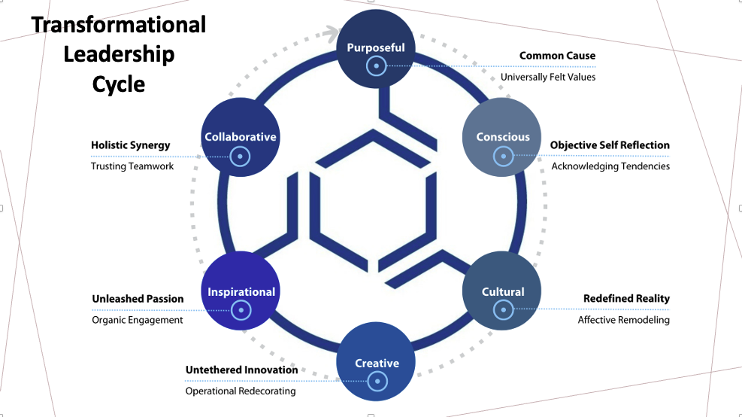

Slide 29

Transformational Leadership
The Role of Purpose in Systemic Transformation
  What drives your system?
  What are the predominant values?
  What would your “Prime Directive” be if put into words.
  Are these the drivers, the vision, the values you want?
  Is the default toward “doing” or “being”?

Slide 30

Transformational Leadership
Conscious Leadership in Systemic Transformation
  Objective self-assessment is key.
  Is there willingness to acknowledge the “ripple effect”?
  Are our system partnerships real partnerships?
  Do we serve the system or the people?

Slide 31
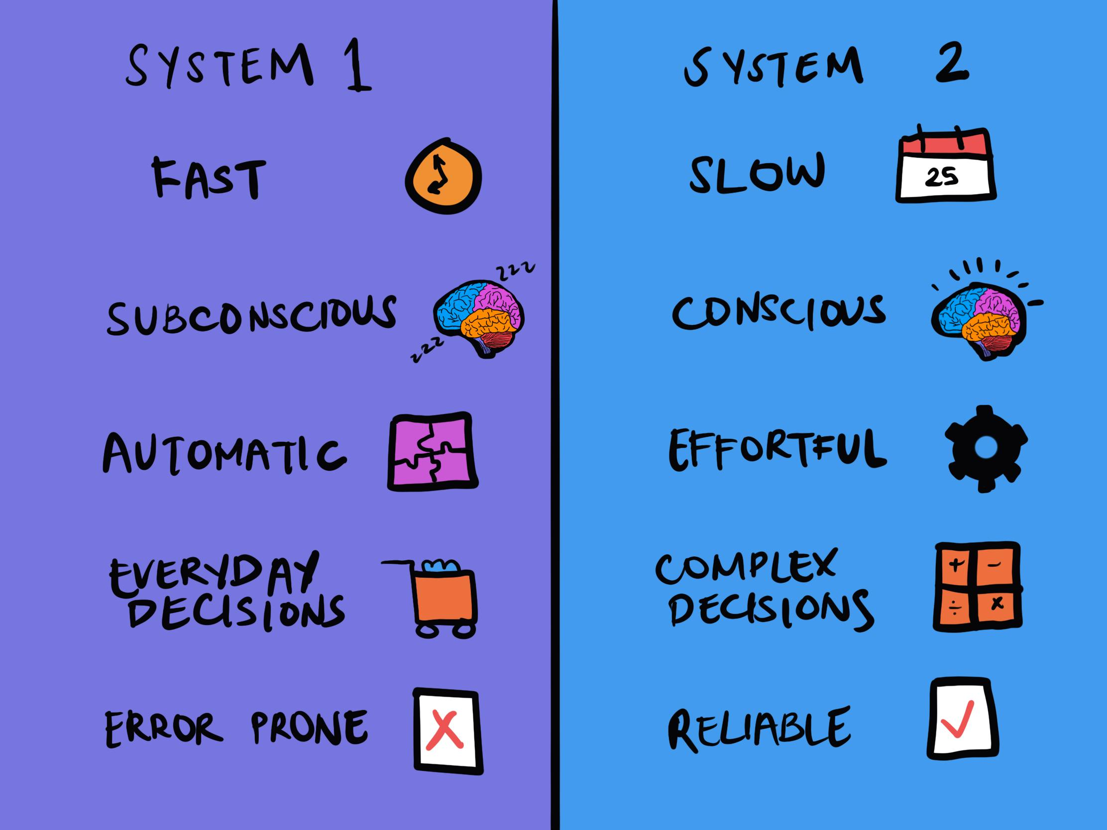
Transformational Leadership
Cultural Change for Systemic Transformation
  “Culture eats strategy for breakfast” –Peter Drucker
  Is our culture grounded in System-1 or System-2 thinking?
  What cultural realities in your organization need addressing around employment of adults with ID?

Slide 32

Transformational Leadership
Creative Leadership for Inspired Systemic Transformation
  Creativity and inspiration are intrinsically linked.
  Creativity in problem solving leads others to feel inspired and inspired people generate impactful creative solutions.
  How might you bring creativity into formulating answers?
  How can you instill inspiration that leads to creativity?

Slide 33

Transformational Leadership
Leading Collaboration for Systemic Transformation
  Having aligned purpose, culture, creativity, and inspiration fosters collaboration and not just coordination
  Coordination= organized independent processing
  Collaboration= collective interactive creativity
  What are things you can do now to build collaboration (real partnerships)?

Slide 34
Taking Actionable Steps From Our Discussion Today
Transformational Stewardship: What actionable items can you identify within your leadership scope of influence that can impact the system working with adults with ID for stability and long-term CIE outcomes?
Moving Beyond Partnerships in Name Only: What actions can you take to shift agency culture for real provider partnerships for stability and long-term CIE outcomes?
The “Ripple Effect”: What domino effect can you project (vision?) that leads to a transformed services provision system for stability and long-term CIE outcomes?

Slide 35



Questions?
Contacts:
Russ Thelin: Russell.Thelin@umb.edu
Suzzanne Freeze: Suzzanne.Freeze@umb.edu
Alberto Migliore: Alberto.Migliore@umb.edu
Visit:
thinkwork.org
selnhub.org
ntctrl.org
Funding was from the National Institute on Disability, Independent Living, and Rehabilitation Research (NIDILRR), Administration for Community Living (ACL), U.S. Department of Health and Human Services (HHS), Grant #90RTCP0011-02; ACL cooperative agreement #90DNPA0007. The opinions expressed herein are those of the authors and do not necessarily reflect the views of the funding agencies.

