Slide 1
From Onboarding to Outreach:
How NCRTM Supports VR Professionals at Every Level
Heather Servais, MS CRC CRL CVE CPM PMP
Project Manager
New Editions Consulting, Inc.

Slide 2
Learning Objectives
Understand how NCRTM supports VR leaders and agencies.
Describe the purpose and scope of NCRTM.
Identify key features of NCRTM.
Learn how to connect with NCRTM.

Slide 3

The Evolving VR Landscape
Onboarding: High staff turnover, need for consistent tools and training.
Shifting Needs & Priorities: Changing workforce demands, technology use, and service delivery methods.
Resources & Support: Scattered information, hard to know what’s reliable or up to date.
Solution: NCRTM centralizes trusted, accessible resources for all levels of VR professionals.

Slide 4

NCRTM Origin Story
Section 15 of the Rehabilitation Act of 1973 as Amended by Title IV of the Workforce Innovation and Opportunity Act (WIOA).
Funded and operated by the Office of Special Education and Rehabilitative Services (OSERS), Rehabilitation Services Administration (RSA).
Maintained through a contract with New Editions Consulting, Inc.

Slide 5
NCRTM’s Reach & Audiences
VR Leaders.
Counselors.
Providers.
Researchers.
Businesses.
Individuals with Disabilities.
Employers.

Slide 6

NCRTM Library – What’s Inside
Over 3,800+ Resources:
Podcasts.
Information Briefs.
Articles.
Toolkits.
Fact Sheets.
Access the NCRTM Library

Slide 7
Trainings & Events
Events collected from across the VR field.
Live and on-demand options available.
360+ on-demand trainings to explore.
New partner events added regularly.
Featuring TA centers, RSA grantees, and federal partners.
Many sessions offer CRC credits.
Access Trainings & Events posted on NCRTM

Slide 8

Elisha Jenkins
Director
Delaware Division of Vocational Rehabilitation

Slide 9
Accessibility (Section 508) Resources
Tutorials & simulations: Why accessibility matters.
Quick guides & job aids: Word, PowerPoint, Excel, PDFs.
Webinar accessibility tools & checklists.
Federal standards and reference materials.
Access Accessibility Resources on NCRTM

Slide 10
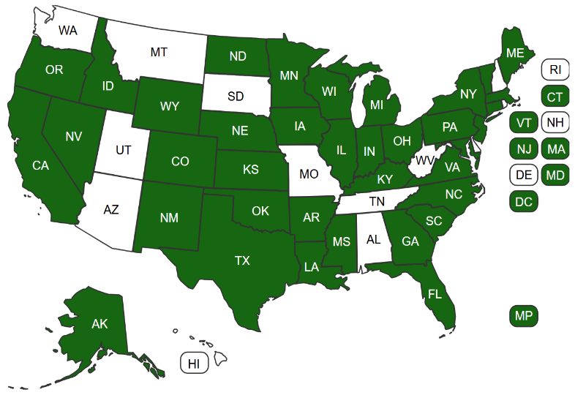
NCRTM DIF Program Page
Overview of current and past DIF projects.
Search and filter tools to explore programs.
Interactive project map.
Contractor information and support contacts.
Access the NCRTM Disability Innovation Fund (DIF) Program page

Slide 11

NCRTM Services & Programs Page
Resources targeted to Individuals with Disabilities.
Information about competitive integrated employment, career advancement, employment laws.
Starting point for VR counselors and VR customers.
Access the Services & Programs: For Individuals with Disabilities page

Slide 12

NCRTM Business Engagement Page
Information for businesses and employers.
Connections with state VR agencies.
Tools and resources to support hiring individuals with disabilities.
Access the NCRTM Business Engagement page

Slide 13

David Leon
Director of Workforce Programs
Virginia Department for Aging and Rehabilitative Services

Slide 14

Amplifying Products & Success Stories
Library.
Newsletter.
YouTube.
X.
LinkedIn.
Podcast.

Slide 15

Connect with the NCRTM
Sign up for the NCRTM Newsletter.
Follow NCRTM on X and LinkedIn.
Explore the NCRTM YouTube Channel.
Contact the NCRTM Team.

Slide 16
One & Done Re-Cap
What is one key insight from today’s session that really stood out for you?
What is one specific action you will take when you return to your agency, based on what you learned?

Slide 17

Thank you!
Heather Servais Email: hservais@neweditions.net
NCRTM Team Email: ncrtm@neweditions.net

Slide 18
Disclaimer
The National Clearinghouse of Rehabilitation Training Materials (NCRTM) is maintained by New Editions Consulting, Inc. and funded by the U.S. Department of Education (Department), Rehabilitation Services Administration (RSA). The contents of this presentation were developed under contract 91990023D0037-91990024F0377 from the Department. The Department does not mandate or prescribe practices, models, or other activities described or discussed in this presentation. The content of this presentation may contain examples of, adaptations of, and links to resources created and maintained by another public or private organization. The Department does not control or guarantee the accuracy, relevance, timeliness, or completeness of this outside information. The contents of this presentation does not necessarily represent the policy of the Department. This presentation is not intended to represent the views or policy of or be an endorsement of any views expressed or materials provided by any Federal agency. (EDGAR 75.620)

Slide 19
Sample NCRTM Library Materials
Resources from the NCRTM for Vocational Rehabilitation Counselors New to the Profession (NCRTM)
Introduction to Vocational Rehabilitation (VR) for Job Seekers (NCRTM)
NCRTM Material Spotlight Featuring Mathematica's What Works to Promote Competitive Integrated Employment Among People with Disabilities? A Systematic Evidence Review (NCRTM)
Plenty with 20: The Top 20 Tips for Acclimating New Administrators to VR (VRTAC-QM)
Smarter Outreach, Better Connections: How Artificial Intelligence (AI) Is Supporting VR Services (VRTAC-QE)
19

Slide 20
Sample On-Demand Trainings
Project Management for People Who Are Not Project Managers (NCRTM)
Managing Counselor Workload Guilt: Strategies for Achieving Balance and Prioritizing Well-Being (NCRTM)
Introduction to Section 508: What is it and Why is it Important?
(New Editions, NCRTM)
Data Literacy Training Series (VRTAC-QM)
Ethics and Artificial Intelligence (AI) (CIT-VR)
Improving Retention of State Vocational Rehabilitation Counselors (VRTAC-QE)
20

