Slide 1

West Virginia Combined (WVDRS):
Increasing Employment Outcomes
“The Secret Sauce”

Slide 2
Outcomes & Overviews PY ‘21 to PY ‘23
WVDRS increased the number of participants exiting in competitive integrated or supported employment by 59.6%.
  (907 in PY21 to 1,677 in PY23)
WVDRS Measurable Skill Gains rate improved from 49.9% to 77.6% during that same period.
Eligibility determinations remain above 90%.
  WV Combined=Less than 60 calendar days from application date.
Notes:
WVDRS increased the number of consumers we served and increased job retention cases which account for approximately half of 26 closures. We anticipate that WVDRS should experience increases in 26 closures because of the large number of applicants beginning in PY21 that will be nearing case closure, as anticipated status 26. Many consumers applied while in high school; then went on to college. The agency also elected to continue to serve job retention cases regardless of their OOS category until February of 2025.

Slide 3
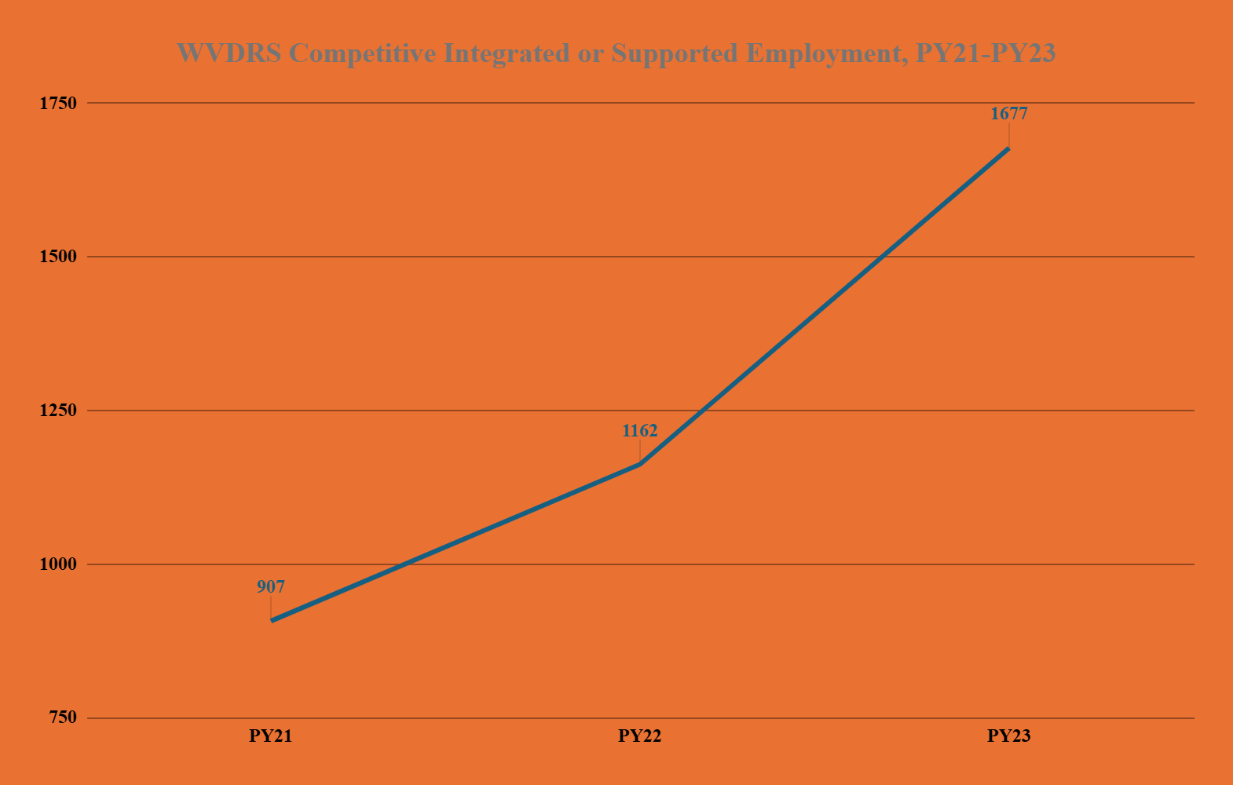
Outcomes & Overviews PY ‘21 to PY ‘23

Slide 4
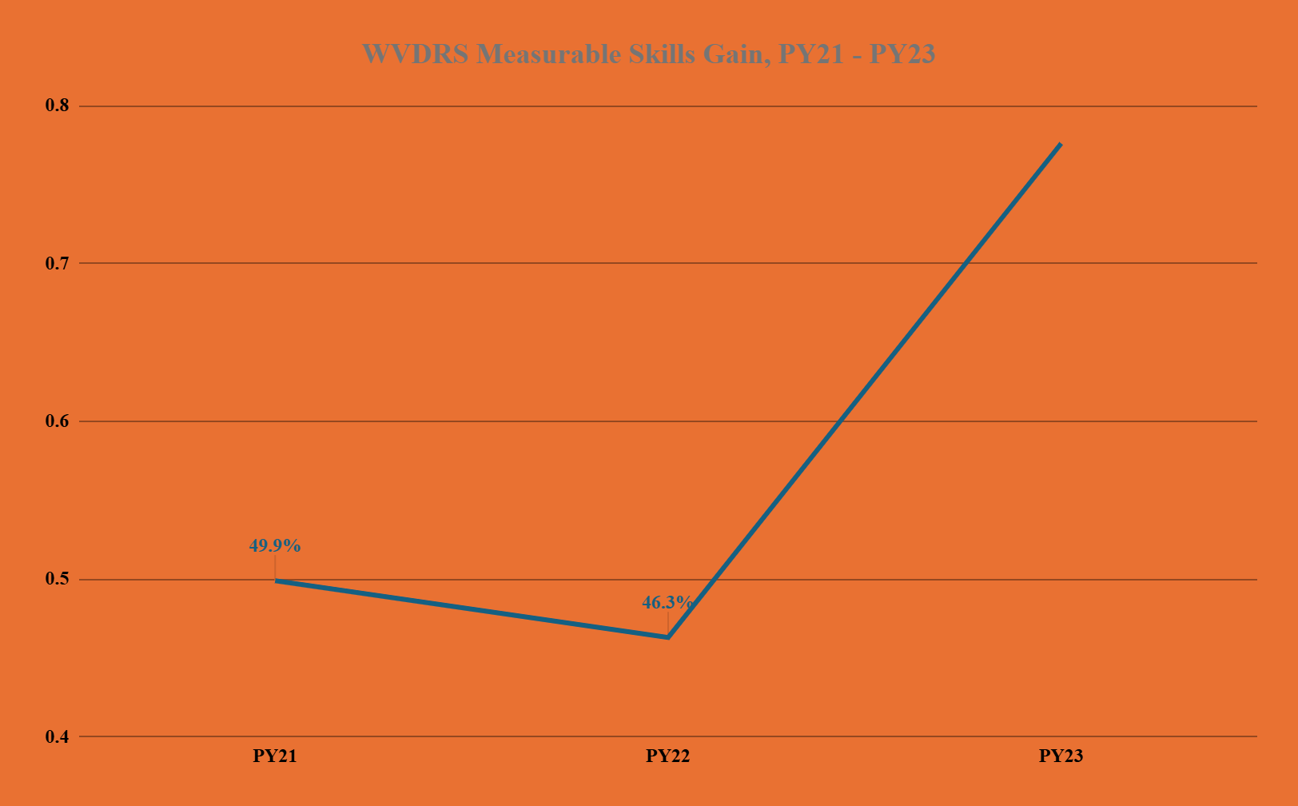
Outcomes & Overviews PY ‘21 to PY ‘23
77.6

Slide 5
How Did WVDRS Achieve Outcomes:
WVDRS staff committing to go above and beyond and work outside of their previous roles, silos, and geographic locations.
WVDRS revised policy and case management procedures to reduce administrative burdens on Field Staff and Consumers.
WVDRS placed emphasis on reducing the usage and need of eligibility and IPE extensions, leading to rapid engagement in the system.
Notes:
Policy Revision-Allowed counselors to handle a higher caseload while also processing consumers through the VR process more quickly and efficiently, time from status 02 to status 10 decreased by more than 25%.

Slide 6
How Did WVDRS Achieve Outcomes:
Maximizing Partnerships/Resources: Engagement, Outreach, and Cross Referrals.
Maximizing Partnerships/Resources: Data sharing agreements and full utilization of WVDRS in-house case management system allows for targeted data collection and referral tracking.
Maximizing Partnerships/Resources: WVDRS reaches out to College and Vocational School administration, deans of relevant schools within colleges, professors within those programs, providing outreach materials directly to students via physical and electronic contact.
Notes:
Maximizing Partnerships-The agency enhanced its engagement and outreach and cross referrals with may external partners including the WV Department of Education, WorkForce WV, WVU, WVSU, Marshall University, Women Work WV, I/DD Council, WV Women Work, WorkForce WV, the State Workforce Development Board, the Interagency Collaborative Team, WV Employment First Task Force, No Wrong Door WV, WV Grow Your Own, and many others. These partnerships enabled the agency to receive more high quality referrals.
College-Furthermore, there was a direct targeting of college students with disabilities, particularly college seniors about to enter the job market, to offer job placement and other needed vocational rehabilitation services….a student who applies will be in the system for many years, so to increase 26 closures, the agency also had to identify applicants who would likely need less time under an IPE before becoming successfully employed.

Slide 7
How Did WVDRS Achieve Outcomes:
Attrition (closures prior to IPE) are reviewed at the State, District Office, Local Office, and Field Counselor level.
Utilization of Technology: Multiple modes of contact were implemented, text, emailing, calls, sending PDFs, and usage of e-signature.
WVDRS reinstated benchmarks for counselors.
Employer Engagement and Recognition.
Notes:
Benchmarks-e.g., expected number of referrals, applicants, IPEs, etc) and monitored those on a regular basis. Vacancies and lower-than-projected performance locations were supplemented by temporary staff (recruiting former retired counselors to come back part time)

Slide 8
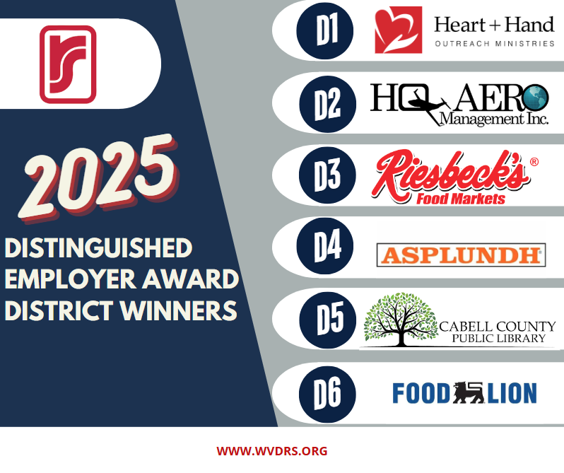
Notes:
Example of engaging employers through recognition (Occurs during National Disability Employment Awareness Month). Recognized during the WVDRS Ability Works Ceremony each October and local media outlets are informed with permission from the employer.

Slide 9
What is “The Secret Sauce”?
WVDRS “secret sauce” has many ingredients:
  Coordinated blend of expanded partnerships.
  Flexible service delivery model.
  Youth-focused innovation and Consumer Services.
  Field Staff Empowerment: Clear, practical training and ongoing feedback on performance measures (not just MSG) has allowed counselors to focus on high-impact activities.
  Continuous Improvement Culture: Regular internal reviews and sharing of best practices across WV Districts and Communities of Practice.

Slide 10
West Virginia Combined (WVDRS)
Contact Information:
  Aaron B. Topping, Senior Manager
  aaron.b.topping@wv.gov
  304-993-7135

