Slide 1

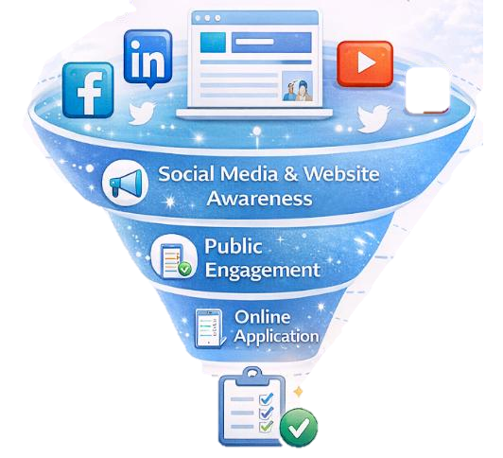

From Visibility to Access
How Nevada VR Uses Digital Media and Online Services to Strengthen Engagement and Efficiency
Nevada Vocational Rehabilitation
Mechelle Merrill MS, CRC, CPM
Deputy Administrator of Programs
Sheena Childers MS, CRC, CPM
Rehabilitation Bureau Chief II
CSAVR Spring Conference
March 31, 2026 | 9:30 AM

Slide 2




Session Goals
Align Digital Communication and Access
Online applications and E- signatures
Understanding how Nevada VR aligned digital communication with service access and agency efficiency.
Learn how online applications and e-signatures improve intake outcome and processing speed.
Social Media Engagement
Branding and Trust
Explore how social media supports the VR mission, values, and success stories.
Recognize how consistent branding builds trust, credibility, and professionalism
Digital Tools expand access and improve efficiency

Slide 3




Key Components of Nevada VR’s Digital Strategy
Website as the Digital Front Door
Online applications and DocuSign
Online Access
General VR and Blind Services
Pre-ETS
NV TRIP
Online applications
DocuSign integration
Faster intake and service entry
Digital Tools expand access and improve efficiency
Social Media Campaign
Branding and Trust
Strategic Social Media
Mission focused messaging
Share success stories
Increase public awareness
Philosophy – Belief in work and independence.
Ethos – Values guiding VR services.
Good News – Outcomes and success stories.
Consistent Branding

Slide 4

Digital Transformation at a Glance
📈 180% increase in applications
⏱️ Reduced intake wait times
📄 Paperless application with DocuSign
⚙️Improved agency efficiency
Notes:
Speaker Notes
“This slide summarizes the impact of Nevada VR’s shift to digital access and digital communications.”
“What we’ll show next is how these results were achieved.”

Slide 5
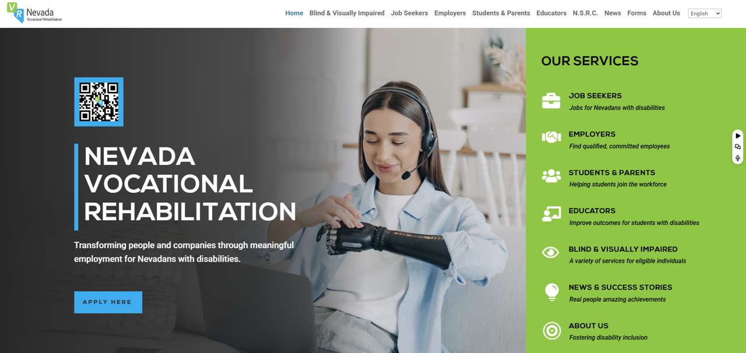




VR Nevada Website
Online Applications
Transparent communication about available services
Contact Us drove increased response time
Notes:
Importance of us being a .gov. That heightened our priority in search results
Helps with legitimacy

Slide 6
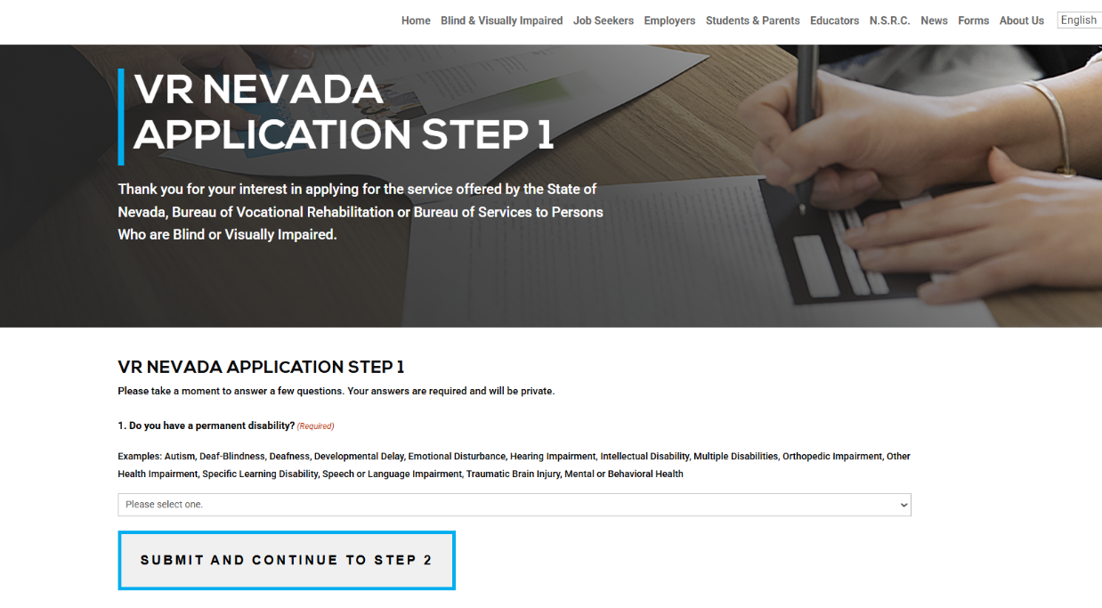
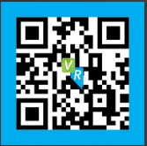
VRNEVADA.NV.GOV

Slide 7
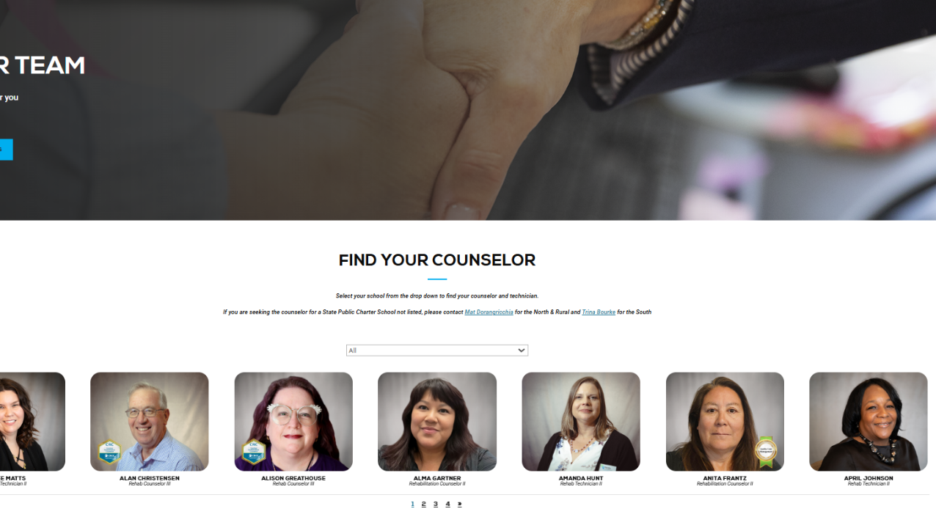

Slide 8
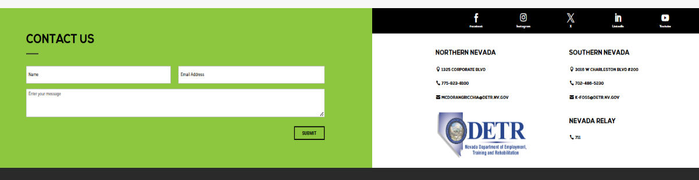

Slide 9
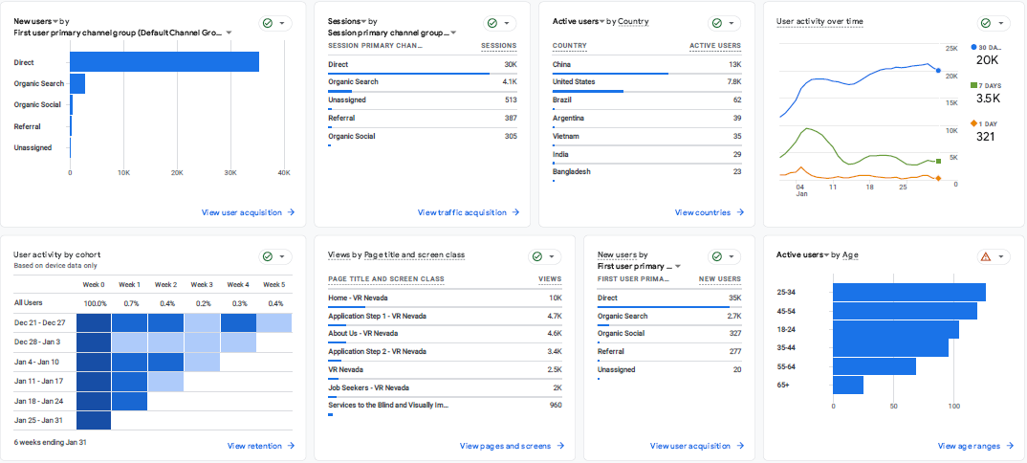
Digital Access Growth Through the VR Nevada Website
Notes:
Google analytics from January 2026

Slide 10
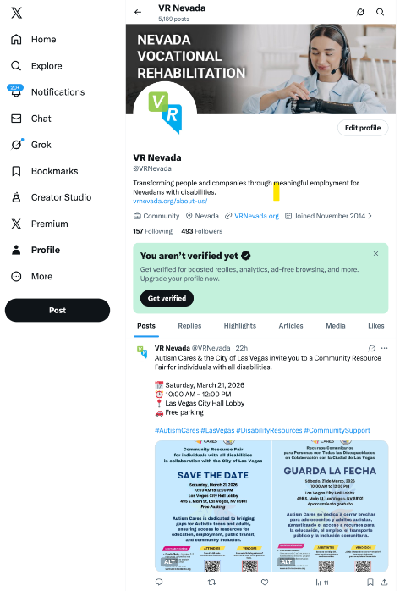
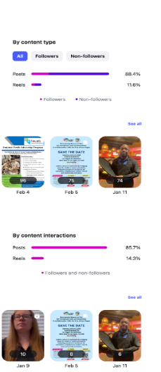
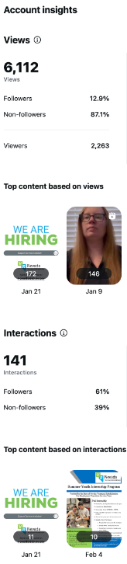
VRNevada Website Data
Notes:
Instagram analytics
Twitter analytics

Slide 11

How we use DocuSign
VR And Blind Service Applications
IPE Signatures
FPA Signatures
Releases of Information
Program participation
SYIP, Project SEARCH, college forms, etc.
Disclosure documents requiring participant signature
Service Agreements - VR contracts
Notes:
How we use DocuSign
- VR And Blind Service Applications
- IPE Signatures
- FPA Signatures
- Releases of Information
- Program participation – SYIP, Project SEARCH, college forms, etc.
- Disclosure documents requiring participant signature
- Service Agreements
- VR contracts
Chart that shows avg envelope time
Before and after initiation
Monthly number of envelopes

Slide 12


Social Media
Multi Platform Presence
VR Dedicated Channels
Facebook
LinkedIn
Instagram
YouTube
VR focused messaging
Employment success stories
Program highlights
Annual Social Media Plan
Public Information Officer
Planned campaigns
Monthly themes
Performance tracking
Content strategy and messaging
Brand consistency
Media coordination
Community engagement
Think content creator
Notes:
Facebook
Instagram
X
LinkedIn
YouTube
What role does the PIO play?
Talk about the challenge of the PIO being at the dept. level and the importance of educating the PIO
Computer and tech savvy
Artistic and creativity
Think content creator

Slide 13

Application Growth After Digital Modernization
+180%
420
150
Paper-Based Application
(Pre-Pandemic)
Online Application + DocuSign
Notes:
Speaker Notes
“Once the application was moved fully online, we saw applications nearly triple.”
“This wasn’t driven by marketing alone—it was driven by access.”
“Removing paper removed friction.”

Slide 14

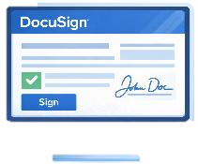


What Drove the 180% Increase?
Before
After
Paper application
Manual signatures
Mailing / scanning / in-person steps
Longer processing times
Online application
DocuSign e-signatures
Immediate submission
Faster intake processing
Notes:
Speaker Notes
“The increase wasn’t accidental—it was structural.”
“DocuSign allowed us to complete forms in real time.”
“Staff time shifted from paperwork to service delivery.”

Slide 15
Impact on Intake & Agency Efficiency
📈 Faster application completion
⏱️ Reduced intake wait times
📄 Fewer incomplete applications
⚙️Improved staff workflow
Notes:
Speaker Notes
“Even without perfect metrics, the operational impact was clear.”
“Counselors and support staff reported smoother intake and fewer delays.”

Slide 16

Digital Media → Digital Access Pipeline
Social Media Visibility
Website Engagement
Online Application
DocuSign Submission
VR Participation
Posts
Success stories
Program awareness
VR Nevada website visits
Service information
Program pages
Online application access
Easy digital entry
Secure e-signatures
Immediate submission
Eligibility process
VR services begin
Notes:
Speaker Notes
“Digital media didn’t exist in isolation.”
“Our communications strategy directly supported access to services.”
“This funnel shows how visibility converts into participation.”

Slide 17



What We Learned…
NV Trip
Intake Team
Help complete VR applications
Explain VR services and programs
Determine eligibility
Give counselor more time to connect appropriate VR services
Online transition planning tool for students with disabilities
Connects families to education, employment, and independence resources
Supports school to work transition planning
Guides students toward adult life and employment

Slide 18
NV TRIP
DIF grant partnership with the Nevada Department of Education
Strengthens collaboration between VR and education partners
Partnerships to Pathways roadmap for Nevada transition services
Supports coordinated school to work transition planning
Notes:
DIF grant partnership with Nevada Department of Education
Partnerships to pathways – roadmap for NV transition services

Slide 19
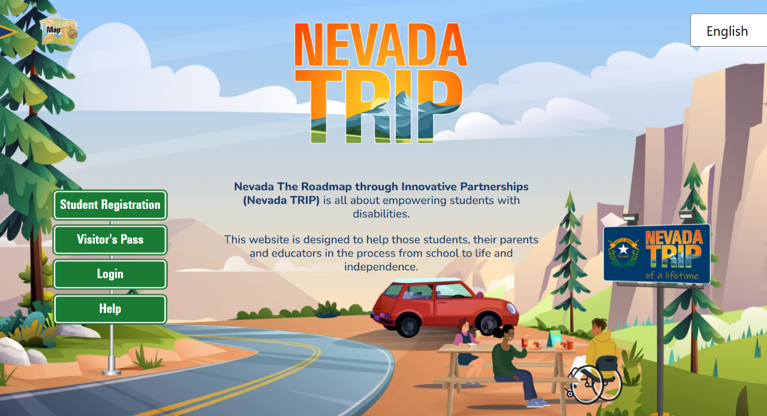
NEVADATRIP.NV.GOV

Slide 20



Why This Matters for State VR Agencies
Increased access without additional staff
Improved equity through online access
Stronger public awareness
Scalable, replicable approach
Success depends on alignment between leadership, IT, and program staff.
Notes:
Speaker Notes
“This model doesn’t require a large communications team.”
“It requires alignment between leadership, IT, and program staff.”

Slide 21








Steps to Modernize State VR Engagement
Treat Your Website as the Front Door
Move Applications Fully Online
Integrate E-Signatures
Align Digital Media with Access Points
Notes:
Speaker Notes
“These are modular steps.”
“States can implement them incrementally.”

Slide 22
Key Takeaway Metric
+180%
420
150
Paper-Based Application
(Pre-Pandemic)
Online Application + DocuSign
Notes:
Remember the slide from earlier. That single number shows the impact of digital modernization. 180% increase in applications occurred after removing paper barriers and aligning digital media with access

Slide 23
Conclusion
Nevada VR shows how digital media, consistent branding, online applications, and electronic workflows expand service access.
These changes reduce delays, increase efficiency, and strengthen the VR mission.
A 180% increase in applications highlights the impact of removing barriers and meeting individuals where they are, online.

Slide 24

Questions
Thank you for attending
Nevada Vocational Rehabilitation
https://vrnevada.nv.gov

Slide 25
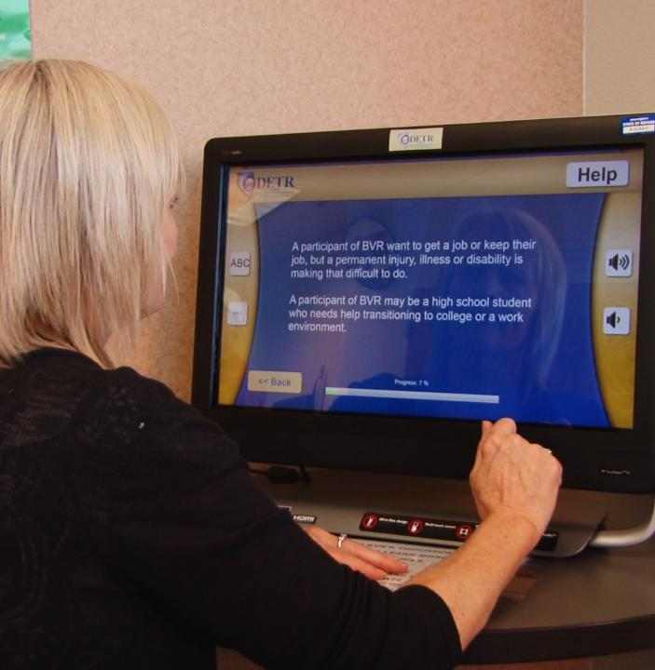

CONTACT US
Mechelle Merrill
(775) 687-6862
mwmerrill@detr.nv.gov
Sheena Childers
(702) 486-5234
snchilders@detr.nv.gov

