Slide 1


David Conners
Notes:
My Name is David Conners
I am the I&D Director for Convergint

Slide 2





Who is Convergint?
$2.5 billion in revenue with a sole focus on systems integration
Convergint is a global systems integrator focused on delivering results for our customers through unparalleled service excellence
Hundreds of locations and over 10,000 colleagues across the globe
Local leaders empowered to make decisions close to the customer
Purpose-built specifically for mission-critical verticals
https://www.convergint.com/
Notes:
Who is Convergint?
We’re a GLOBAL security solutions integrator.
We install & service – Low Voltage Data equipment
10k employees from APAC, Europe, NA, latin America, middle east
120 office in North America and over 200 worldwide – with Chicago being our main corporate office
Franchise model – makes us successful
Verticals

Slide 3









Solutions overview
Electronic security
Fire and life safety
Video surveillance & analytics
Secure identities & credentials
Access control
Intelligent fire & smoke detection
Air sampling detection
Test & inspect
Financial security
Healthcare technologies
Locksmithing
Remote drive-up systems
Modular vaults & vault doors
Location intelligence
Patient protection
Environmental & temp monitoring
Audio-visual
Building automation
Sound systems
Digital signage
Video walls
HVAC controls
Energy management
Indoor air quality
Situational awareness
Digital transformation
Mass notification
Advanced sensors
GSOC & Fusion centers
AI & computer vision
IoT & edge computing
Cloud solutions
https://www.convergint.com/solutions/overview/
Notes:
What does Convergint do?
Here you can see an overview of the solutions we offer:
Electronic Security
Access control (Utilize intelligent access control solutions to restrict, allow, and track users)
Video surveillance (Use advanced technology to view, store, and manage surveillance data anywhere in the world)
Intrusion detection system (Leverage advanced sensor technology and monitoring to protect people, perimeters, and critical assets)
Financial Security (Banks and Financial institutions)
Safe deposit boxes & cash lockers (Containment of customer valuables and protection against theft and fire)
ATMs (Core-integrated ITMs from Convergint provide forward-facing technology that can benefit every branch)
Drive-up systems and deal drawers
Vaults
Cash recyclers
Audio-visual
Audio-visual (Develop solutions that can be used individually or integrated to meet the needs of customers)
Meeting rooms & video conference (video walls and digital signage)
Broadcast system
Situational Awareness
Location intelligence
Mass notification (Provide information to building occupants in emergency situations through different technologies)
Thermal imaging
Drone detection
Radar detection
Fire & Life Safety
Fire and smoke detection (Protect single building to multi-building campuses that demand strict requirements)
Suppression systems (Protect critical environments and high-value assets by utilizing special hazard fire suppression systems)
Notification appliances (Require a flexible approach to color, ambient operating environment, mounting requirements, and mass notification)
Emergency communications (Promptly notify with UL listed digital voice emergency communication and notification)
Air sampling detection (Provide the earliest possible warning on an imminent fire with spring section and programmable sensitivity)
Healthcare Technologies (Hospitals and Clinics)
Infant security
Nurse call automation
Medical carts
Building Automation
HVAC control systems
Lighting control
Hazardous gas monitoring
Digital Transformation
Expert colleagues will help you make the right decisions and gain a competitive advantage with innovative solutions designed to analyze your digital workspace, identify opportunities, drive revenue, and reduce costs. Through automation and integration, Convergint can make your business profitable and productive, helping you become the digital leader in your industry.
Location intelligence
AI and computer vision
Drone detection

Slide 4
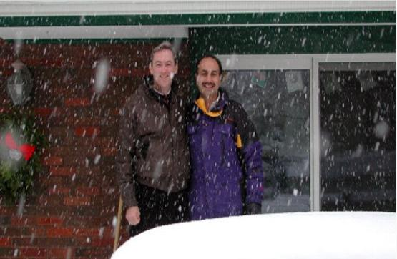
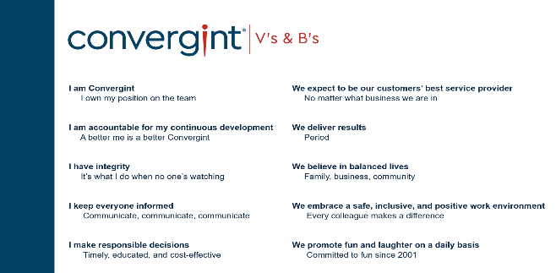
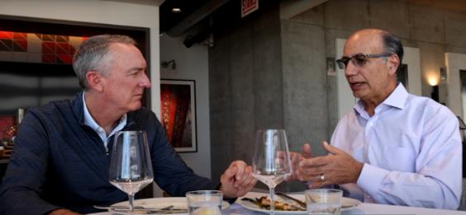
Convergint History!
Greg Lernihan
&
Dan Moceri
https://www.convergint.com/about/company-history/
Notes:
Founded in 2001 by Greg Lernihan and Dan Moceri
Envisioned creating a business that combined the strengths of both large and small companies.
This started as a brainstorming session in a friend's basement in IL.
Convergint on a solid foundation of our 10 Values and Beliefs.
These were put into place even before we hired our first colleague.
Some prioritize business, sales numbers or products, there goal was to prioritize the people

Slide 5





Talent: The Lifeblood of Convergint
Talent isn’t just important at Convergint – it’s who we are
Why Talent Matters?
Our success is built on the strength of our people
60%+ of our roles are Techs, PMs, and Sales
Strategic partnerships (like CSAVR) help expand and diversify our talent pipeline
Talent Acquisition
Colleague Development
Colleague Retention
Attract & Recruit the great talent
Listening & Supporting Balance
Training & Mentorship
Notes:
Biggest issues is diversifying our talent pool – CSAVR is going to help with get a bigger net
- Intentionality - high number, I'd say 90s stubble across our field
so how do we diversify our candidates and bring visibility to the opportunities that we have.
Adjacent Talent Pool
Summary of Talent Acquisition –
Marketing the opportunity, knowledge session, word of mouth, job fairs
Recruit Talent - Recruiting frontline, PMs, AE etc..
Develop talent by engaging them in our culture/I&D, training & development plans, - Retain Top Talent
What does this Correlate too:
Stronger Teams: Inclusive teams drive higher engagement, better performance, and innovation.
Better Hiring & Retention: Early engagement with I&D helps attract and retain top talent.
Operational Success: A diverse and inclusive workforce enhances collaboration, problem-solving, and customer satisfaction.
Work with CSAVR – Hired 2% more colleagues that identify as having a disability
2024 accommodations for disabled colleagues
Not about making accommodations up front but more about asking the colleagues what specifically they need

Slide 6



Convergint always focused on equal opportunity
Accessibility
We use an accessibility widget on our website through AccessiBe to make sure it is useable for all web visitors. This also helps make sure we are fully ADA and WCAG compliant.
Advocacy
We participate in the Disability Index through DisabilityIn, providing us a holistic view of our company's disability practices. We take that feedback and use it to advocate for change within departments that have room for growth.
Education
Recently we partnered with CSAVR to host an internal webinar with hiring manager around accessibility and accommodations. We got great engagement and feedback from leaders who attended.
Notes:
Examples of the pillars in action:
Work with CSAVR
2024 accommodations for disabled colleagues
Not about making accommodations up front but more about asking the colleagues what specifically they need

Slide 7






Convergint - Talent Acquisition
X CSAVR
2024
2025
https://www.convergint.com/careers/career-opportunities/
Notes:
2024
Established partnership with CSAVR and Kathy
Established partnership with Disabledperson.com for access to the resume database, Talent Acquisition Portal.
Created a workshop for Convergint’s hiring managers combined with CSAVR for Disability Awareness.
Partnered with HR to streamline accommodation process
2025
Connect with CSVARs partners to introduce Convergint.
Increase applicant flow from Disableperson.com
Continue to build awareness around Convergint with federal and state agencies, community partners, veterans' employment agencies and employment networks
Increase disabled and veteran talent across Convergint
Comparing Q1 in 2024 to Q1 in 2025, we’ve hired over 3% more colleagues who identified as having a disability
Comparing Q2 in 2024 to Q2 in 2025, we’ve hired .8% more colleagues who identified as having a disability
Overall 1H of 2025 is up by 1.92% compared to 2024

Slide 8
Thank you

