Slide 1


Business Relations and Career Development in Action at the State and Local Level
Empowering people, strengthening networks, expanding opportunity
Notes:
*Jeff
Introduction order: Jeff, Alfonso, Kathleen

Slide 2
Business Relations and Career Development Overview
Empowering Employment
  Dual Customer Strategy
  Single Point of Contact
Notes:
*Kathleen

Slide 3
Dual Customer Strategy
  .
A service model that supports two distinct customer groups:
  Vocational Rehabilitation (VR) Participants – individuals seeking employment support
  Businesses – employers seeking qualified candidates
Shared goal: sustainable employment and workforce development
Notes:
*Kathleen

Slide 4
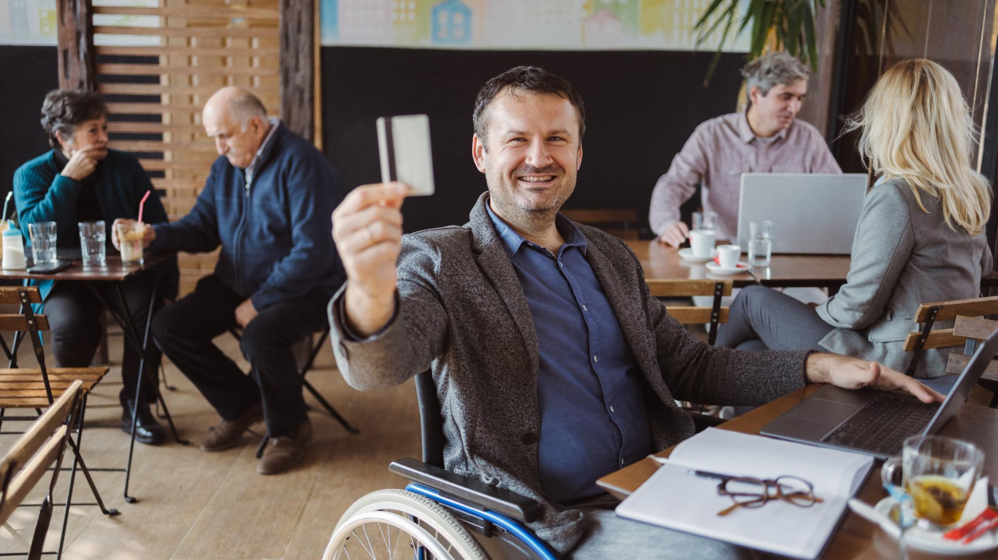
Understanding the Dual Customer Approach
Vocational Rehabilitation (VR) Participants
  Personalized career guidance and support overcoming employment barriers.
  Access to meaningful employment opportunities.
Business/Employer Needs
  Businesses gain access to qualified candidates and support with onboarding and retention.
Inclusive Training Programs
  No-cost trainings like Disability Etiquette and Windmills promote inclusive workplace practices.
Notes:
*Kathleen

Slide 5

Balancing Needs of Participants and Businesses
Advocacy and Support
  Strong advocacy, skill-building, and job matching to overcome employment barriers and reach career goals.
Business Needs for Efficiency
  Businesses prioritize efficiency, reliability, and clear communication during hiring to ensure smooth recruitment.
Aligning Services
  The strategy aligns VR services to meet both Participants and business expectations without compromising support quality.
Mutual Understanding and Collaboration
  Fostering open communication and collaboration enhances employment experiences for Participant's and businesses alike.
Notes:
*Kathleen

Slide 6

Single Point of Contact (SPOC) Model
Notes:
*Jeff

Slide 7

Defining SPOC and Its Role
Central Communication Hub
  Central liaison managing communication between participants and business partners.
Building Trust and Accountability
  Regular contact by SPOC fosters trust and accountability with participants and employers.
Problem Solving and Support
  SPOC quickly resolves issues and provides tailored support to meet participant and employer needs.
Enhancing Employment Services
  The SPOC model improves service efficiency and strengthens relationships in complex employment settings.
Notes:
*Jeff
Single Point of Contact (SPOC) model is a strategic approach that designates a specific liaison to serve both vocational rehabilitation participants and business partners. T
-This individual acts as the central hub for communication and coordination, streamlining interactions and ensuring consistency in service delivery.
-Builds trust and accountability by maintaining regular contact with both customer groups, addressing concerns, and facilitating job placements.
-Effective in complex employment environments where multiple stakeholders are involved.
-By centralizing responsibilities, the SPOC can quickly resolve issues, track progress, and provide tailored support to participants and employers.
-Role requires strong interpersonal and problem-solving skills, as well as a deep understanding of disability awareness and employer engagement.
-Overall, the SPOC model enhances the efficiency and effectiveness of employment services, leading to improved outcomes and stronger relationships.

Slide 8
Benefits and Implementation of SPOC
Key Benefits of SPOC Model
  Streamlines communication, accelerates problem resolution, and improves employment outcomes effectively.
Roles and Responsibilities
  Coordinate job placements, bridge communication between teams and employers, and track progress to ensure satisfaction.
Best Implementation Practices
  Assign SPOCs with interpersonal skills, use shared data systems, and train in disability awareness and employer engagement.
Measuring Success
  Monitor placement rates and satisfaction scores regularly to evaluate SPOC model effectiveness and improve services.
Notes:
* Jeff

Slide 9
Practical Application in the field
13 Districts Statewide
Workforce Development Section
13 Regional Directors
13 Regional Business Specialists
61 Business Specialists
Notes:
*Jeff
-CA has 13 Districts (this # includes BFS)– Support localized workforce initiatives and community engagement
-WDS- centralized coordination of business engagement, training, workforce programs, business support, DOR staff support
-RDs each oversee one of the 13 Districts in CA – Lead strategic efforts and aligning regional goals with statewide priorities
-RBS – serve as liaison between businesses and workforce services in each region
-Bus. Spec. – provide direct support to businesses/employers, job seekers and community partners
*Explain how this compliments/enhances quality of services to the business customer

Slide 10
Workforce Landscape Impact
  These approaches improve employment outcomes by integrating best practices and overcoming common challenges.
Notes:
*Jeff

Slide 11

Real-World Applications and Challenges
Notes:
*Alfonso
Case Example and Outcomes, Challenges and Efficiency Strategies

Slide 12

Case Example and Outcomes
Dual Customer Strategy Impact
  Integrates participant and employer needs, improving employment outcomes and satisfaction.
SPOC Model Benefits
  Enhances coordination, increasing job placements and employer support.
Improved Retention and Satisfaction
  Effective coordination leads to higher long-term job retention and stakeholder satisfaction.
Data-Driven Decision Making
  Continuous feedback and data analysis are key to sustaining successful employment programs.
Notes:
*Alfonso
Examples:
Hands on Hyatt – Alfonso
Amazon Web Services – Jeff
Amazon/Accommodations Team – Kathleen
Ulta (new partnership) – Kathleen

Slide 13

Challenges and Efficiency Strategies
Implementation Challenges
  Challenges include filling job orders, finding suitable candidates, and managing limited staff time and resources effectively.
Automation Benefits
  Automation streamlines tasks such as candidate matching, communication tracking, and progress monitoring to ease staff workload.
Staff Training Importance
  Continuous professional development equips staff with skills to handle complex employment scenarios and improve service delivery.
Notes:
* Alfonso

Slide 14
Key Takeaways
Dual Customer Strategy Benefits
This strategy addresses the needs of both participants and businesses, fostering sustainable employment and workforce growth.
Single Point of Contact Model
The SPOC model enhances communication, builds trust, and ensures accountability among stakeholders for improved service delivery.
Continuous Improvement
Adopt, implement best practices, and evaluate these models to ensure ongoing impact and success.
Practical Application
Statewide workforce engagement structure of a coordinated team delivers state and localized workforce solutions and support to businesses.
Notes:
*Alfonso
Dual Customer Strategy and Single Point of Contact (SPOC) model are powerful tools for strengthening employment ecosystems and improving service delivery.
-By simultaneously addressing the needs of vocational rehabilitation participants and businesses, these approaches foster sustainable employment and workforce development.
The SPOC model enhances communication, builds trust, and ensures accountability, leading to better outcomes for all stakeholders.
Consider practical application methods.
California’s workforce system is structured around 13 Regional Directors, each leading a district.
Each district includes 1 Regional Business Specialist who connects employers to workforce services.
61 Business Specialists provide direct support to businesses, job seekers, and community partners.
This structure ensures consistent statewide strategy, local flexibility, and stronger outcomes through targeted engagement and collaboration.
Together, these strategies drive meaningful, lasting employment success and contribute to the overall health of the labor market. Organizations are encouraged to adopt these models, implement best practices, and continuously evaluate their effectiveness to ensure ongoing improvement and impact.

Slide 15


Contact Information
Jeff Noyes, Regional Director
San Diego District, CA Department of Rehabilitation
Jeffrey.Noyes@dor.ca.gov
Alfonso Jimenez, Regional Director
Inland Empire District, CA Department of Rehabilitation
Alfonso.Jimenez@dor.ca.gov
Kathleen Alonzo, Business Engagement Manager
Workforce Development Section, CA Department of Rehabilitation
Kathleen.Alonzo@dor.ca.gov
Notes:
*Alfonso

Slide 16

Questions
Notes:
*ALL of us
Invite thoughts, questions, and ideas from the audience to foster engagement and collaborative learning.
Encourage participants to share their experiences, challenges, and suggestions related to the Dual Customer Strategy and SPOC model.

