Slide 1



Own It
A Partnership to Increase Future-Ready Skills & Reduce Barriers Through Entrepreneurial Mindset

Slide 2
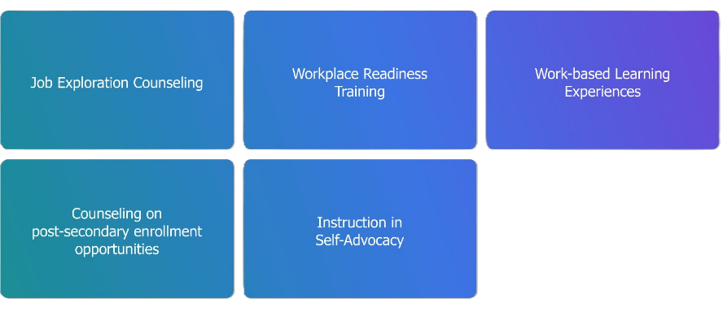
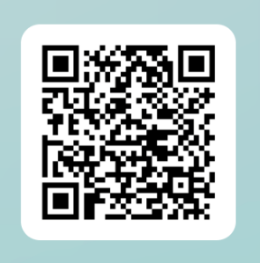
Where is your state strongest in providing pre-ETS services right now?
The Workforce Innovation Opportunity Act 5 (WIOA) required pre-employment transition services
POLL
Scan here

Slide 3


Work Should Be Possible For Everyone
Notes:
Talent is everywhere
Opportunity is not
Our job is to close that gap
Every young person deserves the chance to build a future, contribute their talents, and participate fully in the economy.
Yet for millions of people with disabilities, that opportunity is still out of reach.

Slide 4



The Workforce Reality for People with Disabilities
 | No Disability | All Disabilities | People with vision loss
Employment Rate | 75% | 37% | 44%
Unemployment | 4% | 8% | 12%
Self-Employment | 6% | 10% | 15%
Wages | 100% (baseline) | 74% of non-disabled wages | 67% of non-disabled wages
Notes:
People with disabilities are about half as likely to be employed.
Even when they are working, they often earn significantly less.
And yet something interesting happens when barriers appear in traditional employment.
Many individuals turn to entrepreneurship.
Employment &. Unemployment Data Resource
U.S. Bureau of Labor Statistics
Persons with a Disability: Labor Force Characteristics 2024
Self Employment Data
U.S. Bureau of Labor Statistics
Kessler Foundation
Vision Impairment Employment & Wages Data
American Foundation for the Blind
National Institutes of Health

Slide 5
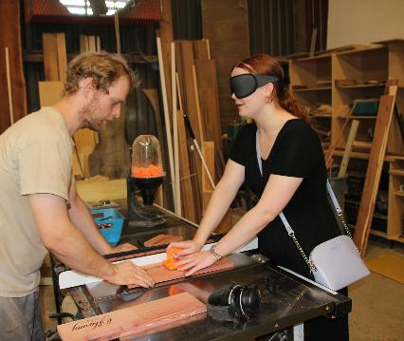
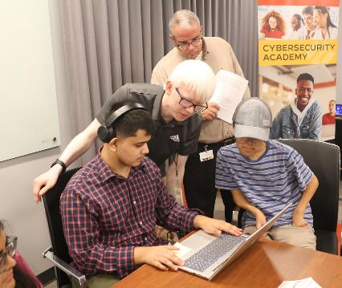
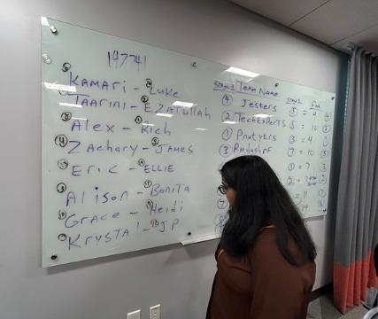
Blind & Vision Impaired Employment Snapshot
42%
of individuals who identify as blind or low vision report an annual income of less than $20,000/year
8.7 million
individuals between 18 and 64 identify as being blind or having a vision impairment
Notes:
43.1%
of individuals who are blind, vision impaired or deafblind are not in the labor force

Slide 6
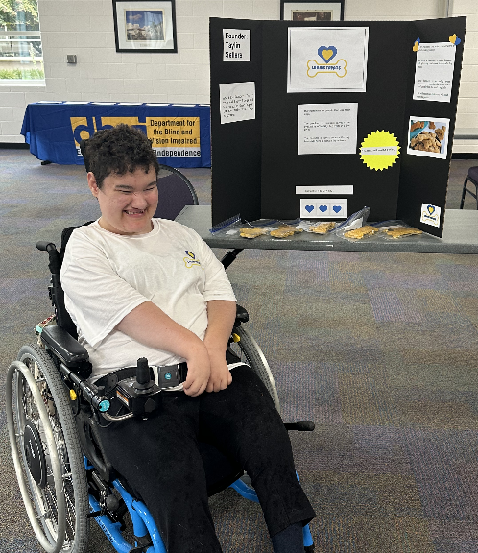
Skills Alone Are Not Enough
Students often lack:
Confidence
Ownership of future
Exposure to possibilities
Ability to adapt to a changing market
Problem-solving identity
Economic participation mindset
Notes:
The top three (of ten) expected transformative workforce trends
Broadening digital access
By 2030, 60% of employers expect digital access to transform their business.
This transformation is a result of advancements in AI, robotics, and energy drivers
This one change is expected to drive the fastest-growing AND fastest-declining roles with increased demand for digital and technology literacy
Increased cost of living/General economic slowdown
A net job creation affected by inflation.
Slower growth is expected to displace 1.6 million jobs globally
Climate-change mitigation
Driving demand for roles such as renewable energy engineers, environmental engineers, and electric and autonomous vehicle specialists
World Economic Forum, The Future of Jobs Report 2025

Slide 7
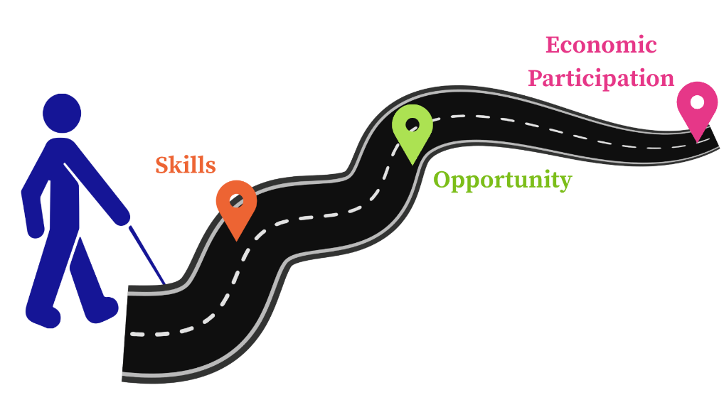
What if We Prepared Students Differently?
Notes:
Instead of asking: What job can this student do?
Ask:
What problems can they solve?
What ideas can they create?
What value can they bring to the economy?

Slide 8
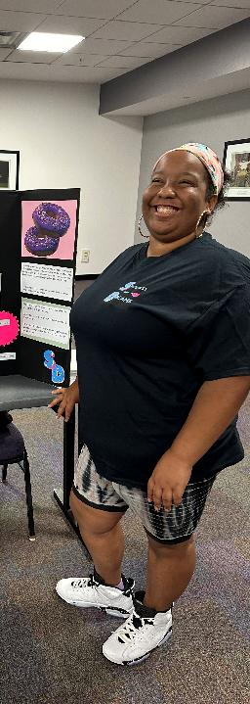
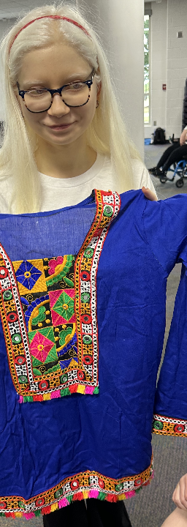
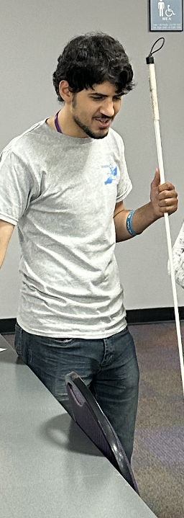
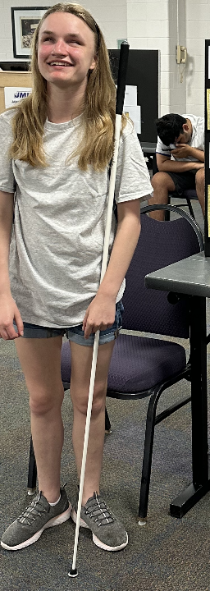
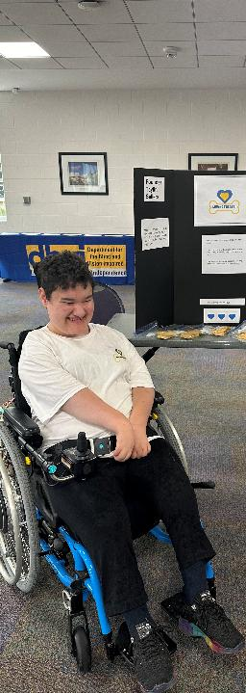






Slide 9
What barriers most limit your students’ workforce readiness?

Slide 10
Access is More than Compliance
Students leading ideas
Creating solutions
Participating in economic activity
The Access Ladder
Moving beyond compliance
Students actively contributing
Problem-solving opportunities
Strengths-based learning
Accessible instruction
Assistive technology
Flexible learning design
ADA requirements
Accessible materials
Basic accommodations
Notes:
Access is not just about entering the room.
It is about owning a place in the economy.
Many systems are excellent at Level 1 and Level 2.
Our partnership focuses on Levels 3 and 4.

Slide 11




Who We Are
The Virginia Department for the Blind and Vision Impaired
Education Services: 0 -22 years old
Pre-Employment Transition Services: Students 14 – 22 years old, enrolled in a recognized education program
Youth Services: Adolescents age 14-22 who are not enrolled in a recognized education program
Adult Services: Individuals age 14+ who are interested in gaining employment, maintaining employment, or re-entering the workforce with a primary disability of being regarded as blind, vision impaired or deafblind.

Slide 12
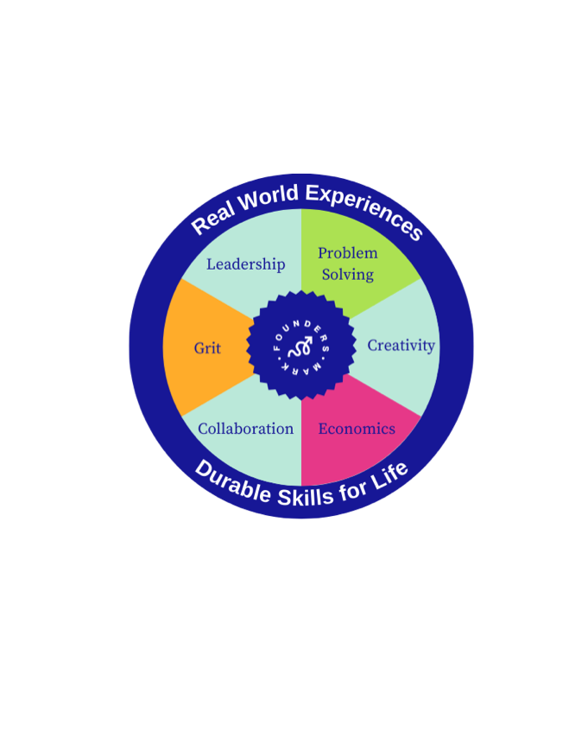

Who We Are
Experiential Workforce Learning Partner
Experiential career readiness
Entrepreneurial mindset
Real-world skill labs
Youth-led problem solving
Public demonstration model

Slide 13
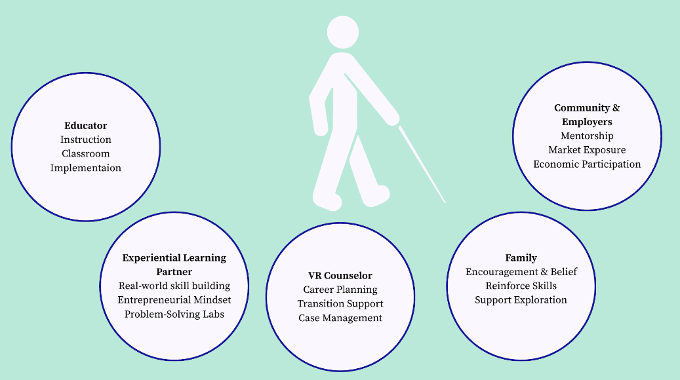


A Partnership Model That Expands Impact
Notes:
Key takeaway on slide
When VR systems partner with experiential learning organizations,
students gain skills, confidence, and economic pathways.
Speaker point
Emphasize scalability:
This model does not require VR agencies to build entirely new programs.
It expands impact through partnership.
That resonates strongly with administrators.

Slide 14
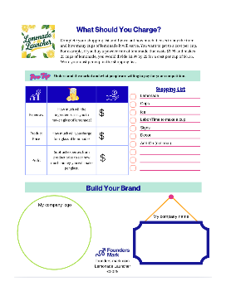
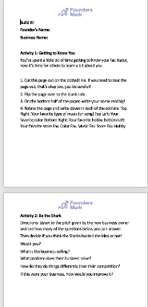
Smart Adaptations = Access
Original Workbook Format
Barriers
Paper workbooks
Taught in person
Visually complex activities
Vendor's first time working with individuals who are blind, vision impaired or deafblind
How Accessibility is Built In
Workbook was converted to an accessible MS Word document
Sessions held virtually so students from around the Commonwealth could participate
All visual information was described to ensure understanding and relevance to the activity
Vendor met individually with the students to facilitate the completion of the capstone project of logo and web-site design
Accessible MS Word Document Workbook Format
Notes:
Zoom etiquitte could be a barrier
Use of common digital platforms such as visual design (Canva), web design (Square Space), social media
Dual authentication logins created a barrier
Personal access to the markets and customers

Slide 15

Transferrable Skills Learned
Teamwork
Self-Advocacy
Reasoning
Creativity
Attention to Detail
Critical Thinking
Communication
Leadership
Problem-Solving
Adaptability
Relationship Building
Time Management

Slide 16
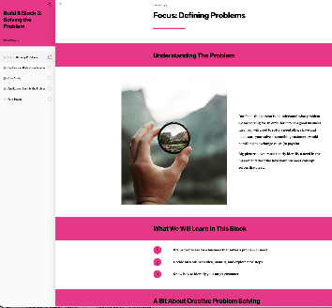
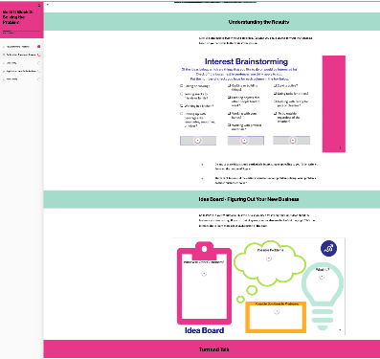
The Founders Mark Model: Creating Opportunities & Building Agency
Exposure
Students see new possibilities.
Skills
They practice real-world problem solving.
Confidence
They begin to see themselves as capable.
Agency
They believe they can shape their future.
Economic Participation
They pursue employment, entrepreneurship, or career pathways.
Real-World Solutions
They produce real solutions, products, and services for customers.
Notes:
Agency is the bridge between education and employment.
Workforce readiness is not only about skill development.
It is about helping students believe they can contribute value.

Slide 17
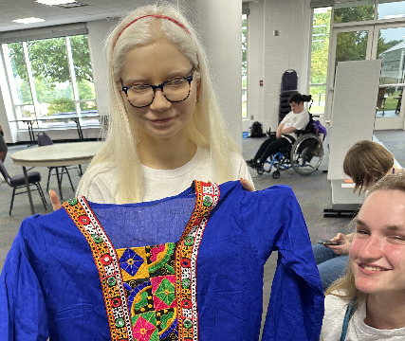
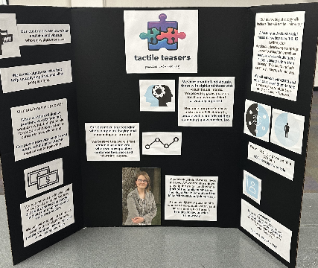
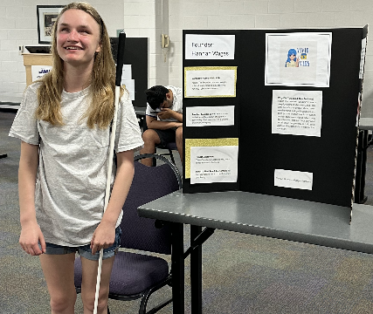
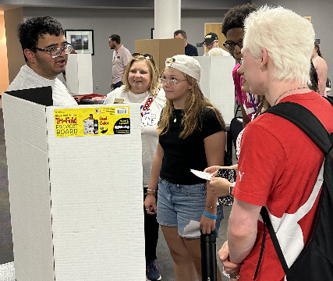
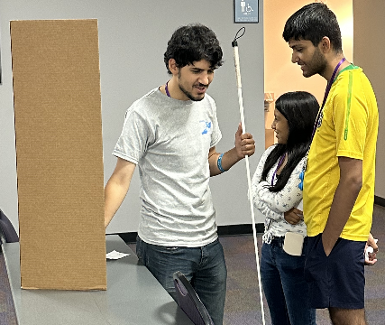
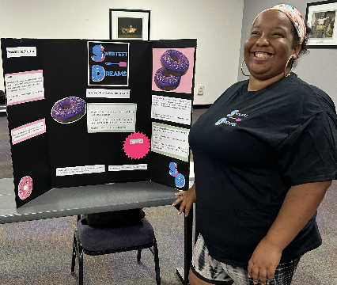

Slide 18
What are 5 realistic and achievable business ideas your students could create?
Notes:
Table Discussion: 5 minutes for prompt
Group Share: What are the ideas, how do they build skills for workforce pathways?

Slide 19
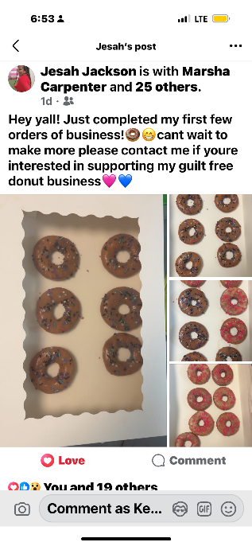
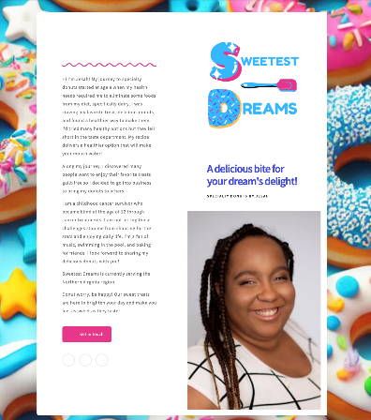
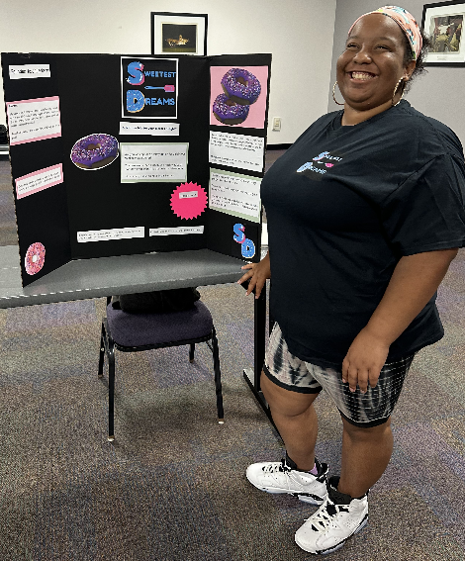

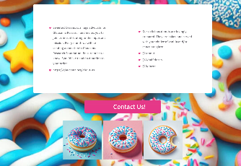


Slide 20
Why Entrepreneurship Is a Powerful Pathway
Work Can Be Designed Around Strengths
Technology Is Rapidly Expanding Access
Problem Solvers Create Valuable Solutions
Entrepreneurship Is Already Happening
Notes:
When access, skills, agency, and opportunity align,
students with disabilities can fully participate in the workforce.

Slide 21
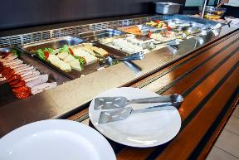

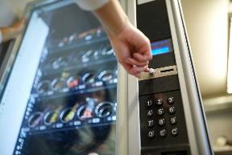

Randolf-Shappard Program:
Virginia Enterprises for the Blind
Large dining facilities on Virginia Military Bases
Micro markets in State buildings
Virginia Blinds vending facility program authorized by the Randolph-Shappard program (RSP)
    RSP was enacted into law in 1936
    Provides the following:
    The opportunity for qualified individuals who are blind to own their own business
    Provides training in areas related to human resources, fair labor standards, accounting, inventory control, etc.
    Initial inventory and start up costs including initial inventory and equipment
Vending facilities in State and Federal buildings and Commonwealth rest stops
    Fire extinguisher inspection and replacement services

Slide 22
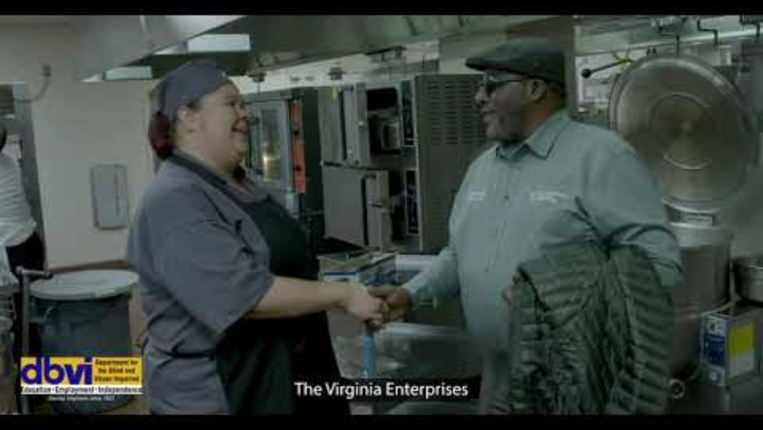
Virginia Enterprises for the Blind
Notes:
https://youtu.be/gIijwkdxZjc

Slide 23


Funding & Systems Alignment
Virginia's workforce strategy is designed to maximize the efficient and effective use of Federal funds across various public systems.
Blending
Pooling funding from multiple sources to support a common goal
Braiding
Simultaneous service delivery by two or more workforce partners
Sequencing
Sequential service delivery: Capitol allocation of funding in phases or sequences

Slide 24
Pre-ETS Training for Self-Employment Opportunities
DBVI barriers to self-employment as competitive integrated employment
    Vocational Rehabilitation Counselors not trained in business development or ownership
    Lack of accessible options through the Small Business Association
    Leadership not trained in entrepreneur opportunities creating hesitation to approve
DBVI advantages to pre-ETS training related to self-employment
    Students who have a basic concept of the effort needed to own and run a business
    Students who have looked at the business market learning how to develop proposals for necessary services
    Students who have the passion and drive to create and own their own business
Outcome: Individuals and Vocational Rehabilitation Counselors have the ability to start the IPE related to Entrepreneurship opportunities from a solid starting point
Notes:
The WIOA 5 required pre-employment transition services
1. Job Exploration Counseling
2. Workplace Readiness Training
3. Work-based Learning Experiences
4. Counseling on post-secondary enrollment
opportunities
5. Instruction in Self-Advocacy

Slide 25
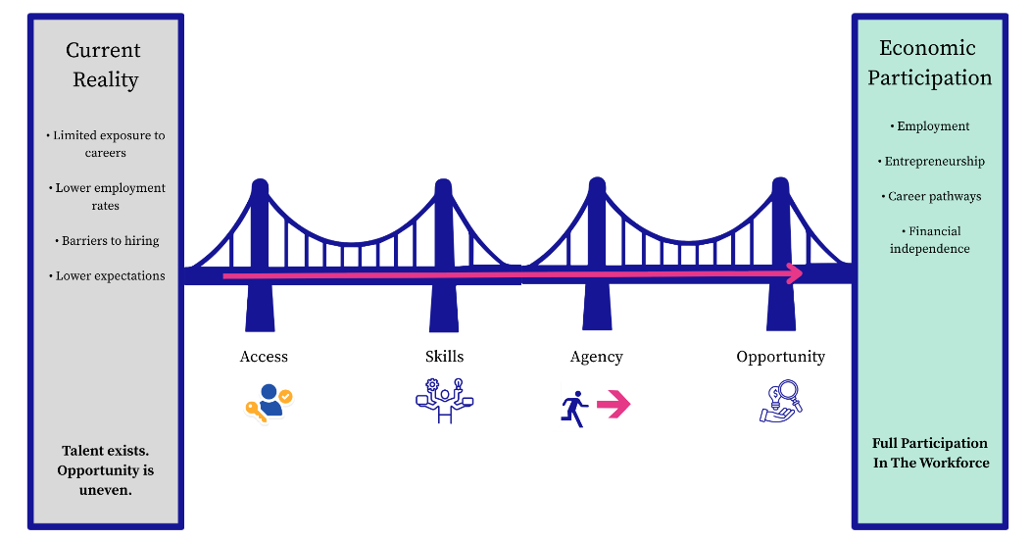
Vocational Rehabilitation is
Building the Bridge to Economic Participation
Notes:
The future of work is evolving quickly.
But the real question for all of us in this room is simple:
Are we building bridges that students can actually cross?
Through partnerships between vocational rehabilitation agencies, schools, and experiential learning organizations, we can ensure that more students move from access to agency… and from agency to economic participation.

Slide 26


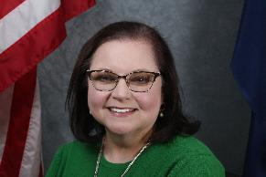
Megan Hall
Director, Vocational Rehabilitation & Workforce
Megan.hall@dbvi.gov
dbvi.gov
Kendall Morris
Founder, Founders Mark
Kendall@founders-mark.com
(804)916-0446
founders-mark.com

