Slide 1

COUNCIL OF STATE ADMINISTRATORS OF VOCATIONAL REHABILITATION
2025 FALL CONFERENCE
Time is Now: Elevating our Story through our Customers

Slide 2
Welcome New directors John Connelly, Interim CEO
Stacy Cervenka • IA- B
Gentry Cline • WV-C
Darrel Hannum • ND-C
Amy Howell • TN-C
Elvira Seman • Northern Marianas Island-C
Stephon Scott • NM-G
Beth Townsend • IA-G

Slide 3
Announcements

Slide 4
Welcome Address from…
Kim Rutledge
Director of California-
Combined
Jane Elizabeth Burdeshaw
CSAVR President Executive Committee
Director of Alabama Department of Rehabilitation Services-Combined

Slide 5
General Session 1
Telling Our Story:
A Celebration of 100 Stories in 100 Days

Slide 6

Dacia Johnson Director of Oregon Blind

Slide 7

Our North
Star:
Every citizen with a disability has a
meaningful career that allows them to
lead a full and productive life.
Every business is attracting and
retaining talent with disabilities
for their workforce.
The public VR program is the
key to achieving this vision.
This Photo by Unknown Author is licensed under CC BY-NC-ND

Slide 8
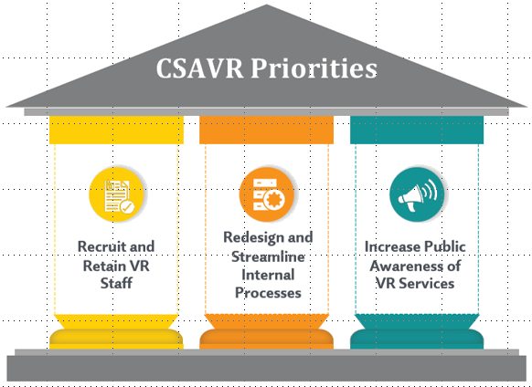
Update on CSAVR Strategic Priorities
Summer 2025
Executive Committee determined that some of this work has moved from strategic to operational.
CSAVR will continue to share best practices through the standing committees and conferences.
Increase Public Awareness is the primary focus/priority moving forward.
This work has been centered around
the VR Message House.

Slide 9

Fall 2024
CSAVR
Conference
We Introduced the
Message House.

Slide 10
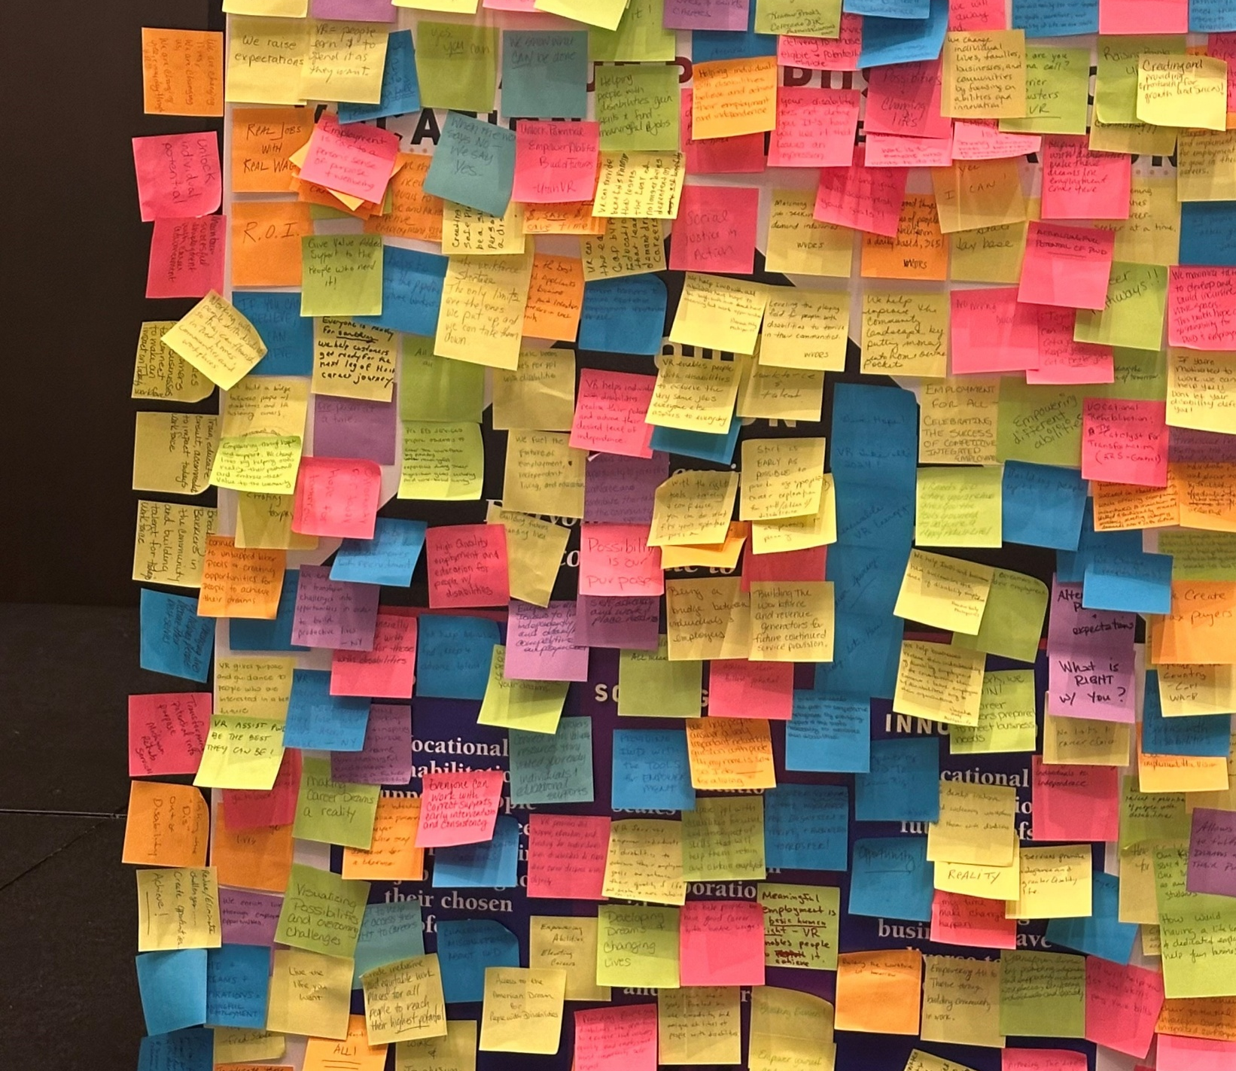
Fall 2024
CSAVR
Conference
We asked for your ideas/messages about the proposition of the public VR Program, and we filled the house!

Slide 11
Spring 2025
CSAVR Conference
Telling the VR Story and Bringing the Message House to Life
Communicate as often as possible that VR services are making a difference.
Target high priority audiences (congress • policy makers) that have a direct impact on the public VR program.
Engage business customers on highlighting the partnerships that meet their need for talent.
Leverage the power of the VR consumers who are participating in the workforce in their chosen careers.

Slide 12
100 Stories in
100 Days Campaign
Elevate the visibility of the Public VR Program and its collective impact.

Slide 13
stories that resonate with target audience
Short and succinct - 100-150 words.
Strong call to action.
Show impact in legislators’ districts (city, state).
Highlight impact on businesses.

Slide 14

Field of Dreams: Making the 100 Stories Campaign a reality
Working together to amplify the stories

Slide 15


The Power of Partnerships:
California DOR and
LEGOLAND
Kim Rutledge
Director of California-
Combined
Diane Derudder LEGOLAND Regional Commercial Excellence Director
Ramon Avitia Jr. Model Citizen
LEGOLAND

Slide 16
LEGOLAND PARTNERSHIP OPTIONS

Slide 17
LEGOLAND INCLUSION PERSPECTIVE

Slide 18
Graduation Day

Slide 19
LEGOLAND:2024 Employer Partner of the Year

Slide 21

Grace Miller • Associate

Slide 22
100 Stories in 100 Days: Turning Voices into Impact
How to Replicate, Sustain, and Leverage Storytelling Campaigns

Slide 23
The Blueprint — How to Replicate It
People
Process
Platform

Slide 24
Announcing the Winners!

Slide 25
Beyond Collection — How to Use the Stories
🏛️ Legislative packets
🗞️ Press & media
💻 Web & social
❤️ Staff morale & training

Slide 26
Our Message House is filled with the faces of the public VR
Program:

Slide 27
Field of Dreams:
Making dreams possible!
Financial Advisor • Head Injury Specialist • Entrepreneur • Animal Spa Therapist • Transportation Engineer • Skincare Founder • Childcare Specialist • Journalist • Psychologist • Farmer • Paralegal • Barber • Social Worker • RV Service Technician • Cybersecurity Analyst • Teacher • Physician Assistant • Sales Manager • Non-Profit Founder • Author • Licensed Professional Counselor • Park Attendant • University Professor • Band Director

Slide 28

California’s Communication
STRATEGIES
We are just getting started.
MORE TO COME On Wednesday:
CSAVR’s New Communication Professional Network
You won’t want to miss it!

Slide 29
Questions?​

Slide 30
THANK YOU

