Slide 1
VR Program Performance
CSAVR Spring 2026 Conference
April 1, 2026

Slide 2
Trends in Intake and Participation

Slide 3
Participant Trends Across WIOA Programs
WIOA Core Program | PY 2017 | PY 2018 | PY 2019 | PY 2020 | PY 2021 | PY 2022 | PY 2023 | PY 2024 | % Change First/Last
I: Adult | 781,174 | 640,822 | 357,558 | 264,869 | 287,659 | 299,910 | 278,770 | 250,160 | -68%
I: DW | 469,601 | 413,948 | 256,498 | 191,195 | 227,936 | 212,018 | 185,436 | 187,108 | -60%
I: Youth | 148,492 | 154,120 | 137,289 | 123,359 | 124,708 | 132,506 | 131,402 | 121,531 | -18%
II: AEFLA | 1,427,339 | 1,311,058 | 1,125,137 | 725,127 | 920,567 | 1,120,769 | 1,288,367 | 1,322,842 | -7%
III: W-P: ES | 4,330,507 | 3,807,065 | 3,409,790 | 2,435,120 | 2,500,982 | 2,344,726 | 2,452,241 | 2,561,317 | -41%
IV: VR | 932,835 | 896,528 | 872,862 | 811,591 | 808,303 | 818,646 | 872,460 | 937,969 | 1%
WIOA Participant Share | 2024 | Percent
DOL Core Programs (Adult, DW, Youth, and Wagner Peyser Employment Services) | 3,120,116 | 58%
ED Core Programs (AEFLA and VR) | 2,260,811 | 42%
Total | 5,208,676 | -

Slide 4
Trends in VR Intake and Participation (continued)

Slide 5
Current Agencies Implementing an OOS
The following 14 VR agencies are operating under an Order of Selection, as approved by RSA in their Program Year 2024-2027 WIOA State Plan, and have some or all priority categories closed. The six VR agencies that have elected to serve eligible individuals, who require VR services to maintain employment, outside of their OOS are marked with an asterisk.
  Colorado Division of Vocational Rehabilitation (CO-C): 0 of 3 priority categories open
  Idaho Division of Vocational Rehabilitation (ID-G): 0 of 3 priority categories open
  Kentucky Office of Vocational Rehabilitation (KY-C): 0 of 4 priority categories open
  Maryland Division of Rehabilitation Services (MD-C): 1 of 3 priority categories open
  Minnesota Vocational Rehabilitation Services (MN-G): 1 of 4 priority categories open
  Missouri Vocational Rehabilitation (MO-G): 1 of 3 priority categories open*
  Montana Vocational Rehabilitation and Blind Services (MT-C): 1 of 3 categories open
  Oklahoma Department of Rehabilitation Services (OK-C): 1 of 3 priority categories open
  Oregon Office of Vocational Rehabilitation Services (OR-G): 0 of 3 priority categories open*
  Pennsylvania Office of Vocational Rehabilitation (PA-C): 1 of 3 priority categories open*
  Utah State Office of Rehabilitation (UT-C): 1 of 3 priority categories open
  Washington Division of Vocational Rehabilitation (WA-G): 0 of 5 priority categories open*
  West Virginia Division of Rehabilitation Services (WV-C): 1 of 3 priority categories open*
  Wisconsin Division of Vocational Rehabilitation (WI-C): 0 of 3 priority categories open*

Slide 6
Trends in Pre-Employment Transition Services

Slide 7
Pre-ETS Reserve/Expenditures
Pursuant to Section 107 of the Rehabilitation Act, RSA conducts annual reviews of each State to determine whether States are substantially complying with requirements in their WIOA Unified or Combined State Plans.
In FFY 2025, among the 56 States and Territories, four did not meet the reserve requirements:
  Guam – 0.0%
  Idaho – 11.8%
  Kansas – 12.6%
  New Mexico – 14.7%
  In FFY 2020, there were 30 States/Territories that did not meet the reserve requirements.

Slide 8
VR Program: Trends in WIOA Indicator Performance
 | PY 2017 | PY 2018 | PY 2019 | PY 2020 | PY 2021 | PY 2022 | PY 2023 | PY 2024
Measurable Skills Gains Rate | 21% | 23% | 31% | 43% | 43% | 49% | 52% | 52%
Employment Rate Q2 |  | 50% | 51% | 49% | 53% | 56% | 56% | 54%
Median Earnings Q2 |  | $3,875 | $4,005 | $4,280 | $4,776 | $5,130 | $5,513 | $5,331
Employment Rate Q4 |  |  | 43% | 44% | 48% | 53% | 53% | 52%
Credential Attainment Rate |  |  | 11% | 23% | 31% | 38% | 41% | 38%

Slide 9
WIOA Performance across Programs – PY 2024
Indicator/Program | Adult | Dislocated Worker | Youth | Adult Education | Wagner-Peyser | Vocational Rehabilitation | Indicator Averages
Measurable Skill Gains Rate | 74.0% | 72.4% | 67.4% | 50.1% | - | 52.2% | 63.2%
Employment Rate Q2 | 72.2% | 69.0% | 65.9% | 33.9% | 66.8% | 53.8% | 60.2%
Median Earnings Q2 | $8,754 | $9,897 | $5,038 | $7,128 | $8,558 | $5,331 | $7,451
Employment Rate Q4 | 72.3% | 70.5% | 67.4% | 33.8% | 67.5% | 51.9% | 60.5%
Credential Attainment Rate | 73.6% | 75.1% | 62.0% | 29.6% | - | 38.0% | 55.6%

Slide 10
Barriers to Employment by Program – PY 2024
Percent of Participants

Slide 11
Percent of Skill Gains by MSG Type & Program
MSG Type | Adult | Dislocated Worker | Youth | Adult Education | Vocational Rehabilitation
1. Educational functioning level | 1% | 1% | 15% | 81% | 1%
2. Secondary school diploma or equivalent | 0% | 0% | 17% | 13% | 20%
3. Secondary/Post-Secondary Transcript/Report Card | 14% | 10% | 28% | 0% | 68%
4. Training milestones | 25% | 27% | 10% | 1% | 4%
5. Skills Progression | 60% | 62% | 31% | 4% | 6%

Slide 12
Percent of Credential Types Attained by Program
Credential Type | Adult | Dislocated Worker | Youth | Adult Education | Vocational Rehabilitation
1) Secondary School Diploma/or eq. | 1% | 0% | 44% | 65% | 51%
2) AA or AS Diploma/Degree | 5% | 7% | 1% | 35% | 10%
3) BA or BS Diploma/Degree | 2% | 2% | 1% |  | 16%
4) Graduate/Post Graduate | 0% | 0% | 0% |  | 3%
5) Occupational Licensure | 31% | 26% | 10% |  | 3%
6) Occupational Certificate | 44% | 45% | 30% |  | 13%
7) Occupational Certification | 11% | 14% | 7% |  | 4%
8) Other Recognized Diploma/Deg./Cert. | 6% | 6% | 6% |  | 1%
Total Credentials Attained | 55,188 | 19,402 | 31,150 | 56,822 | 37,026

Slide 13
WIOA Performance Assessments by Program
Primary Indicator/ Core Program | Title I Adult | Title I Dislocated Worker | Title I Youth | Title II AEFLA | Title III Wagner- Peyser | Title IV Vocational Rehabilitation | Overall State Indicator Score
Employment Rate 2nd Qtr after Exit
Employment Rate 4th Qtr after Exit
Median Earnings 2nd Qtr after Exit
Credential Attainment Rate
Measurable Skill Gains Rate
Effectiveness in Serving Employers
Overall State Program Score |  |  |  |  |  |  | -

Slide 14
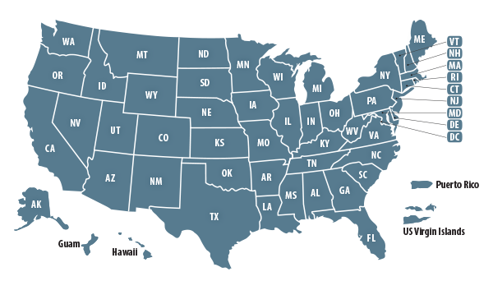
WIOA Performance Assessments in PY 2024
PY 2024
  52 States x 5 Individual Indicators = 260
  (Failing indicator scores <50%)
  + Overall State Program Scores = 52
  (Failing program scores <90%)
  A total of 312 assessments determined internally by RSA
Arkansas and Hawaii had Overall State Program Score failures and have initiated Performance Improvement Plans to avoid successive failures in PY 2025.

Slide 15
“Actual” Performance vs. “Assessed” Performance
A State’s Actual Performance is the result that they achieve at the end of the program year.
  For example, in PY 24, Alabama found that 58.3% of participants that exited after IPE development were employed in the 4th quarter after exit. This ranked 11th among the 52 States.
A State’s Assessed Performance is the result of a calculation that divides actual performance by a statistically adjusted target.
  For example, Alabama’s 58.3% result for the 4th quarter employment rate was divided by the adjusted (target) level of 56.8% for an assessment result of 102.7%. This indicator score ranked 8th among the 52 States.

Slide 16
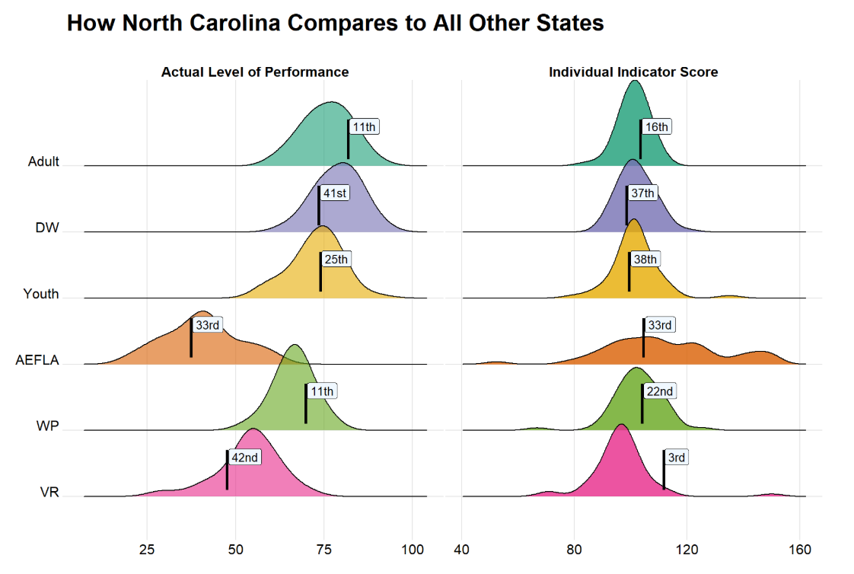
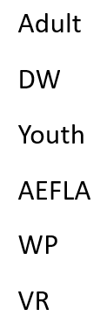
Actual Performance vs. Assessed Performance
State Comparisons by Program/ Individual Indicator: ERQ2
https://www.dol.gov/agencies/eta/performance/results/assessments

Slide 17
Recent Developments and New Resources
PY 24 WIOA Performance Data Published
  PY 24 WIOA Performance in Review
  RSA Performance Assessments
  Performance Assessments Across Workforce Programs (ETA)
PY 2025 Year-to-Date Progress Reflected in RSA Dashboards
PY 2026/2027 Negotiated Performance Levels
  RSA Negotiations Tool Reflects Performance of Blind Agencies

Slide 18
What’s Next in Reporting and WIOA Performance
Performance Negotiations for PY 2026/2027
  Finalized by May of 2026
Two Quarters Remaining in Program Year 2025
  Assess and correct missing and incorrect data
  Use RSA’s Dashboard and investigate flags
  Let RSA know if you have data correction plans
  Opportunity for resubmission diminishes the closer we get to July
  Cannot accept correction requests after PY 25 is complete
RSA-911 ICR Renewal Process to begin in April
  RSA anticipates minimal change and significant burden reduction

Slide 19




Celebrating Success Stories

Slide 20
Connect with RSA
Explore RSA’s Website
Keep up with What’s New
Stay in touch with your:
  RSA State Liaison
  RSA State Team
  RSA Data Unit Liaison

