Slide 1
Maximizing Partnerships & Resources to Deliver Pre- Employment Transition Services
CSAVR
Spring, 2026

Slide 2
National Technical Assistance Center on Transition: the Collaborative – same name, new focused charge
Funded by U.S. Department of Education; Office of Special Education and Rehabilitative Services (OSERS)
Funded from Fall 2025 – Fall 2030

Slide 3
Pre-ETS:
Purpose:
Improve the transition of students with disabilities from school to postsecondary education or to an employment outcome,
Increase opportunities for students with disabilities to practice and improve workplace readiness skills, through work-based learning experiences in a competitive, integrated work setting and
Increase opportunities for students with disabilities to explore post-secondary training options, leading to more industry recognized credentials, and meaningful post-secondary employment
Who provides it:
State Vocational Rehabilitation (VR) agencies in collaboration with Education.

Slide 4
A Decade of Data:
How are we using it?

Slide 5
Students with Disabilities Data Reporting
Students with Disabilities (SWD) - PY 17 through PY 24 |  |  |  |  |  | First to Last Year Comparisons
 | 2017 | 2019 | 2020 | 2022 | 2024 | % Change | # Change
Number of SWD Reported | 525,958 | 682,237 | 622,498 | 662,034 | 757,732 | 44% | 231,774
Number of SWD Received a Pre-ETS | 179,716 | 247,926 | 203,638 | 281,421 | 332,954 | 85% | 153,238
Percent of SWD Reported Who Received a Pre-ETS | 34% | 36% | 33% | 43% | 44% | 10%
Number of Potentially Eligible SWD Who Received a Pre-ETS | 85,245 | 144,346 | 102,495 | 162,530 | 204,031 | 139% | 118,786
Number of SWD, who Applied and Received a Pre-ETS | 94,471 | 103,580 | 101,143 | 118,891 | 128,923 | 36% | 34,452
Percent of SWD, who Applied and Received a Pre-ETS | 53% | 42% | 50% | 42% | 39% | -14%
Total Pre-ETS Provided | 747,837 | 1,349,877 | 1,171,303 | 1,624,554 | 1,787,897 | 139% | 1,040,060

Slide 6
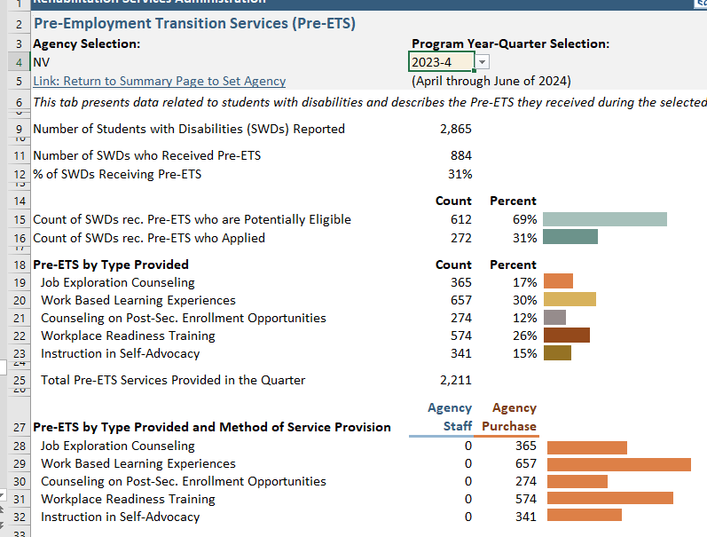
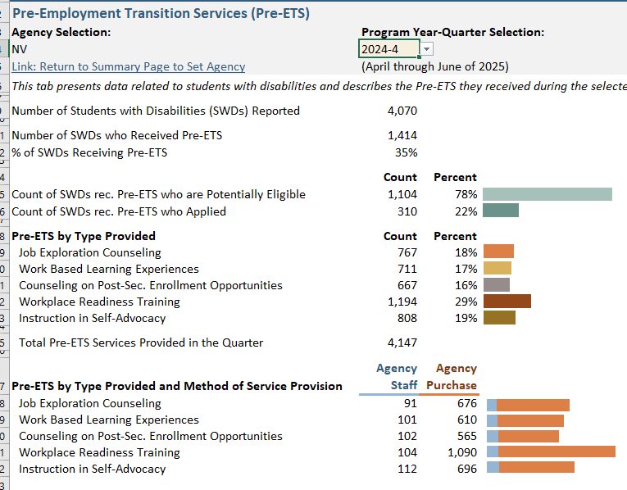
Using Data for decision making:
VR Data Comparison – PY 2023 Q4 VS PY 2024 Q4
Notes:
This is just a snapshot of what the 911 gives you back in the dashboads every quarter. Your case management systems collect alot more data.

Slide 7
Using Data for Resource Planning
What data are you looking at for program planning, specifically regarding resource allocation?
What data do your partners provide?
How much time do we spend as leadership teams in sharing and using data across partners?
Who has access to the dashboard?
Notes:
Looking at trends.

Slide 8
Student Data and OOS
Section 101(a)(5) of the Act, as amended by WIOA, does not exempt students with disabilities receiving pre-employment transition services prior to the determination of eligibility from a State's OOS.
  If a SWD needs individualized VR services, they must be determined eligible and have an approved IPE.
  If a SWD begins one or more of the required activities prior to being determined eligible for VR services, they may continue to receive any and all pre-employment transition services even if assigned to a closed OOS category.
Notes:
Please see FR page 55692
after 2017, trend has flipped from swd eligible to swd’s potentially eligible PE grew 139% vs Applicants 36%

Slide 9
OOS Resource Considerations & Serving Students
A VR program that has expended its minimum 15% reserve requirement, regardless of whether or not they are under an OOS, may not restrict access to pre-employment transition services for potentially eligible SWD as a result of a lack of resources (e.g. money, staff time).
While an OOS acts as a mechanism for the VR program to regulate the flow of individuals that can be served with the agency’s resources, there is no such mechanism in the statute or regulations for pre-employment transition services.
VR programs are encouraged to examine ways they are providing pre-employment transition services to:
  use strategies to deliver methods that are more cost effective, &
  evaluate services that should be considered an individualized VR transition service that students can receive once they apply, are determined eligible, and have an approved IPE.

Slide 10
Leveraging Internal and External Partnerships

Slide 11

Collaboration
Hey Fred, you’re up. I think you’re supposed to do this part!
Wait, what? Me…I thought that was your responsibility now?
Notes:
Everyone is always payer of last resort
How do we truly partner?
What is the biggest factor - time and investment in partners
With the addition of the five required pre-employment transition services that VR may now provide to students with disabilities, the lines between what constitutes a VR Pre-ETS activity, and what transition services the student receives as part of the local education agency’s responsibility under IDEA, can often become a little blurry. So it's really important for VR and education personnel at the local level to communicate closely with one another in coordinating these services to ensure that transition services are not being duplicated, but rather build upon one another to help the student maximize the services needed to achieve those positive post school outcomes.

Slide 12
Maximizing Internal & External Partnerships
Internal Partners
VR Transition Staff
Dedicated Pre-ETS Staff
Employment Services
BEP
Using Specialized Staff for Career Speakers, Informational Interviews, Job Shadows
External Partners
State & Local Education
Tribal Programs
Workforce
DD
Behavioral Health
Other Agencies:
  Childrens Cabinet
  School boards
  JJ
  Foster Care
Providers
Notes:
Internal - BEP
External -

Slide 13
Maximizing Internal & External Resources
Collaboration is Key!
How are resources being used to ensure the same quality and options for services are statewide?
1
2
What collaborators are you reaching out to reach unserved and underserved students in your state?
3
Who can you partner with to increase your outreach and communication efforts; ensure informed choice?
What opportunities might help you create new partnerships?
4
Notes:
#2- What partners in your state and local communities that serve students that you are not reaching ? (tribal, homeless, foster care , out of school youth, (boys & girls clubs, job corps, WIOA youth title 1, faith-based organizations
#3 - website, social media, agency newsletter, TV and radio (not paid), school newsletter, PTI’s, 15 min presentation to other /consistent outreach and engagement with your partners
#4 - examples
MS and WY both have Tribal VR program director on their interagency statewide teams
WY newsletter - CYBER SHINDIG
MINI CONFERENCE FOR BUSINESS AND INDUSTRY
designed for realtors, manufacturers, and small businesses in NW Wyoming.
College students welcome! Plus, a bonus track for high school students.
3 hrs
Northwest College,
Powell, Wyoming
What to Expect :
Networking & Coffee Kickoff:
Start your morning connecting with peers over coffee and pastries.
Real-World Insights:
Hear directly from professionals in real estate, manufacturing, and small business
about how they've tackled cybersecurity challenges.
Interactive Breakouts:
Choose a track tailored to your interests-Realtors, Manufacturers, Small Businesses,
or Students.
Expert Q&A:
Wrap up the day with a dynamic student-led "Ask the Experts" session, where industry
leaders answer real questions about careers, safety, and cybersecurity.
Hosted By
CyberWyoming & the CyberWyoming Alliance, Wyoming SBDC, Wyoming Manufacturing Works,
Northwest Wyoming Board of REALTORS, & Wyoming Dept of Education CTE Division
KY - invited the school board representative to their transition/pre-ets conference

Slide 14
Co-enrollment Increases Pay
  Co-enrollment of youth receiving employment and training services correlates with higher wages
  WIOA Title I Youth co-enrollment: +$366
  Job Corps co-enrollment: +$833
  Few youth are co-enrolled (underused)—but benefits are large
  Co-enrollment leverages and maximizes disability expertise, resources, training opportunities and employer connections to promote career pathways
Notes:
Co-enrollment is underused but powerful.
Schools and VR counselors can act as connectors, not just service providers.
Shared planning = shared outcomes.

Slide 15
State Examples
Nebraska General & Wyoming

Slide 16
State Sharing
Nebraska
Wyoming
Lindy Foley
Administrator
Nebraska VR
Nebraska Department of Education
Nicky Harper, MSW, LCSW, CRC
Vocational Rehabilitation Administrator
Wyoming Department of Workforce Services

Slide 17

Pre-ETS Improves Earnings & Outcomes
Pre-ETS is a strong predictor of increased wages & employment outcomes
Youth who received Pre-ETS earned an average of $518 more in quarterly wages two quarters after exit than youth who did not receive pre-employment transition services (Hartman et al., 2025).
Pre-ETS + credentials = higher wages
The pre-employment transition services of job exploration counseling, instruction in self-advocacy, workplace readiness training, and work-based learning experiences were significantly associated with employment outcomes (Taylor et al., 2024).
Notes:
Pre-ETS works—but how it’s delivered matters.
States with stronger coordination and clearer service definitions saw larger gains.
This points to practice quality, not just service access.

Slide 18
References
Hartman E.C., Brinck E.A., Anderson C.A., Hergenrather K.C. Education and Pre-Employment Transition Service Predictors of Wages for Transition Age Youth with Disabilities. Journal of Vocational Rehabilitation. 2025;63(2):147-159. doi:10.1177/10522263251356241
Staying Engaged: Knowledge and Research Needs in Student Engagement
Engaging Youth with Disabilities in the Delivery of Pre-Employment Transition Services
Predictors of Post School Success Level of Evidence Chart

Slide 19


Find us on:
#transitionTA transitionTA.org ntactc@uoregon.edu
Thank You!
The contents of this presentation were developed under a grant (H326E250006) from the Department of Education. However, those contents do not necessarily represent the policy of the Department of Education, and you should not assume endorsement by the Federal Government.
19

