Slide 1


Engaging Families to Expand Competitive Integrated Employment Outcomes for Individuals with the Most Significant Disabilities: Lessons from Virginia’s SWTCIE Grant

Slide 2
Disclaimer
“The contents of this presentation were developed under grant H421D220008 from the U.S. Department of Education (Department). The Department does not mandate or prescribe practices, models, or other activities described or discussed in this document. The contents of this flyer may contain examples of, adaptations of, and links to resources created and maintained by another public or private organization. The Department does not control or guarantee the accuracy, relevance, timeliness, or completeness of this outside information. The content of this presentation does not necessarily represent the policy of the Department. This publication is not intended to represent the views or policy of or be an endorsement of any views expressed, or materials provided by any Federal agency (EDGAR 75.620).”

Slide 3



    John Stewart
    Project Manager for the Virginia Department for Aging and Rehabilitative Services’ Real Pay for Real Jobs EPIC Model Project
    Nickie Brandenburger
    Co-Director of the Center for Family Involvement at VCU's Partnership for People with Disabilities
    Chris Martin
    Director of Employment Services at SOAR365

Slide 4

Before we get started
  Take 3 minutes
  Turn to the person next to you
  If you don’t know them, introduce yourself.
  Share with each other one great thing that you learned, or a connection that you made here at CSAVR

Slide 5
Virginia SWTCIE Project
Real Pay for Real Jobs an EPIC Model
Intended to build capacity at a local level to improve and expand services to address the obstacles to employment faced by individuals with disabilities.
Transitioning from and preventing entrance into subminimum wage employment for project participants will be achieved by building local stakeholder capacity to provide improved services leading to competitive integrated employment outcomes

Slide 6
Sub-minimum wage is being eliminated in Virginia
Virginia’s General Assembly 2023 session changed VA State Code
  “Any individual with disabilities employed by an employer that was authorized, prior to July 1, 2023, to employ individuals with disabilities at a subminimum wage pursuant to a special certificate issued under 29 U.S.C. § 214(c) of the Fair Labor Standards Act of 1938, as amended, provided that such individual was employed by and paid a subminimum wage by such employer pursuant to 29 U.S.C. § 214(c) of the Fair Labor Standards Act of 1938, as amended, prior to July 1, 2023;”
  This ended anyone starting employment in subminimum wage after July 1, 2023.
  This code change also eliminates all subminimum wage in VA after June 30, 2030

Slide 7
Providers were already moving away from SWE
Before the legislation passed employers had begun to end 14(c) certificates:
  2017 - 37 employers employing 2379 individuals
  2022 - 13 employers employing 385 individuals
  2026 - 3 employers remain employing approximately 58 individuals
Some providers started paying people minimum-wage but still employed people in segregated environments with little opportunity to advance. This created a situation where people were now “too disabled” to work in sheltered work
One provider stopped providing services altogether
Many participants moved to:
  Day support – activity-based programs
  Home

Slide 8

Strategies
education
partnership development
individualized services
capacity building

Slide 9


takes a holistic approach to employment
Identifying the individual’s strengths, preferences, interests and needs
Utilizing Active Resource Coordination to identify current and needed supports to eliminate barriers to employment
Utilizing Integrated Resource Teams to provide wraparound supports to help people achieve their employment goals

Slide 10

Who is EPIC serving?
Individuals currently working in subminimum wage employment
Individuals formerly working in subminimum wage employment
Individuals educated in self-contained special education high school settings who are at risk for subminimum wage/sheltered employment
Recent graduates educated in self-contained special education high school settings who are at risk for subminimum wage/sheltered employment
Individuals previously deemed having a disability that prevented them from working
Who is
Serving?

Slide 11

education
  Helps people and their caregivers better understand and know how to access Competitive Integrated Employment (CIE)
Peer Mentoring
Family Navigation
Paid Work Experience

Slide 12
Family Navigation
Connect family members to families of people with disabilities who can:
Share their experience about family member searching for work
Share their experience about family member working
Help with family concerns about finding a job that meets:
  Interests
  Needs
  Safety
  Accommodations
Share their experience about who can help:
  Department for Aging and Rehabilitative Services (DARS)
  Job Coaches/Employment Service Organizations– to help find/ learn job
  Work Incentive Specialists (WISA) –to help with understanding benefits
  Many, many more

Slide 13
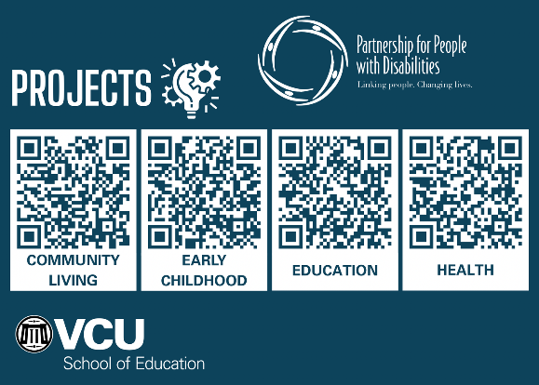


THE PARTNERSHIP
The Partnership for People with Disabilities
  has served 40 yrs as Virginia’s University Center of Excellence in Developmental Disabilities (UCEDD)
  is located in VCU’s School of Education as one of two disability-focused Centers

Slide 14

Who are we?
  Parents and caregivers to family members with developmental disabilities and special health care needs
  Called Family Navigators or Family Mentors
  Possess a strong knowledge of local resources, services and the disability service system
  Diverse and aware of regional culture
  Trained through the CFI
Notes:
Family Mentors, also known as Family Navigators are diverse parents and primary caregivers currently or formerly providing support to a family member with a developmental disability or special health care need. Family Navigators are selected based on the possession of a strong knowledge of local resources, services, disability delivery system, as well as regional culture. Family Navigators are trained through the Center for Family Involvement at the Partnership for People with Disabilities at Virginia Commonwealth University

Slide 15
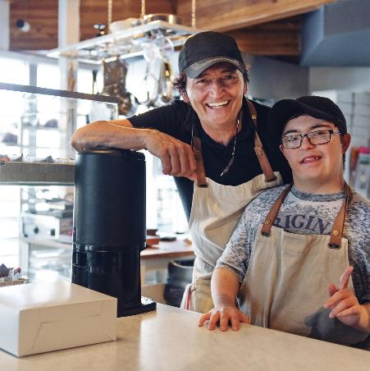
What kind of support an we provide?
Emotional Support
Referral Advice
System Navigational Support
Notes:
Family mentoring provides emotional informational and systems navigational support, and referral advice for family members of EPIC participants working to obtain and maintain Competitive Integrated Employment.

Slide 16

Specialized Peer Support
Cultural Brokers
Latino, African American and Refugee communities
DHH Navigators
Lived experience with a child with hearing loss, general awareness around early hearing loss detection
Specialists
Blind/visual impairment, Aging families, Mental Health and Rural communities
Genetic Navigators
Lived experience with a child with a genetic disorder
Pre-Employment Transition Services (Pre-ETS) Ambassadors
Lived experience with a child currently or formerly in transition

Slide 17

Family Mentoring: Referral Process
Referral Source
Matching/Support
01
DARS Counselor, EPIC Coordinator, Community Partner (Soar 365, School, CSB)
Assigning the mentor, provide support
04
Initial Contact and Information Gathering
Ongoing Support and Resources
02
05
Phone call, email, text, in person/virtual meeting
Check-ins, connecting to community resources, advocacy, IRT
Needs Assessment
Follow up and Evaluation
03
06
Family needs, employment goals, barriers
Tracking progress, gathering feedback

Slide 18

Transportation
Impact of earned wages on benefits
Rural vs. urban, family support, training needs of employee
Fear, misinformation, poverty
Supported Decision Making
Emotional Support
Spectrum of options, guardianship, conservatorship, authorized rep, advanced directive etc.
Listen, validate, share and recognize achievements. Advocacy fatigue is REAL!
03
04
02
05
Family Needs Assessments:
Common Concerns
Other
Access to the CSB/DD Waiver
Immigration, limited follow through/motivation, culture, family caregiving responsibilites
01
06
Understanding of the Community Service Board (CSB) eligibility process, DD Waiver screening, priority level for waiting list

Slide 19
WHAT WORKED
WELL?
  Personalized Peer to Peer support
  Clear and concise information
  Connection to resources
  Collaboration with family and
professionals
  Flexibility (meet the family
where they are)

Slide 20
Data
Total families served: 95
Total hours of support: 190 hours
Families that did not respond: 50

Slide 21
Impacts for providers
Connecting
Connecting individuals to the resources they need
Helping
Helping Families to be better equipped to navigate systems
Helping
Helping families to feel confident in pursuing CIE

Slide 22
Impacts for individuals
Participants earning $12.77 ( current Virginia minimum wage) to as high as $17.00/ hour. Average $15.38/hour
Participants working as many as 20 hours per week
More than half of those who have become engaged in CIE have had their cases closed -rehabilitated

Slide 23
Questions?
    John Stewart
    John.Stewart@dars.virgiia.gov
    Nickie Brandenburger
    tnbrandenburg@vcu.edu
    Chris Martin
    Chris.Martin@soar365.org

