Slide 1
Enhancing Fiscal and Programmatic Collaboration:
New Mexico’s Approach to Financial Transparency and Data-Driven Decisions for client services
Antoinette Holmes – Deputy Director Statewide Programs
Charlene B. Chavez – Statewide Transition Director
Rosalva Lucero – AWARE Program Manager

Slide 2
Challenges Identified
Budget Governance
Coordination
Institutional Knowledge
Management Oversight
KEY CHALLENGES
IMPACT
Inconsistent budget allocation across units
Weak communication between operational units
Limited understanding of agency needs
Limited managerial insight into local budget use
Misalignment with agency priorities
Inefficient planning
Budget not created in collaboration with program management
Reduced ability to optimize resources

Slide 3
GOALS
IDEA
STRATEGY
VRTAC-QM support
Financial Alignment
Data & Research
Communication
Spending Strategies
Strengthen coordination and Technical Assistance
Use Financial Summit to focus funding priorities
Support evidence-based planning
Increase cross-unit collaboration
Optimize local budget allocation

Slide 4
Care & Support FFY
$ 12,829,493.28
$ 12,455,541.64
$ 7,288,733.98
Source: SHARE Financials
FFY23
FFY24
FFY25

Slide 5
Care & Support – SFY23, SFY24 vs SY25*
*Final numbers pending SFY closure

Slide 6
Pre-ETS Total Expenditures by Grant Year
$ 3,113,687.82
$ 3,023,136.76
$ 3,505,166.28
Care & Support
Pre-ETS Expenditures
Source: SHARE Financials

Slide 7
Average Cost Per Working Case*– VR only
*TOTAL Monthly authorization obligation/monthly OPEN cases (PY24)

Slide 8
Average Cost Per Working Case*– Pre-ETS
*TOTAL Monthly authorization obligation/monthly OPEN cases (PY24)

Slide 9
Monthly OPEN (VR) Case Activity – PY24
Source: AWARE (Case Management System)

Slide 10
Monthly NEW (VR) OPEN Cases – PY24
Source: AWARE (Case Management System)

Slide 11
Monthly (VR) Closure Activity – PY24
Source: AWARE (Case Management System)

Slide 12
Monthly OPEN (PRE) Case Activity – PY24
Source: AWARE (Case Management System)

Slide 13
Monthly NEW (PRE) Case Activity – PY24
Source: AWARE (Case Management System)

Slide 14
Monthly (PRE) Closure Activity – PY24
Source: AWARE (Case Management System)

Slide 15
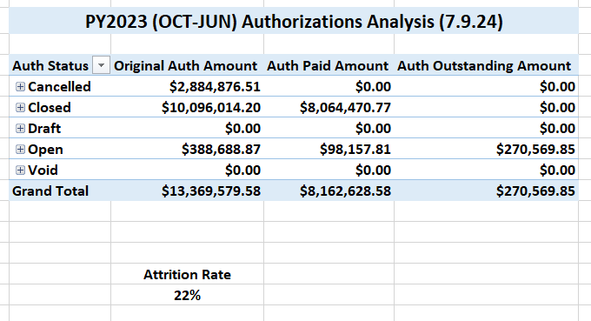
RSU Authorization Activity
PY23 (October ’23 - June ’24)

Slide 16
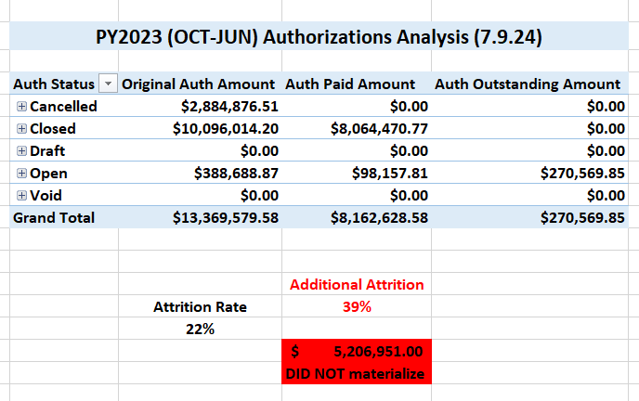
Additional Attrition to Consider

Slide 17
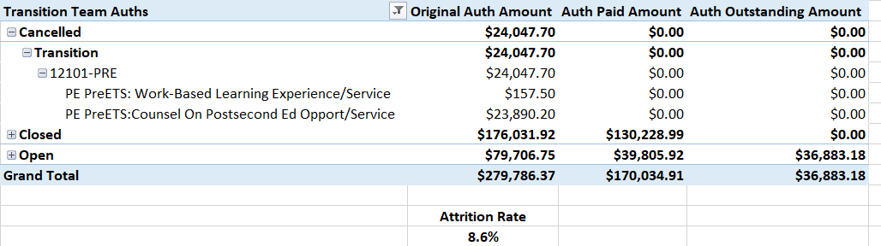
Transition Authorization Activity
PY23 (October ’23 - June ’24)

Slide 18
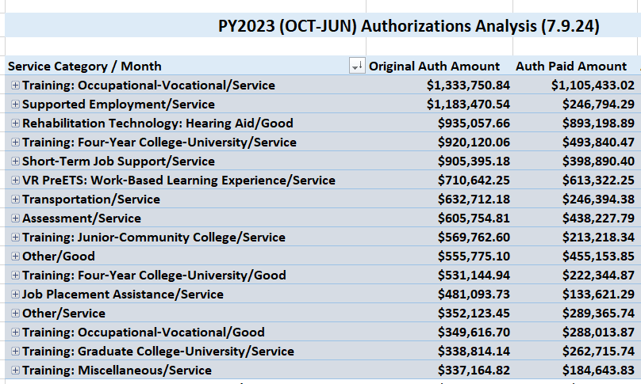
Service Category Activity (October ’23 - June ’24) estimated

Slide 19
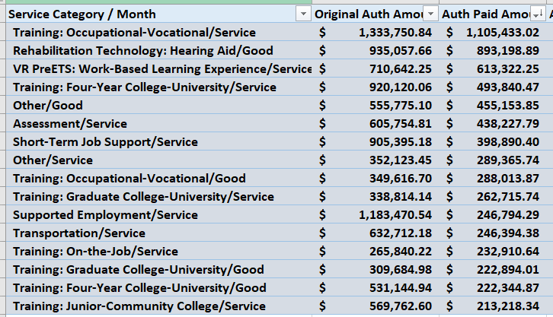
Service Category Activity (October ’23 - June ’24) actuals

Slide 20
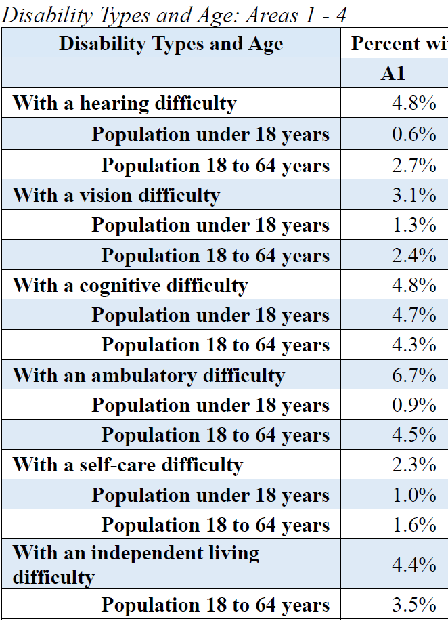
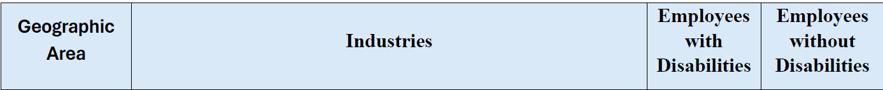
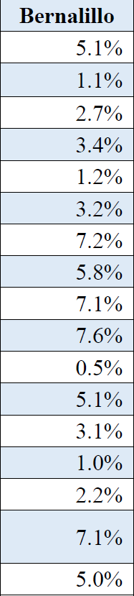
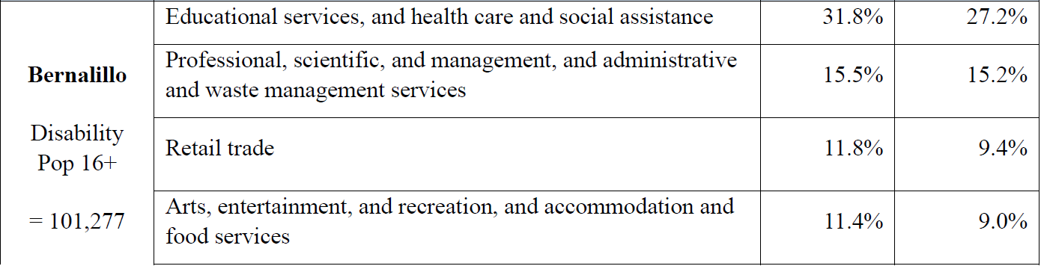
CSNA Field Area Review
Local Area Top Industries by Employment
Disability Types and Age
Median Age = 39.1
Median Working Age = 38.9
Median HHI = $65,075 ($59,726 NM)
Avg Poverty Rate = 13.8%
Median Earnings
w/disability = $39,747 ($36,245 NM)

Slide 21
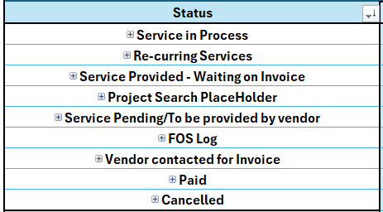
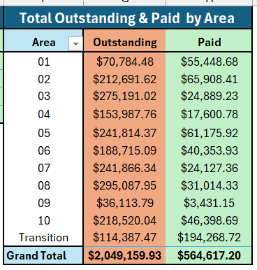
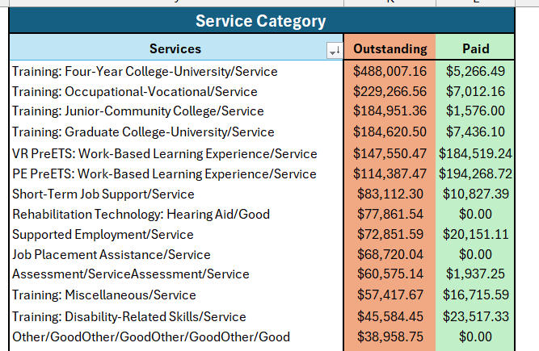
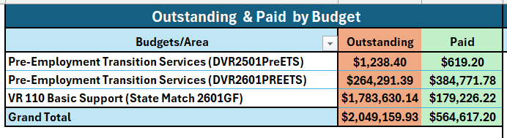
NMDVR Authorization Trackers
Bi-weekly Authorization Trackers
  Field Area review
  Update current authorization status
  9 status categories
MASTER Tracker
  Total Outstanding vs Paid by Area
  Budget by Area Outstanding vs Paid
  Service Category Outstanding vs Paid

Slide 22
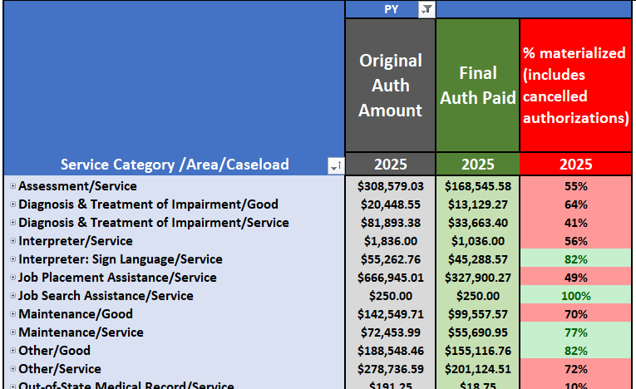
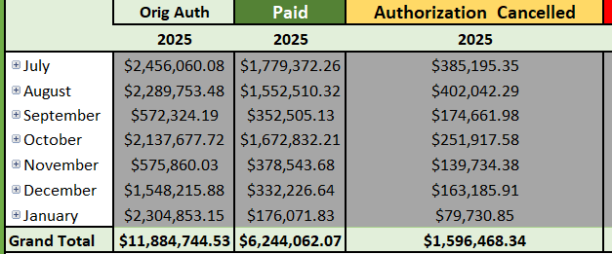
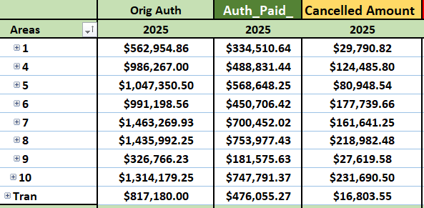
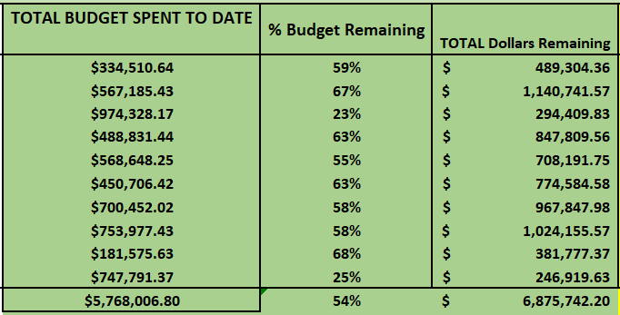
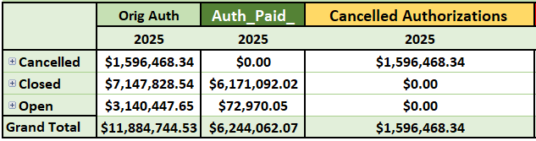
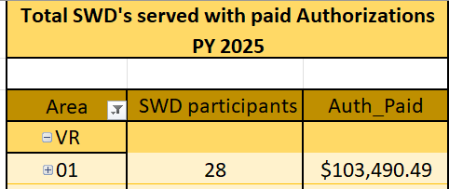
NMDVR Quarterly Attrition Report
Total authorization amount by Service Category, Area, and Caseload
  Identify services under 75% materialized to be reviewed
Authorization activity by Month and by Area
Program Year burn rate (actual quarterly spend vs budget amount)
Authorization activity by status (cancelled, closed, open)
Total SWD activity by Area with paid authorizations

Slide 23
Pre-Employment Transition Services
Tracking the 15% Reserve

Slide 24
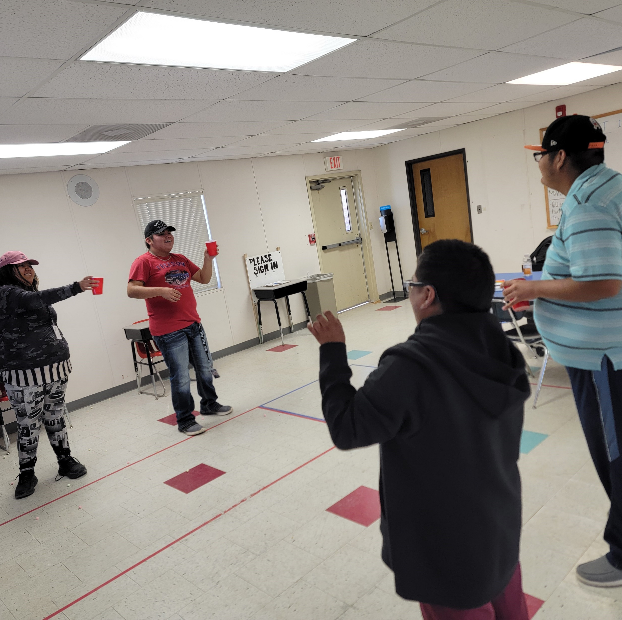
Fiscal Forecasting Impact
Allows us as agency to examine how to budget and be more predicable of services for SWD
Helps the agency plan staffing, scheduling, and budgeting more effectively.
Supports predictable and high‑quality Pre‑ETS service delivery statewide.
Notes:
Example: Project SEARCH, WB Learning sites, increase SWD to sites,

Slide 25
Fiscal Forecasting Impact continued…
Improved Fiscal Tracking and Predictability
Created a Pre‑Employment Transition Services (Pre‑ETS) tracker to improve monitoring of service delivery and fiscal needs.
Enabled the agency to better budget and accurately forecast services for students with disabilities.
Developed and implemented a rate‑setting policy and procedure to promote consistent fiscal planning.
Supported the addition of more Transition Counselors.

Slide 26
Fiscal Forecasting Impact continued…
Strengthened Financial Oversight and Reporting Systems
Implemented Authorization Trackers for increased visibility of funding status and obligations, with bi‑weekly reports shared with transition unit.
Adapted authorization practices to align with ongoing budget obligations and funding timelines.
Developed fiscal management tools, including a cost‑per‑case report, to streamline communication and reporting.

Slide 27
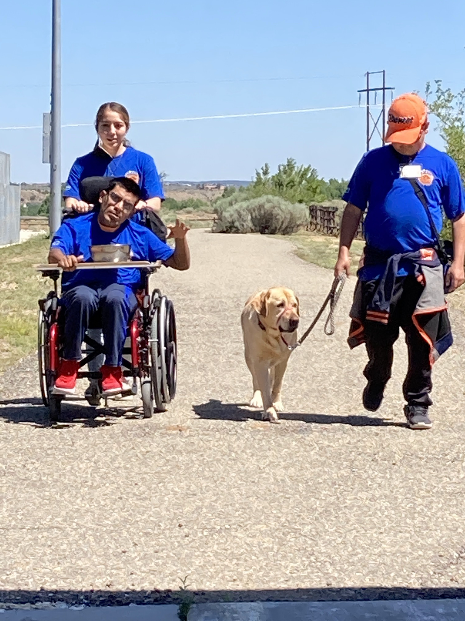
Pre-ETS Outcomes
How the Fiscal work changed Pre-ETS
Enhanced Work‑Based Learning (WBL) Opportunities across New Mexico with Increased WBL sites statewide (6 to 10), broadening access for students.
Expanded partnerships with local educational agencies and private industries.
Increased number of staff in Transition Unit
Notes:
Reference slide above

Slide 28
Pre-ETS Total Expenditures by Grant Year
$ 3,113,687.82
$ 3,023,136.76
$ 3,505,166.28
Care & Support
Pre-ETS Expenditures
Source: SHARE Financials

Slide 29
Transition Expenditures by Service Category via 3rd Party Contractors (PY24 vs PY25)
PY24
PY25

Slide 30
Client Service Delivery and Budget Management

Slide 31
Understanding Population Served by Area
Population size and demographics
Shared characteristics and community needs
Cost consideration
Budget allocation and planning
Unique needs of each service area
Service location differences

Slide 32
Understanding Local Service Needs
Unique needs of each service area
Local infrastructure and resource availability
Cultural and community factors
Efficient resource distribution
Tailoring services to local demand
ensuring accessibility and sustainability

Slide 33
Maximizing Services for Client Services
Expand
Collaboration/ comparable benefits
Enhance
Assess practices
Explore
Understand the unique composition of the service area
Policy understanding and implementation of DRAN principles applicable to client services and IPE development.
Update and revise policies or create new ones.
Strategic partnerships
Gain community resource knowledge
Area Managers – guide the team
Plan accordingly
Educate units and gain perspective

Slide 34
Key Lessons & Operational Continuity
Implemented Authorization Trackers to improve visibility of funding status and obligations. Report is shared bi-weekly with the Administrative Services Unit.
Adapted authorization practices to manage ongoing budget obligations and funding timelines.
Rebuilt and reconfigured internal applications to support Period of Performance (PoP) monitoring.
Developed fiscal management applications to streamline financial communication and reporting (i.e., cost per case report).
Providing ongoing training for management to strengthen understanding of financial processes and tools.
Ongoing training to educate all client service personnel on DRAN for use in identifying planned services for the Individualized Plans for Employment (IPEs).
Lasting tools and applications
Expansion of knowledge
  Who are the people involved?
Change in administration
Newly developed and revised policies

Slide 35
Thank you!

