Slide 1




Redefining Access: Innovative Pathways Through Pre-ETS
New Jersey Division of Vocational Rehabilitation Services
Dr. Felicia Hopson, Aaron Samuels & Toni Scott

Slide 2

Agenda
National Challenge
Federal Framework
New Jersey DVRS Strategy
Innovative Pre-ETS Technology
Paid Work-Based Learning
Pre-College Summer Programs
Workforce Ecosystem Integration
Community-Based Partnerships
Outcomes & Future Direction

Slide 3
National Challenge
National workforce data shows:
  Only 22.8% of working-age individuals with disabilities are employed compared to 65.2% without disabilities
  Youth with disabilities are twice as likely to be disconnected from work or school
For marginalized youth, barriers multiply:
  Interrupted education
  Limited exposure to career pathways
  Stigma and attitudinal barriers
  Limited work history
Notes:
Youth with disabilities face significant workforce barriers

Slide 4
Federal Framework
The Workforce Innovation and Opportunity Act (WIOA) requires:
  VR agencies reserve 15% of federal VR allotment for the provision of Pre-Employment Transition Services
Pre-Employment Transition Services (Pre-ETS) Required Services:
  Job Exploration Counseling
  Work-Based Learning Experiences
  Counseling on Post-Secondary Education
  Workplace Readiness Training
  Instruction in Self-Advocacy
Notes:
34 CFR §361.65(a)(3)

Slide 5


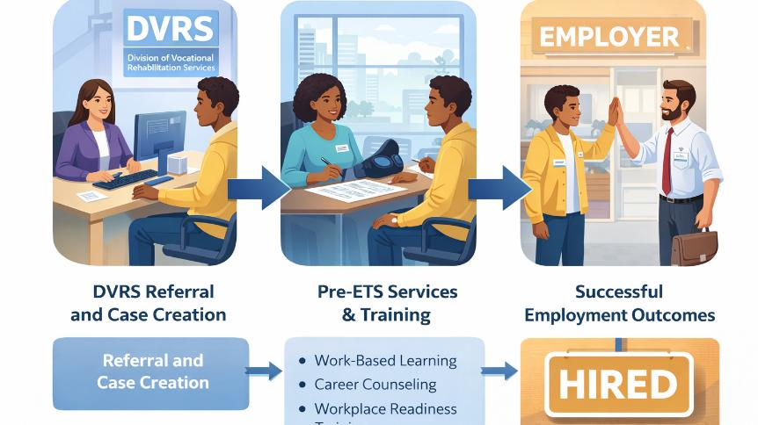


Slide 6
New Jersey DVRS Strategy
Expanding Access Through Innovation
Focus populations include:
  Justice-involved youth
  Youth in alternative education programs
  Students with IEPs and 504 plans
  Opportunity youth disconnected from school and work
  Youth experiencing systemic barriers
Notes:
All of these must be a SWD
Mental health, substance use disorders, etc.

Slide 7
New Jersey DVRS Strategy
Expanding Access Through Innovation
New Jersey DVRS is expanding Pre-ETS through:
  Technology-enabled career exploration
  Paid work-based learning
  Pre-College Summer Programs
  Community-based partnerships
  Workforce ecosystem integration

Slide 8


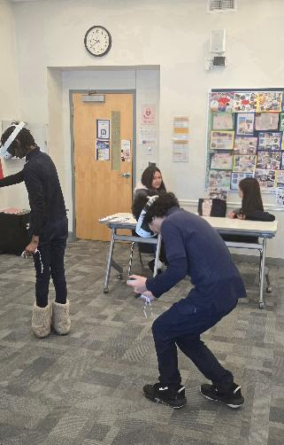

Innovative Pre-ETS Technology Initiative
Transfr Virtual Reality

Slide 9
Virtual Career Exploration & Training
Under our Innovative Pre-ETS Grants, NJ DVRS launched a statewide initiative bringing immersive career exploration technology into VR services.
DVRS partnered with: Transfr VR + Approved Pre-ETS Providers
The initiative equips:
  DVRS Counselors
  Educators
  Workforce staff
  Students with disabilities

Slide 10
Innovative Use of Virtual Reality
Immersive access to 150+ high-demand careers
Exposure across 16 career clusters
Supports informed pathway selection
Reduces transportation and access limitations
Trauma-informed, low-risk exploration environment
Transfr Video Library | VR Demos, Customer Story Videos & Immersive Learning Clips

Slide 11
Virtual Career Exploration
Provides safe, immersive exploration of high-wage careers with guided digital coaching
Increase engagement among unserved and underserved youth
Expands vision beyond local labor market constraints
Connects exploration directly to paid WBLE opportunities
Aligns career awareness with credential planning
Accessible for diverse learning styles

Slide 12
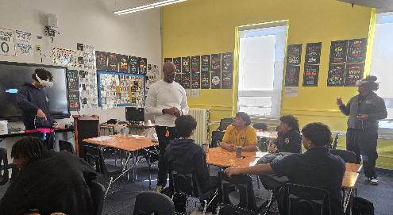
What Virtual Career Exploration Provides
Immersive training allows learners to explore careers
Healthcare
Advanced Manufacturing
Skilled Trades
Information Technology
Logistics
Green Technology
Trainee Experience - Transfr Video Library

Slide 13
Paid Work-Based Learning
Pre-ETS Paid Internship

Slide 14
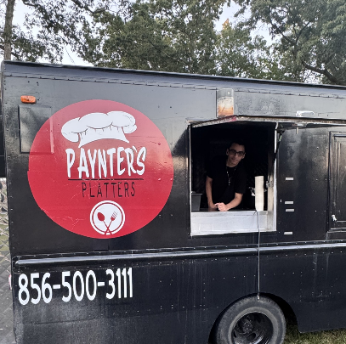
Why Paid Work-Based Learning Matters
Research consistently shows that youth with disabilities who gain early work experience have significantly better employment outcomes.
Students who participate in paid work experiences are:
  More likely to obtain competitive integrated employment
  More likely to pursue post-secondary education or training
  More likely to remain employment long-term

Slide 15
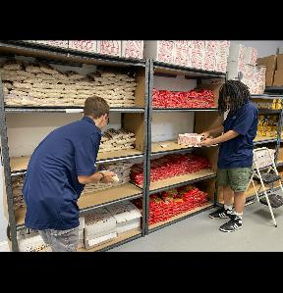
Why Paid Work-Based Learning Matters
Research consistently shows that youth with disabilities who gain early work experience have significantly better employment outcomes.
Students who participate in paid work experiences are:
  More likely to obtain competitive integrated employment
  More likely to pursue post-secondary education or training
  More likely to remain employment long-term

Slide 16
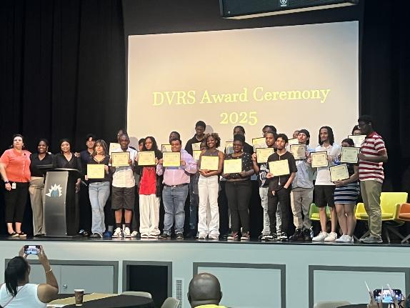
Evidence Behind Paid Work-Based Learning
Students with disabilities who have paid work experience during high school are significantly more likely to be employed after graduation.
Youth who participate in paid internships are 2-3 times more likely to obtain employment within one year of leaving school.
Early work experience improves:
  Workplace confidence
  Employer familiarity
  Soft skill development
  Career decision-making
Source: NTACT Transition Research Evidence, U.S. Department of Education, Rehabilitation Services Administration

Slide 17
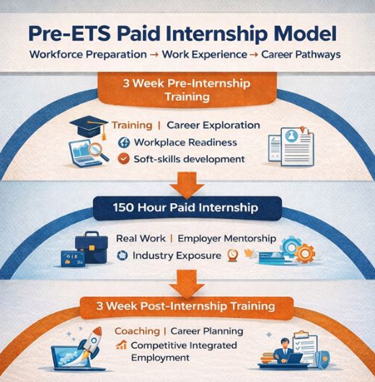
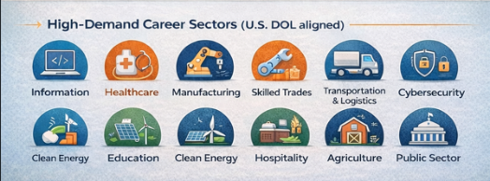
New Jersey DVRS Paid Internship Initiative
Notes:
NJ DVRS developed a Pre-ETS Paid Internship designed to expand access to work-based learning opportunities for underserved youth

Slide 18
Removing Barriers Through Paid Work-Based Learning
Systemic Barriers
  Limited employer access
  Lack of work history
  Transportation challenges
  Disconnection from workforce systems
Perceptual Barriers
  Employer misconceptions about disability
  Low expectations placed on youth with disabilities
  Lack of exposure to workplace environments
Paid Work Experience Changes the Narrative
  When employers engage directly with students:
    Perceptions shift
    Confidence grows
    Career pathways become visible

Slide 19
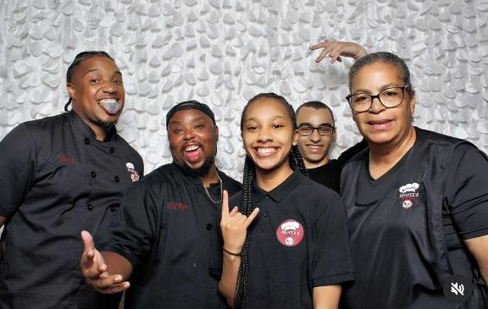
Paid Work-Based Learning as a Workforce Pipeline
Outcomes may include:
  Competitive integrated employment
  Apprenticeship entry
  Post-secondary education enrollment
New Jersey integrates WBLE through partnerships with:
  American Job Centers
  Workforce Development Boards
  DVRS Business Outreach Team
  Industry employer networks
  Community providers

Slide 20
Pre-College Summer Programs
Pre-ETS Counseling on Enrollment in Post-Secondary Education

Slide 21
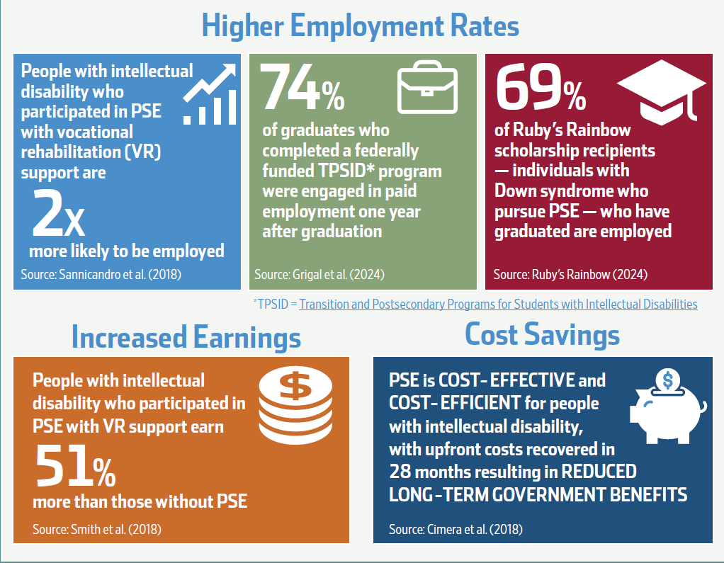

Slide 22
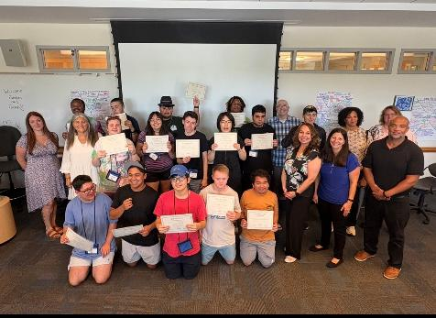
Pre-College Summer Program
Pre-College Summer Program provides structured residential college experiences designed to prepare students with disabilities for life after high school
These programs combine:
  Academic exposure
  Career exploration
  Workplace readiness training
  Social and independent living skill development

Slide 23
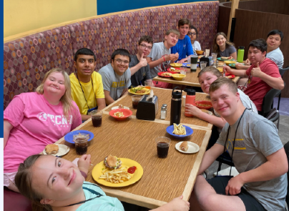
Pre-College Summer Programs
Within the Pre-ETS framework, experiences support:
  Counseling on post-secondary education
  Workplace readiness training
  Instruction in self-advocacy
  Job exploration counseling
  Work-based learning experiences
Notes:
These programs allow students to experience college life while still in high school, reducing uncertainty and building confidence about post-secondary pathways.

Slide 24
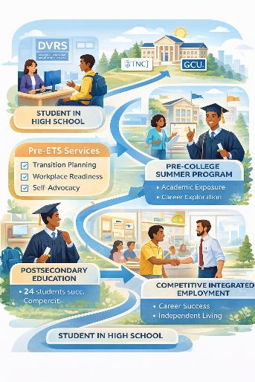
Pre-College Summer Program
Program Structure:
  Two-session immersive summer residency
  10-day residential program
  Campus-based experiential learning
Students engage in:
  Transition planning
  Academic enrichment
  Social-emotional skill development
  Career and vocational exploration
Notes:
The PCSP at The College of New Jersey provides a transformative experience for high school students with intellectual and developmental disabilities

Slide 25

Case Studies

Slide 26
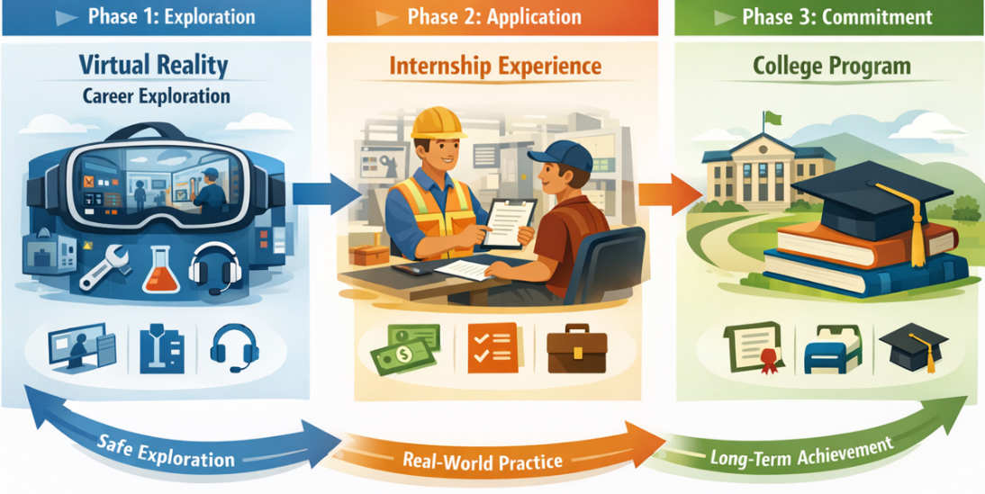

Slide 27
Workforce Ecosystem Integration

Slide 28
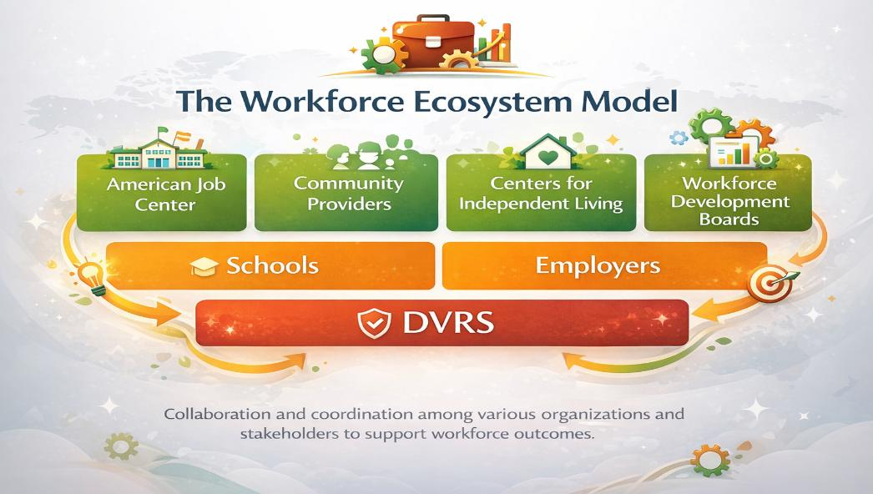

Slide 29
Alignment with Federal & State Goals
IDEA Transition Requirements
Pre-ETS Benchmarks
(WIOA Title IV)
Workforce Development Goals
Notes:
Handout to guide this slide

Slide 30
Community Based Partnerships

Slide 31

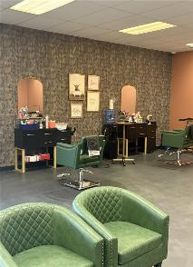
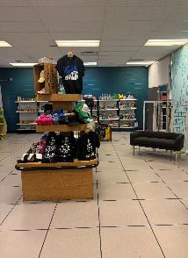
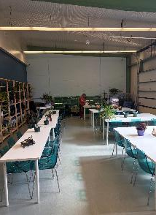
The Park @ Resources for Independent Living
Notes:
In September 2024, RIL purchased the former Cumberland County Technical School, now known as “The Park @ RIL.” This site offers 65 acres, with the building offering 120,500sq ft. with three separate wings.
The opening of the first wing was April 2025 which hosts 11 theme-based classrooms, 2 relaxation rooms, cafeteria, a gymnasium, a book-sharing library, outpatient mental health counseling and a baseball field located directly across the street.

Slide 32
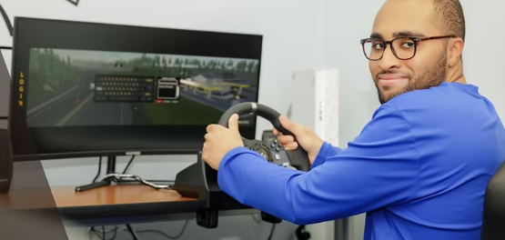
Driving Simulator- Center’s for Independent Living
Benefits of Drive-Ability
Improved independence and mobility for participants with disabilities.
Increased chances of obtaining sustainable gainful employment.
Enhanced road safety awareness and responsible driving behavior.
Greater opportunities for active participation in the community.

Slide 33
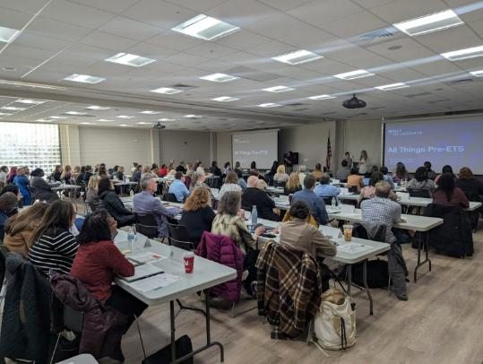
All Things Pre-ETS Training

Slide 34


Partners

Slide 35

Notes:
DIF Pathways to Post Secondary Success

Slide 36
Foundation Academy & DVRS
What Makes This Partnership Innovative
Impact
Pre-ETS embedded directly into the master schedule
Dedicated service blocks (not passive referral-based services)
DVRS & school workforce team in active coordination
Proactive identification of eligible and potentially eligible scholars
Integrated data tracking to maximize authorized hours
Eliminates common administrative barriers
Reduces missed service hours
Increases scholar engagement and compliance
Aligns service delivery with measurable skill gains

Slide 37
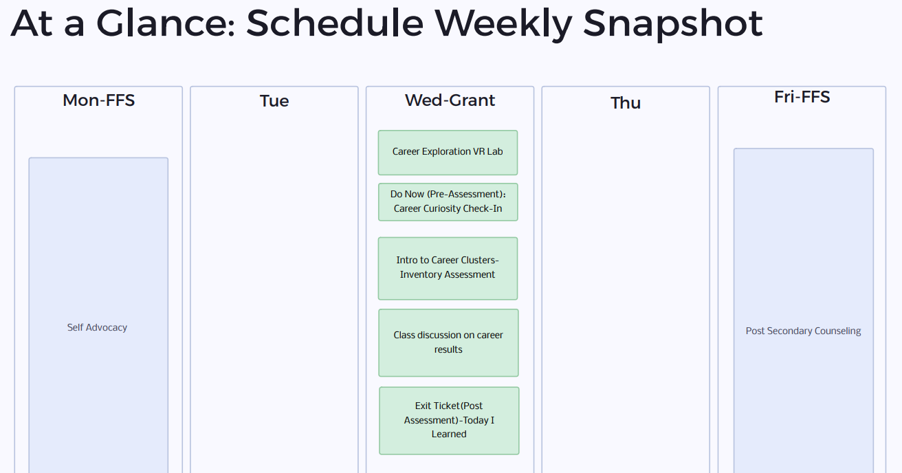

Slide 38
Key Takeaways & Discussion
Expanding Access Requires Innovation- reaching underserved and disconnected youth requires proactive and creative service models.
Technology Can Transform Career Exploration- immersive tools like virtual reality expand career awareness and engagement.
Paid Work Experience Improves Outcomes- early work experience increases long-term employment success for youth with disabilities.
Partnerships Build Workforce Pipelines- collaboration with schools, workforce systems, and community partners strengths transition
Notes:
Toni (grounded, personal, purpose-driven):
At the heart of everything we talked about today are young people who are trying to find their place in the world. And the truth is, for many of them—especially those from underserved communities—the pathway isn’t always clear, and the opportunities aren’t always equal. That’s why the work we do matters so deeply. When we take the time to truly see each student, to understand their reality, and to connect them with the right experience, we’re not just delivering a service—we’re opening doors that may have otherwise stayed closed.
⸻
Aaron (reflective, visionary, uplifting):
And when we do that—when we align opportunity with intention, and access with purpose—we begin to create something bigger than any one program or pathway. We begin to build a system that works the way it’s supposed to—one that lifts people up, meets them where they are, and helps them move forward with confidence. That’s how we expand access. That’s how we strengthen outcomes. And ultimately, that’s how we shape a future that’s more inclusive, more equitable, and more full of possibility for every student we serve. Thank you.

Slide 39
Questions?

