Slide 1

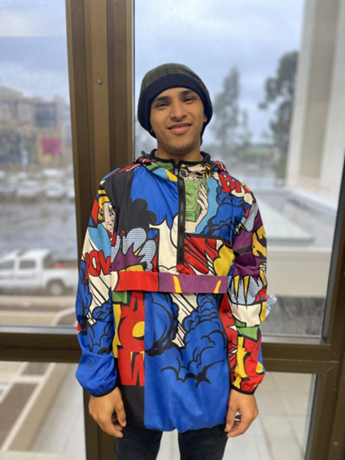

The CA SWTCIE project
The CA SWTCIE Project

Slide 2
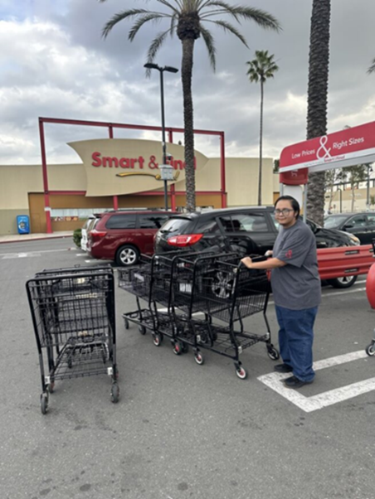
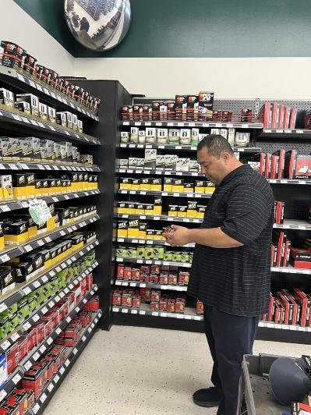
California Subminimum Wage to Competitive Integrated Employment Project
DOR was awarded: Disability Innovation Fund Grant
$13.9 Million
5 Year (October 1, 2022 to September 30, 2027)
To support innovative activities aimed at increasing competitive integrated employment for individuals with disabilities

Slide 3











Partners involved

Slide 4
What makes this program unique?
Participant
Work-Based Learning Experiences
Access to Higher Education
Traditional and Customized Employment Services
Strategies to Overcome Barriers
Peer Mentoring
Benefits Counseling

Slide 5


CSP Program Sites
Both have:
Longstanding Workability III programs
College to Career (C2C) Programs
Strong partnerships with the local Department of Developmental Service agencies and the Department of Rehabilitation

Slide 6


CSP services
Educational Services and Supports
4-5 course offerings of personal/social development/soft skills and vocational focused curriculum​
1:1 educational coaching for inclusive classes​
Access to all college programs and services​

Slide 7
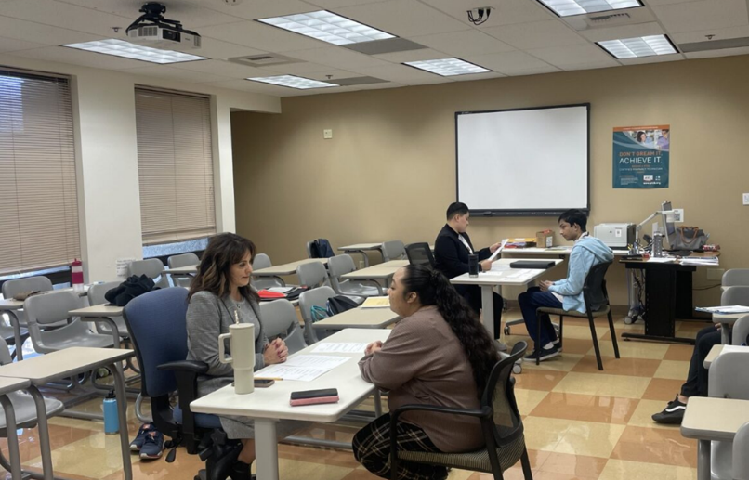
CSP services, continued
Individualized Employment Services
Employment Preparation
-Employment Portfolio
-Interview preparation
-Volunteer and paid work experience
Job Development and Placement
-Teaching how to find a job
-Advocating with employers
-Interview and onboarding assistance
Retention
-Assistance with training
-Job Coaching
-Consistent communication between job developer and employer

Slide 8
Referral Sources and Outreach strategies
Strengthened relationships with local Department of Developmental Services (DDS) agencies in both regions
Conduct regular presentations to DDS teams
Engaged with Adult Transition Programs
Collaborated with former 14(c) providers

Slide 9
Partner Support and buy in
Built trust and visibility
Reinforced shared goals
Maintained engagement
Collaborated with Adult Transition Programs
Partnered with former 14(c) providers

Slide 10
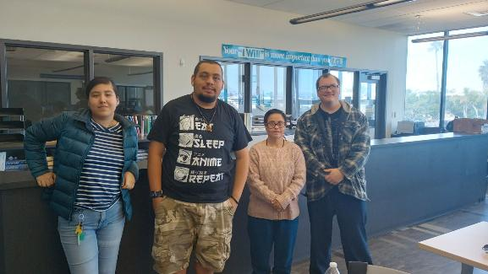
Peer Mentoring and Family Supports

Slide 11
Key Learnings
College staffing structures present unique challenges
Institutional policies and campus rules must be considered
Flexibility and coordination are essential
Clear communication and planning is key
Building internal champions supports sustainability

Slide 12
Future Plans - Sustainability
Replicable model
Documented best practices and lessons learned
Strengthen partnerships for long term impact
Build program capacity
Continue to evaluate outcomes to demonstrate effectiveness

Slide 13
Key Takeaways of the Program
Empowers individuals with disabilities to achieve meaningful, community-based employment at or above minimum wage
Provides comprehensive, coordinated supports — integrating education, career training, benefits counseling, and employment services under one program
Strengthens partnerships between the Department of Rehabilitation, community colleges, and local service providers
Creates a replicable model that can inform future statewide efforts to expand competitive integrated employment (CIE)
Promotes inclusion and economic self-sufficiency, reducing reliance on segregated or subminimum-wage work settings

Slide 14
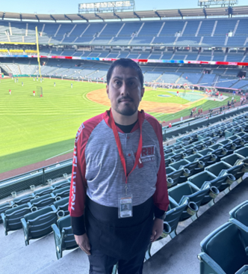
Successes
Parent Quote:
“Hello good evening, I am sending this message to let you know the progress that I have seen in Perla.
Before participating in CSP, she wasn’t able to do things like pay for items at the store or wake up on her own to go to school. I am so satisfied with this program because it’s helping her.
I never thought I’d see these changes in her. She still has more progress ahead, but this is a great start. I’m very grateful and content.””
Angel:

Slide 15
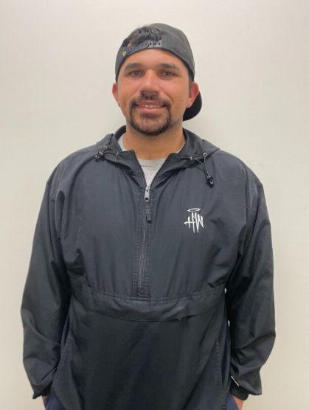
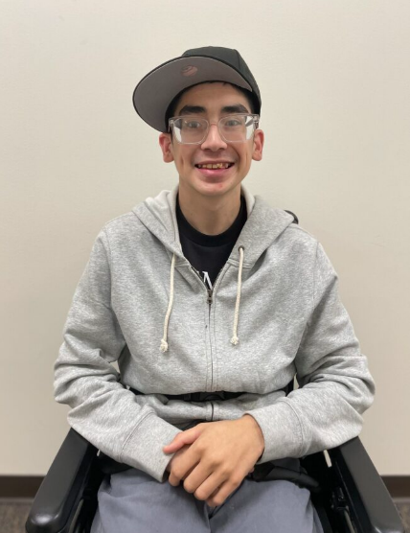
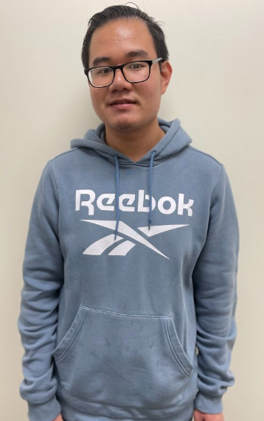

Student Quotes
"CSP taught me what a job really means. They help me a lot and understand what I can accomplish."
-Josh B.
"I would like help finding an AUHSD job working with kids."
-Forrester T.
"I would like to get a job where I can organize items and put items where they belong."
-Huang N.
"My favorite part about CSP is going to college and making friends."
-Emmanuel C.

Slide 16
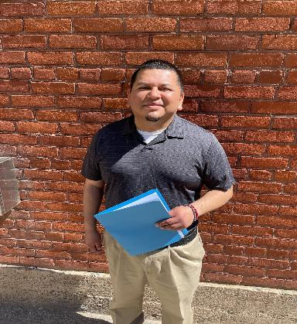


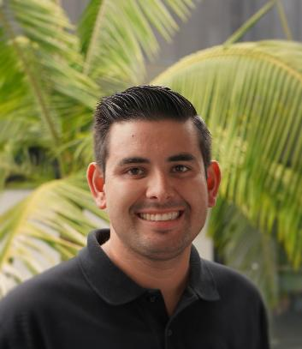

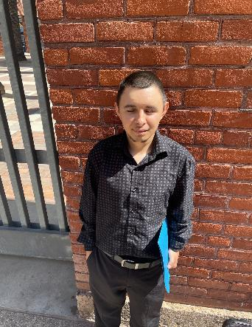
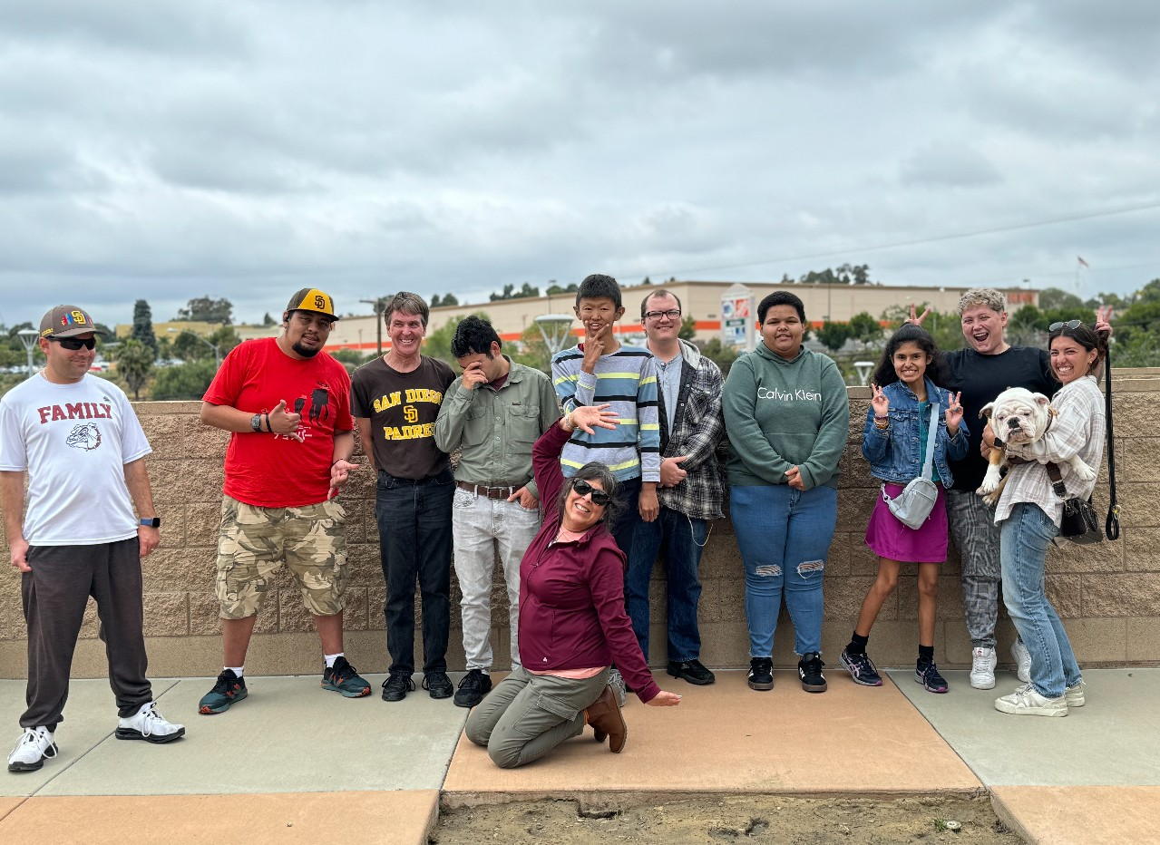
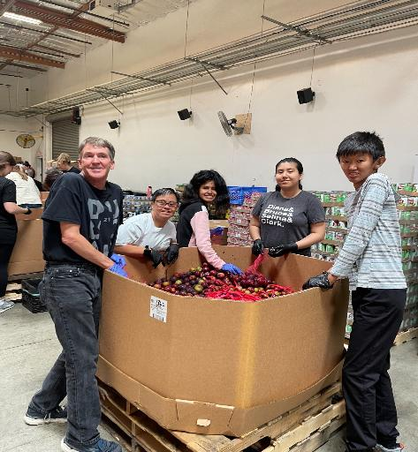



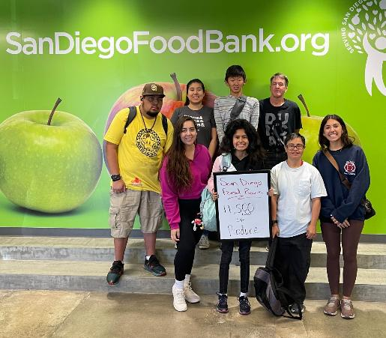
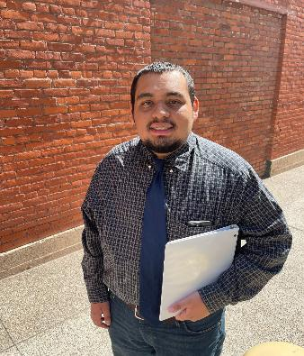

CSP student collage
The contents of this presentation were developed under a grant number H42D220015 from the Department of Education. However, those contents do not necessarily represent the policy of the Department of Education, and you should not assume endorsement by the Federal Government. (Authority: 20 U.S.C. §§ 1221e-3 and 3474.

Slide 17
Supporting the Transition from Subminimum Wage to Competitive Integrated Employment
Collaboration with DDS to identify former 14(c) employers
Outreach and technical assistance offered at no cost through DOR/CSP–TransCen partnership
Eight employers currently receiving hands-on support
Focus: operational evaluation, customized service design, and ongoing training
Many adding Customized Employment to their service models
Partnership with Griffin-Hammis Associates (GHA) to provide CE ACRE training and mentoring

Slide 18

Thank you!
Thank you!
Leslie Baker, CSP Project Director
leslie.baker@dor.ca.gov

