Slide 1
MassAbility NextGen Careers
MassAbility’s demonstration innovation project:
RISE Career Advancement Model
Road to Independence, Self-Sufficiency, and Employment
Later named NextGen Careers
Service recipients: Young Adults (YA) ages 18-30, primarily ID/DD, autism and sensory disabilities, with a focus on underserved communities. Most are new to the agency, not VR connected.
Concept: Alternative to standard VR focused on enhancing psychological factors shown to have a positive impact on employment and career advancement for YA; namely, self-efficacy, self-awareness, self-sufficiency, and self-advocacy Career Self-Actualization
Intended outcome: We expect YA who participate in RISE will have improved levels of career readiness and career sustainability, and decreased reliance on public assistance.

Slide 2

Key Features of the NextGen Program
Recruit Diverse participants: Young Adults- 18-30, underserved communities (ID/DD/Autism/sensory disabilities
Recruit Diverse staff not Voc Rehab Counselors
YA choose their lead staff (could be counselor/peer/job placement)
Small caseloads (50)
Careers Focused: STEM, short term training
Focus on Career Self Actualization: Self CAReS: Capacity, Advocacy, Realization, Sufficiency
Multidisciplinary Team using Integrated Resource Team Approach (Young Adult, their support network, NextGen Careers Counselor, Employment Success Specialist, Family Partners, Peer Mentor, Benefits Counselor)
Frequent contact using preferred contact method
Unpaid volunteer or first work experience converted to paid opportunities
Development of a career portfolio
Career Exploration Academy (evening, remote)
Short term training/STEM focused/not long-term VR track
Experienced provider network to support first time work experiences

Slide 3
Practices to be Integrated
FROM: Current Practice in General CS | TO: New Practice with Young Adults
Early Engagement. Often interpreted as "quick to plan, quick to service" | Engagement involves all team members and family voice is included. Self-CAReS capacities are addressed at the onset of service and throughout including in vendor service models.
CS Counselor works 1:1 with Job Seekers. Connects with JPS when ready. | Early engagement of Job Placement staff as part of the young adult’s team
JPS's want a complete JPS checklist prior to first meeting with job seeker. | The entire team utilizes the checklist as a planning tool.
No practice model for family engagement | Family voice is effectively integrated into standard practice
No formal communication/meeting strategy for participants | Frequency, intensity, and collaborative communication and meetings that are responsive to young adult preferences.

Slide 4
Integration to the field process
In this final year we are in the process of identifying the systems changes that we will bring to the career services division.
MassAbility will add a Young Adult Director
Transition remaining cases to the field
Transition some of the NextGen staff into the current Career Services structure/vacancies
Identify Career Services staff who have skills and an affinity for serving young adults
Expand Integrated Resource Team approach with focus on YA
Bring in Job Placement staff early in services for YA
Job Placement staff can identify and contract for services needed to support the YA
Planning around training for all Career Services staff around the Career Self-Actualization -Self-CAReS
Family Partners- evaluating how best to keep this model
Peer Support- evaluating how best to keep this model
Expand language in contracts for Community Rehab Providers specific to best practices identified

Slide 5
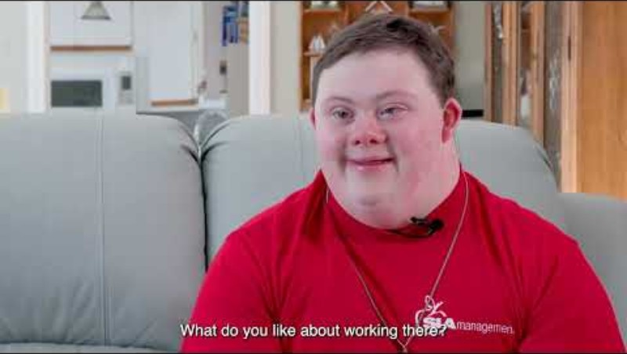
NextGen Spotlights

