Slide 1


The OOS Playbook:
Planning, Managing, and Exiting with Confidence
CSAVR Leadership Forum
NVRTAC
November 1, 2025

Slide 2

Disclaimer
The contents of this presentation were developed under grant #H264J200002 from the U.S. Department of Education (Department). The Department does not mandate or prescribe practices, models, or other activities described or discussed in this document. The contents of this presentation may contain examples of, adaptations of, and links to resources created and maintained by another public or private organization. The Department does not control or guarantee the accuracy, relevance, timeliness, or completeness of this outside information. The content of this presentation does not necessarily represent the policy of the Department. This presentation is not intended to represent the views or policy of or be an endorsement of any views expressed, or materials provided by any Federal agency. (EDGAR 75.620)

Slide 3





Meet the Panelists
Cora McNabb
KY-C
Dee Torgerson
MN-G
Chanda Hermanson
MT-C
Keith Ozols
OR-G

Slide 4


Order of Selection (OOS) Status
As of July 17, 2025
2 Agencies Currently Operating Under an OOS
3 Agencies – All categories closed
7 Agencies – One category open
2 Agencies – Two categories open
RSA – OOS Information
Time is of the essence – State Plan Modifications are happening now!
State Plan Modification Workgroup

Slide 5


Questions from the Audience

Slide 6
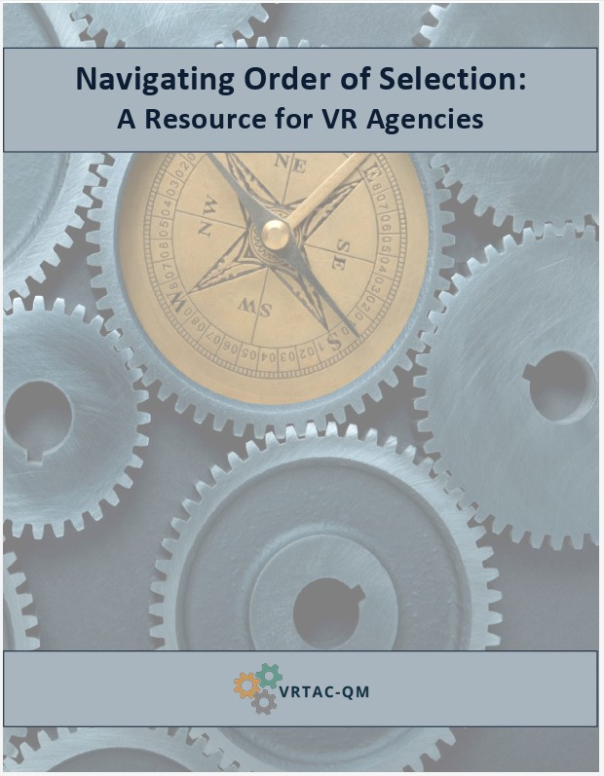
Resources
Navigating Order of Selection: A Resource for VR Agencies
RSA – OOS Information
State Plan Modification Workgroup

