Slide 1



We may be small potatoes, but we make a big impact.
Danté Allen
Deputy Director
Legislation & Communications
We bring integrity, imagination and excellence to every partnership, turning your vision and strategy into communications that connect authentically, build trust and drive meaningful results.
Vocational rehabilitation organizations thrive when their message connects with the people they serve. Partnering with a strong communications agency helps bring that story to life through clear, accessible content designed to inspire. From awareness campaigns and stakeholder reports to events, videos and digital outreach, an experienced communications partner can help elevate visibility, strengthen consumer relationships and showcase the real impact of empowering individuals with disabilities to achieve meaningful employment.

Slide 2
We may be small potatoes, but we make a big impact.
Cynthia Butler
Public Information Officer II
Legislation & Communications
We bring integrity, imagination and excellence to every partnership, turning your vision and strategy into communications that connect authentically, build trust and drive meaningful results.
Vocational rehabilitation organizations thrive when their message connects with the people they serve. Partnering with a strong communications agency helps bring that story to life through clear, accessible content designed to inspire. From awareness campaigns and stakeholder reports to events, videos and digital outreach, an experienced communications partner can help elevate visibility, strengthen consumer relationships and showcase the real impact of empowering individuals with disabilities to achieve meaningful employment.

Slide 3
I Work because DOR Works Campaign
Goal: The multi-media campaign was created to highlight DOR consumers that have found meaningful employment through DOR services.

Slide 4
I Work because DOR Works Campaign
Goal: Allow consumers to share their personal employment journey and how they navigate their disability in their own words.

Slide 5
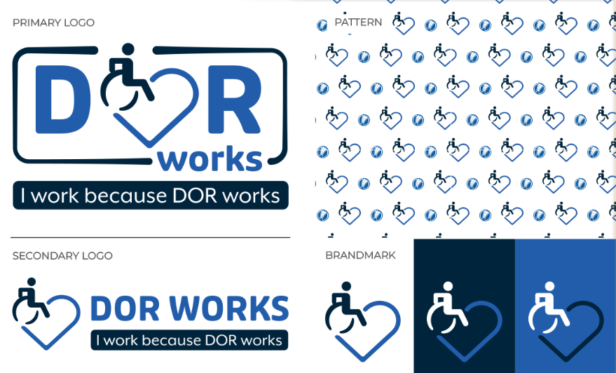
I Work because DOR Works: Elements

Slide 6
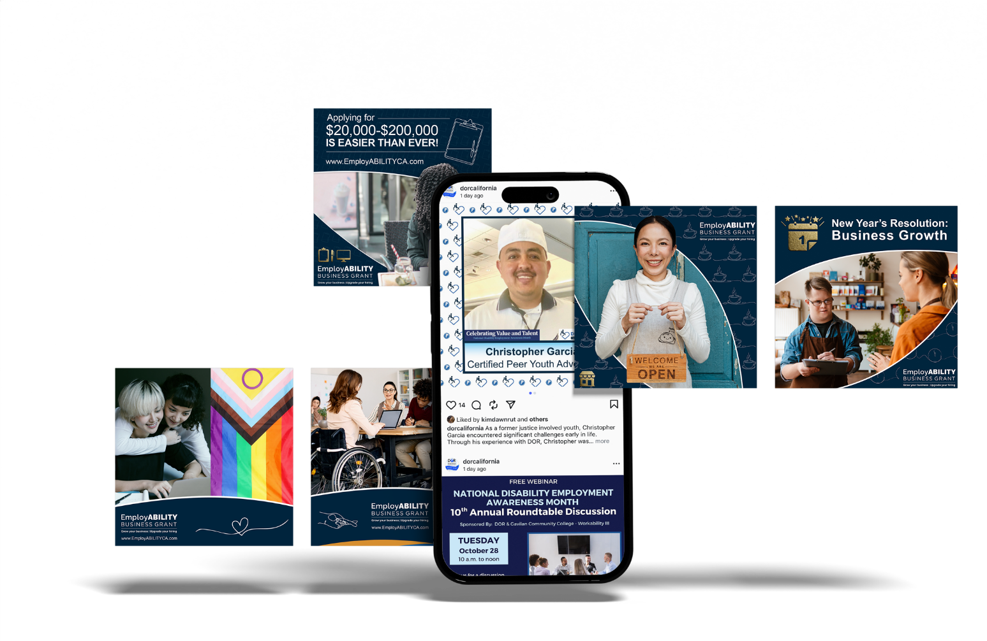
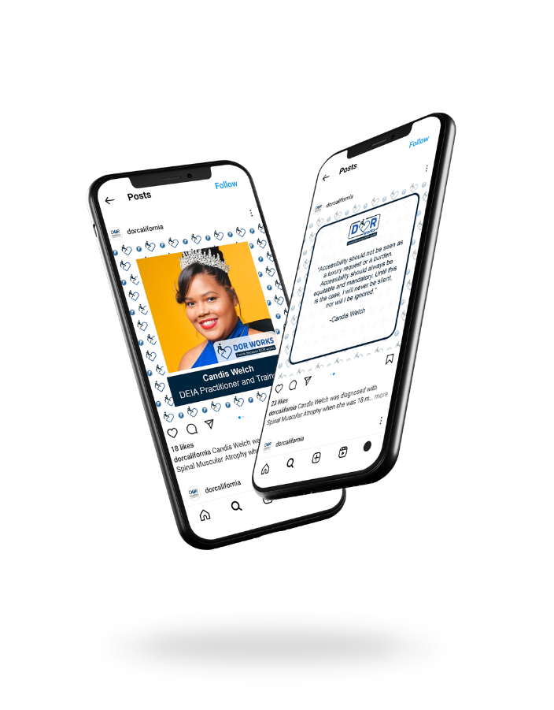
I Work because DOR Works: Social Media

Slide 7
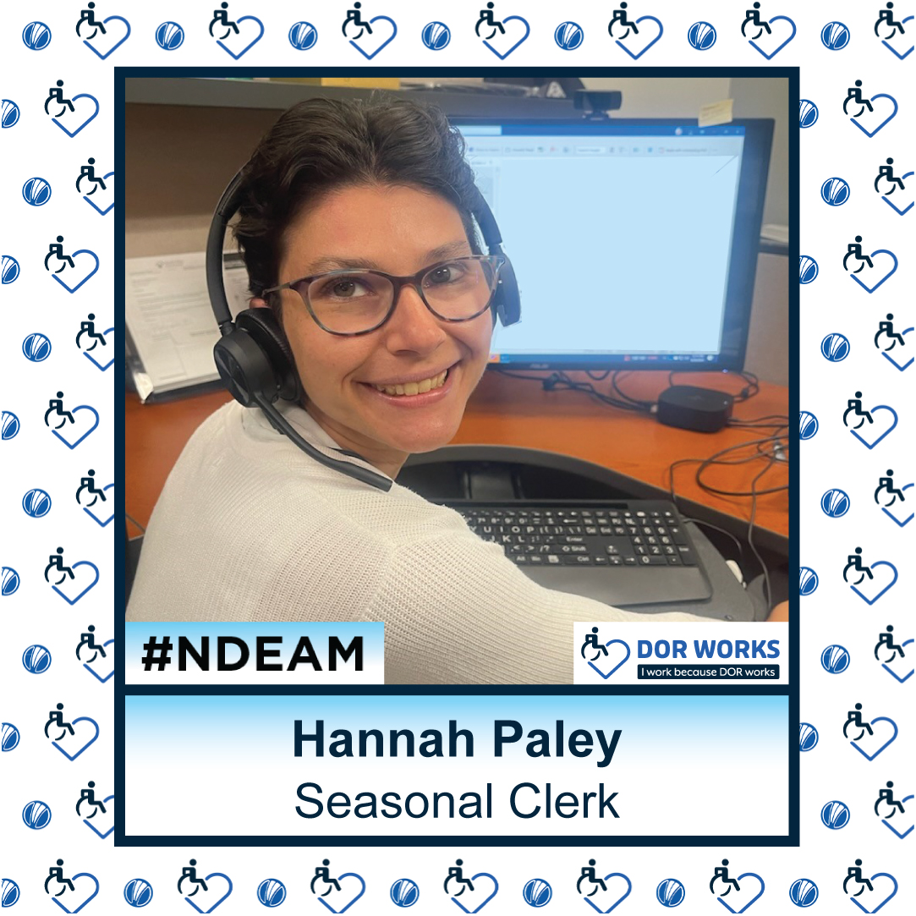
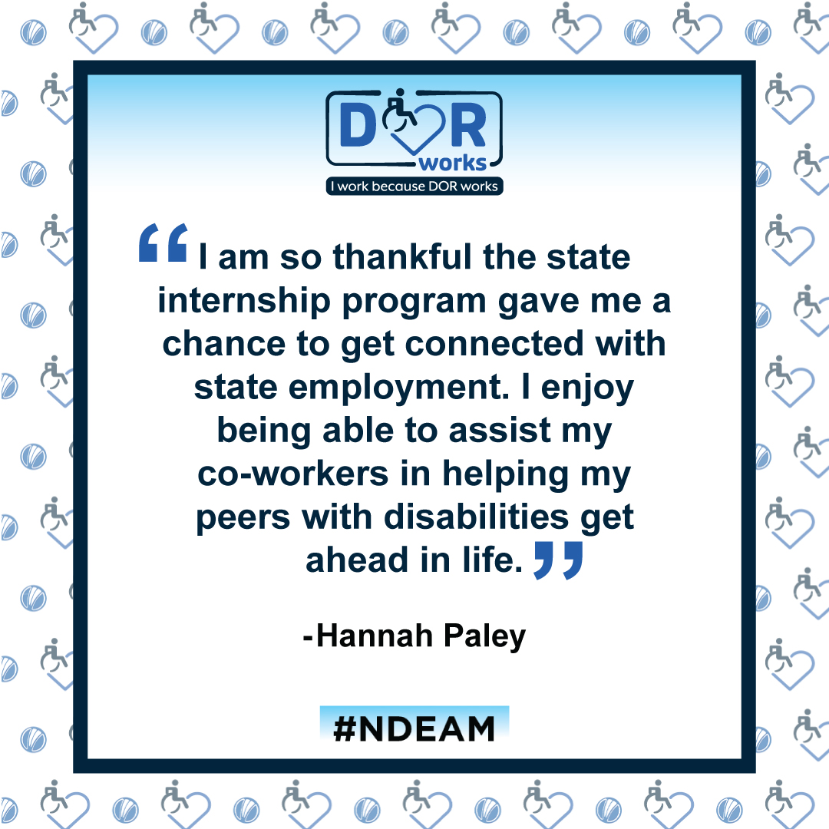

Slide 8
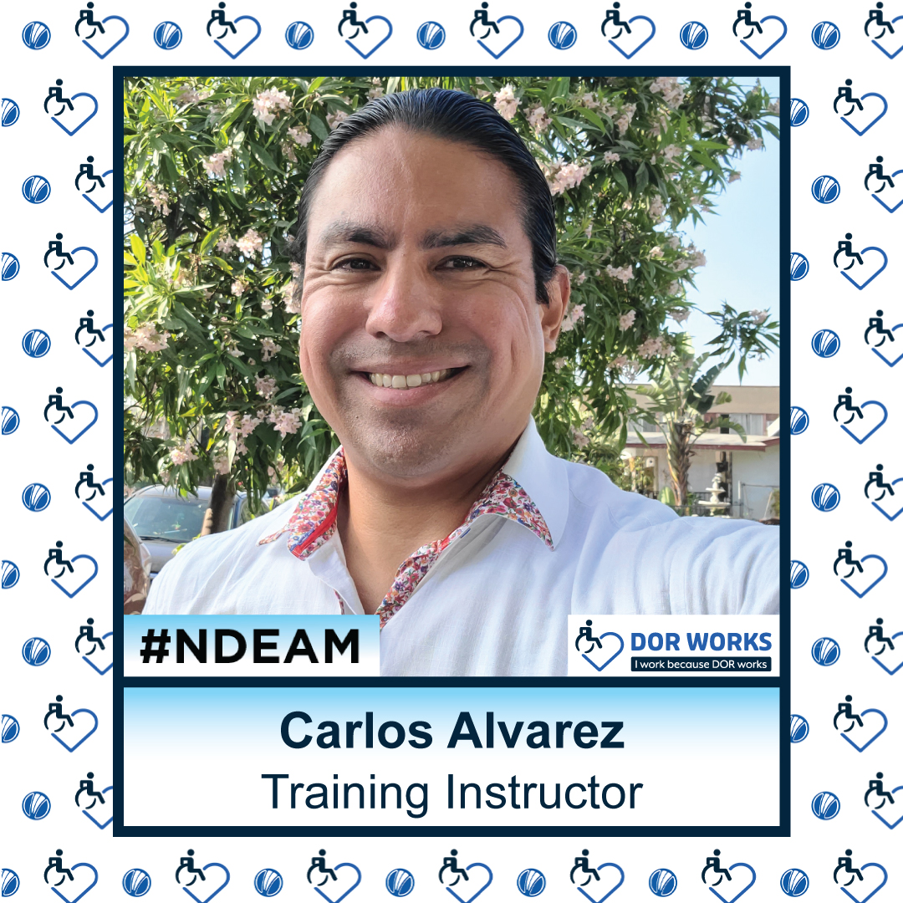
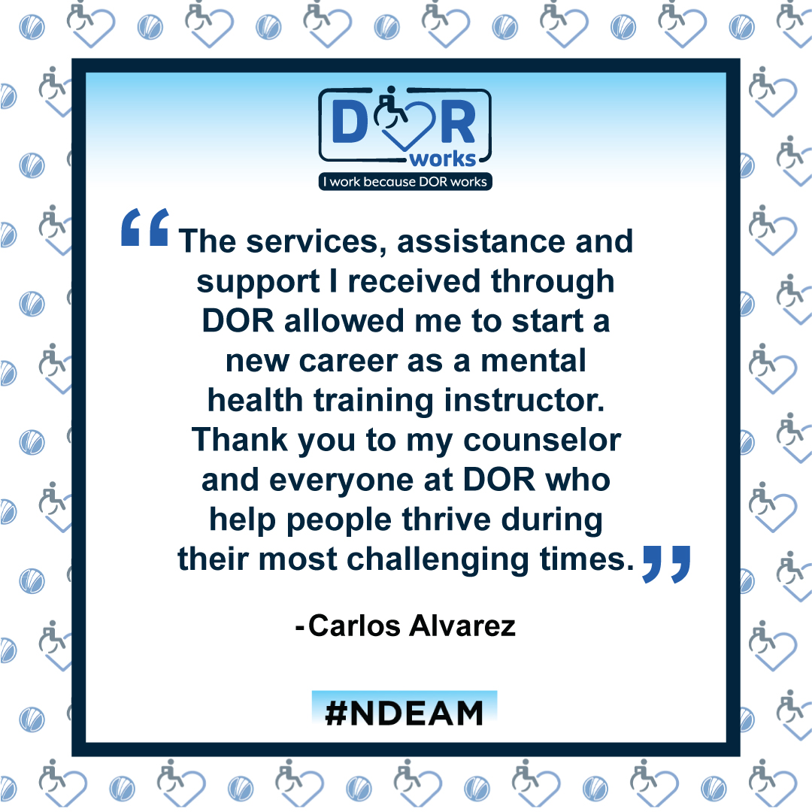

Slide 9
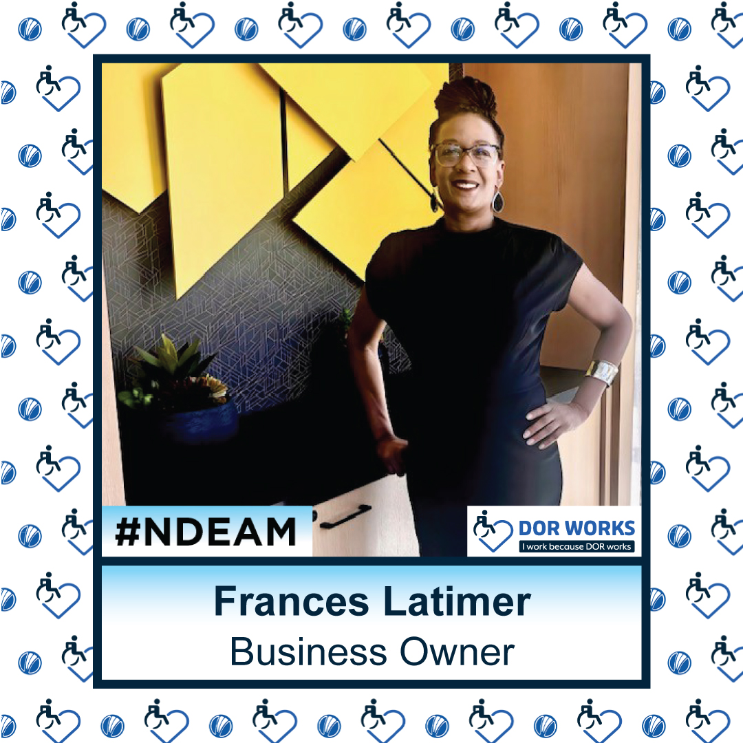
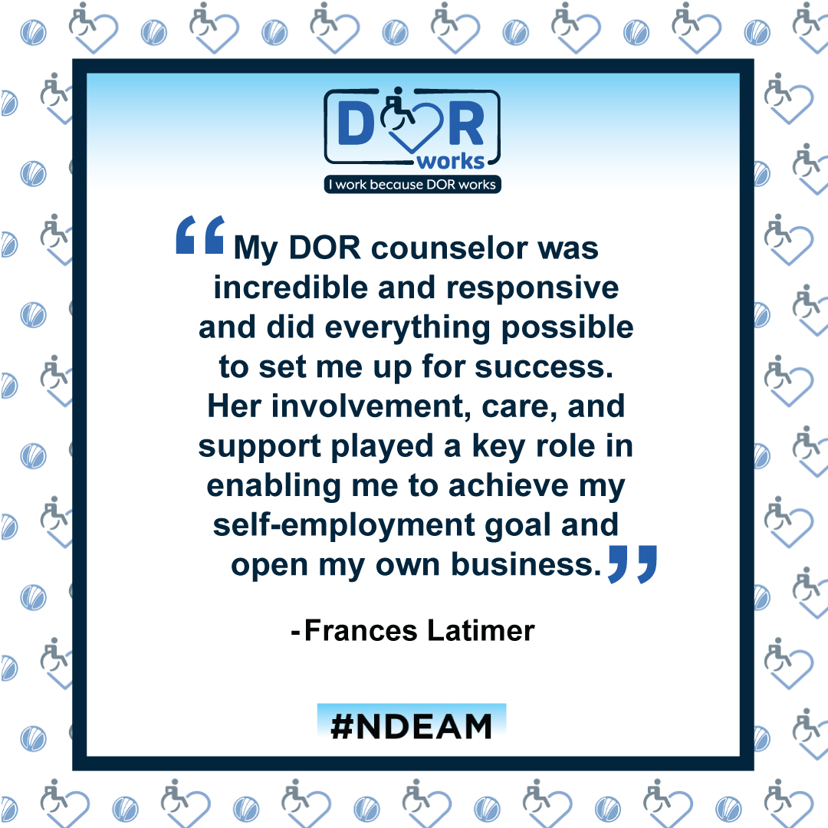

Slide 10
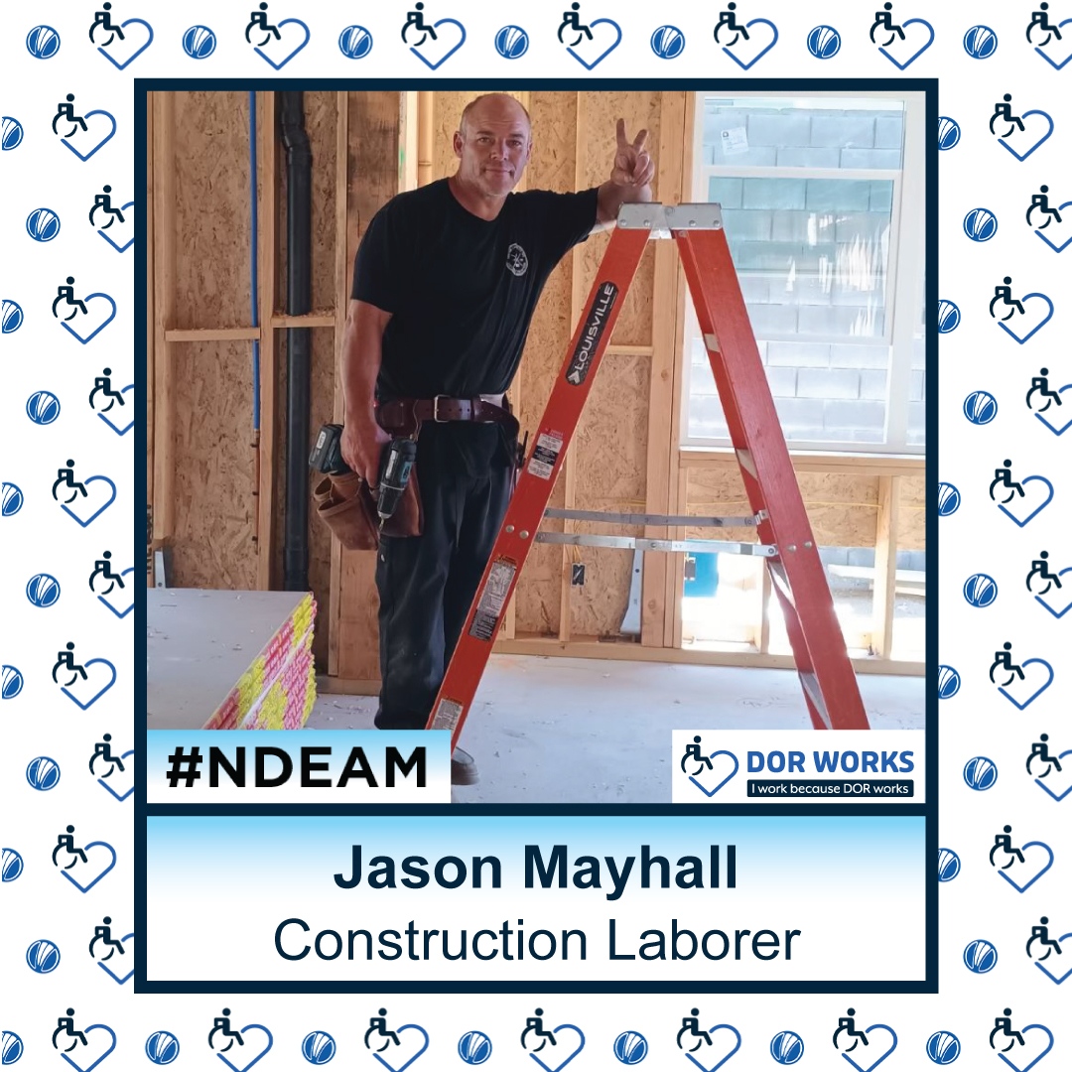
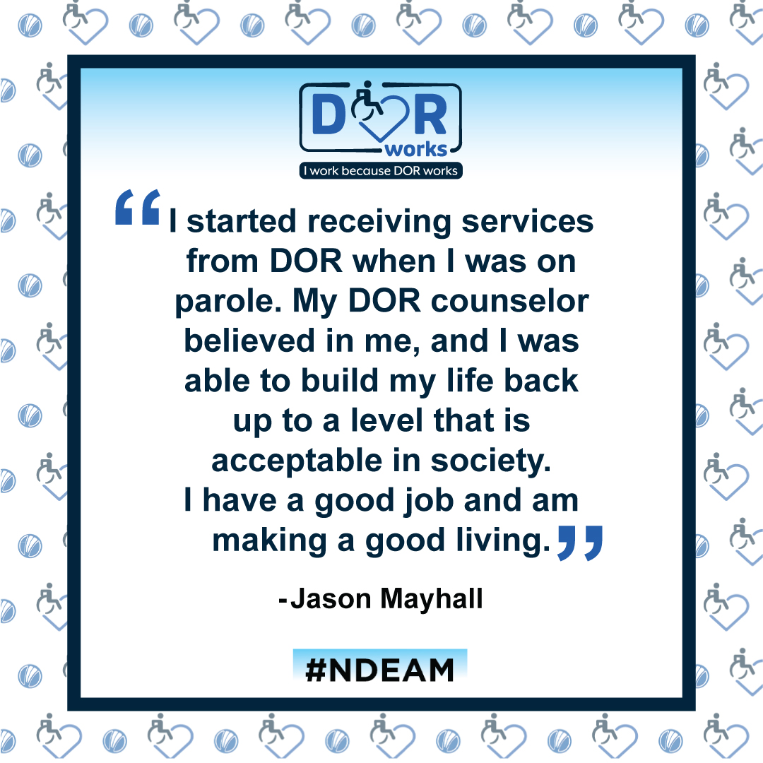

Slide 11
I Work because DOR Works: Social Media
Video Profile:
Riffat Akram is a former DOR consumer and Director of Griffin Technologies Academies, a charter school in Vallejo. Riffat shared her experience growing up with a disability in her native country and how she utilized DOR services to pursue a new career path in education.
I Work Video

Slide 12
We may be small potatoes, but we make a big impact.
Kim Rutledge
Director
We bring integrity, imagination and excellence to every partnership, turning your vision and strategy into communications that connect authentically, build trust and drive meaningful results.
Vocational rehabilitation organizations thrive when their message connects with the people they serve. Partnering with a strong communications agency helps bring that story to life through clear, accessible content designed to inspire. From awareness campaigns and stakeholder reports to events, videos and digital outreach, an experienced communications partner can help elevate visibility, strengthen consumer relationships and showcase the real impact of empowering individuals with disabilities to achieve meaningful employment.

Slide 13

EmployABILITY Business Grant
Notes:
2021 – DOR received $10 million for Demand Side Employment Initiative
$5 million small business grants
$2 million marketing campaign
SHRM partnership
2022 – applications for grant were slow
I came on board, tasked with finding a marketing firm to promote business grant and grantees
Small Potatoes – STL-based business with small business focus
Created a brand for the business grant
Colors, font, accessibility

Slide 14
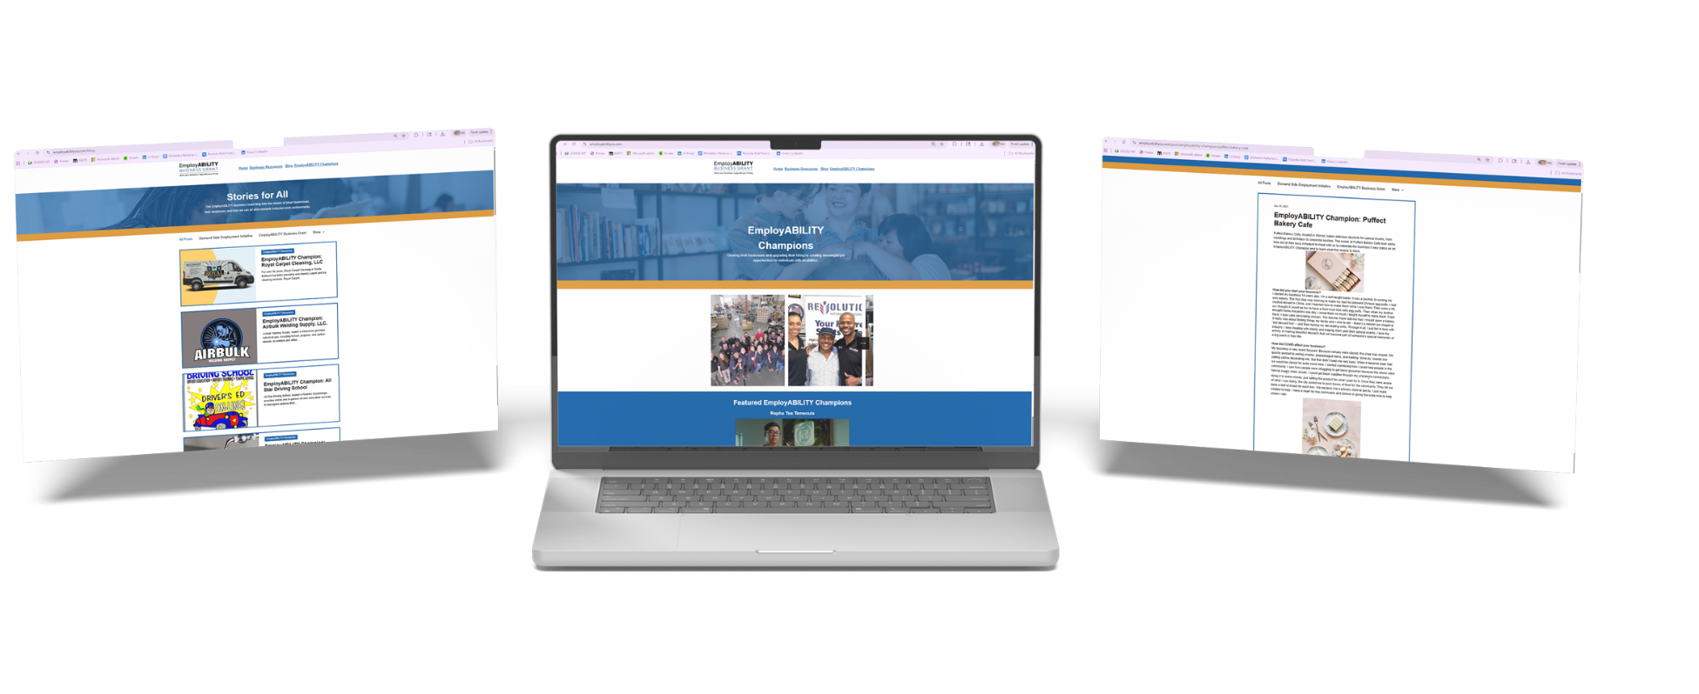
Websites to Drive Action
Notes:
Created a separate website for the EBG
Not a .gov
This was different from a standard govt grant or contract, so that’s what we wanted to convey
Applications quickly started coming in
Promoted grant and website on DOR social media, other venues
Postcards for tabling, etc.

Slide 15
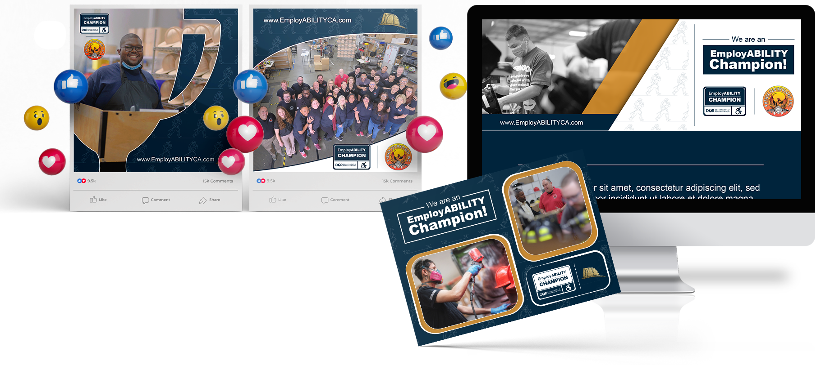

Small Business Social Media Campaign
Notes:
Spotlighted each grantee
Gave them branding, stickers, logo to make them feel like a champion

Slide 16
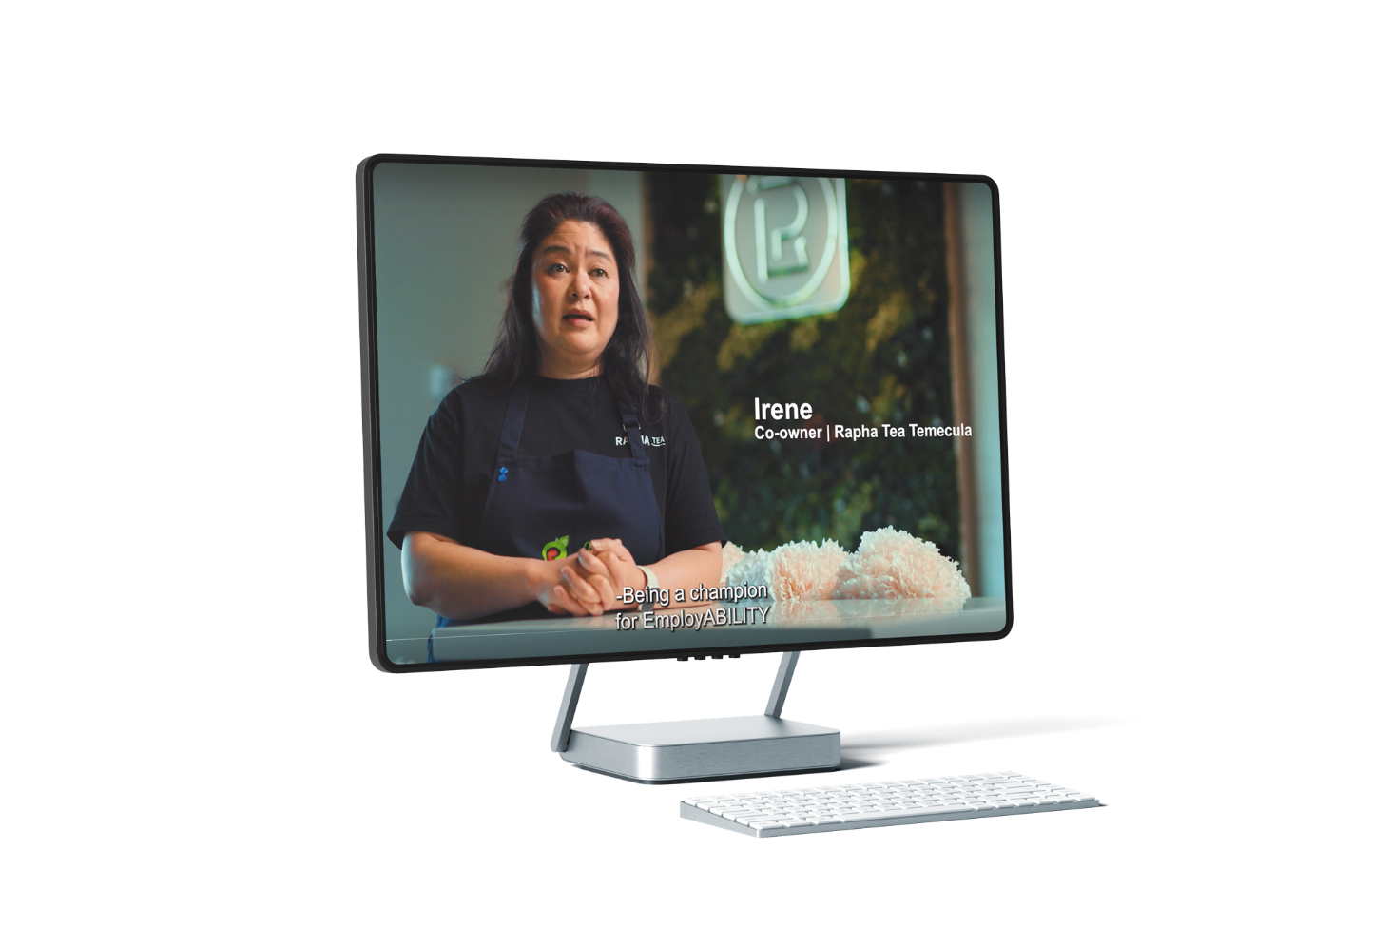
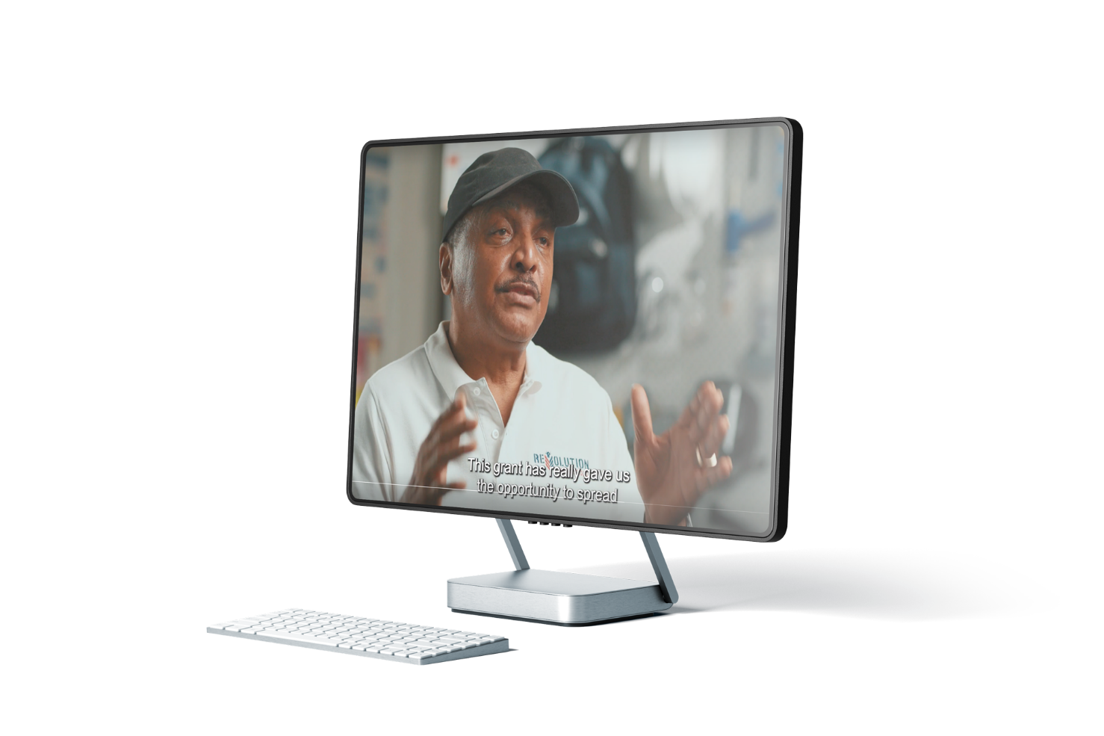
Videos with Heart and Purpose
Notes:
Long-form spotlight videos for 2 Southern California businesses
Both the business and DOR can use videos for promotional purposes
Talk about going on video shoot at the Revolution National Pest Council

Slide 17
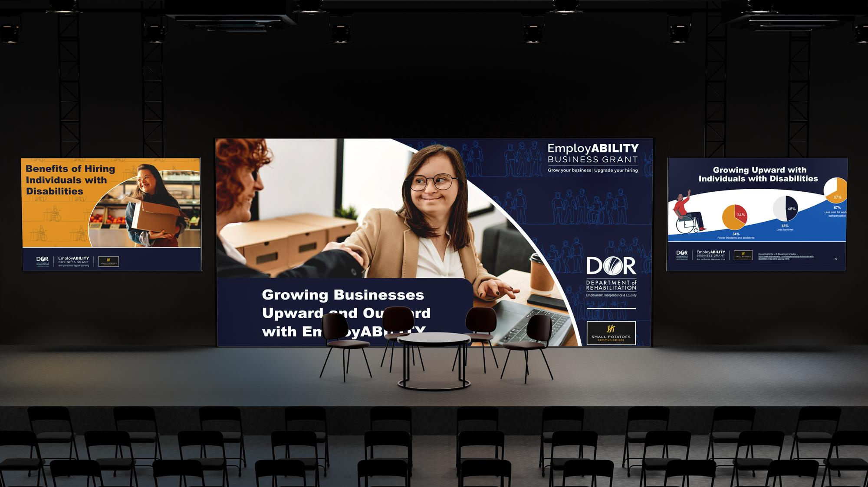

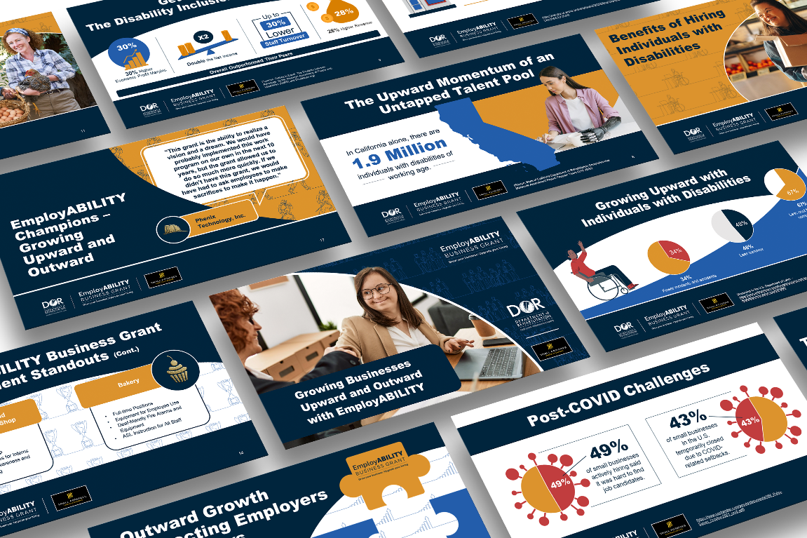
Presentations
Presentations
Notes:
With SPC, DOR leadership presented twice at the CWA conference
2022 – promote the grant and get businesses to apply
2023 – highlighting grantee small businesses

Slide 18
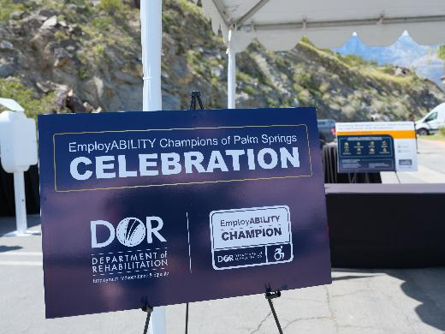
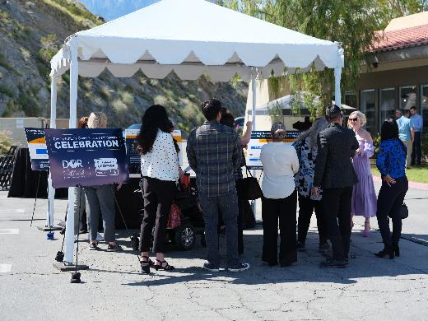
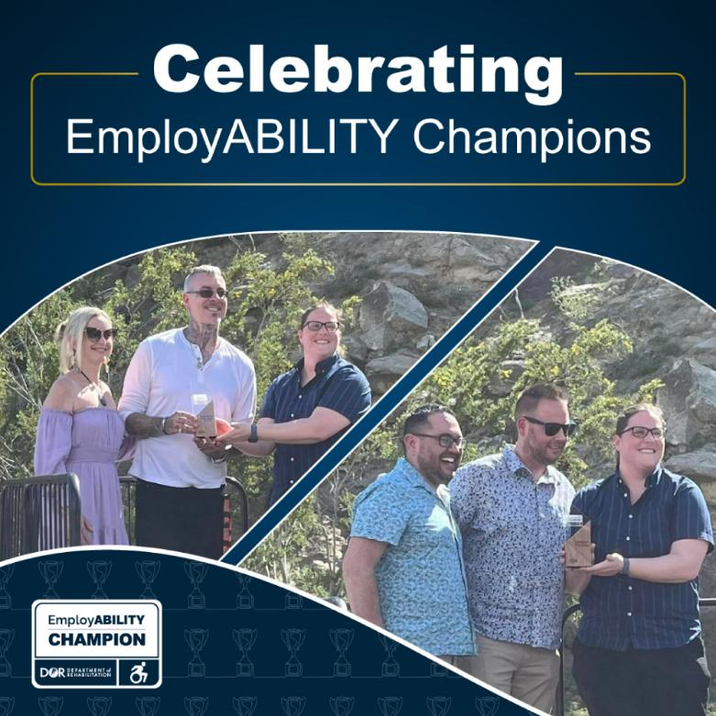
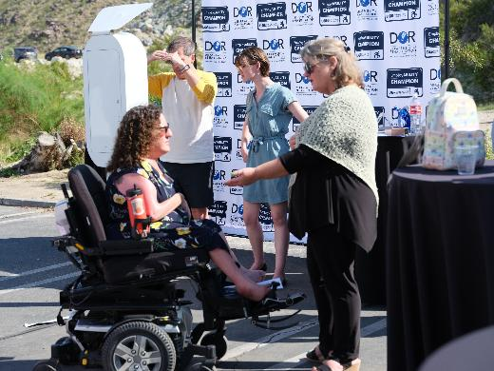
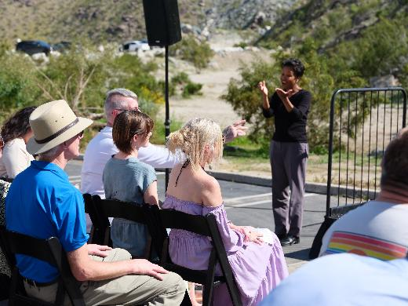
Moments that Move People
Notes:
The event
Celebrating 2 small businesses in 1 strip mall in Palm Springs
Abigail and Frisky Business
Conclude – SPC partnership allowed us to have elevated business engagement
Taking out the staleness and the restrictions of govt helped us appeal to small businesses, private sector
All learned along the way
Toss to Keith

Slide 19
Keith Ozols
Director
Vocational Rehabilitation

Slide 20
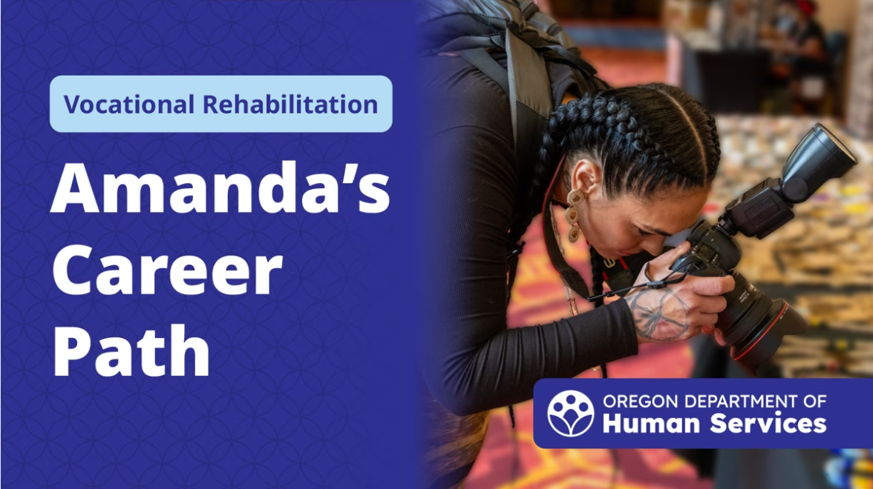
Partnering with Tribal VR in Oregon
Notes:
Clicking on photo should open the video. Or go to https://vimeo.com/1111018293

Slide 21
CSAVR Communications Professional Network
A community of practice for communications professionals to support one another and learn from each other in order to:
  Continue the momentum of the 100 stories in 100 days campaign by continuing to share VR success stories on social media
  Communicate to lawmakers and policymakers the value of VR to businesses and local economies
  Tell stories that highlight why VR matters to business

Slide 22
The details
Co-chairs representing Alabama, Oregon and Utah.
Meets third Tuesday of the month. Next meeting is Nov. 18.
Opportunity to email group with questions and ideas between meetings.
Guest presenters and roundtable discussions on timely topics.
Upcoming topics
Telling the story of why VR matters to business
Communications planning for order of selection
How to promote your success stories
Leveraging LinkedIn to reach new audiences
Creative ways to reach young adult audiences

Slide 23

Call to action
Find your local VR champions in the business community and tell their story.
Does your state have a communications campaign or project you’re proud of? Present to the CPN! Email diane.navarrete2@odhs.oregon.gov
Is your state represented? Join the CPN! Email kwest-evans@csavr.org
Notes:
In Oregon: Linked-in campaign to drive new businesses to follow us @orhumanservices
Business shoutouts
Business testimonials
We gather these by:
Creating a form for staff and providers to use to nominate businesses for shoutouts and testimonials. Promote this in newsletter, staff meetings.
Partnering with SRC on quarterly business awards.

